Slide 1
The CP vs. MOF problem
“What was originally a coordination compound became a coordination polymer and was then transformed into a metal–organic framework compound. No one knows if all coordination polymers are metal–organic framework compounds or vice versa.
Does anyone care?”
G. R. Desiraju, Angew. Chem. Int. Ed. 50, 52–59, 2011
Notes:
Neil

Slide 2
Many People Care!
IUPAC project: Coordination polymers and metal- organic frameworks: terminology and nomenclature guidelines
During the course of the work we estimate that:
more than 1500 scientist
has read about the project and
over 100 have taken part
in the online surveys or other feedback channels.
Notes:
Lars

Slide 3
The IUPAC task group on
Coordination polymers and metal- organic frameworks: terminology and nomenclature guidelines
Since 2009, the IUPAC division of Inorganic Chemistry has initiated above project.
A discussion paper:
Coordination polymers, metal–organic frameworks and the need for terminology guidelines
S. R. Batten, N. R. Champness, X. M. Chen, J. Garcia-Martinez, S. Kitagawa, L. Öhrström, M. O'Keeffe, M. P. Suh, J. Reedijk
Crystengcomm 14, 3001, 2012 .
Notes:
Neil: These were the formal objectives of the task group.
Lars: Do you have to worry that IUPAC will try to impose a lot of rules that we don’t like? (Question to N)

Slide 4
The IUPAC task group on
Coordination polymers and metal- organic frameworks: terminology and nomenclature guidelines
Terminology of Metal-Organic Frameworks and Coordination Polymers (IUPAC 2013 Recommendation)
Stuart Batten, Neil Champness, Xiao-Ming Cheng, Javier Garcia-Martinez, Susumu Kitagawa, Lars Öhrström, Michael O’Keeffe, Myunghyun Paik Suh, Jan Reedijk,
Pure and Applied Chemistry, 85, 1715-1724, 2013
Notes:
Neil starts, title, I am … over to Lars

Slide 5
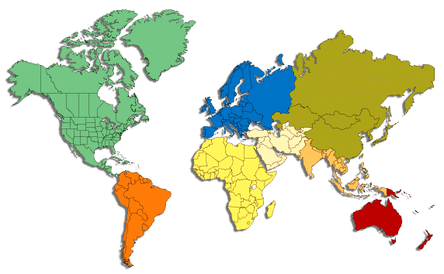









Members
Lars Öhrström
Sweden
Neil Champness
UK
Susumu Kitagawa, Japan also IZA
Jan Reedijk, the Netherlands,
Xiao-Ming Chen, PR China
Javier Martinez, Spain
Myungh Paik Suh, South Korea
Mike O’Keeffe, USA
also IZA
Stuart Batten
Australia
Notes:
Lars present group members

Slide 6
Why?
Nomenclature and terminology should always create added value.
They are tools to incorporate new results into the greater weave of science and enable us to go from the specific to the general.
New terminology should also help us to constructively discuss new compounds, materials and phenomena without having to proceed through endless preambles of definitions.
Notes:
Lars: Agreement need about terminology. Why should we bother?

Slide 7
Why?
“Diplomacy is about surviving until the next century - politics is about surviving until Friday afternoon.”*
“Science politics is about surviving the next grant application review – nomenclature and terminology is about making science survive to the next generation.”
* The fictive Cabinet secretary Sir Humphrey Appleby in the BBC series “Yes, Prime minister”, 1986
Notes:
Not shown but we kind of like it.

Slide 8
The IUPAC task group on
Coordination polymers and metal- organic frameworks: terminology and nomenclature guidelines
The objectives of this project were:
(1) to produce guidelines for terminology (glossary of terms) and nomenclature concerning topology.
(2) to ensure that these guidelines are accepted by a large group of leading researchers in the field, and
(3) to have these guidelines implemented or referred to in the instructions to authors of leading general and inorganic chemistry journals.
http://stage.iupac.org/web/ins/2009-012-2-200
Notes:
Neil: These were the formal objectives of the task group.
Lars: Do you have to worry that IUPAC will try to impose a lot of rules that we don’t like? (Question to N)

Slide 9
How did we work?
The task group held an initial meeting in Glasgow (UK) 2009.
An additional smaller meeting in San Juan (Puerto Rico, USA) 2011, partly using Skype.
A final meeting in Stockholm (Sweden) 2012.
Notes:
Lars

Slide 10
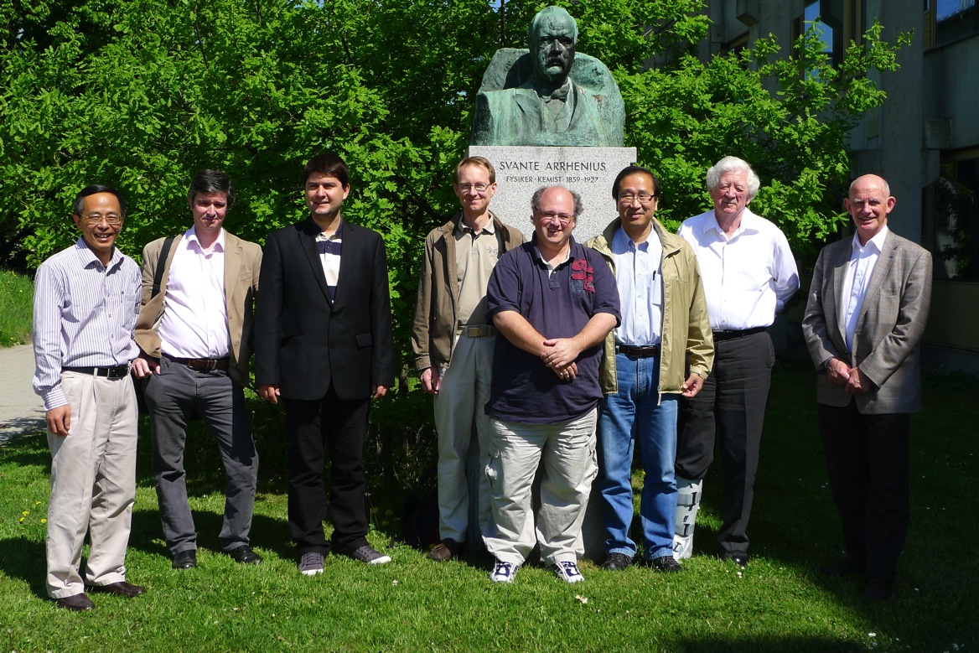
The Stockholm Agreement
Notes:
Neil

Slide 11
The Stockholm Agreement
COORDINATION POLYMER
COORDINATION NETWORK
MOF
Notes:
Lars
And we start with…

Slide 12
Coordination Polymer
A coordination compound with repeating coordination entities extending in 1, 2 or 3 dimensions.
Comment:
Coordination polymers do not need to be crystalline.
These compounds may in some cases, such as those being composed of carboxylates, be regarded as salts.
See: S. R. Batten, N. R. Champness, X. M. Chen, J. Garcia-Martinez, S. Kitagawa, L. Öhrström, M. O'Keeffe, M. P. Suh, J. Reedijk, Crystengcomm 14, 3001, 2012
Notes:
Neil

Slide 13
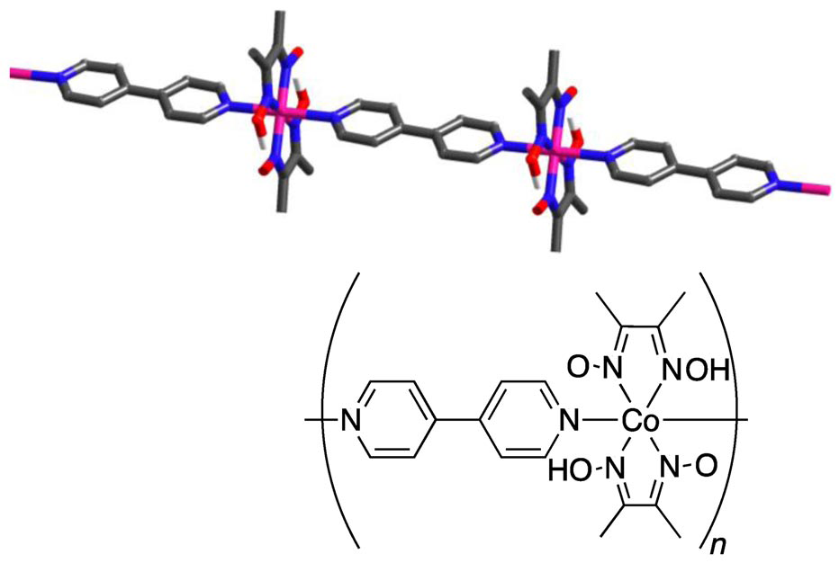
Coordination Polymer
A coordination compound with repeating coordination entities extending in 1, 2 or 3 dimensions.
A classical type of single-chain coordination polymer is the (4,4'-bipyridine-N,N)-bridged cobalt(II) compound
Kubel, F.; Strahle, J. Z.Naturforsch.,B:Chem.Sci. 1982, 37, 272.
Notes:
Neil

Slide 14
Coordination Network
A coordination compound extending, through repeating coordination entities, in 1 dimension, but with cross-links between two or more individual chains, loops or spiro-links, or a coordination compound extending through repeating coordination entities in 2 or 3 dimensions.
Comment:
The preferred and most widely understood term will likely be Coordination Polymer, but the IUPAC will endorse also the use of the term Coordination Network although it should be clear that these two terms are not synonymous
Notes:
Lars

Slide 15
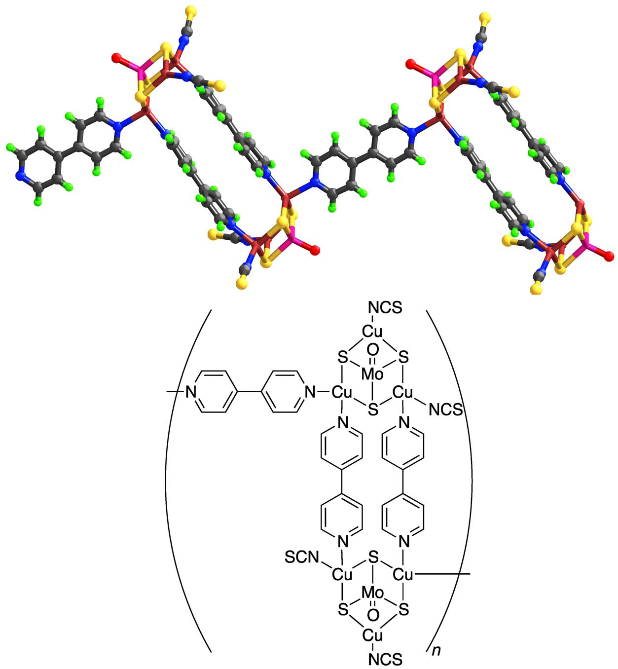
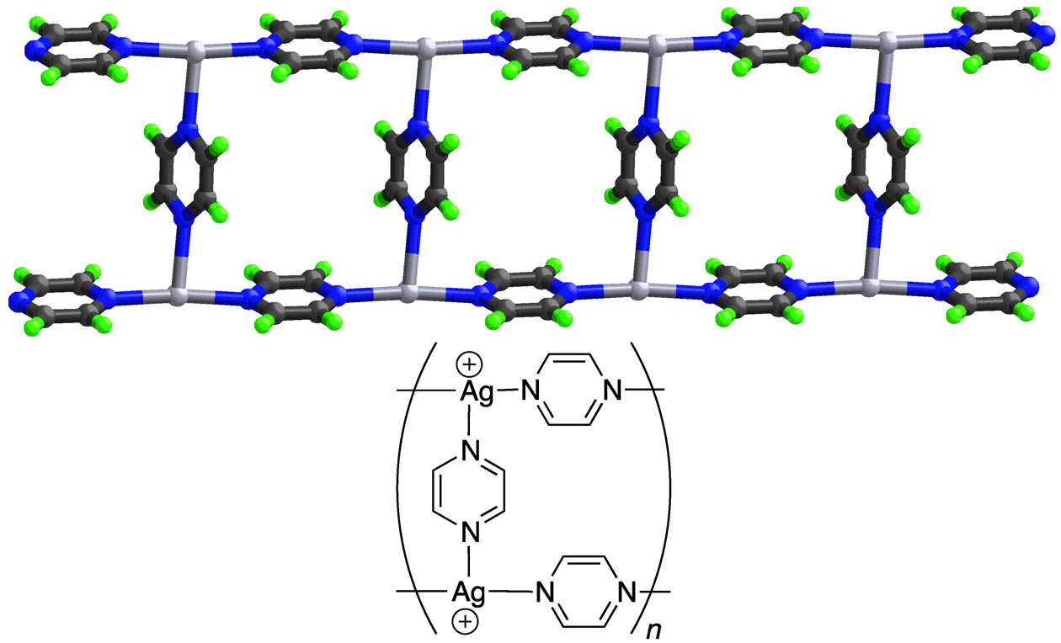
Coordination Network
Example of cross-links forming a coordination network
Venkataraman, D.; Lee, S.; Moore, J. S.; Zhang, P.; Hirsch, K. A.; Gardner, G. B.; Covey, A. C.; Prentice, C. L. Chem.Mater. 1996, 8, 2030
Example of loops forming a coordination network
Notes:
Lars

Slide 16
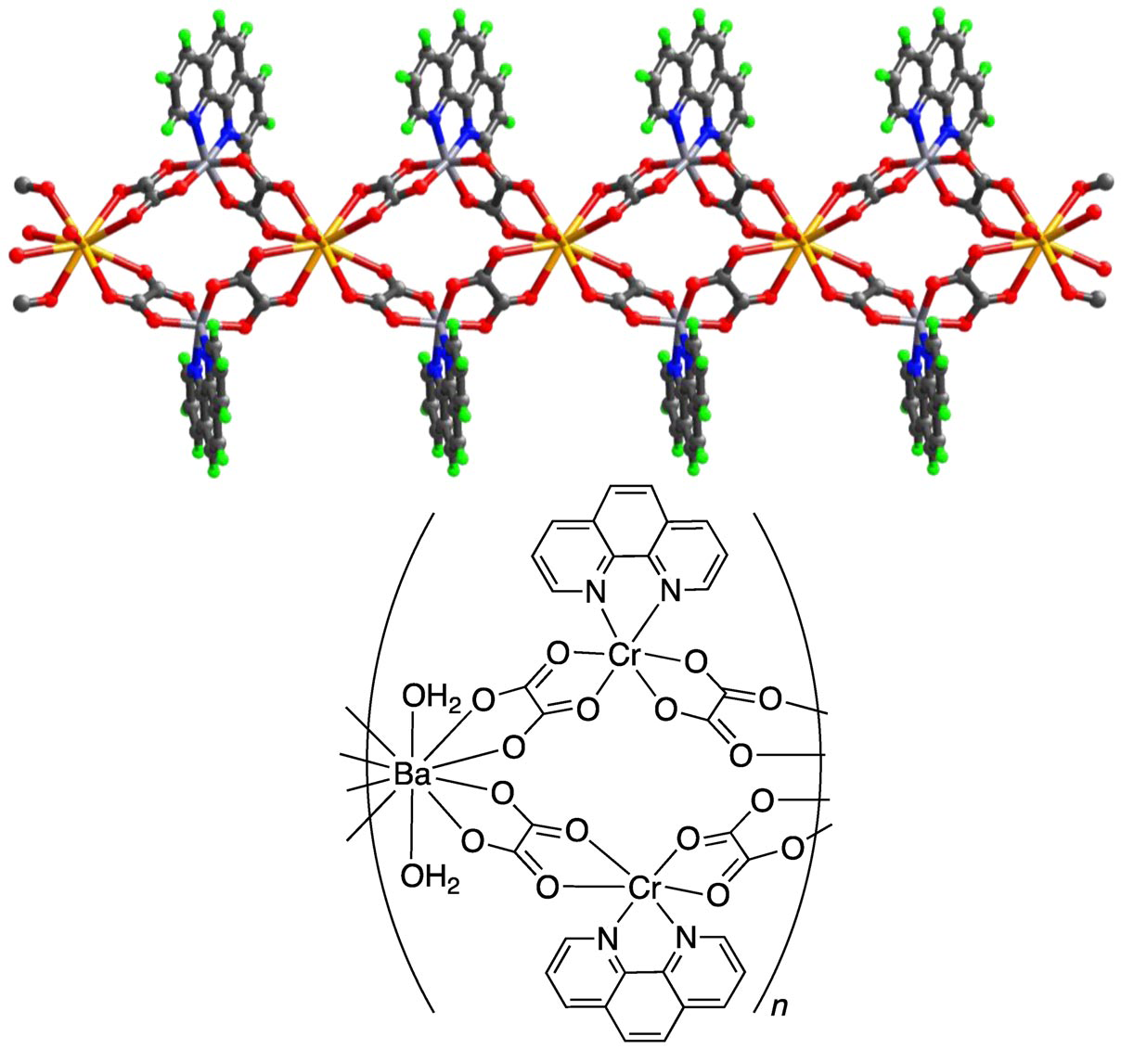
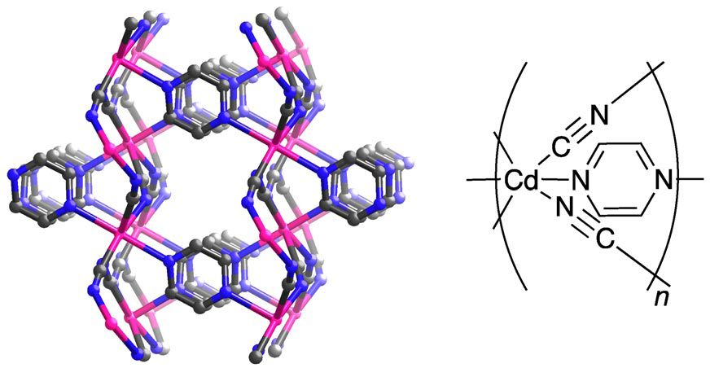
Coordination Network
Example of a coordination network that is also a 3D-coordination polymer
Example of spiro connections forming a coordination network
Notes:
Lars
We don’t want to call any of these metal-organic frameworks do we?

Slide 17
Metal-Organic Framework
A Metal-Organic Framework, abbreviated to MOF, is a Coordination Network with organic ligands containing potential voids.
Comment:
Many systems are dynamic and changes in structure and thus corresponding changes in potential porosity or solvent and guest filled voids may occur depending on temperature, pressure or other external stimuli.
This comes very close to a self-definition which is important as this term is now occurring also outside the inorganic chemistry community.
Notes:
Neil

Slide 18
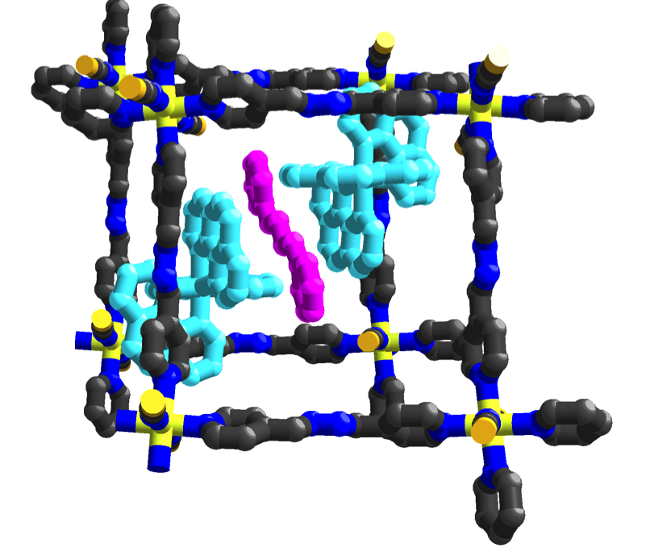
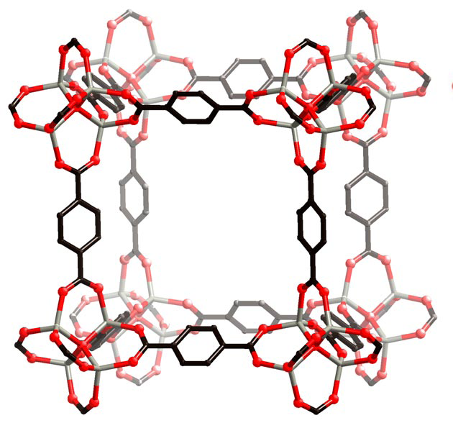
Metal-Organic Framework
Archetypical MOFs
Ghazzali, M.; Langer, V.; Larsson, K.; Öhrström, L. Crystengcomm 2011, 13, 5813.
Notes:
Neil

Slide 19
Net or network topologies
The use of topology to enhance the description of crystal structures of 3D-coordination polymers and MOFs is strongly recommended.
It is important that the utmost clarity, unambiguity and transparency are used when presenting these topologies in a scientific article.
Comment:
Accurate and careful use of network topologies will make scientific communication more efficient.
Notes:
Lars

Slide 20
Topology Descriptors
Detailed recommendations on topology descriptors cannot be made at the present time.
However:
The use of the symbols or codes in the Reticular Chemistry Structural Resource (RCSR) database is encouraged.[1]
For the more general topology terms such a point symbols it is recommended that the advice outlined by an ad-hoc assembled group of scientist from the USA, Russia and Italy [2] is followed.
[1] O'Keeffe, M., M. A. Peskov, S. Ramsden and O. M. Yaghi (2008). Acc. Chem. Res. 41, 1782-1789. http://rcsr.anu.edu.au/
[2] V. A. Blatov, M. O'Keeffe, D. M. Proserpio, CrystEngComm 12, 44 (2010)
Notes:
Neil

Slide 21
Other Terms
IUPAC should not at the present time endorse any other terms in the area. The only term that is explicitly discouraged is “hybrid organic-inorganic materials”.
The view of the group is that a simple prefix to the endorsed terms Coordination Polymer and Metal-Organic Framework can easily and more efficiently communicate any further specification needed. Such specification typically would indicate properties, such as in Porous Coordination Polymer, constituents such as carboxylate-MOF, or network topology, such as dia-MOF, such terms not being mutually excluding, but rather used as the authors see fit to emphasize different aspects of their materials.
Notes:
Lars

Slide 22
NOMENCLATURE
A task group chaired by IUPAC Polymer division’s Richard Jones is currently revising the IUPAC recommendations from 1984 for the nomenclature of Coordination and Inorganic Polymers.
Comment
The use of an IUPAC endorsed name in a flowing text will be cumbersome (although essential to include).
The task group can agree with the common practice of giving important new compounds trivial names based on their place of origin followed by a number such as HKUST-1, MIL-101, and NOTT-112.
Notes:
Lars

