Slide 1
Single Crystal to Single Crystal Transformations in Metal Organic Frameworks
Parimal K. Bharadwaj
Indian Institute of Technology Kanpur
Karachi, April 28, 2014

Slide 2
Our research efforts
  Macrobicyclic cryptands
  a) Fluorescence sensors
  b) Non-linear optical effects
  c) Langmuir-Blodgettry & Vesicles
  d) Nanoporous materials
  e) Utilization of solar energy
  Metal Organic Frameworks
Sorption of gases
Dynamic framework
Catalysis
Proton conductivity
SC-SC Transformations

Slide 3
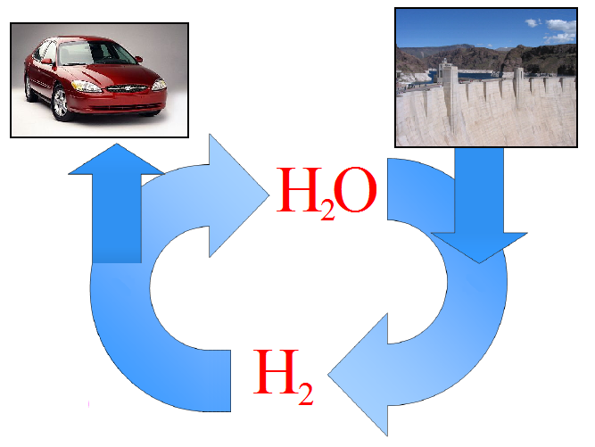
A Vision of a Hydrogen Future
Water will be the coal of the future
Jules Vernes (1870)

Slide 4
Fuel cell
Nafion presently used as a separator membrane, cannot be used beyond 80^{o C}

Slide 5
US-DOE 2017 Target for H₂
Combustion product is water when employed in fuel cells/internal combustion engine
5.5 wt.% in gravimetric capacity
An ability to operate within the temperature range -40 to 60 °C under a maximum delivery pressure of 100 atm
A lifetime of 1500 refuelling cycles
A refueling time of about 5 minutes

Slide 6
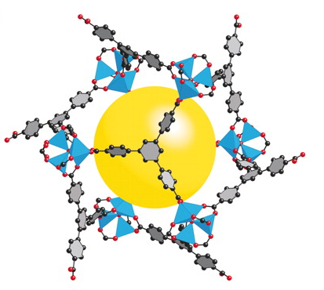
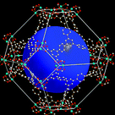
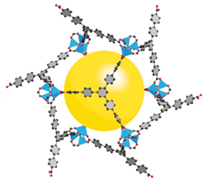
Some representative MOFs with highest H₂ uptake
Zn(NO₃)₂
H₂ uptake 7.5 wt% at 77 K and 70 bar
Solvothermal
MOF-177
Cu(NO₃)₂
H₂ uptake 10.0 wt% at 77 bar and 77 K
Solvothermal
NOTT-112
Zn(NO₃)₂
At 298 K and 100 bar MOF-200-27Li shows 10.30 wt % H₂ uptake
Solvothermal
MOF-200

Slide 7
Strategies for Hydrogen and other Gas Sorption
Large voids and low density : unstable framework and massive interpenetration
Hydrophobic channel preferred
Medium voids gives stable framework
Coordinatively unsaturated metal centres
Functional sites in the cavity

Slide 8
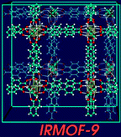

Slide 9
Tuning the Gas storage capacity by
Pore Functionalization

Slide 10
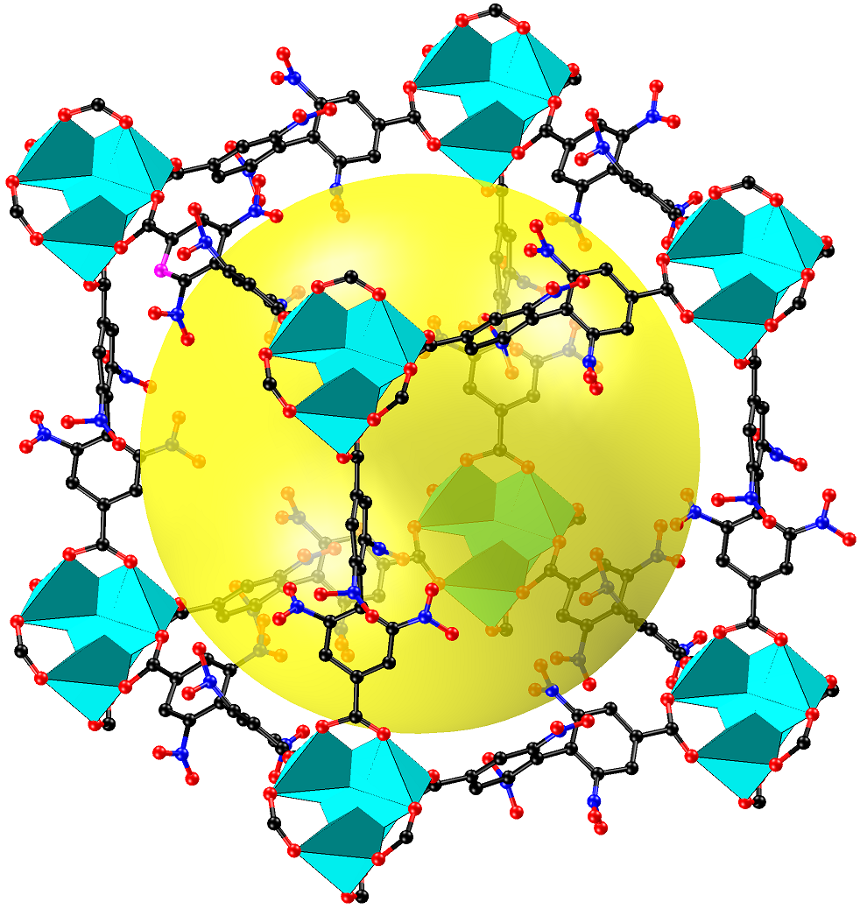
Solvent Accessible Void: 56%,
d = 1.0 g/cc

Slide 11
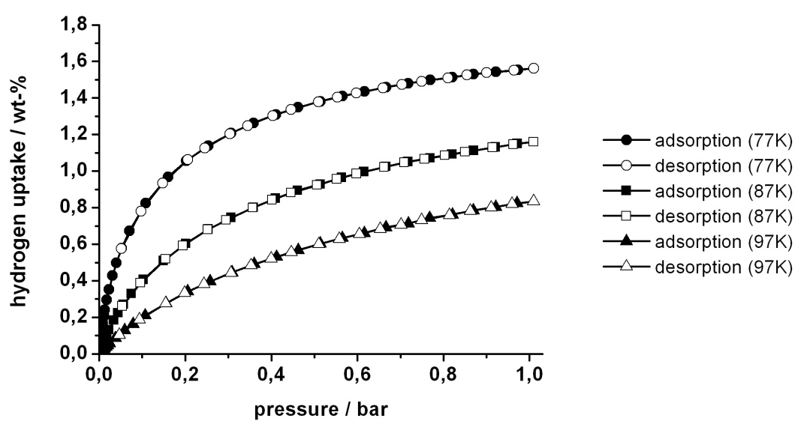
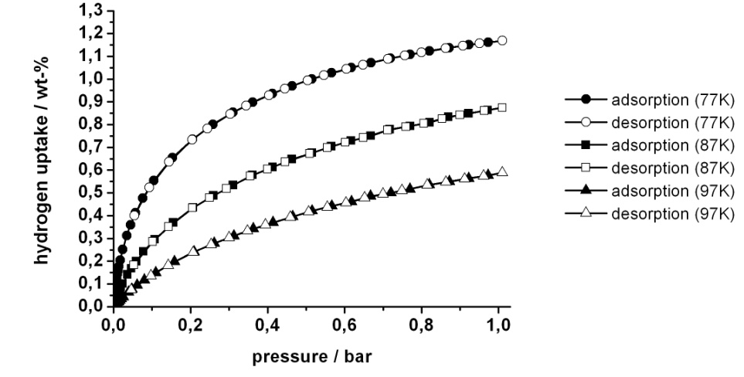
Hydrogen Adsorption Isotherms
Compound 1
Hydrogen-physisorption
(at 77 K, 1 bar): 1.56 wt.%
(at 87 K, 1 bar): 1.16 wt.%
(at 97 K, 1 bar): 0.83 wt.%
ΔH_{ads} = 7.4 kJ/mol
Compound 2
Hydrogen-physisorption
(at 77 K, 1 bar): 1.17 wt.%
(at 87 K, 1 bar): 0.87 wt.%
(at 97 K, 1 bar): 0.59 wt.%
ΔH_{ads} = 7.6 kJ/mol

Slide 12
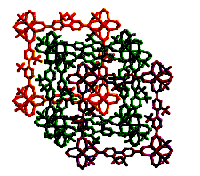
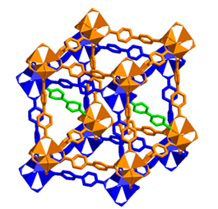
Inorg Chem 2013

Slide 13
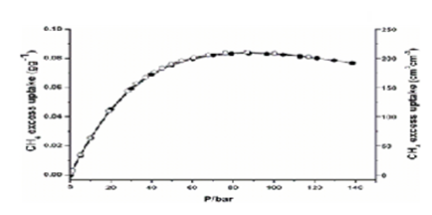
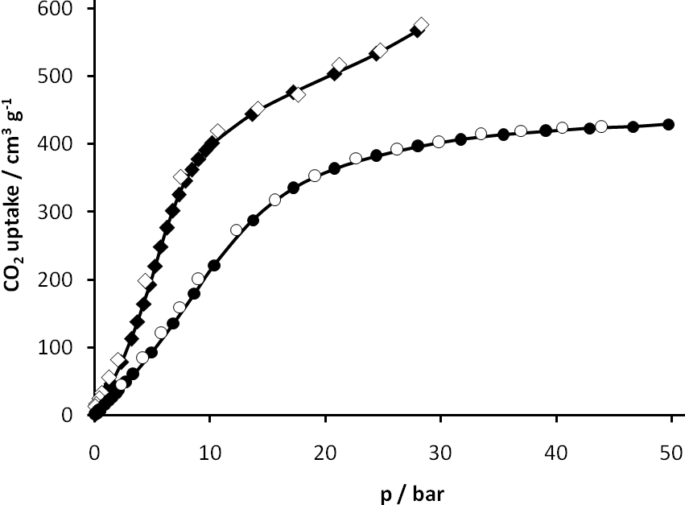
Inorg Chem 2013
Hydrogen physisorption isotherm at 77 K.

Slide 14
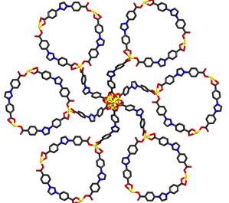
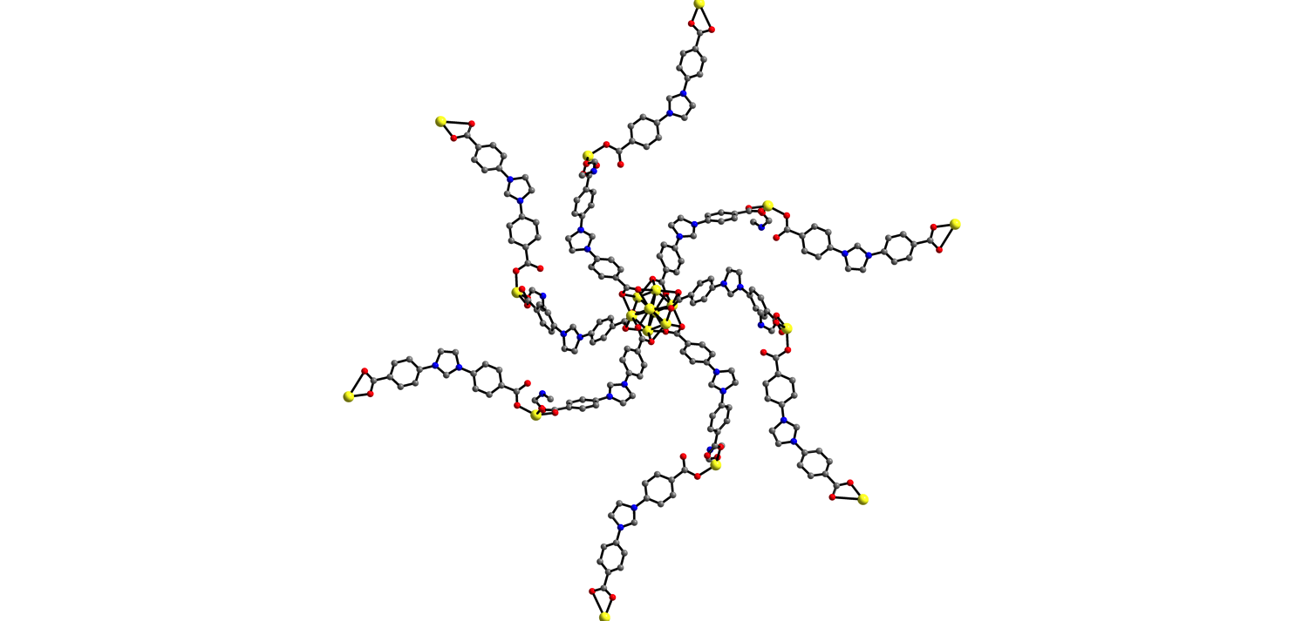
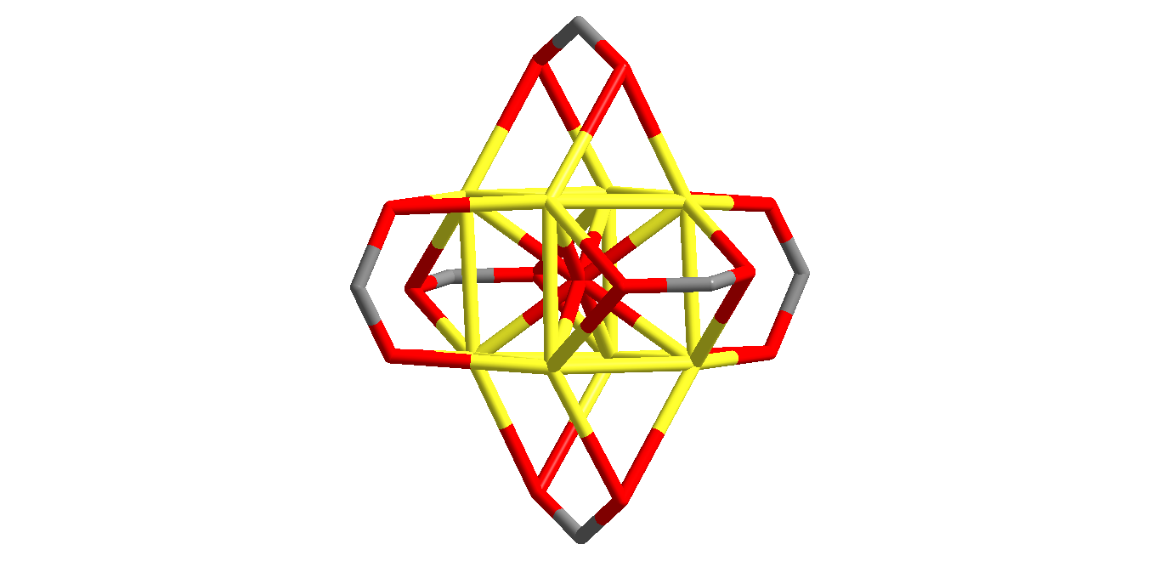

Slide 15
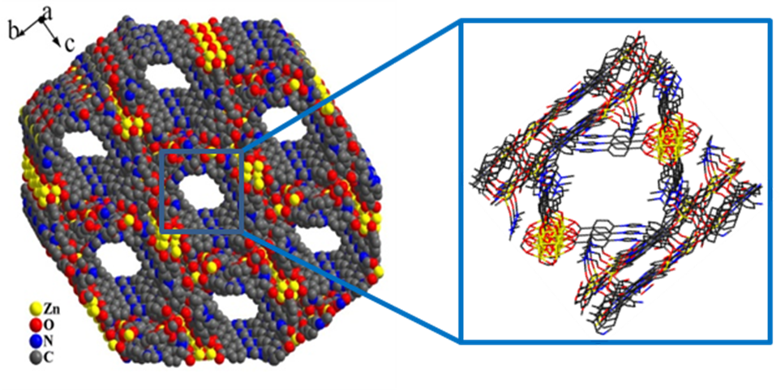

Slide 16
Proton conductivity dependence on humidity at 298 K. The measurement was executed with increase (open circles) and decrease(closed circles) in humidity.
Water adsorption (open circles) and desorption
(filled circles) isotherms at 298 K.
J. Am. Chem. Soc. 2012

Slide 17

Dynamic reversible bicycle pedal Motion in Crystalline State
Inorg. Chem. 2010

Slide 18
Heat Induced Bicycle Pedal Motion in SC-SC Fashion

Slide 19
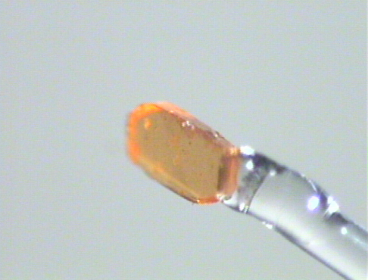
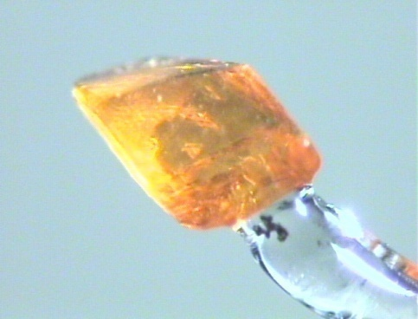
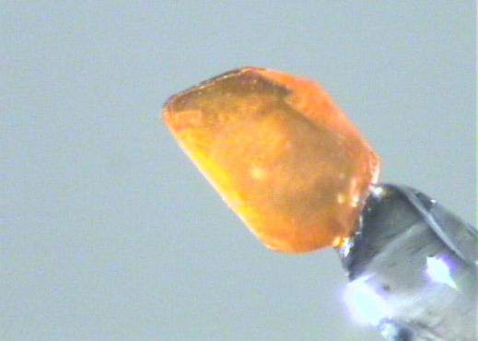
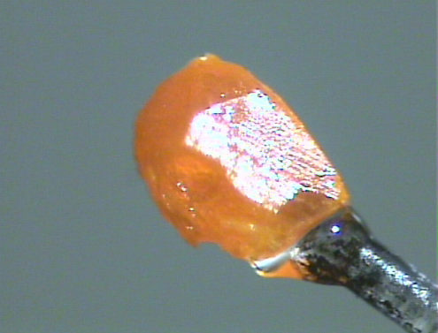
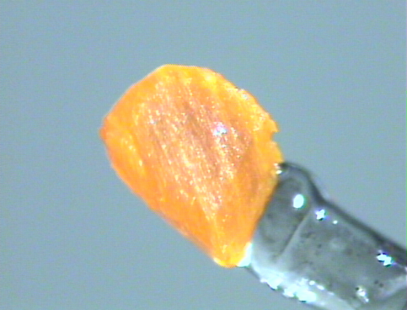
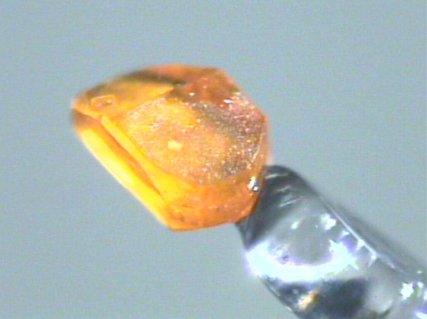
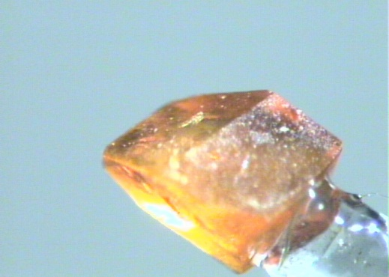
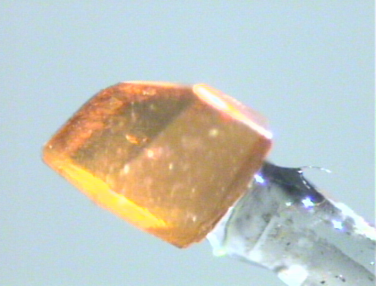
Photographs of the mother crystal
1
2
2a
2b
2c
3
4
2´
Inorg. Chem. 2010

Slide 20
Separation of Geometrical Isomers
J.Am.Chem.Soc. 2009

Slide 21
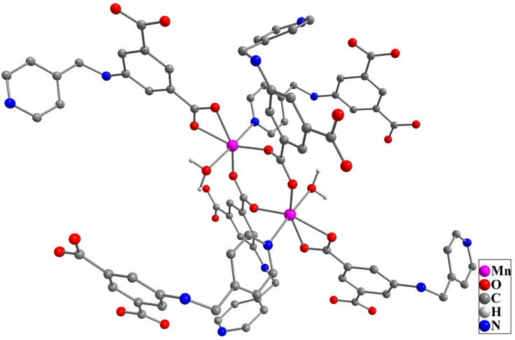
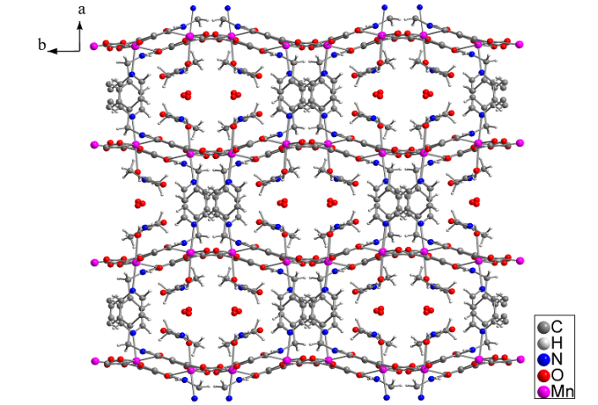
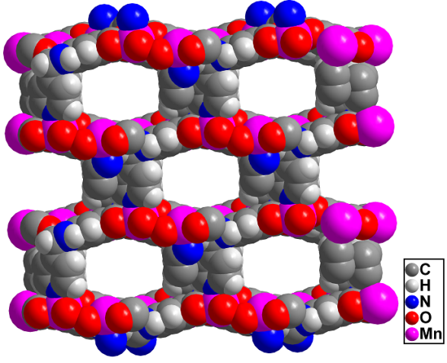
The dimeric unit
3-D diagram
Showing empty cavity
Hydrophilic channels
Dimension is approximately 7.36 X 4.37 Å²
45.2 % void volume
C─H···O, C─H···π interactions and water pentamer
One crystal is chosen named Mother Crystal

Slide 22
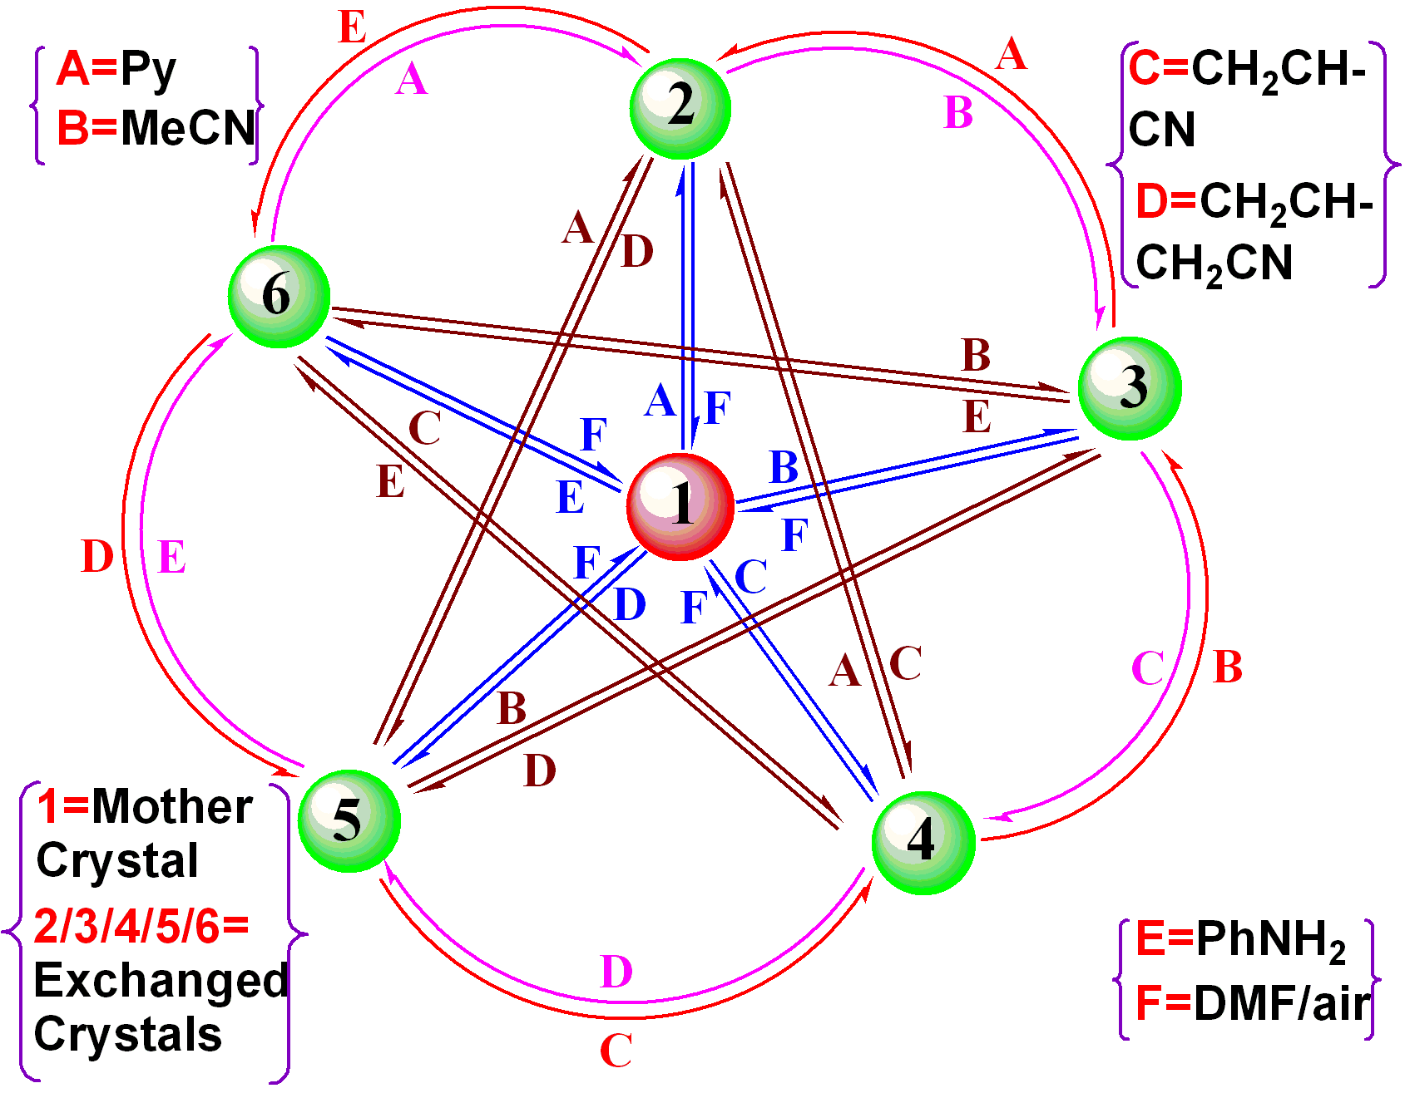
A schematic representation for the reversible substitution
reactions at Mn(II) center within the pores of complex 1.

Slide 23
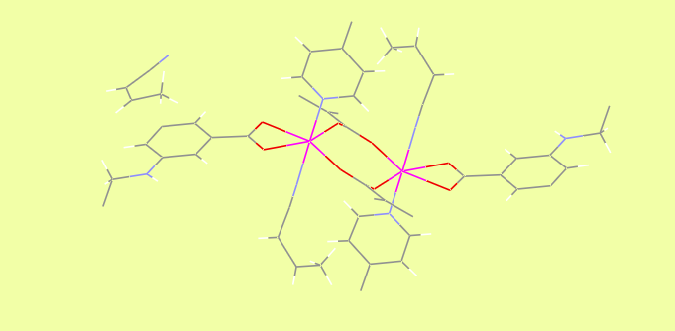
Mother Crystal
Mixture of cis & trans Crotonitrile
(60 trans, 40% cis)
Inclusion of only cis crotonitrile

Slide 24
Cyanosilylation
Addition of silyl cyanides (mainly trimethylsilyl cyanide ) to aldehydes and ketones
A convenient route to formation of cyanohydrins that are key intermediates in the synthesis of fine chemicals and pharmaceuticals
Catalyzed by Lewis acids

Slide 25
Knoevenagel Reactions
Addition of active methylene compounds to aldehydes
An important precursor
Catalyzed by bases as well as acids

Slide 26
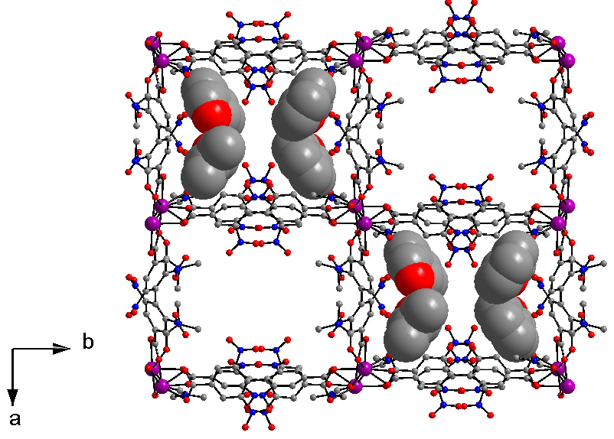
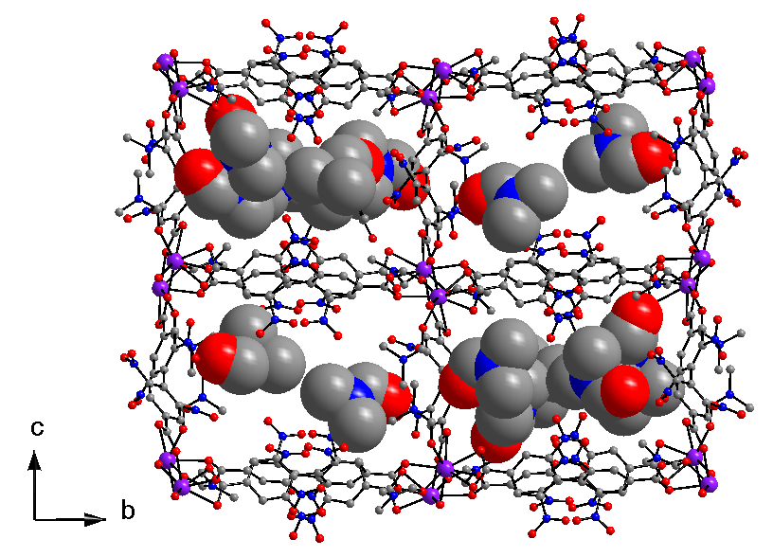
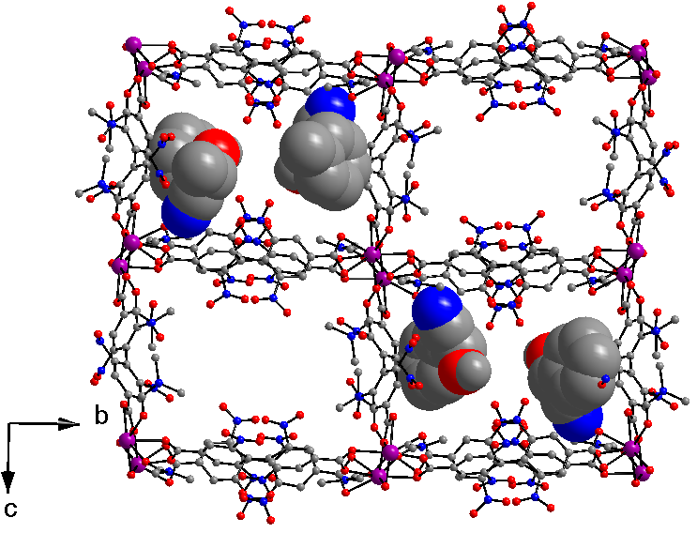
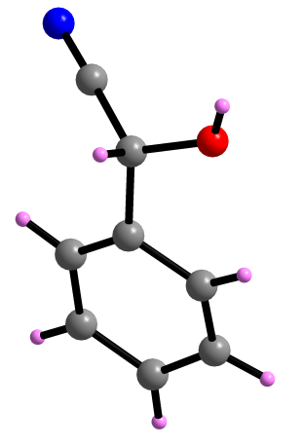
Chem. Eur. J. 2011

Slide 27
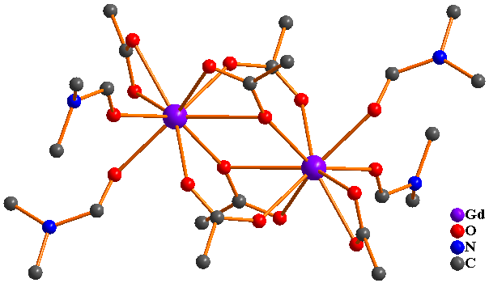
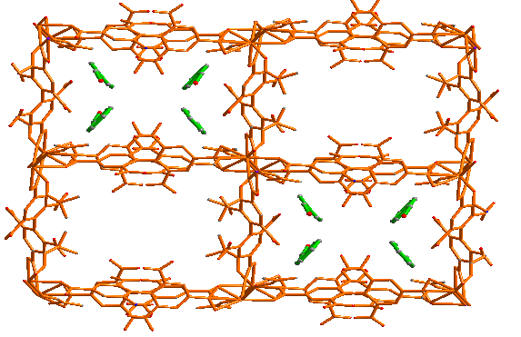

Slide 28
Crystal to Crystal transformation from Zn₄O to Cu₄O !!!

Slide 29

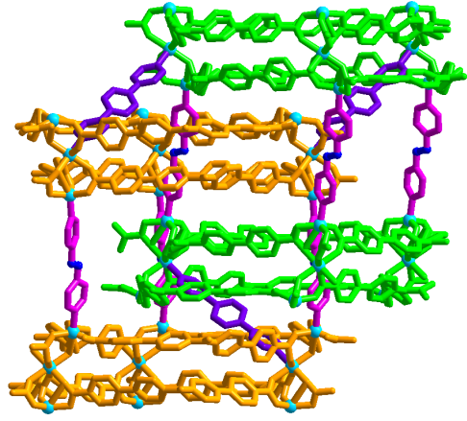
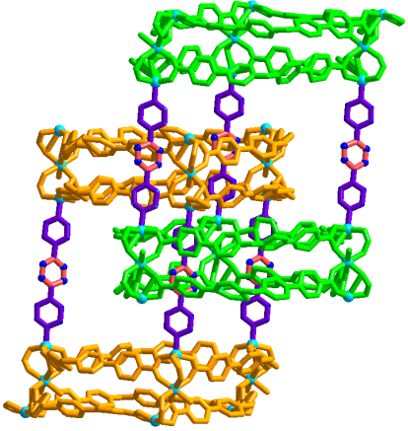
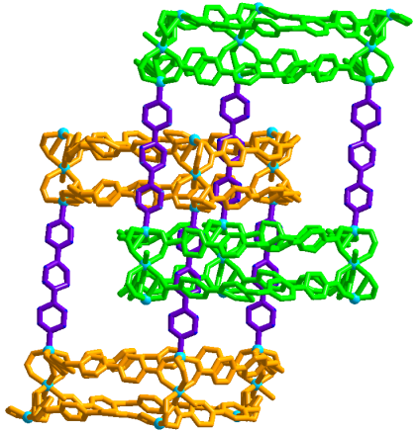
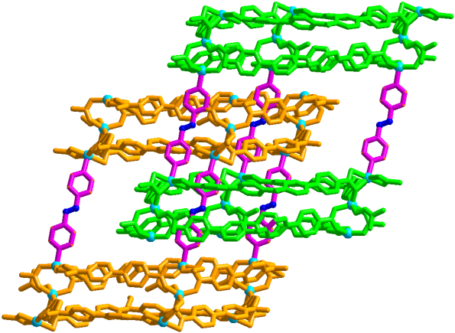
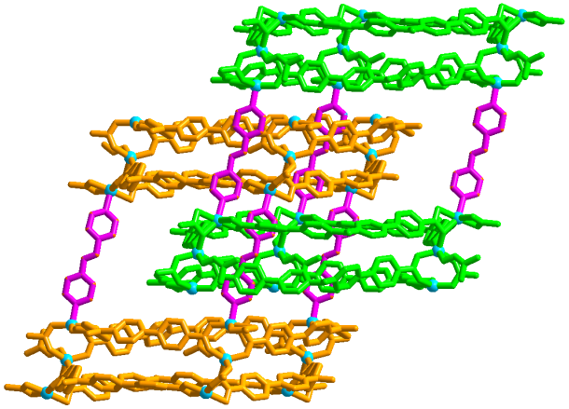
Single-Crystal-to-Single-Crystal Pillar Ligand Exchange in Porous Interpenetrated Zn(II) Frameworks
Zn²⁺
a =
d
DMF, 90 °C
b
a
a
c
c
d
b =
c =
d =

Slide 30
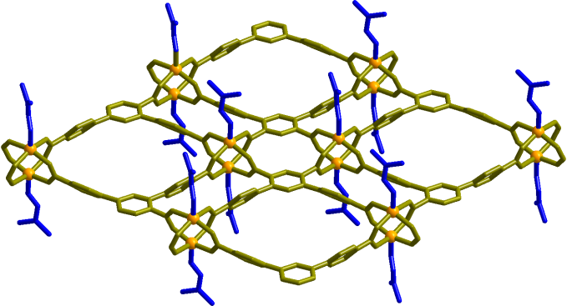
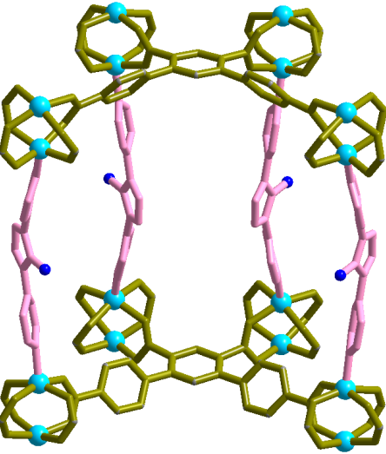
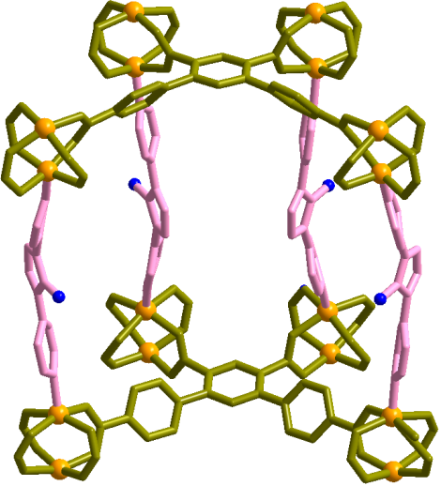
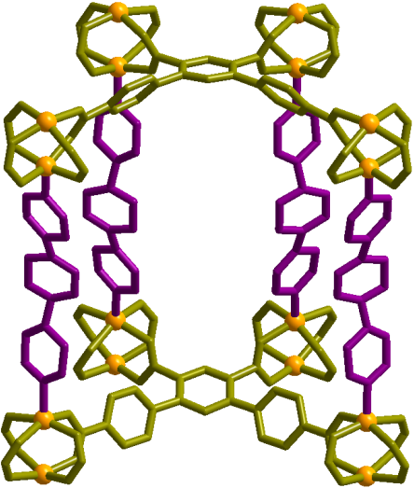
Achieving a Rare 2D→3D Transformation in a Porous MOF: Single-Crystal-to-Single-Crystal Metal and Ligand Exchange
Zn(II)
Porous 2D layer
Cu(II)
Porous 3D pillar-layer

Slide 31
Acknowledgement
Arshad Aijaz, Rajkumar Das, Manish Sharma,
Prem Lama, Rupali Mishra, Rashmi Agarwal,
Musheer Ahmed, Atanu Santra, Jhasaketan Sahoo, Ruchi Singh, Tapan Pal, Sanchari Pal, Nabanita,
Dinesh De, Mayank Gupta, Ashis, Vivekanand
Dr. Subhadip Neogi, Dr. Susan Sen, Dr. N. Obasi
Professor Dr. Stefan Kaskel
Professor Quiang Xu
Professor L. J. Barbour
Funding
DST(J C Bose Fellowship)
DST-DFG
IIT Kanpur
DST (SERB, Green Initiative)
CSIR, New Delhi

Slide 32
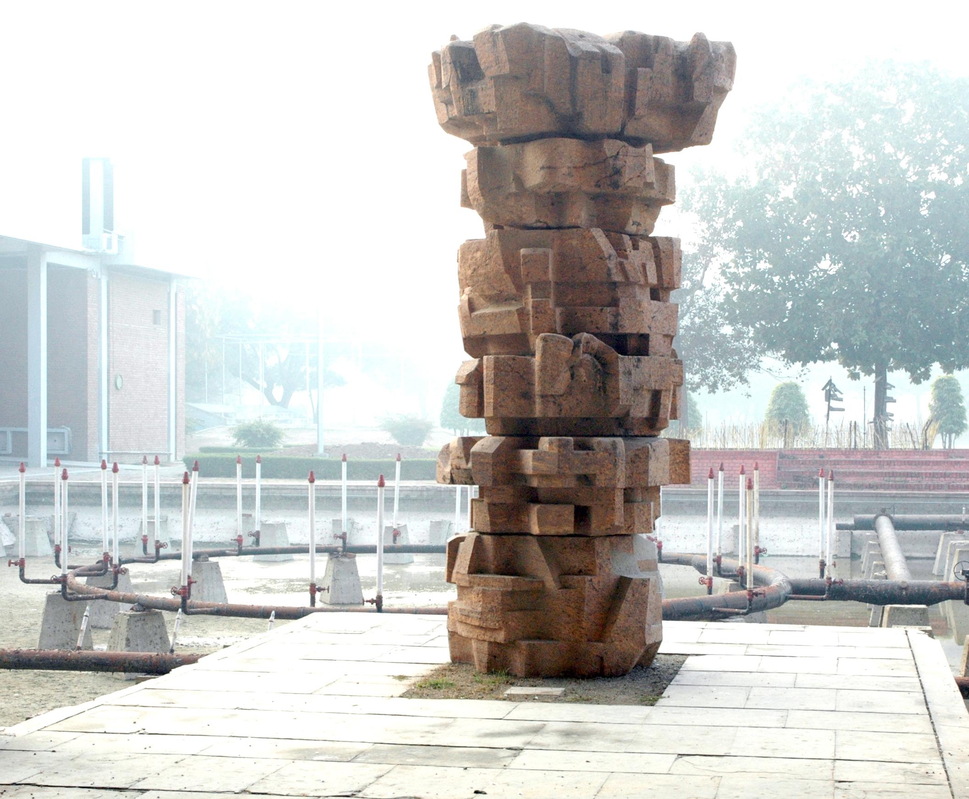
Thank You

Slide 33
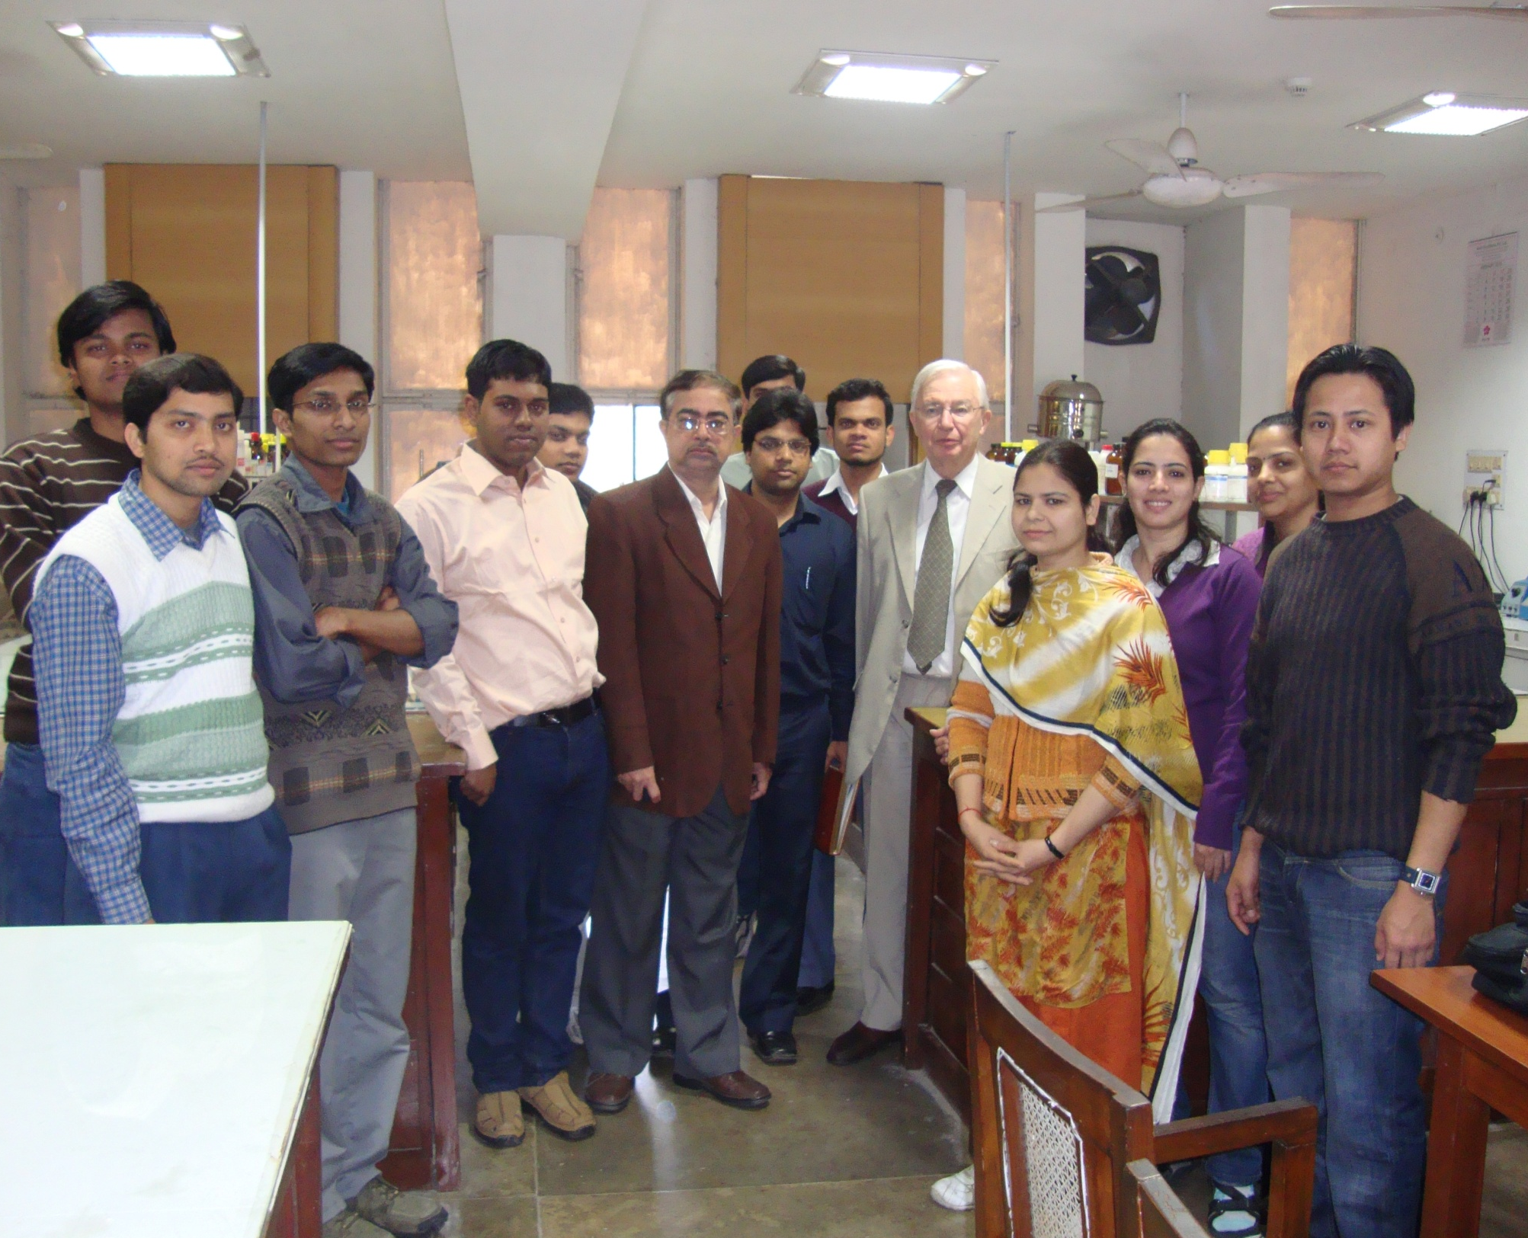

Slide 34
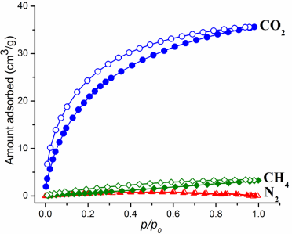
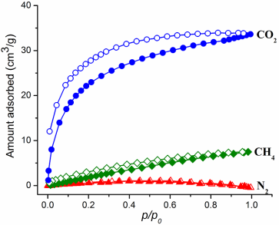
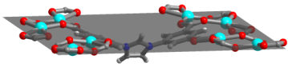
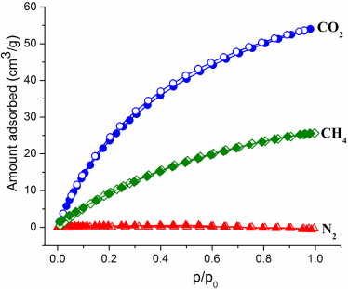







Modulation of Pore Sizes in Pillared-Layer
Metal-Organic Frameworks for Enhanced Gas Adsorption
Zn(II)
Dalton 2014
Zn²⁺, DMF
or
or
90 ºC, 72h
Increasing length
Increasing pore size
34
Notes:
34

Slide 35
Guest Induced Bicycle Pedal Motion in SC-SC Fashion

Slide 36
Guest Induced Bicycle Pedal Motion in SC-SC Fashion

Slide 37
Issues with Hydrogen
Hydrogen is an ideal energy carrier, having three times gravimetric heat of combustion of gasoline (120 MJ kg⁻¹ vs. 44.5 MJ kg⁻¹)
Not widely available on planet earth
Usually chemically combined in water or fossil fuels (must be separated)
Electrolysis of water requires prodigious amounts of energy
Storage problems
Transportation problems
Notes:
Unfortunately, pure hydrogen is not widely available on our planet. Most of it is locked in water or hydrocarbon fuels. It can be produced using other high-energy fuels, i.e. fossil fuels, but such methods require fossil fuels and generate CO2 to a greater extent than conventional engines and thus contribute to global warming more than if those fossil fuels were to be used directly to power automobiles for example. It can also be produced using huge amounts of energy and water. Nuclear power can provide the energy, but has well known disadvantages. Some 'Green' energy sources are capable of generating energy in a cost effective way if the externalities of conventional energy sources are factored in, but the policies of the world's major governments do not factor them in. However, most 'green' sources tend to produce rather low-intensity energy, not the prodigious amounts of energy required for extracting significant amounts of hydrogen using thermochemical electrolysis for example. This is called the production problem.
http://en.wikipedia.org/wiki/Hydrogen_economy

Slide 38
Hydrogen
Combustion product is water when employed in fuel cells/internal combustion engine
A vehicle with a driving range of 400 km per tank of fuel, about 8 kg of hydrogen is needed for a combustion engine-driven automobile and 4 kg for a fuel-cell-driven one
Industrial and domestic use (town gas - 50% hydrogen in the UK until the 1950's). Hydrogen as a vehicle fuel dates back to the 1800's but heightened in the 1970's with the oil crises and with technological advances in the 1980's.

