Slide 1




MOF Membranes： Synthesis，Adsorption for Green Application
Shilun Qiu
The State Key Laboratory of Inorganic Synthesis and Preparetive Chemistry, Jilin University, Changchun,CHINA
Email-sqiu@jlu.edu.cn
April 28, IYCr, Karachi

Slide 2
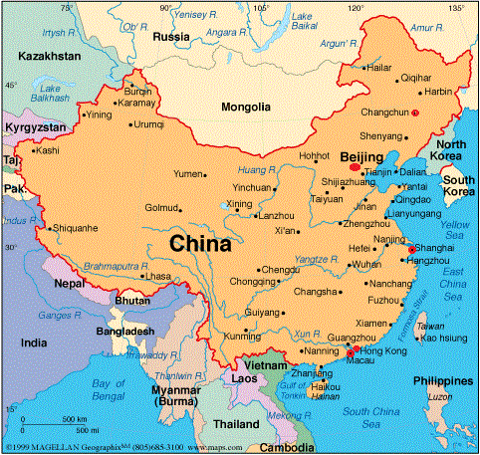

Slide 3

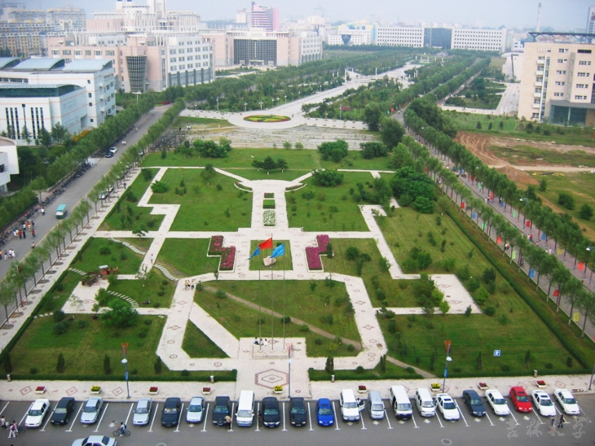
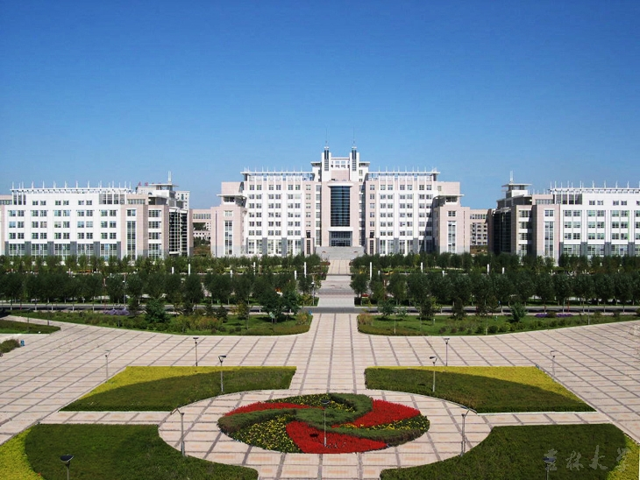
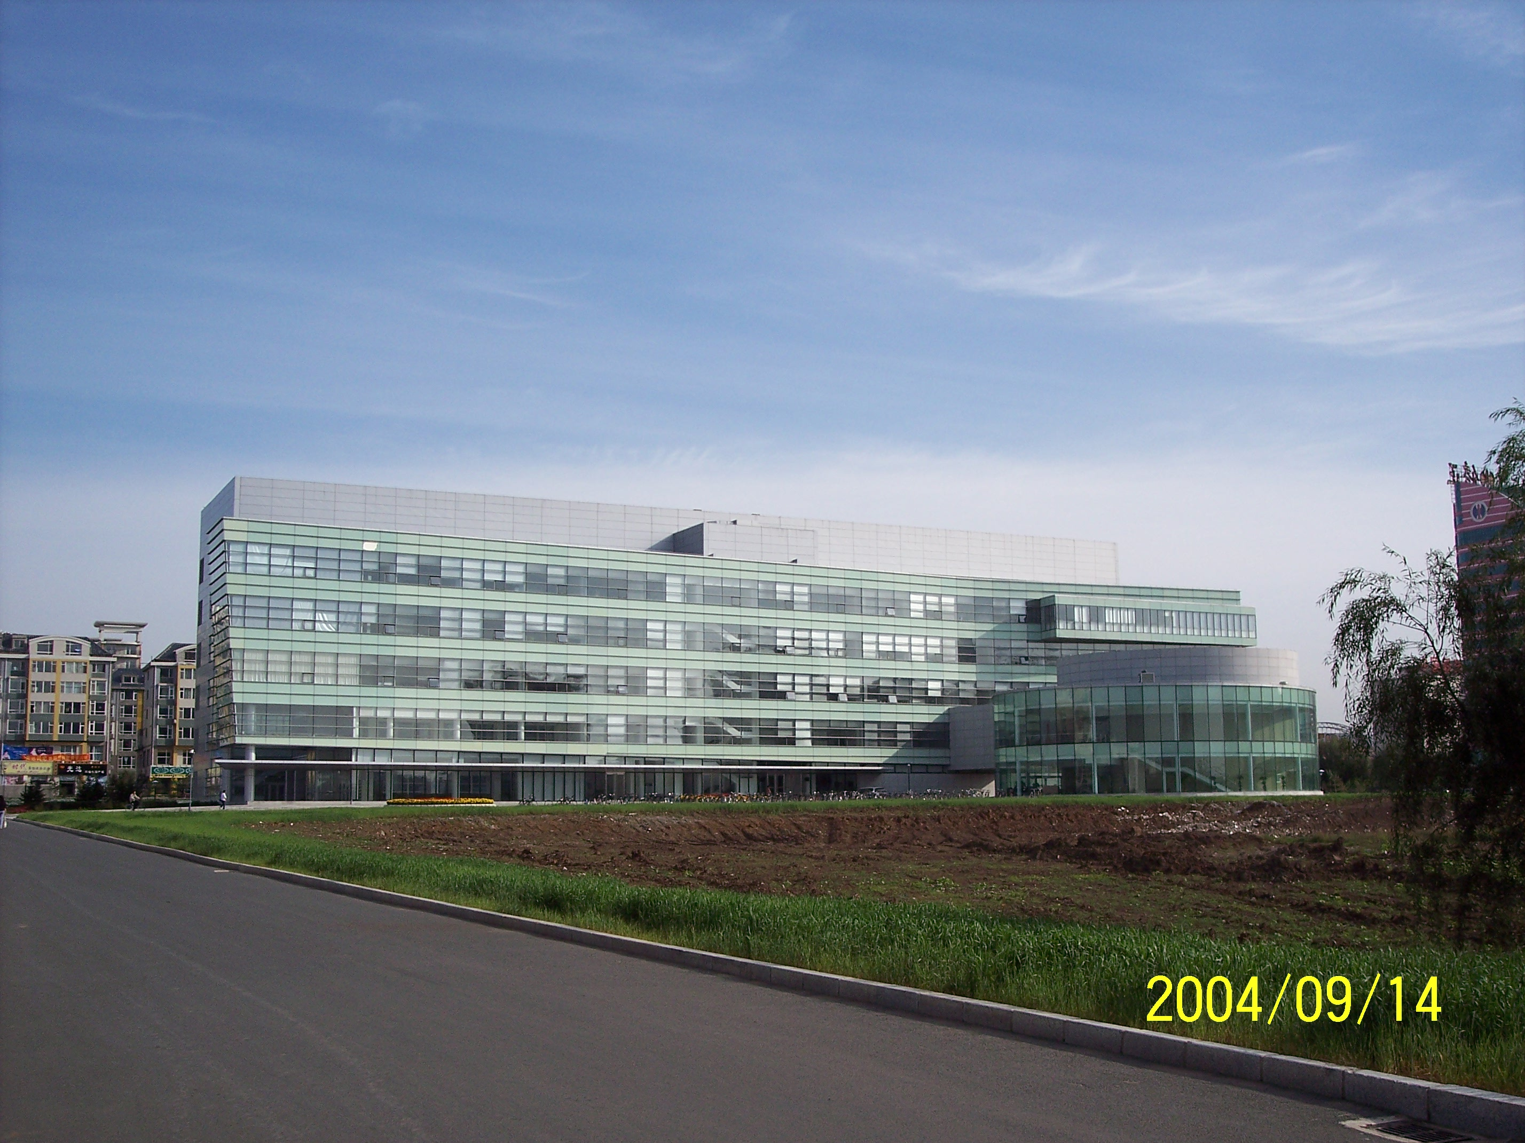
Typical Scene
in Changchun
Jilin University
Main Campus
Chemistry Building
SKL Inorg. Synth. & Prep. Chem.

Slide 4
Outline
Brief introduction of Porous materials and Membrane
Synthesis approaches for MOF membranes
1. In-situ
2. Seeded growth
3. Microwave
4. Interfacial synthesis
5. Contra-diffusion synthesis
Applications for green chemistry
1. Sensors
2. Separations
3. Devices
4. Chiral resolution
Conclusion

Slide 5
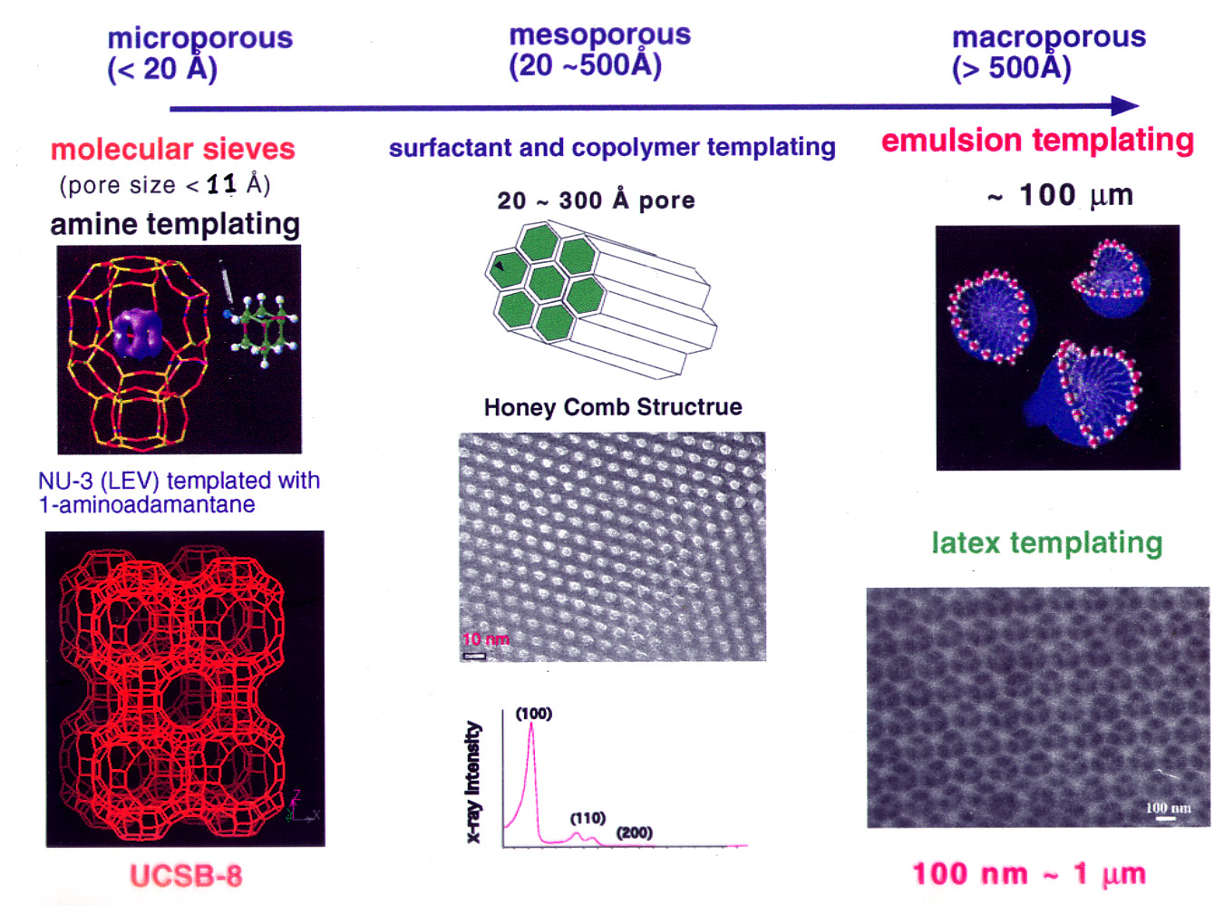
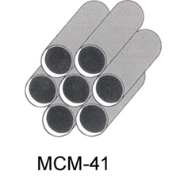
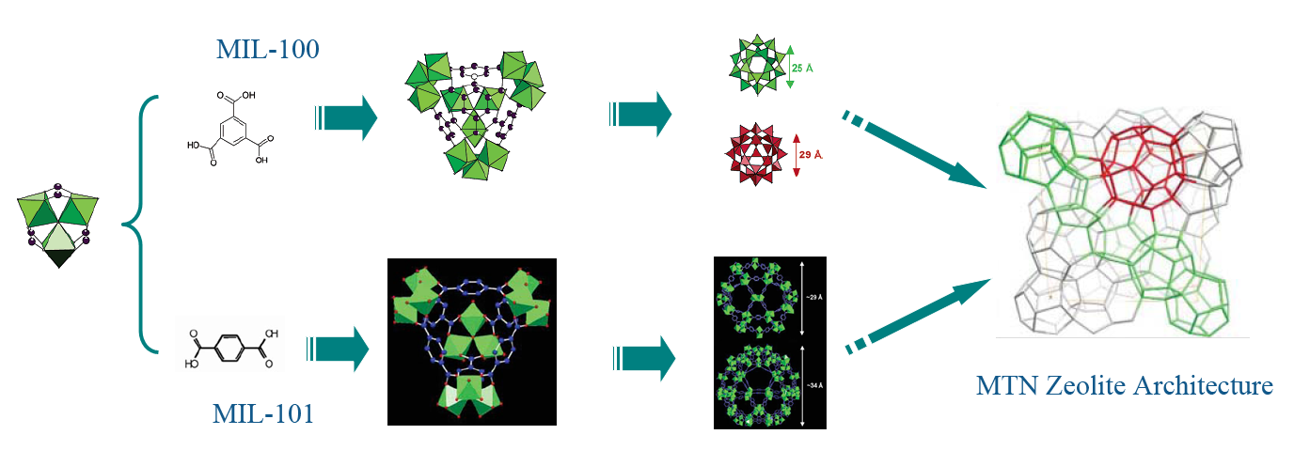
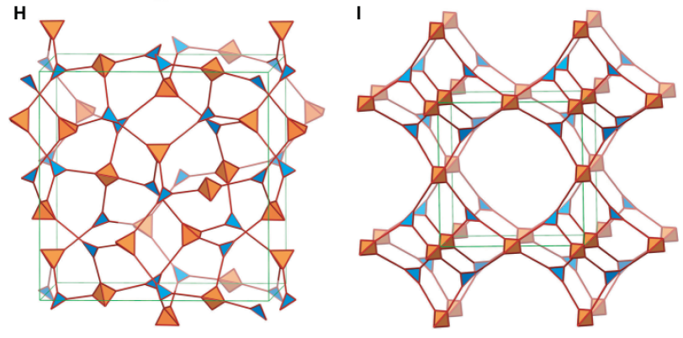
Ordered porous materials
Zeolite & Mesoporous Silica（Inorganic）
MOFs （ Coordination Polymers）
COFs (Covalent Organic Framework )

Slide 6

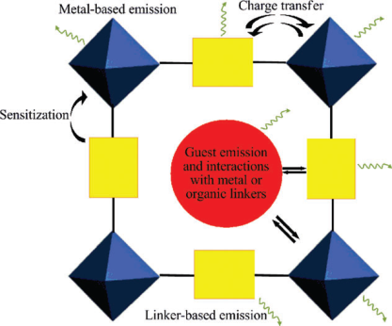
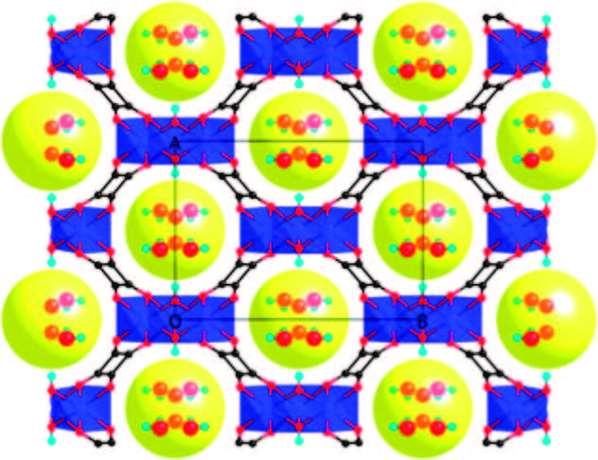
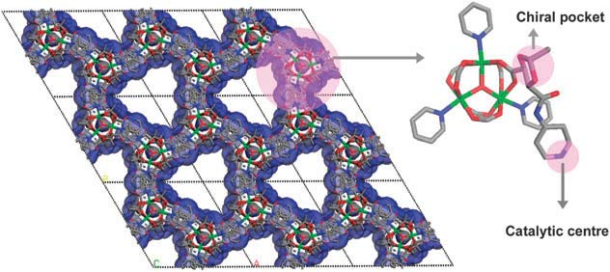
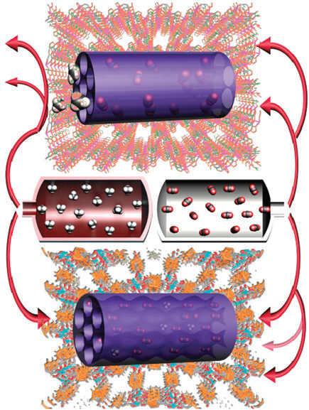
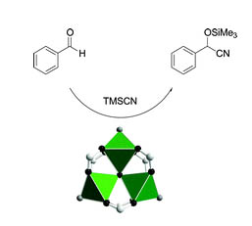
Applications
Optical Materials
Molecular Magnet
Molecular
Separation
Porous Materials
Gas Separation
Hydrogen Storage
Catalytic Materials

Slide 7
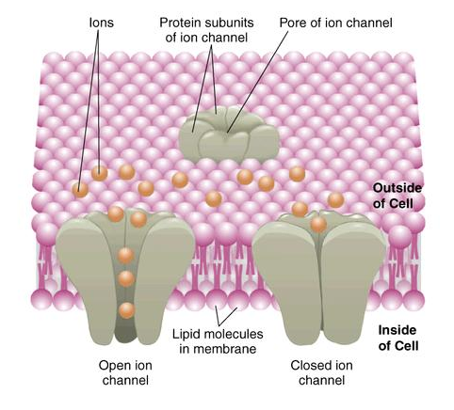
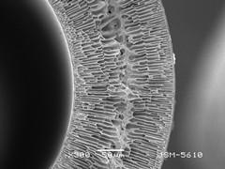
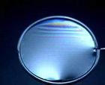
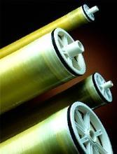
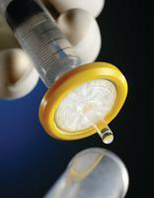
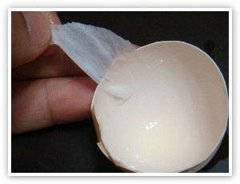
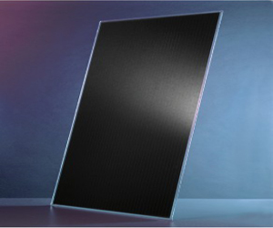
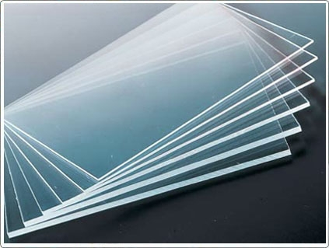
A variety of Membranes and Films
Hollow fiber
liquid membrane
Cell membrane
Reverse osmosis membrane
Egg shell membrane
Solar energy film
Filter membrane
Film to the glass
Membranes can be
of various thickness, with homogeneous or heterogeneous structure.
classified according to pore diameter.

Slide 8


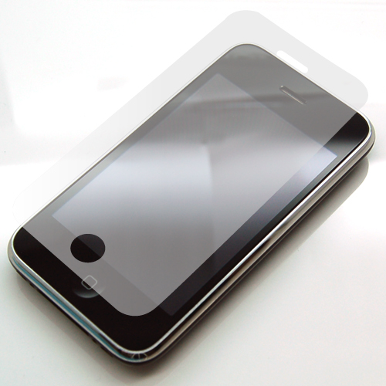


Superiority of Membranes and Films compared to powder materials
High
efficiency
Continuous
work
Easy to
operate
Energy
saving
Recyclable

Slide 9
Synthesis approaches of membranes and films
Porous Membranes and films
Zeolites
MOFs
Polymer
Membranes and films
Membranes and films
Membranes and films
In-situ
Thermally induced
phase separation
Seeded growth
Microwave
Immersion precipitation
phase transformation
Interfacial synthesis
Contra-diffusion synthesis
Molten state stretching
under stress
Vapor phase
Layer-by-layer preparation

Slide 10
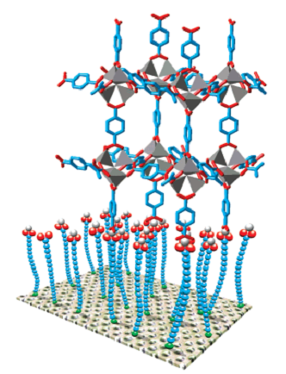
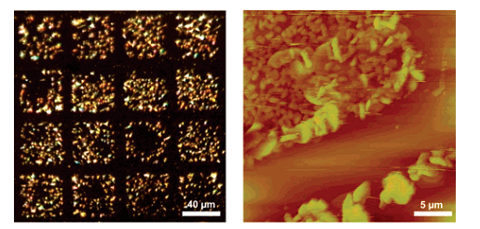
In-situ method
MOF-5 film
Self-Assembled Organic Monolayers (SAMs)
Optical microscope (left) and an AFM image (right) of a selectively grown MOF-5 film on a patterned SAM of 16-mercaptohexadecanoic acid and 1H,1H,2H,2H-perfluorododecane thiol on Au(111).
Anchoring a typical MOF-5 building unit to a carboxylic acid-terminated SAM.
R.A. Fischer, etc. J. Am. Chem. Soc., 2005, 127, 13744-13745

Slide 11
Microwave synthesis
ZIF-8 membrane
(left) SEM image of the cross section of a simply broken ZIF-8 membrane.
(right) EDXS mapping of the sawn and polished ZIF-8 membrane (color code: orange, Zn; cyan, Ti).
H. Bux, F. Liang, Y. Li, J. Cravillon, M. Wiebcke and J. Caro, Journal of the American Chemical Society, 2009, 131, 16000.

Slide 12
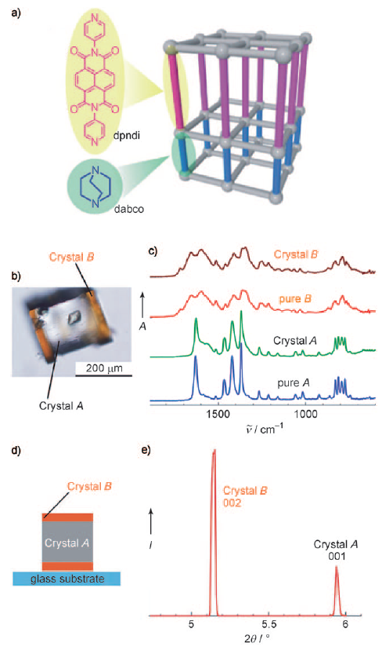
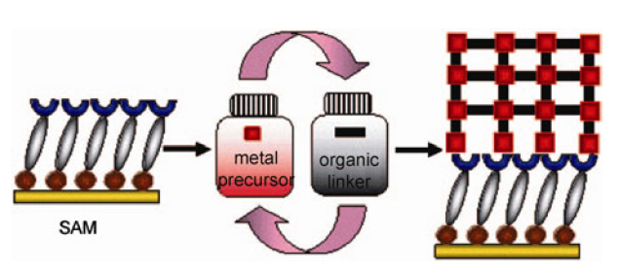
Layer-by-layer preparation
Layer-by-layer (LbL) growth of MOFs on SAMs by repeated growth cycles: immersion in a solution of metal precursor, washing, immersion in a solution of the organic ligand, washing.
Layer-by-layer (LbL) growth of MOF A and MOF B
O. Shekhah, H. Wang, D. Zacher, R. A. Fischer, Angew. Chem. Int. Ed. 2009, 48, 5038.
S. Furukawa, K. Hirai, Y. Takashima, K. Nakagawa, M. Kondo, T. Tsuruoka, O. Sakata, S. Kitagawa, Chem. Commun. 2009, 5097.

Slide 13
^{Interfacial synthesis}
HKUST-1 and ZIF-8 membrane
Deposition of MOF layer on a support (brown) in a homogeneous mixture. Undesired nucleation can occur.
A thin film of [Cu₃(BTC)₂] was obtained by layering a solution of the ligand in 1-octanol on top of an aqueous cupric acetate solution
Interfacial preparation of a MOF layer using a biphasic synthesis mixture: an aqueous metal-ion-containing solution (blue) and an organic ligand solution (purple).
A thin film of ZIF-8 obtained by layering a solution of the ligand in 1-octanol on top of an aqueous zinc nitrate solution.
Dirk E. De Vos, etc., Nature Chemistry, 2011, 3, 382-387

Slide 14
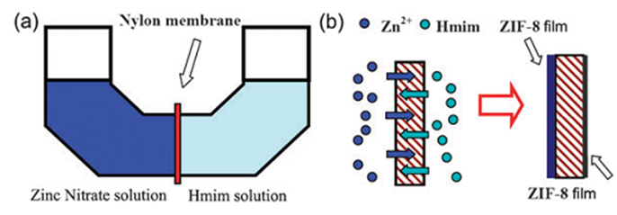
^{Contra-diffusion synthesis}
ZIF-8 membrane
(a) Diffusion cell for ZIF-8 film preparation; (b) schematic formation of ZIF-8 films on both sides of the nylon support. (Hmim = 2-methylimidazolate)
Cross-section SEM image of the ZIF-8 film at the zinc nitrate solution side.
SEM images of ZIF-8 films prepared on nylon membranes for 16 h (a, d), 24 h (b, e), and 72 h (c, f). Zinc solution side (a–c) and Hmim solution side (d–f).
H. Wang, Chem. Commun., 2011, 47, 2559–2561

Slide 15
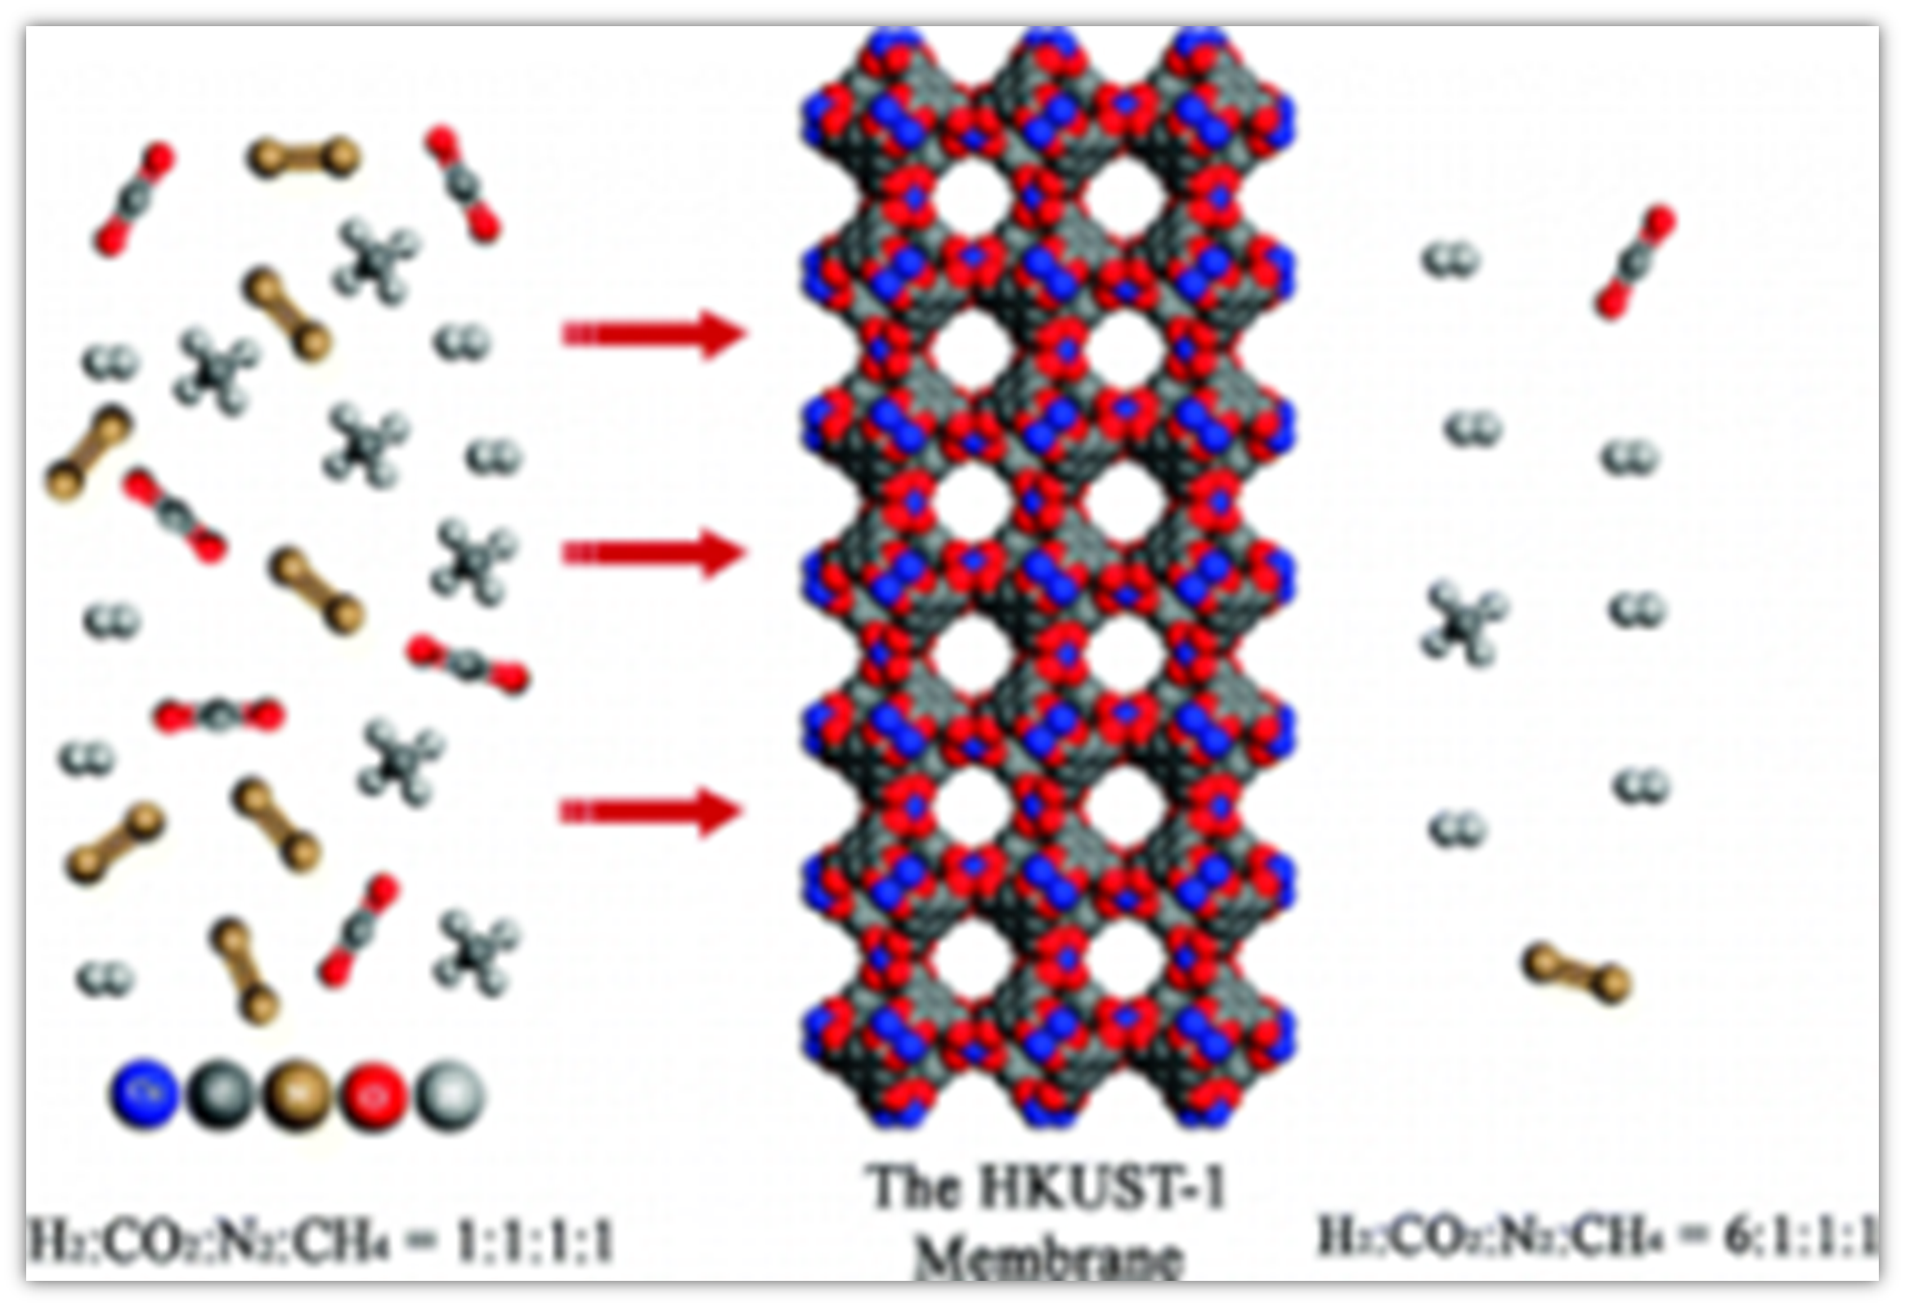
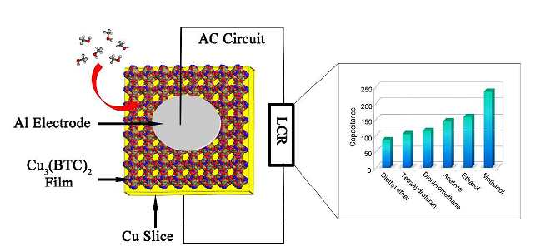
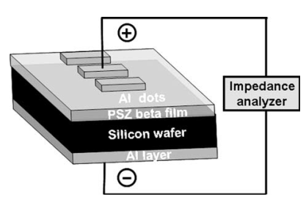
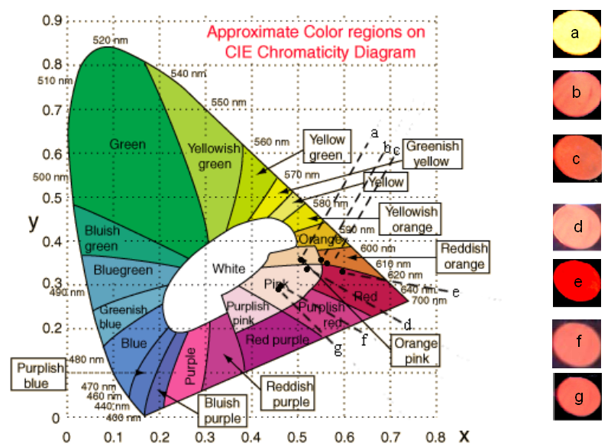
Porous Membranes and Films in our group
Separation
Chiral Resolution
Sensor
Low-κ dielectrics
Devices

Slide 16
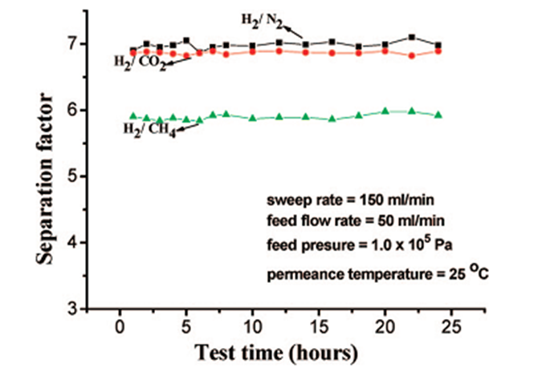
In-situ (direct synthesis) method
HKUST-1 membrane
Separation
^{Twin Copper Source}
Optic micrographs of (a) copper net and (b) net-supported Cu₃(BTC)₂ membrane; SEM image of (c) the surface and (d) cross section of the membrane.
Plot of H₂/N₂,H₂/CH₄ and H₂/CO₂ separation factor of the copper net supported Cu₃(BTC)₂ membrane with change in test time.
Hailing Guo, Guangshan Zhu, Ian J. Hewitt, and Shilun Qiu, J. AM. CHEM. SOC. 2009, 131, 1646–1647

Slide 17
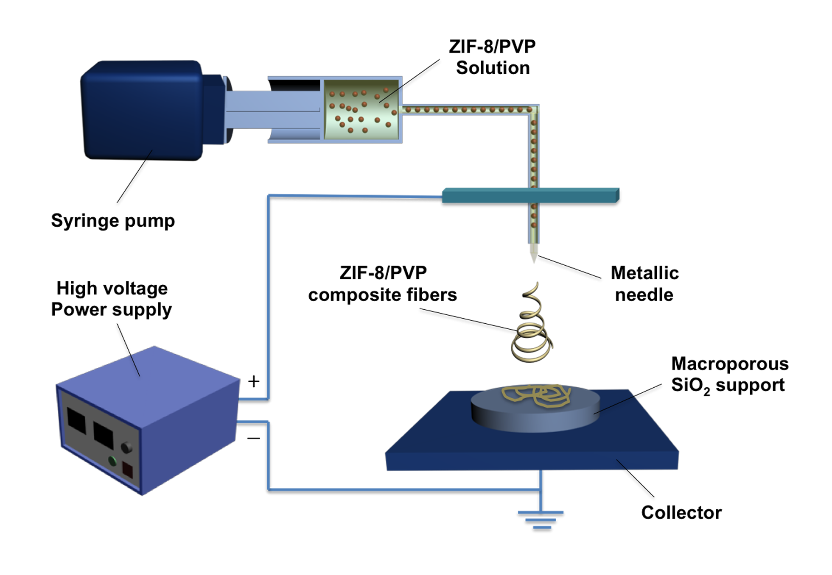
^{Electrospinning}
ZIF-8 membrane
Separation
Introduced into the synthesis of supported microporous membranes for the first time
(a)
(b)
Schematic diagram of the electrospinning process for (a) planar support (macroporous SiO₂ wafer) and (b) tube support (porous Al₂O₃ tube) seeding.
1. Suitable for various substrates, especially tubes
2. With possibility of large-area processing
3. Precisely control the thickness of the seed layer
4. Uniform seed coating on the support surface
^{Advantages :}
Lili Fan, Ming Xue, Zixi Kang, Huan Li, Shilun Qiu J. Mater. Chem., 2012, 22, 25272–25276

Slide 18

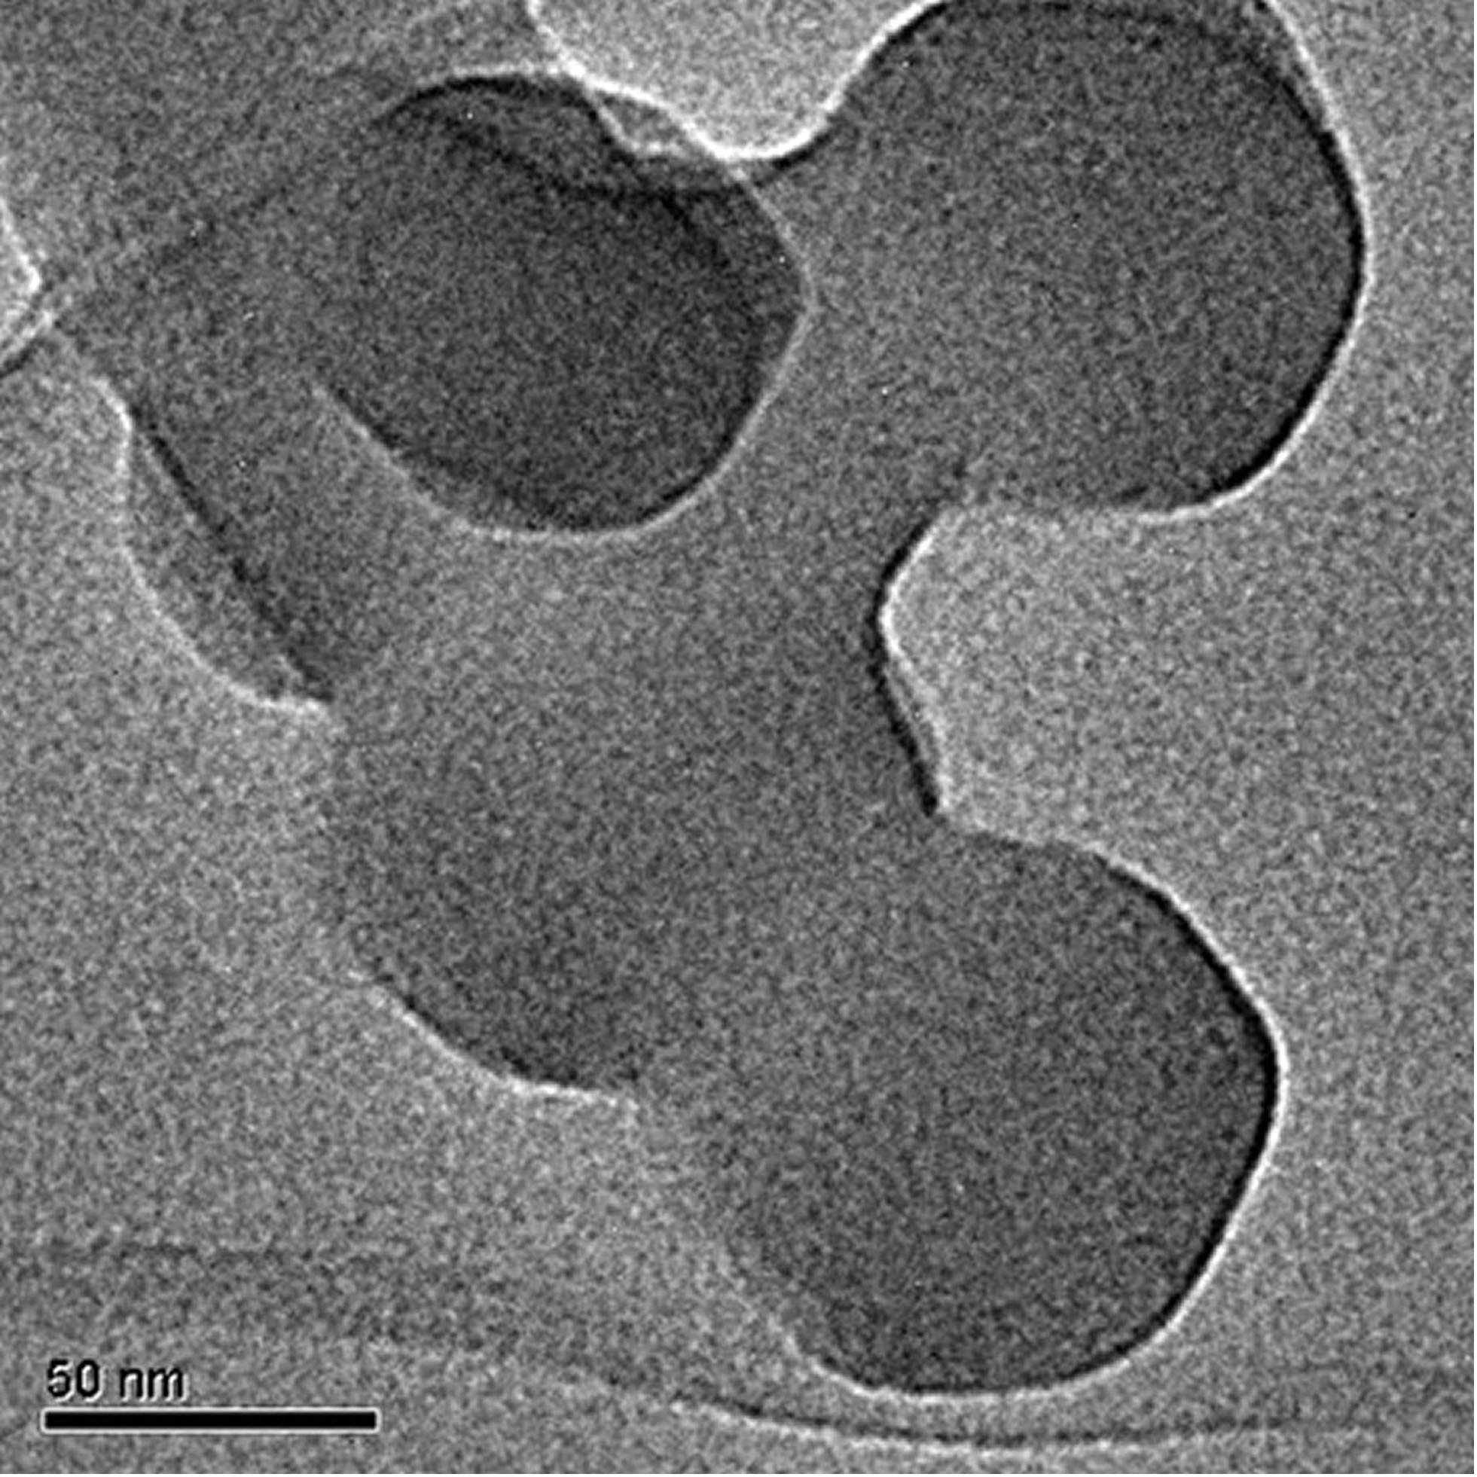
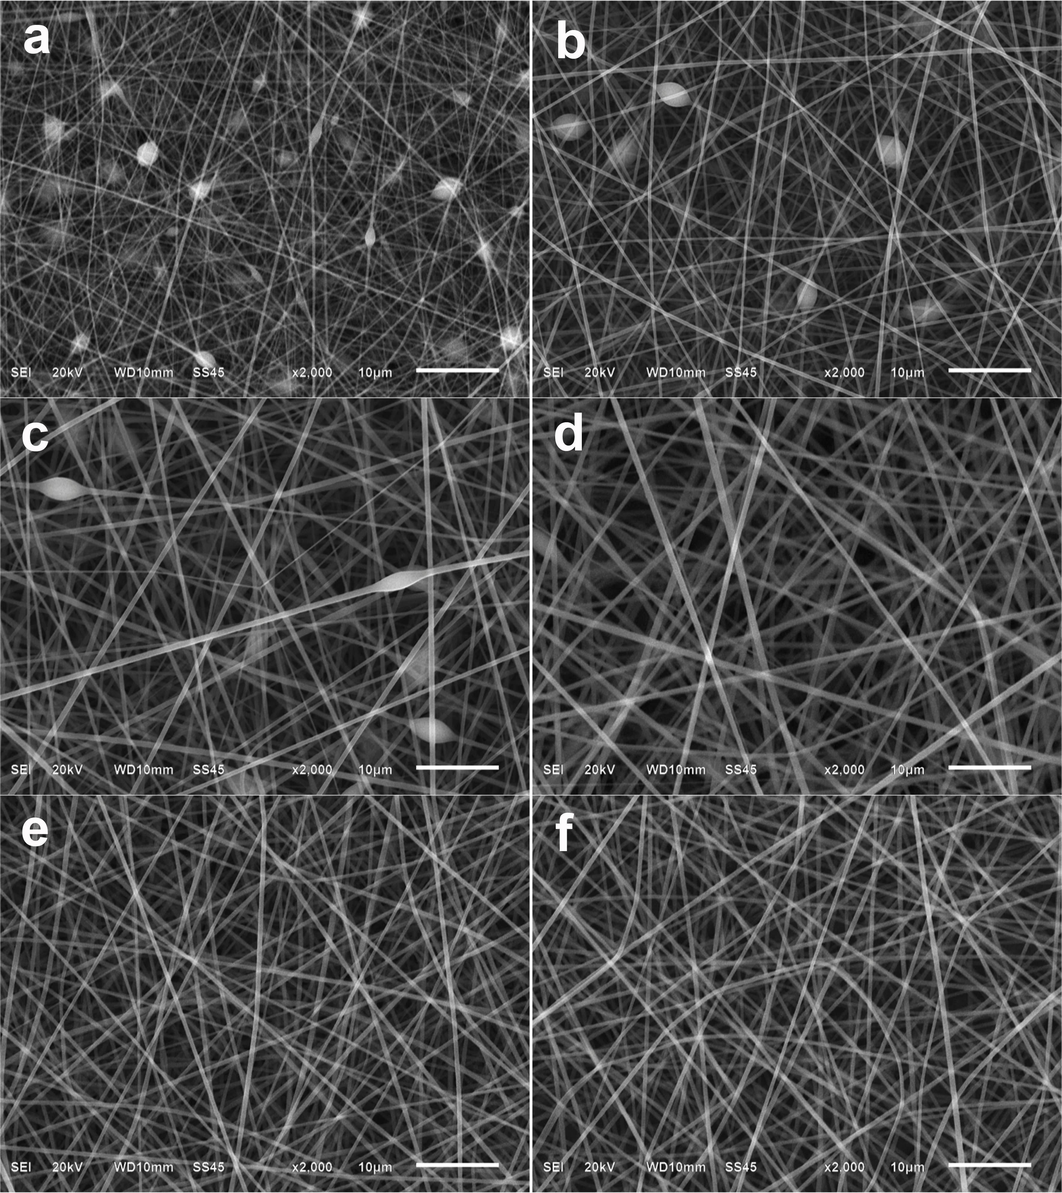
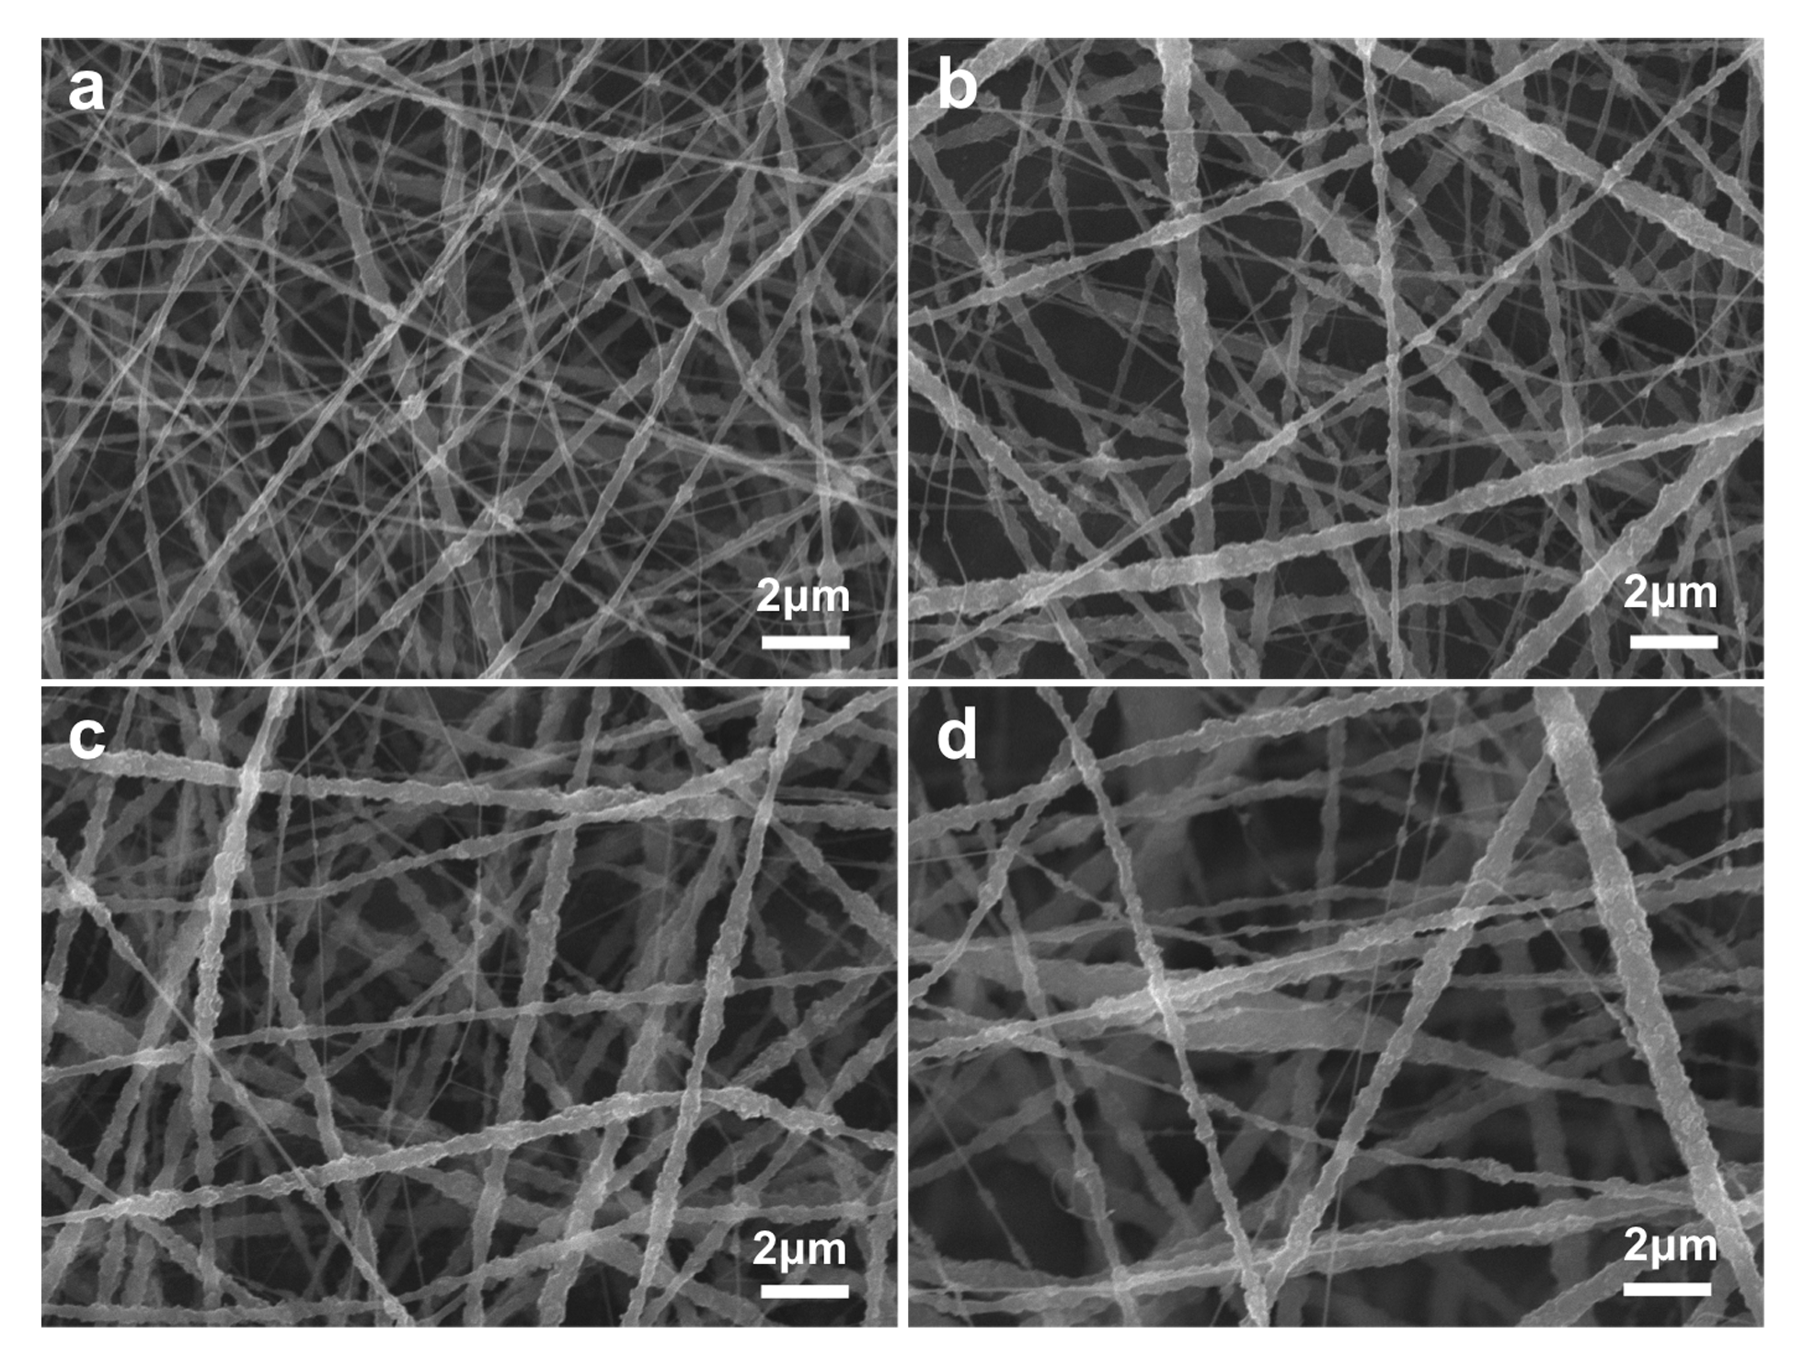
Separation
ZIF-8 membrane
^{Electrospinning}
ZIF-8 has a sodalite (SOD) zeolite-type structure with 3.4 Å small aperture. The remarkable thermal and chemical stability, as well as the simple synthetic steps make it an ideal candidate.
85nm
SEM images of ZIF-8/PVP composite fibers electrospun from methanol solutions of 12 wt% PVP and different seed concentrations (a) 6 wt%, (b) 8 wt%, (c) 10 wt% and (d) 12 wt%.
SEM images of the PVP fibers from concentrations of methanol solutions: (a) 8%, (b) 9%, (c) 10%, (d) 11%, (e) 12%, and (f) 13%.
✓
✓
Lili Fan, Ming Xue, Zixi Kang, Huan Li, Shilun Qiu J. Mater. Chem., 2012, 22, 25272–25276

Slide 19
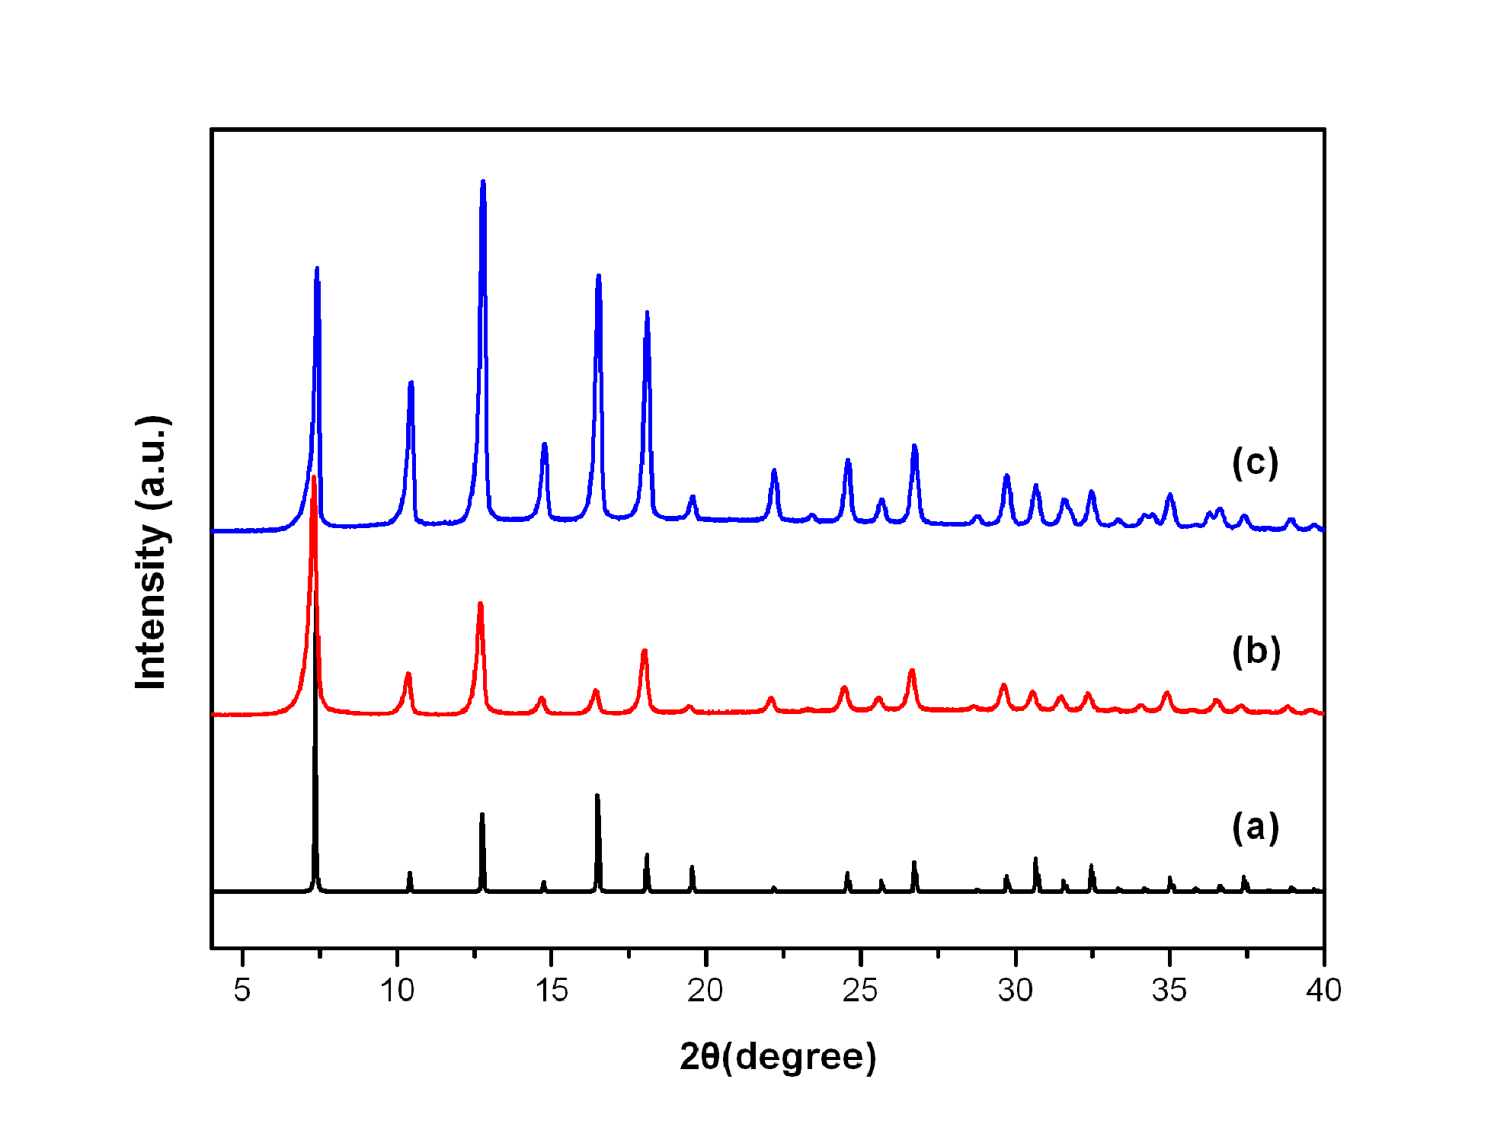
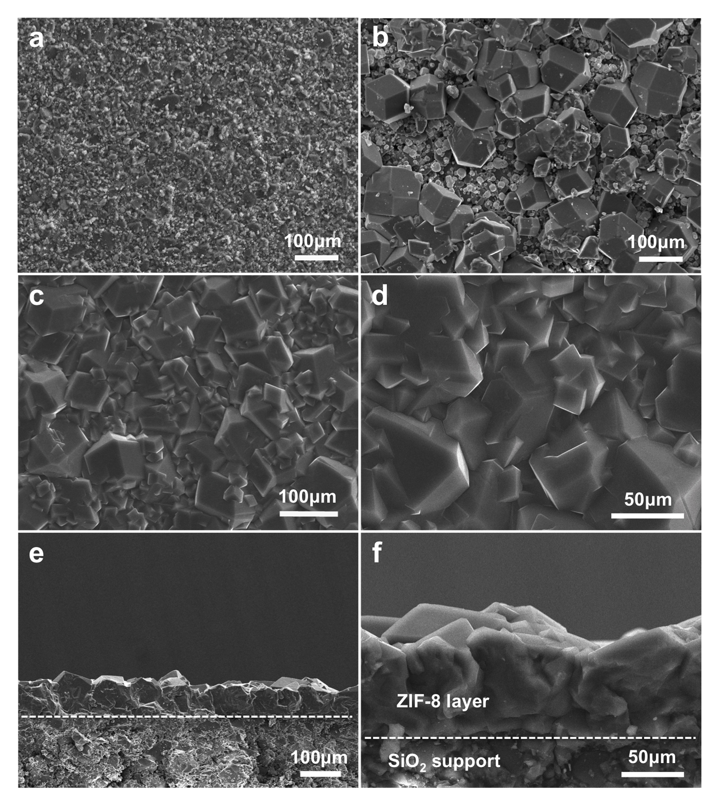
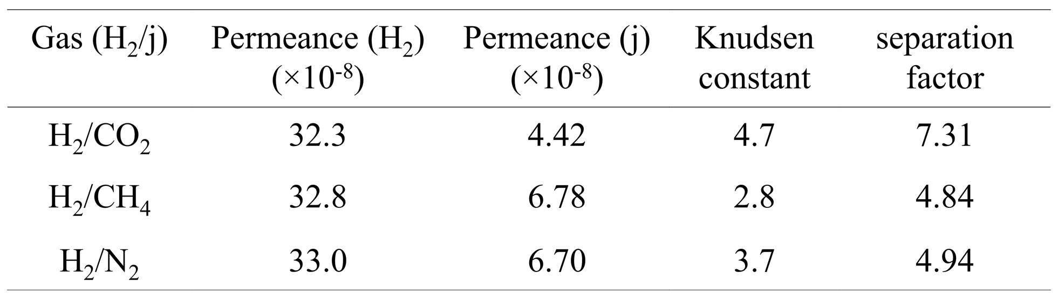
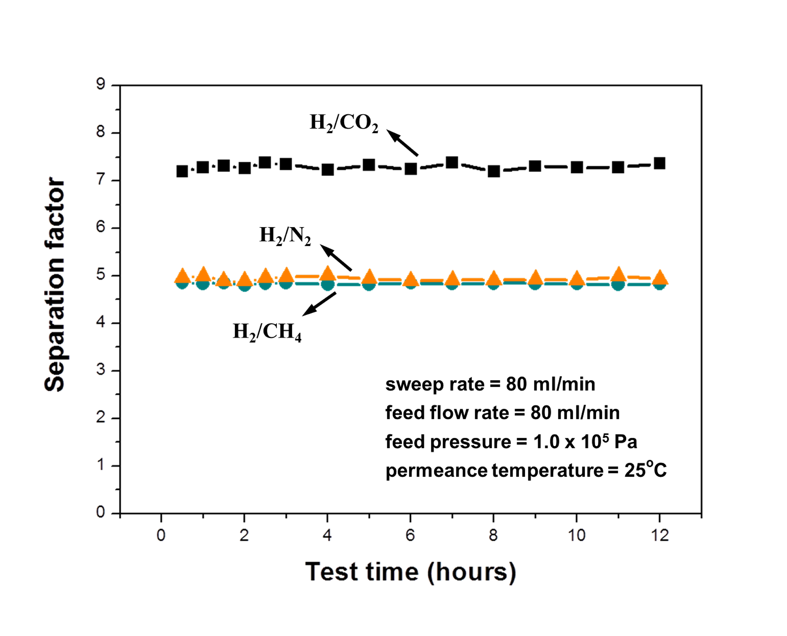
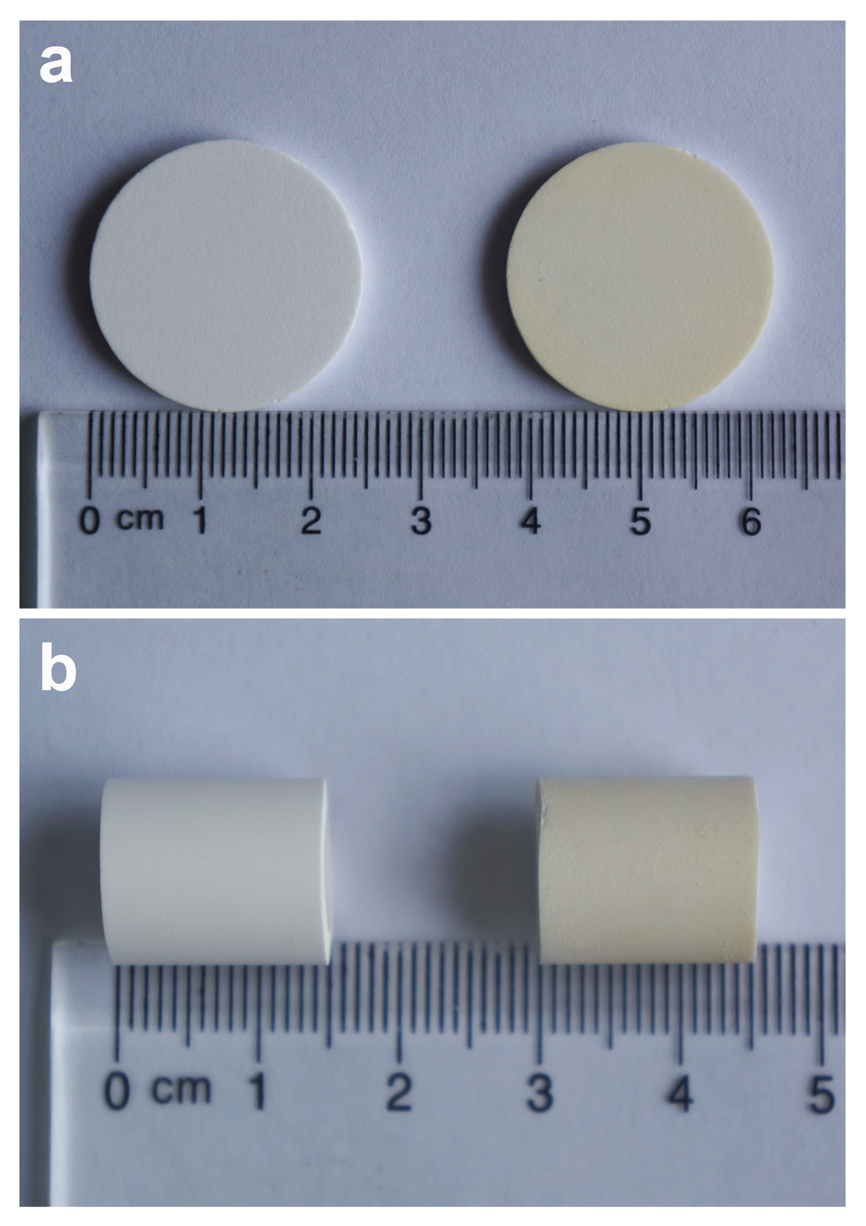
Separation
ZIF-8 membrane
^{Electrospinning}
Table Permeance (molm⁻² s⁻¹Pa⁻¹) and separation factors (H₂ versus other gases) of the ZIF-8 membrane at 298 K and 1 atmospheric pressure. The volume ratio for the mixed gas systems is 1 : 1
ZIF-8 membrane
ZIF-8 seeds
simulated ZIF-8
XRD patterns of the simulated ZIF-8 (a), ZIF-8 seeds (b) and synthesized ZIF-8 membrane (c).
SiO₂ wafer
membrane
SEM images of the support surface (a), top-view of the ZIF-8 membrane without (b) and with (c and d) seeding fibers, cross-section view of the ZIF-8 membrane (e and f).
Plot of H2/CO2, H2/N2 and H2/CH4 separation factors of the ZIF-8 membrane with changes in testing time.
Al₂O₃ tube
membrane
Lili Fan, Ming Xue, Zixi Kang, Huan Li, Shilun Qiu J. Mater. Chem., 2012, 22, 25272–25276

Slide 20
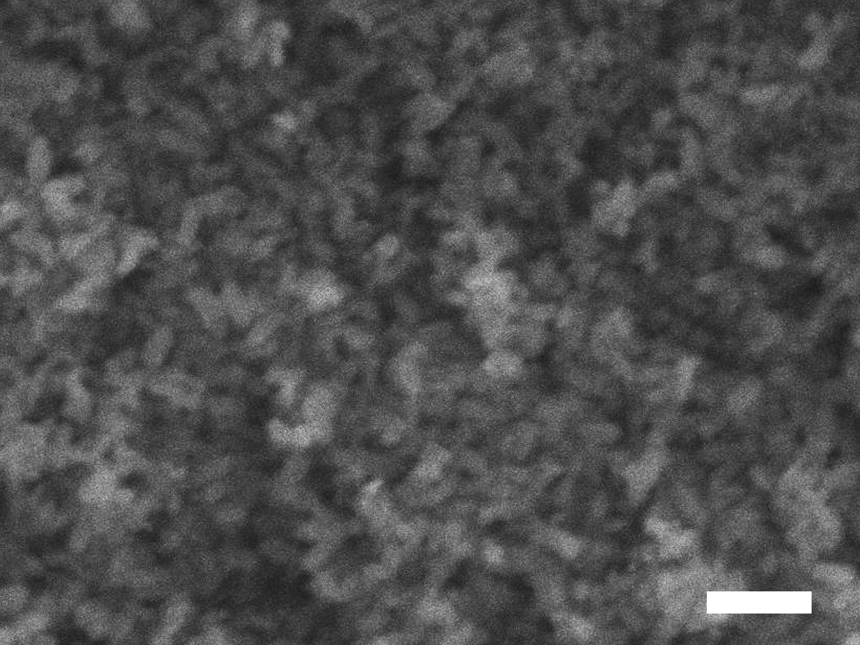
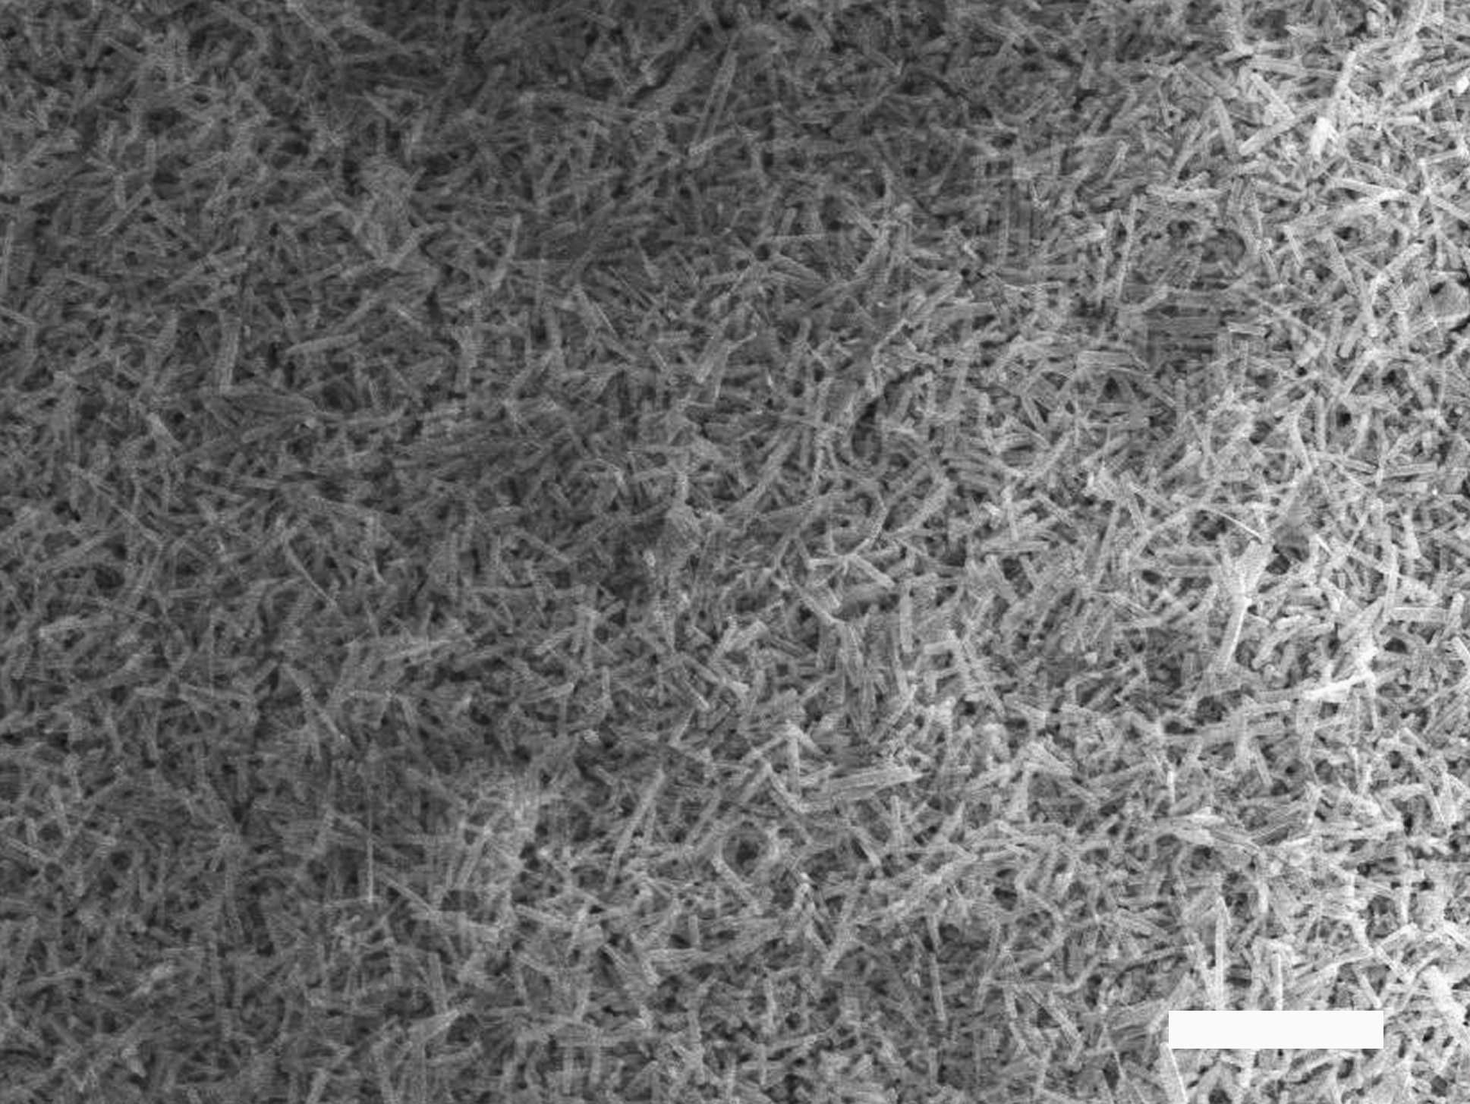
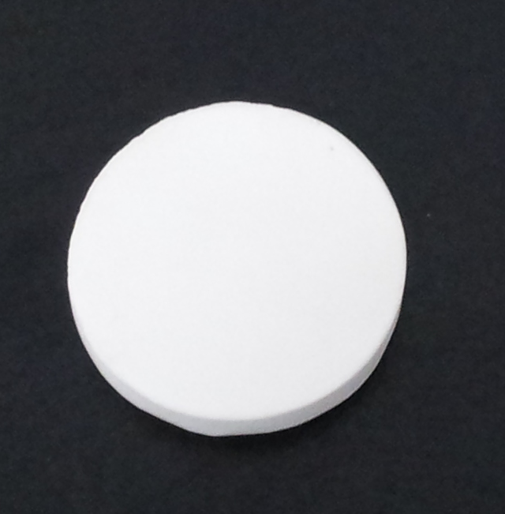
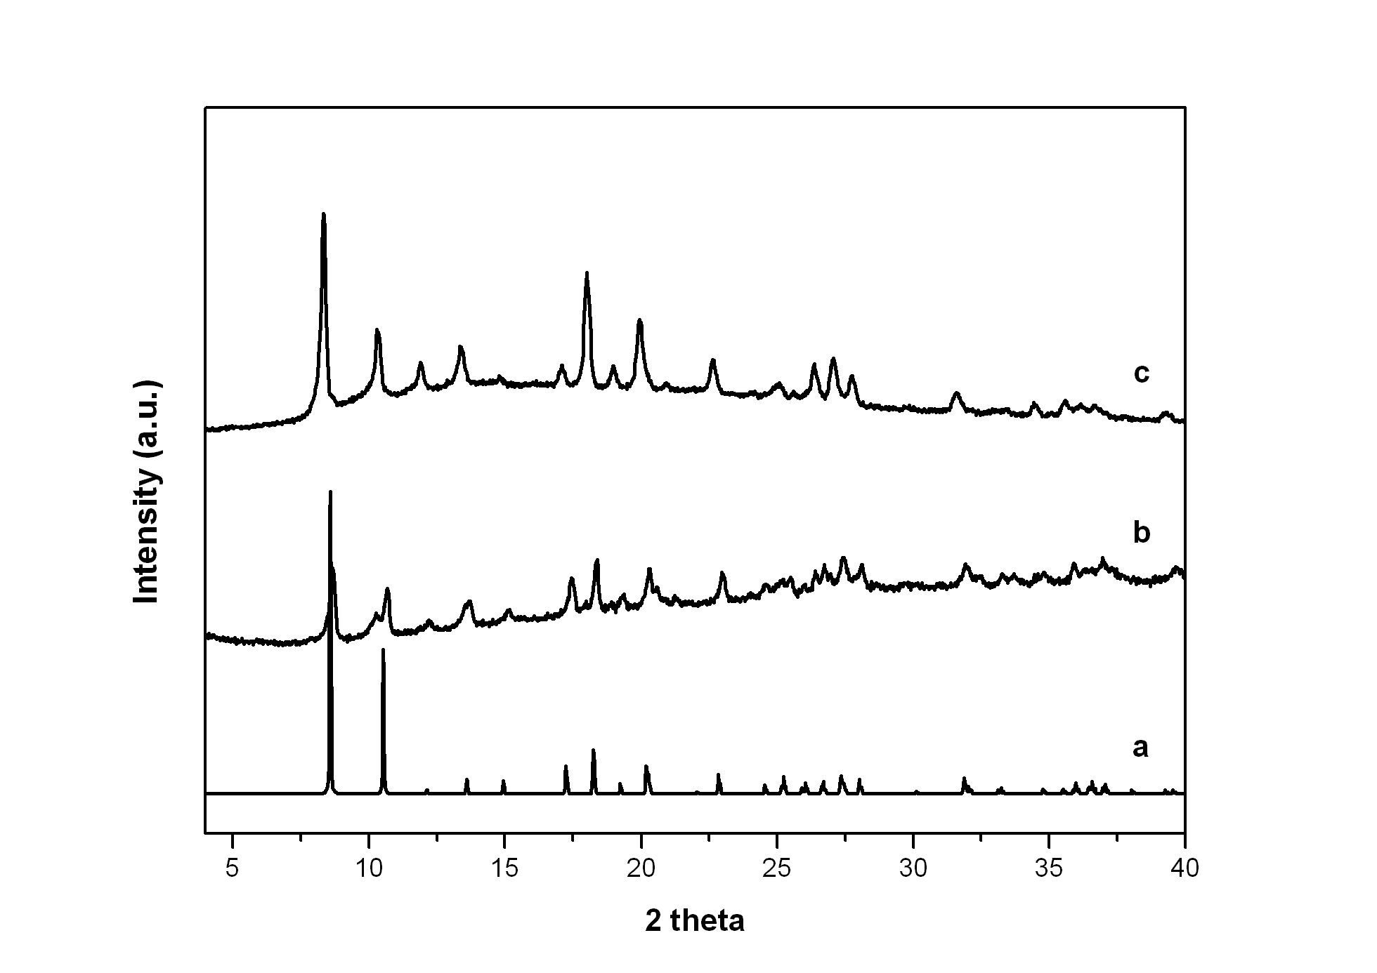
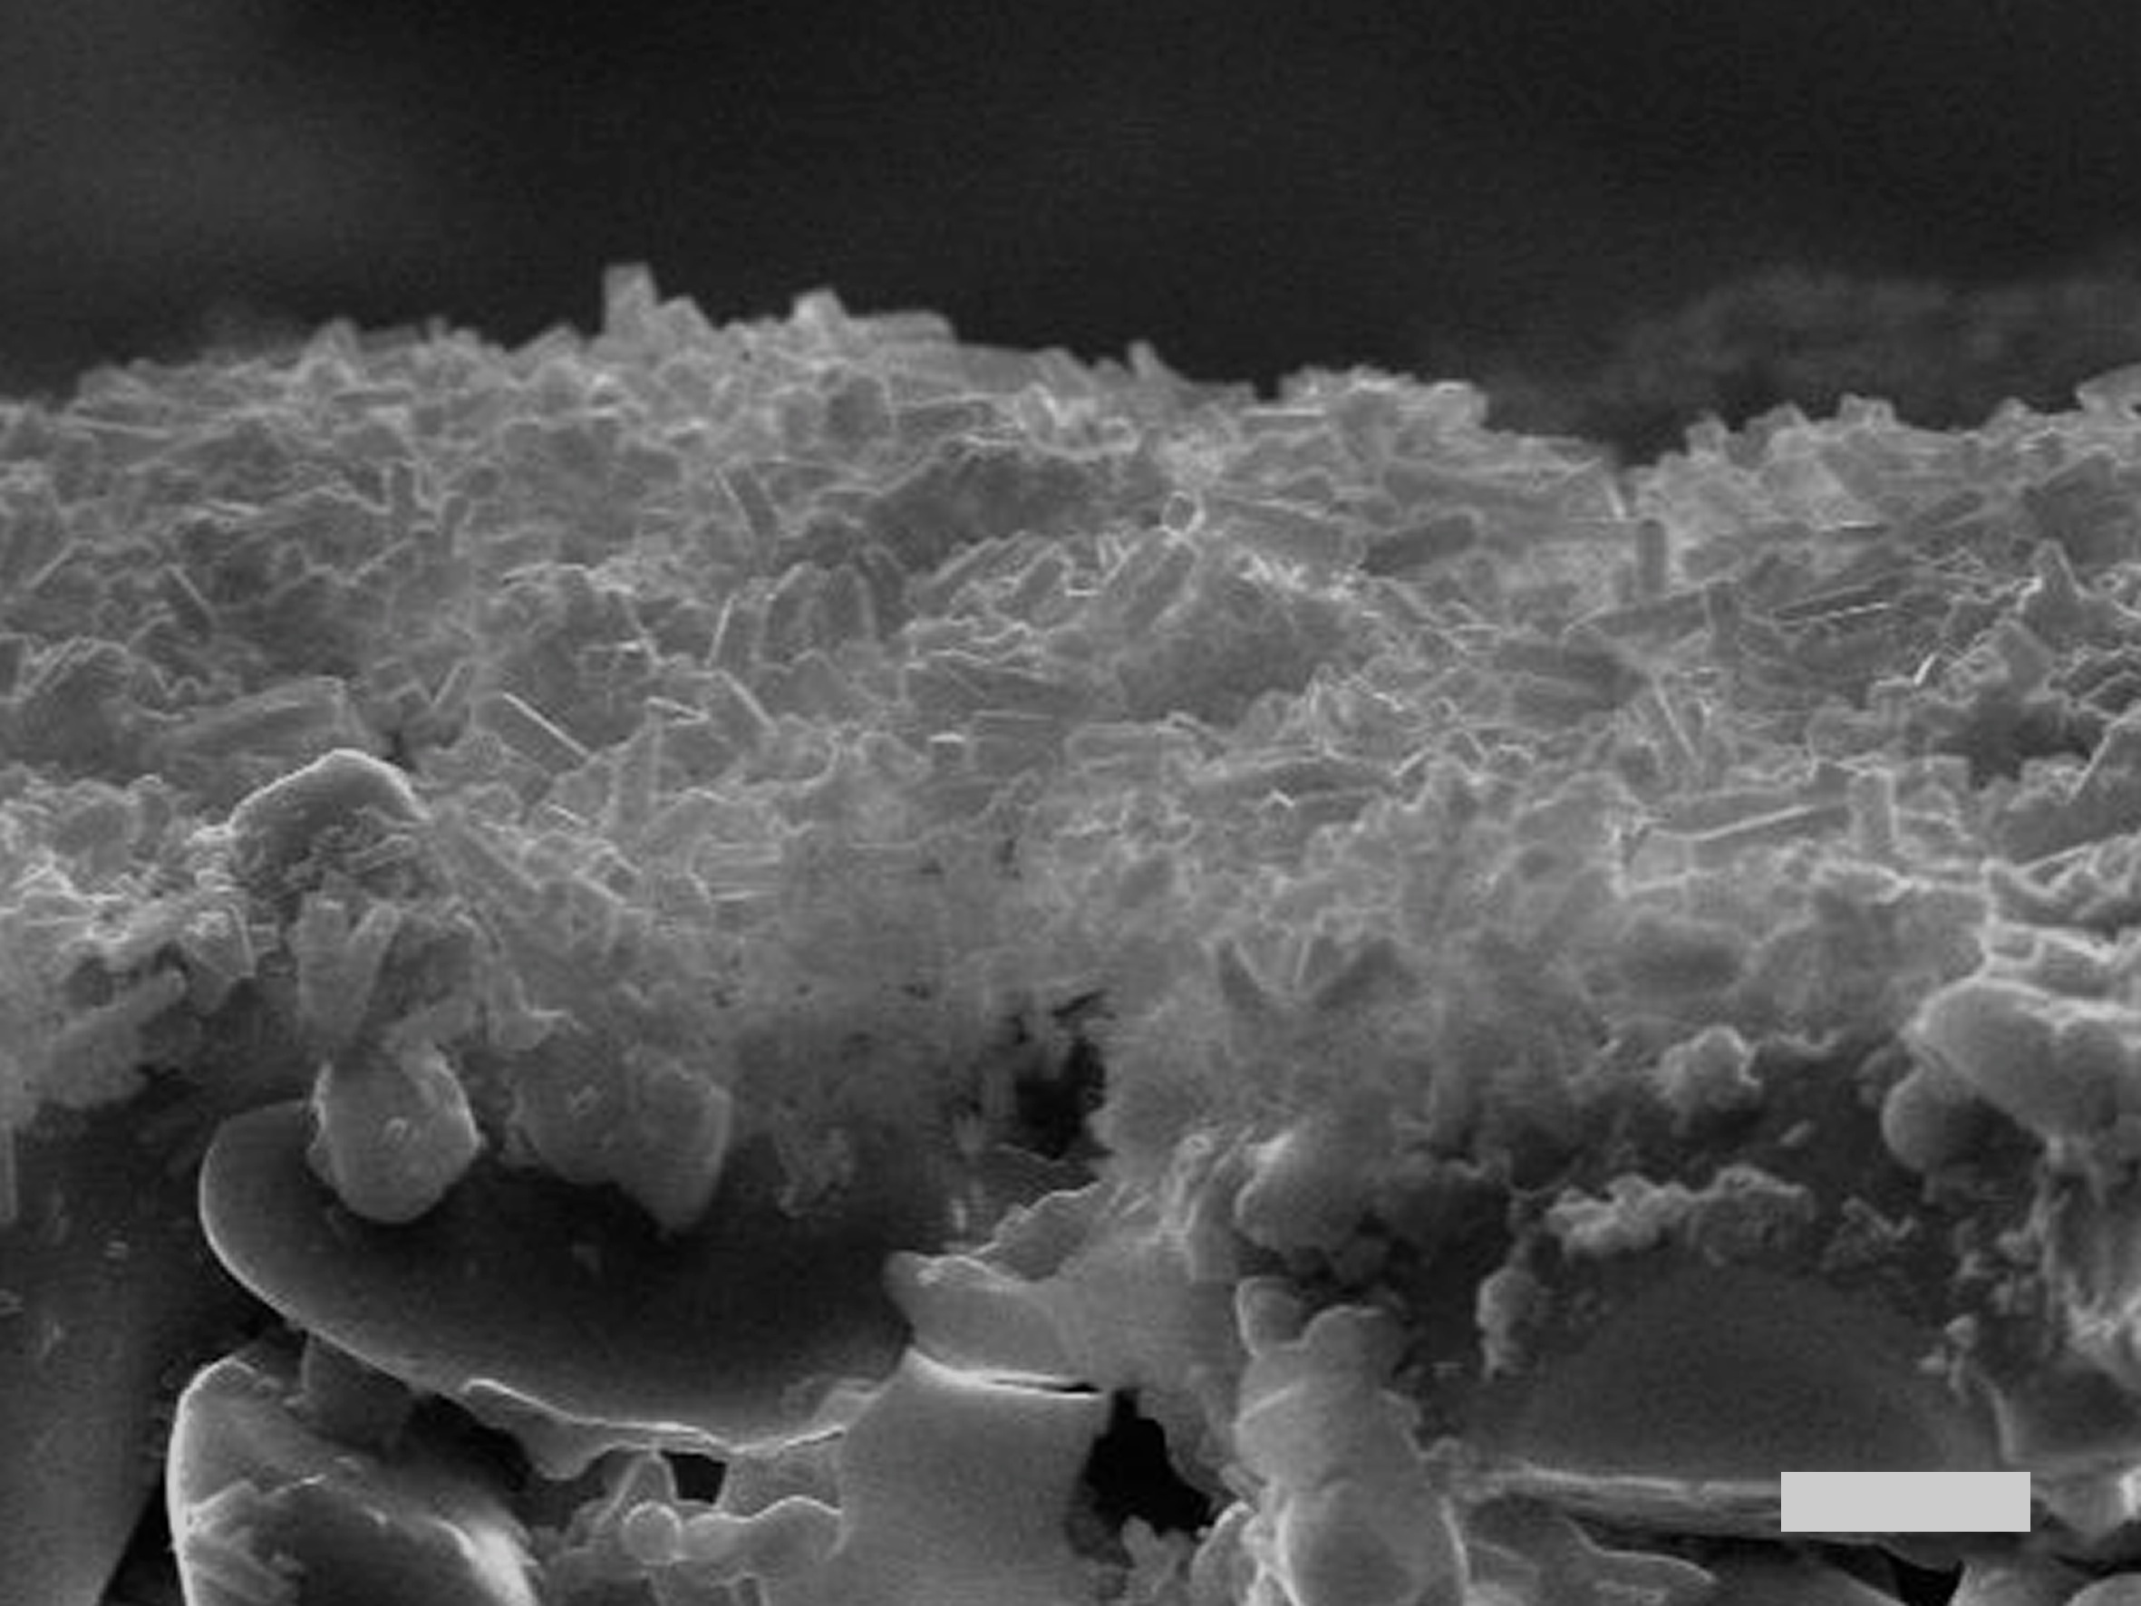
Separation
JUC-32 film
^{Electrospinning}
JUC-32 seeds
JUC-32 film
5μm
20μm
1μm
Cross-section
JUC-32 film
silica disc
JUC-32 seeds
5μm
simulated
Lili Fan, Ming Xue, Zixi Kang, and Shilun Qiu, accepted ^{by Science China Chemistry}

Slide 21
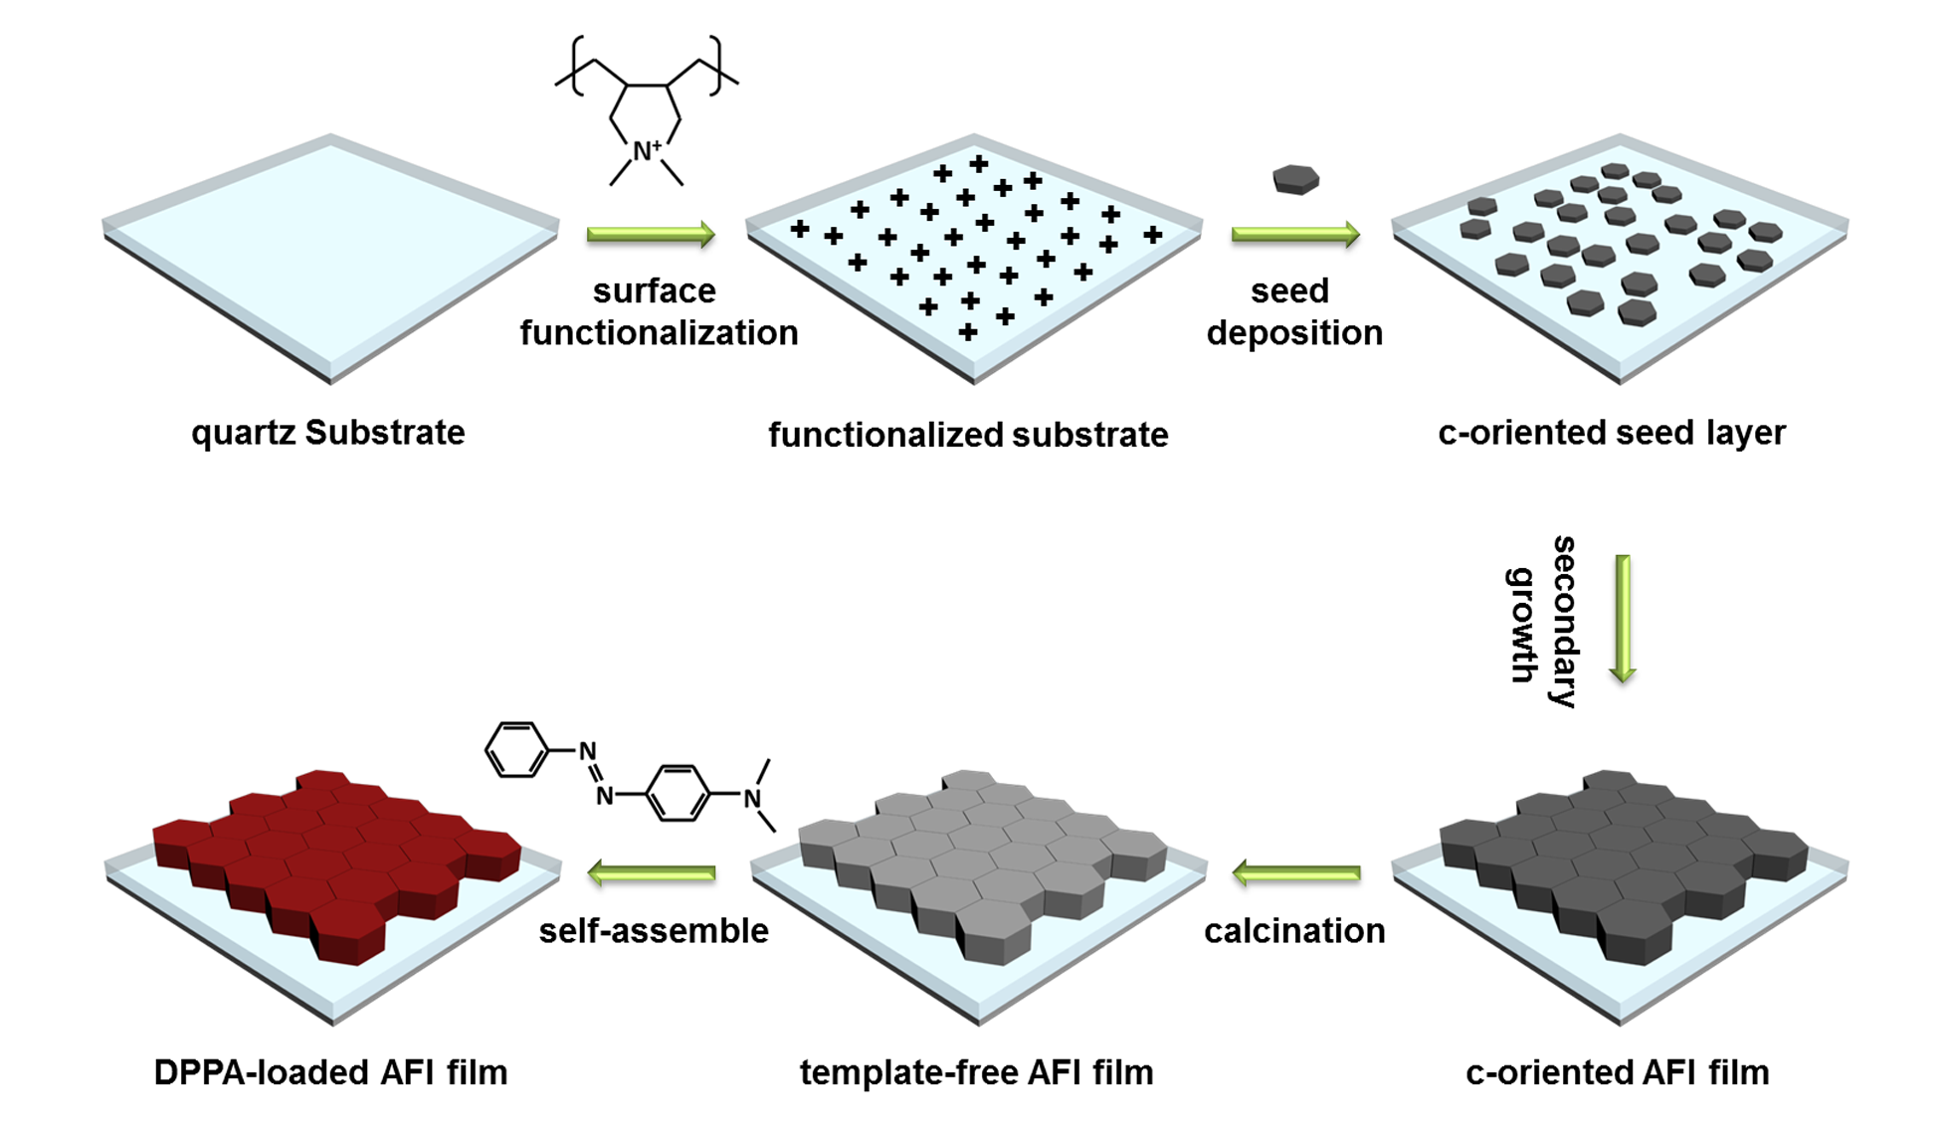
Host-guest system
C-oriented SAPO-5 film
Sensor
^{Quartz slice}
Schematic diagram of preparation of DPPA-loaded SAPO-5 film on quartz support. (DPPA= dimethyl-(4-phenylazophenyl)-amine)
Ming Xue, Lili Fan, Zixi Kang, Wenting Zhang, Huan Li, Shilun Qiu J. Mater. Chem. 2012, 22, 17644–17648

Slide 22
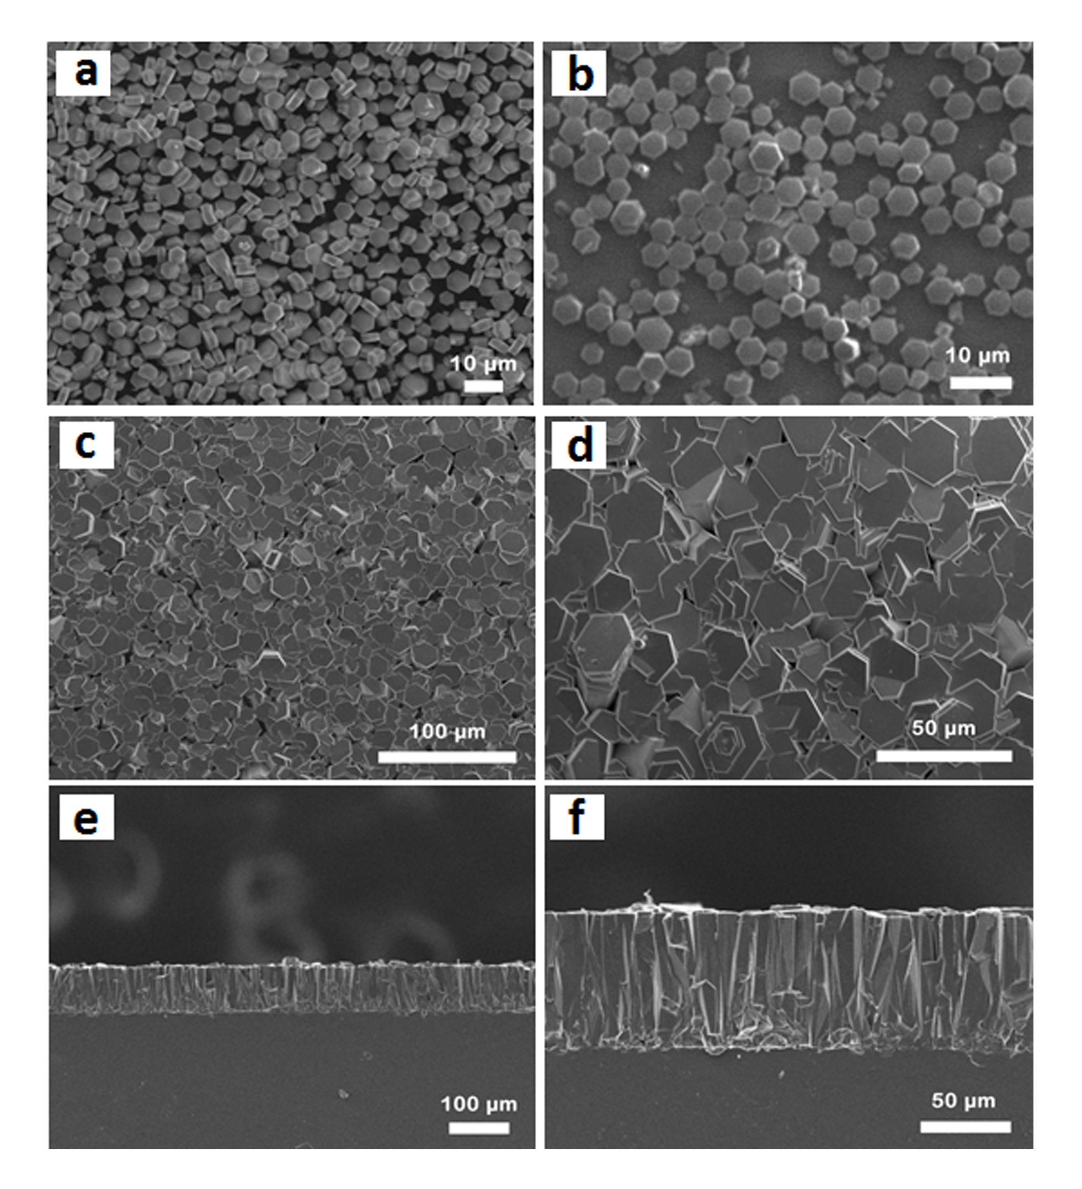
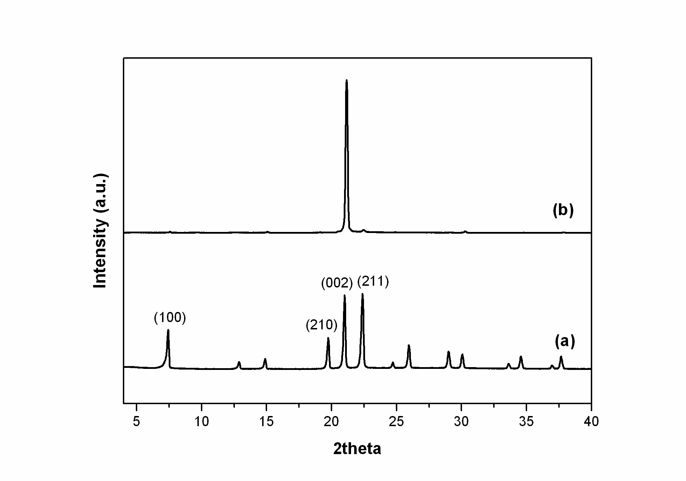
Host-guest system
C-oriented SAPO-5 film
Sensor
^{Quartz slice}
SAPO-5 film
SAPO-5 seeds
XRD patterns of SAPO-5 seeds (a) and c oriented SAPO-5 film (b).
.
SEM images of seed crystals (a), c-oriented seed layer (b), c- oriented SAPO-5 film surface (c and d) and cross-section (e and f).
Ming Xue, Lili Fan, Zixi Kang, Wenting Zhang, Huan Li, Shilun Qiu J. Mater. Chem. 2012, 22, 17644–17648

Slide 23
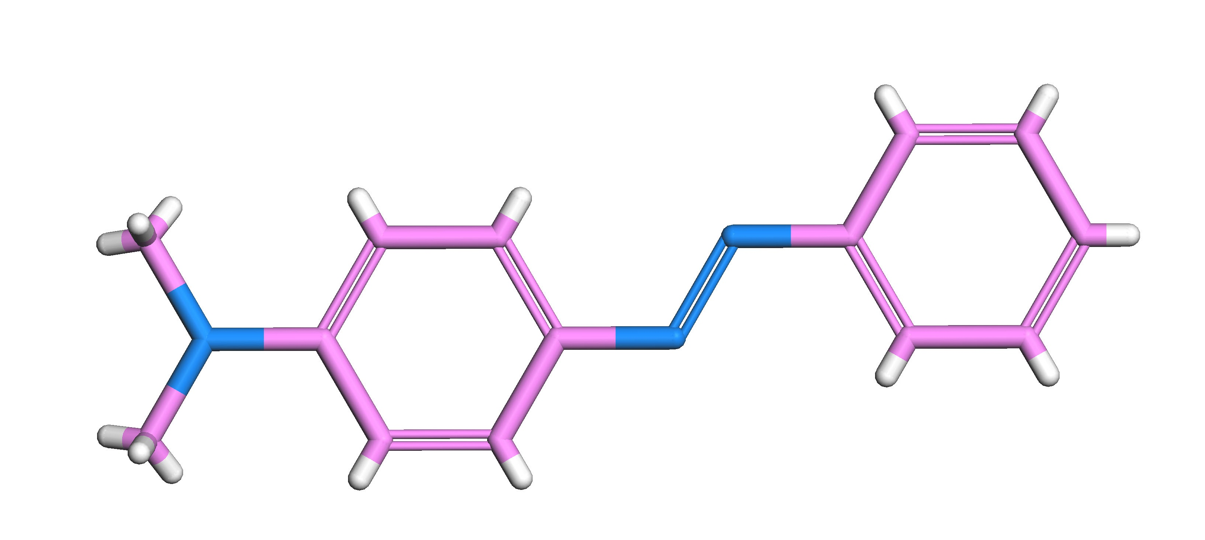




Host-guest system
C-oriented SAPO-5 film
Sensor
^{Dye}
^{Dye loaded SAPO-5 film}
^{SAPO-5 film}
UV absorption spectra of template-free SAPO-5 film (a), dye in ethanol (b) and dye-loaded SAPO-5 film (c).
UV absorption intensity as a function of concentration for Cu²⁺, Zn²⁺, Co²⁺, Pb²⁺, Cd²⁺, Hg²⁺.
Ming Xue, Lili Fan, Zixi Kang, Wenting Zhang, Huan Li, Shilun Qiu J. Mater. Chem. 2012, 22, 17644–17648

Slide 24

Humidity sensing
HKUST-1 film
Sensor
^{Copper slice}
Hydrophobic part
Hydrophilic part
Pore network of Cu3(BTC)2: (a) View from [100] direction, hydrophilic (dimeric cupric tetracarboxylate units) and hydrophobic (aromatic rings) parts. (b) View from [111] direction.
(a) Photo of as-prepared Cu3(BTC)2 film (right: with Al electrodes); SEM images of (b) the surface, (c) surface in magnification, (d) cross-section view
Capacitance response to the relative humidity (RH) of the film sensor.
Temporal response to different RH of the film sensor.
Jia Liu, Fuxing Sun, Feng Zhang, Zhu Wang, Rui Zhang, Ce Wang, Shilun Qiu, J. Mater. Chem. 2011, 21, 3775–3778

Slide 25



VOCs sensing
Zn₃(BTC)₂ film
Sensor
^{Zinc slice}
Schematic representation of typical fabrication of Zn₃ (BTC)₂ film.
SEM images of (a) the film synthesized with H₂O₂ activation for 6 h; (b) magnified view of (a); (c) and (d) cross-section view at 45◦.
XRD patterns of (a) simulated Zn₃(BTC)₂ and (b) the film on zinc slice.
Xiaoqin Zou, Guangshan Zhu, Ian J. Hewitt, Fuxing Sun, Shilun Qiu, Dalton Trans. 2009, 3009–3013

Slide 26



VOCs sensing
Zn₃(BTC)₂ film
Sensor
Emission spectra of Zn₃(BTC)₂ film with different concentrations of (a) dimethylamine, methanol and acetone, (b) dimethylamine, n-propylamine, n-butylamine and aniline in ethanol solutions (λ_{ex}= 327nm).
Emission spectra of Zn₃(BTC)₂ film with different solvents in presence of dimethylamine (λ_{ex}= 327nm).
Emission intensities of Zn₃(BTC)₂ film after 10 circles with different dimethylamine concentrations in ethanol.
Xiaoqin Zou, Guangshan Zhu, Ian J. Hewitt, Fuxing Sun, Shilun Qiu, Dalton Trans. 2009, 3009–3013

Slide 27
Luminescent Thin Film
Eu_{1−x}Tb_{x-}MOF films
Devices
^{Spin-coating}
with sodium oxalate
with sodium acetate
with sodium formate
without capping reagent
simulated
XRD patterns of Ln-MOFs. (a) simulated, (b) without capping reagent, (c) with addition of sodium formate, (d) with addition of sodium acetate, and (e) with addition of sodium oxalate.
SEM images of Ln-MOFs crystals synthesized: (a) without capping reagent; with addition of (b) sodium oxalate, (c,d) sodium formate and (e,f) sodium acetate.
SEM images of Tb_{0.5}Eu_{0.5}-MOF film viewed from: (a) the surface and (b) the cross section.
Hailing Guo, Yongzhong Zhu, Shilun Qiu, Johannes A. Lercher, Hongjie Zhang, Adv. Mater. 2010, 22, 4190–4192

Slide 28
Luminescent Thin Film
Eu_{1−x}Tb_{x-}MOF films
Devices
Tb³⁺/Eu³⁺
2.75
2.44
0.30
0.40
1.95
1.02
1.46
1.46
1.95
1.02
2.44
0.40
2.75
0.30
Photoluminescent spectra of as-prepared Eu_{1−x}Tb_{x}-MOF films with Tb³⁺/Eu³⁺ mol ratio of: (a) 2.75, (b) 2.44, (c) 1.95 (d) 1.46, (e) 1.02, (f) 0.40 and (g) 0.30.
Comparison of the color of calculated chromaticity with that of the measured (on the right side). Tb³⁺/Eu³⁺ mol ratio: (a) 2.75, (b) 2.44, (c) 1.95, (d) 1.46, (e) 1.02, (f) 0.40, (g) 0.30.
Hailing Guo, Yongzhong Zhu, Shilun Qiu, Johannes A. Lercher, Hongjie Zhang, Adv. Mater. 2010, 22, 4190–4192

Slide 29

Seeded growth
Ordered AFI film
Devices
(a) AlPO₄-5 structure along the [001] (upper) and [100] (bottom) directions, respectively. (b) Schematic representation of the preparation of the {001} (upper) and {100} (bottom) substrates. (c) Schematic drawing of the epitaxial growth of AlPO₄-5 film from the {001} (upper) and {100} (bottom) faces of the substrates.
Rui Xu, Guangshan Zhu, Xiaoju Yin, Xin Wan, Shilun Qiu, J. Mater. Chem. 2006, 16, 2200–2204

Slide 30




Seeded growth
Ordered AFI film
Devices
1mm
Optical micrograph of AlPO₄-5 single crystals
XRD patterns of AlPO₄-5 film grown on (a) {001} and (b){100} faces of AlPO₄-5 crystal substrate.
Absorption (a) and emission spectra (c) of the AlPO₄-5/RhB film and absorption of RhB in aqueous solution (b).
{001}
{100}
3h
6h
3h
6h
4.5h
4.5h
Different reaction times: (a) after 3 h, (b) 4.5 h, (c) 6 h and (d) the cross-section image of (c) on AlPO₄-5 {001} basal face; (e) after 3 h, (f) 4.5 h, (g) 6 h and (h) the cross-section image of (g) on the AlPO₄-5 {100} basal face.
Rui Xu, Guangshan Zhu, Xiaoju Yin, Xin Wan, Shilun Qiu, J. Mater. Chem. 2006, 16, 2200–2204

Slide 31




Chiral
resolution
Memberane based Chiral resolution
Ni₂(asp)₂(bpy) membrane
^{“Single Nickel Source”}
L-asp = L-aspartic acid
bipy = 4,4'-Dipyridyl
Schematic diagram of homochiral MOF membranes preparation by in situ growth on nickel nets.
3D frameworof Ni₂(L-asp)₂(bipy) viewed along the [010] direction. Ni green, C gray (chiral centers yellow), N blue, O red, H white.
(a) Leica picture and (b) SEM pictures of surface of Ni₂(L-asp)₂(bipy) membrane, (c) detail of the densely packed crystallites, (d) cross-section SEM picture of Ni₂(L-asp)₂(bipy) membrane
Digital photo of the nickel net (left) and the nickel net supported membrane
Zixi Kang, Ming Xue, Lili Fan, Jinying Ding, Lianxun Gao, and Shilun Qiu, in preparation

Slide 32




Chiral
resolution
Memberane based Chiral resolution
Ni₂(asp)₂(bpy) membrane
P=0.1MPa
P=0.2MPa
Comparison of the ee values for diol mixtures at different temperatures and pressures
Changes of membrane flux with temperature and pressure
Zixi Kang, Ming Xue, Lili Fan, Jinying Ding, Lianxun Gao, and Shilun Qiu, in preparation

Slide 33

Ultra-microporous MOFs Membrane
JUC-150 membrane for gas separation
Scheme 1. (a): Schematic diagram of preparation of the Ni₂(L-asp)₂P (P = bipy or pz) membranes on nickel nets. (b): Schematic description of compounds 1 and JUC-150 structures. Ni cyan, C gray, N blue, O red; H atoms are omitted for clarity.
Kangzi Xi, Ming Xue and Shilun Qiu etc., Energy & Environmental Science (Submitted)

Slide 34

Kangzi Xi, Ming Xue and Shilun Qiu etc., Energy & Environmental Science (Submitted)

Slide 35


Slide 36


Acknowledgment
Financial Support:
National Natural Science Foundation of China (NSFC)
National Basic Research Program of China “973”
Ministry of Science & Technology of China
Ministry of Education of China
Prof. Teng Ben, Prof. Guangshan Zhu
Drs. Daliang Zhang, Ming Xue, Hao Ren
PhD students: Cuiying Pei, Lili Fan, Zixi Kang

