Slide 1
a Double Dose:
combining Single-Crystal and Powder XRD
for Analysis of Pharmaceutical Materials
Eric Hovestreydt,
Arnt Kern, Martin Adam
Bruker AXS GmbH
www.bruker.com

Slide 2
From Discovery to Production
The Applications for X-ray Diffraction
Discovery
Development
Production
Lead Finding
Optimization
Preclinical
Phase I
Phase II
Phase III
Marketing
XRPD
SC-XRD

Slide 3
X-Ray Techniques
X-ray diffraction techniques
  Single crystal diffraction (SC-XRD)
  Powder diffraction (XRPD)
  Small angle scattering (SAXS)
X-ray imaging
  Computed tomography (CT and micro CT)

Slide 4
X-Ray Diffraction Techniques
Single Crystal Diffraction
Discovery
Development
Production
Lead Finding
Optimization
Preclinical
Phase I
Phase II
Phase III
Marketing
XRPD
SC-XRD

Slide 5
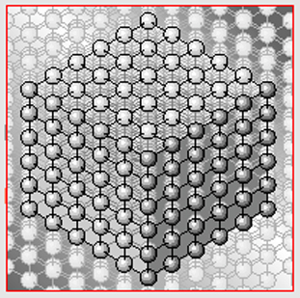
X-Ray Diffraction Techniques
Single Crystal Diffraction
Provides accurate 3D structures and functional information
Protein structure determination
(screening, in-house data collection)
Proteins binding to drugs, DNA or other proteins
Small molecules in the bio-/pharma industry
  Structure determination
  Accurate bond lengths and angles
  Absolute stereochemistry
  Packing diagram and intermolecular contacts
  Phase Analysis (Temperature!)
Single crystals of pharmaceutical materials can often not be grown to a „sufficient" size!

Slide 6




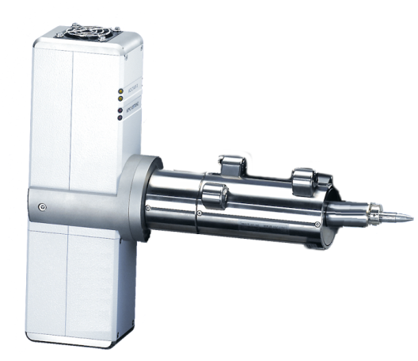
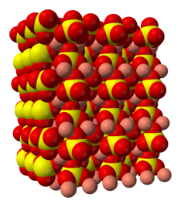
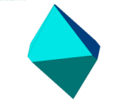
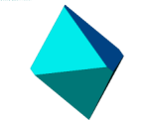
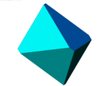


X-ray Diffraction
  Crystals are solid materials with atoms, molecules, or ions arranged in an orderly repeating pattern extending in all three dimensions.
  X-ray wavelengths are on the order of interatomic distances
    Molybdenum radiation: 0.71Å, Gallium radiation: 1.34Å Copper radiation: 1.54Å
    Carbon-carbon single bond: 1.54 Å.
  X-rays (electromagnetic waves) pass through the crystal as a diffraction grating and the resulting diffraction pattern is recorded on the CMOS detector.
X-ray Source
Crystal
Detector
Software
Structure
6

Slide 7
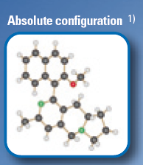
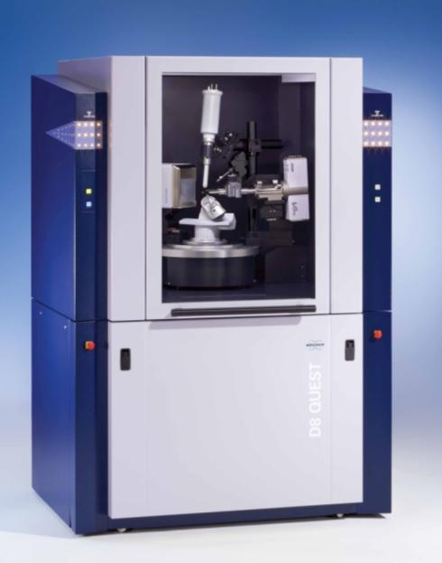
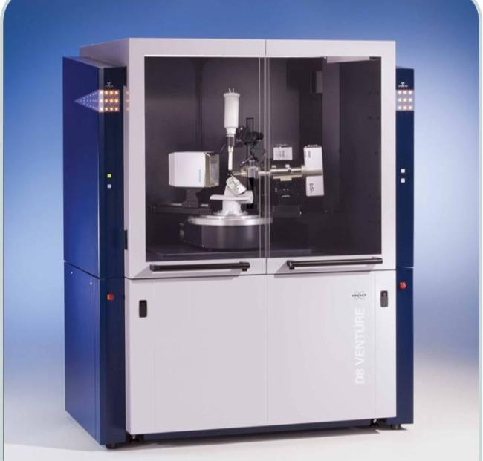
Chemical & Biological Crystallography
D8 QUEST
D8 VENTURE

Slide 8
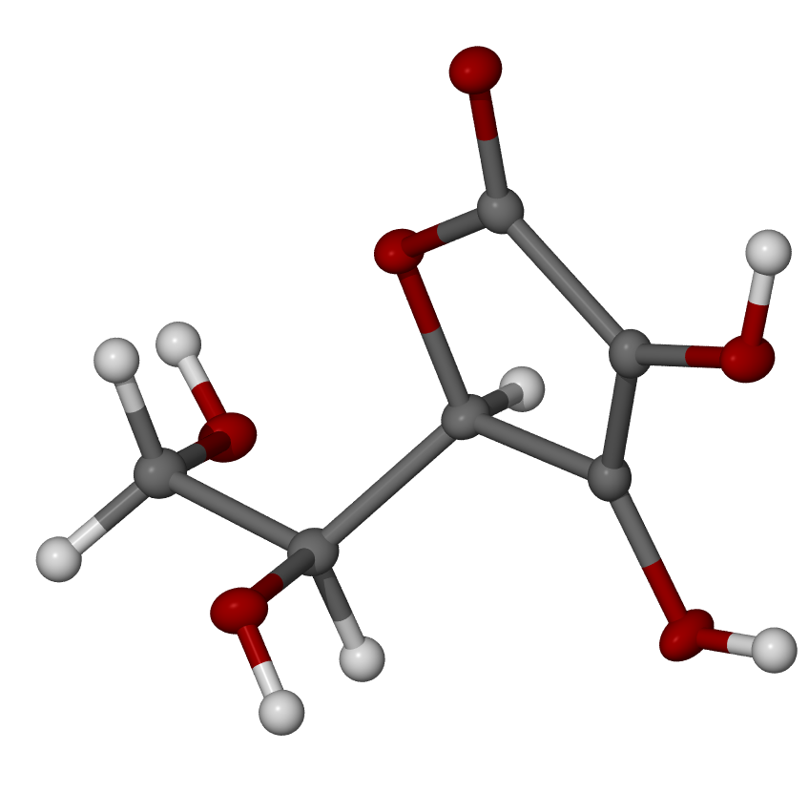
Absolute configuration of molecules
An absolute configuration in stereochemistry is the spatial arrangement of the atoms of a chiral molecular or group and its stereo-chemical description e.g. R or S.
L-Ascorbic acid
D
B
D
B
(5R)-[(1S)-1,2-dihydroxy-ethyl]-3,4-dihydroxy-furan-2(5H)-one
A
C
C
A
R
S

Slide 9
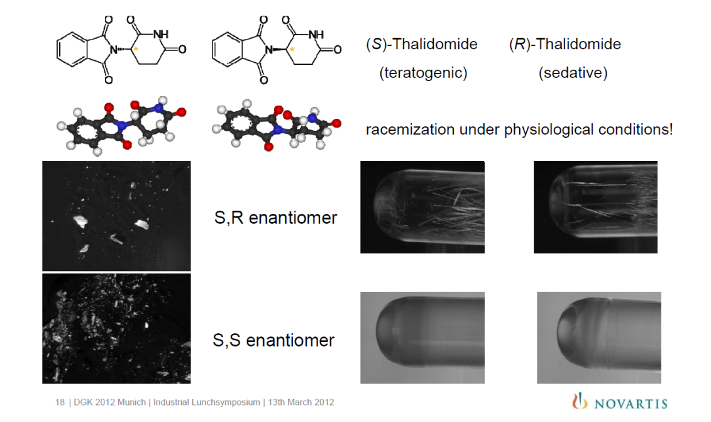
Typical examples

Slide 10
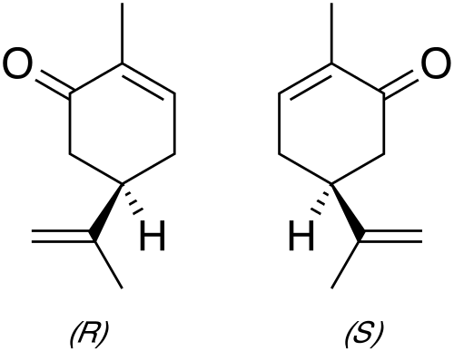

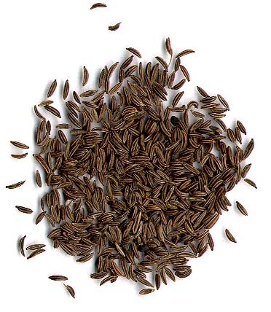
Example of Biological Significance of Stereoisomers
enantiomers
(R)-(-)-carvone
(S)-(+)-carvone
smells like spearmint
smells like caraway

Slide 11
Light atom structures
The reliable determination of the absolute structure of these compounds requires to detect small anomalous signals in the order of only 0.2 … 1%.

Slide 12
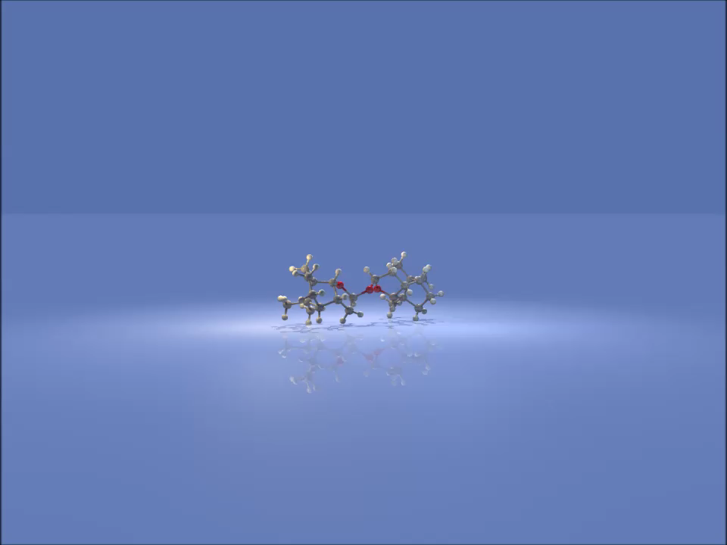
  (2S)-(−)-2,2′-Oxybis(octahydro-7,8,8-trimethyl-4,7-methanobenzofuran)
0.15 × 0.05 × 0.04 mm³
2175 frames were collected with a
total exposure time of 4.14 hours
Data to 0.75 Å
96% complete, 4 fold redundant
R(int) = 3.68%
R1 = 3.18%, wR2 = 8.27%
<|F²_{anom}|>/<F²> = 0.17%
Flack x = 0.024(39) (Parsons‘)
Absolute structure can be determined reliably
P2₁
a = 7.7975(2) Å,
b = 12.8027(3) Å,
c = 10.9201(3) Å
β = 101.9650(10)°

Slide 13
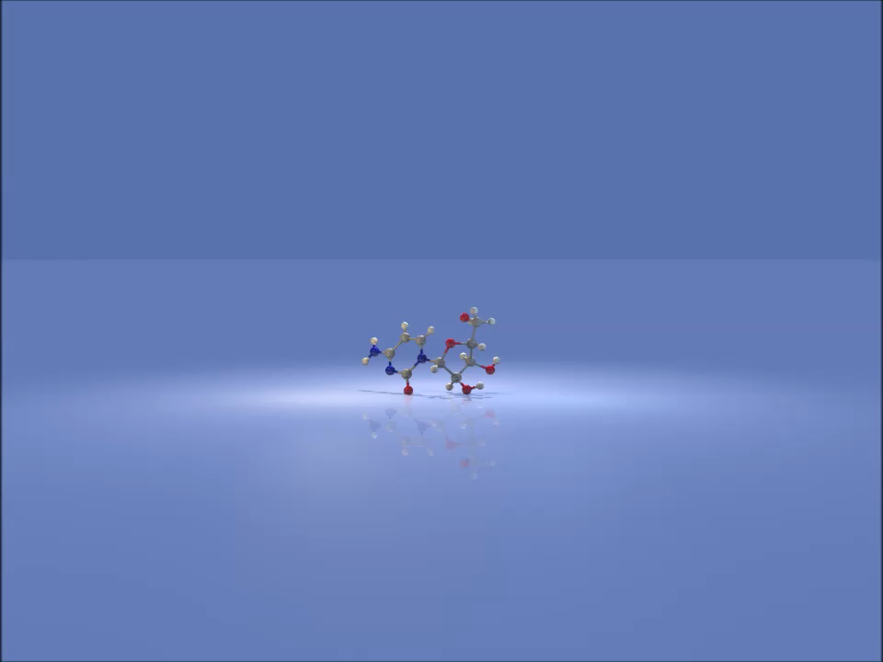
Cytosine β-D-riboside, Cytidine
0.24 × 0.20 × 0.18 mm³
Total exposure time of 3 hours.
Data to 0.71 Å
97.4% complete, 7 fold redundant
R(int) = 10.88%
R1 = 2.73%, wR2 = 7.15%
<|F²_{anom}|>/<F²> = 0.20%
Flack x = 0.00(3) (Parsons‘)
Absolute structure can be determined reliably
P2₁2₁2₁
a = 5.0742(2) Å,
b = 13.9292(6) Å,
c = 4.7144(6) Å

Slide 14

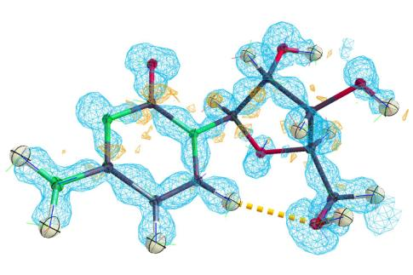
Cytosine β-D-riboside, Cytidine
Simulated precession pattern to 0.71Å
Invariom refinement R1 (INV) 1.77%

Slide 15
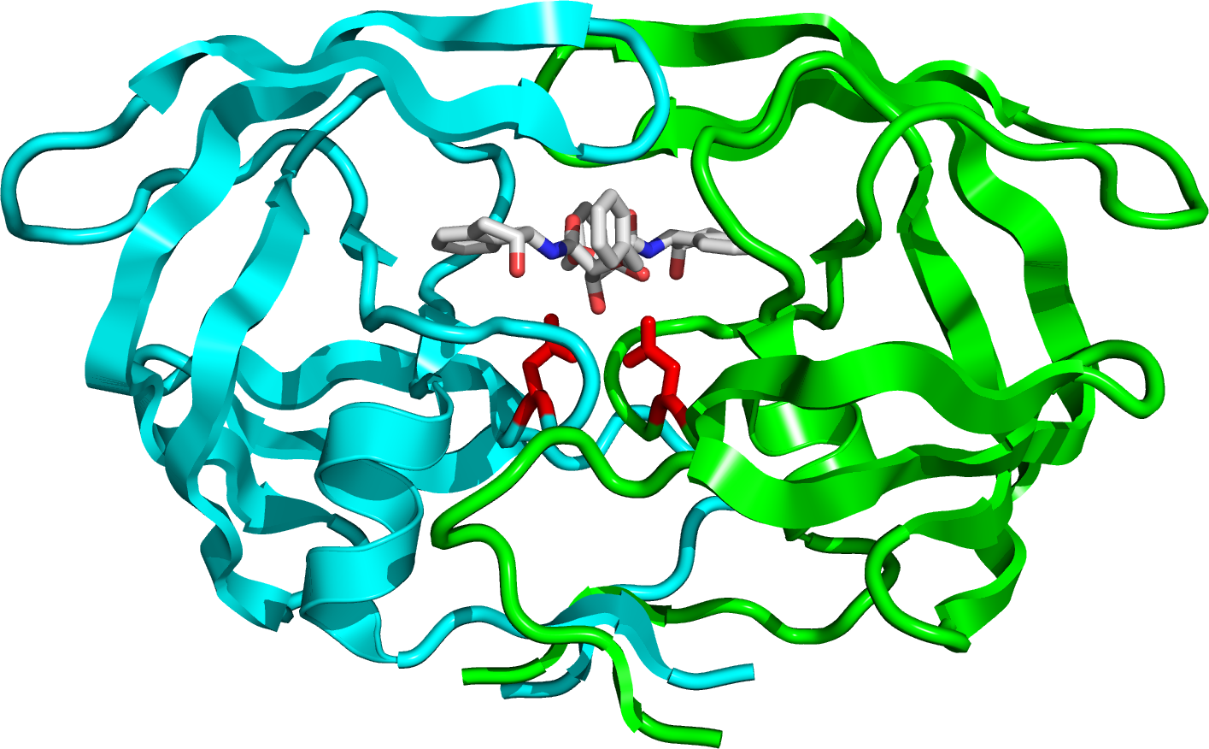
Ligand binding studies
The structure of HIV protease, a viral enzyme critical in HIV’s life cycle, provided insight in how to block this enzyme. For most enzymes, made up of two equal halves, both halves have an active site, but HIV protease has only one active site, that, once blocked with a small molecule, could shut down the whole enzyme and theoretically stop the virus’ spread in the body by using the enzyme’s structural shape as a guide.
http://en.wikipedia.org/wiki/HIV-1_protease

Slide 16
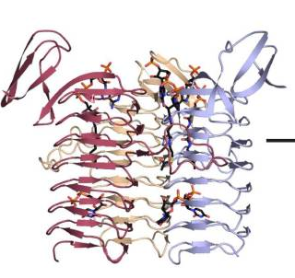
Ligand binding studies
The D8 VENTURE is an excellent system to quickly screen samples for bound ligands.
3-N-ACETYL TRANSFERASE
Source Bordetella petrii
Contains bound CoA
21 kD, 192 aa
Unit cell
a=68.5, b=108.0, c=91.1 Å
β=102.3°
Space group: P2₁
Structure solved in Hazel Holden’s laboratory, University of Wisconsin

Slide 17
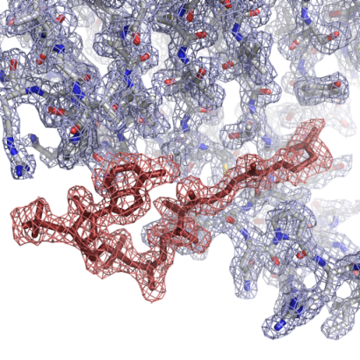
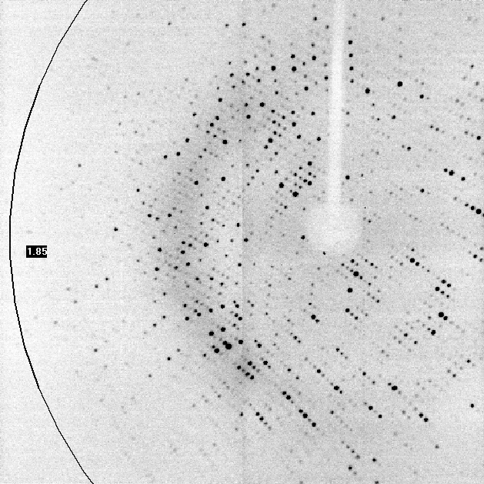
Ligand binding studies
10 hour data set
Resolution 2.0 Å
R_{merge} = 0.072 (0.25)
I/σI = 9.5 (2.8)
Multiplicity = 3.9 (2.0)
Fomfc map contoured at 3σ (red density) clearly shows the position of the CoA ligand

Slide 18
X-Ray Diffraction Techniques
Powder Diffraction
Discovery
Development
Production
Lead Finding
Optimization
Preclinical
Phase I
Phase II
Phase III
Marketing
XRPD
SC-XRD

Slide 19
From Discovery to Production
Most Important XRPD Applications
Discovery
Development
Production
Lead Finding
Optimization
Preclinical
Phase I
Phase II
Phase III
Marketing
Synthesis of new materials Phase ID, structure analysis
Solid-state characterisation
  Crystallinity Quant. analysis
  Thermal behaviour Phase ID
  Hygroscopic behaviour Phase ID
  Grindability / compressability Phase ID
  Polymorphism Phase ID, structure analysis
Quality control Phase ID, quant. analysis
Solid state reactions?

Slide 20
Why X-Ray Powder Diffraction?
Many materials first show up as powders
Many materials are available only as powders (polymorphism)
Non-ambient studies may be only possible with powders
...
Statistically relevant (representative of the bulk)!

Slide 21
Why X-Ray Powder Diffraction
Polymorphism
Crystal habit/morphology
Crystal surfaces
Dissolution
Density
Flowability
Compressibility
Grindability
Hardness
Crystallinity
Activity
Stability
Hygroscopicity
…
Many material properties depend on crystal structure, e.g.:

Slide 22
Why X-Ray Powder Diffraction
Phase Identification: It is the ability to unequivocally differentiate one crystallographic phase from another that proved to be the greatest asset in the pharmaceutical field
Quantitative Analysis: X-ray diffraction crystallographic techniques are increasingly used to detect, identify and quantify crystalline and amorphous phases
Structure Analysis: While thermal analysis and spectroscopy (IR, Raman, solid-state NMR) may be able to discriminate between an amorphous and a crystalline phase, these techniques cannot definitely characterize (the crystal structure of) polymorphic forms or solvates
Non-ambient Analysis: Can follow phase transitions and reactions in real time

Slide 23
Why X-Ray Powder Diffraction?
Change of solvent
may result in
different polymorph
Milling, tablet formation
may result in
phase transition (p)
Drug Product
Performance
Drying or storing
may cause solid state
reactions or phase
transitions (T, RH, t)
Scale up may lead
to a change in
crystal growth and
different polymorph

Slide 24
Why X-Ray Powder Diffraction?
Nondestructive testing - without the need to dissolve, digest, or destroy the sample
Detection, identification and quantification of crystalline phases down to 0.05% possible
Detection, identification and quantification of amorphous phases down to less than 1% possible
Rietveld Structure determination and refinement
Analysis of final dosage forms
Accepted methodology for new product registrations and patent applications
...

Slide 25
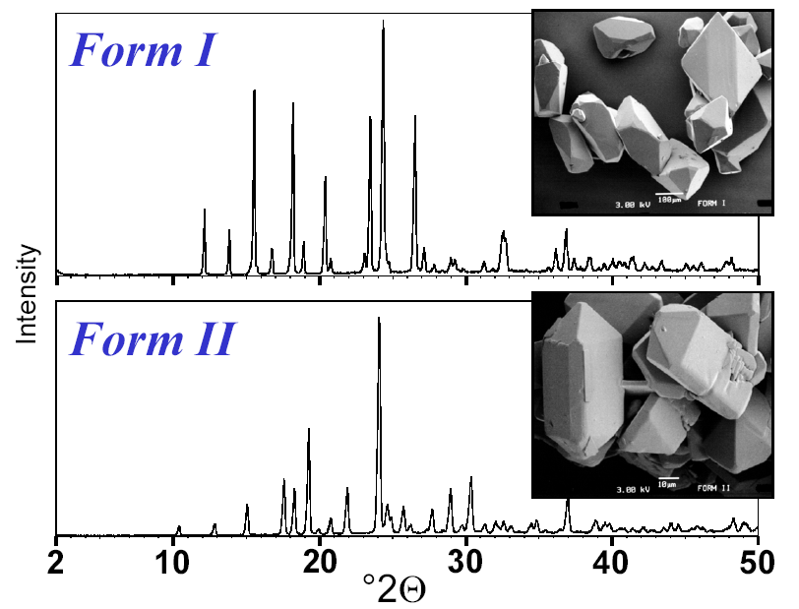
Phase Identification
Polymorphism of Paracetamol
Nichols & Frampton (1998) J.Pharm.Sci. 87(6), 684-693

Slide 26
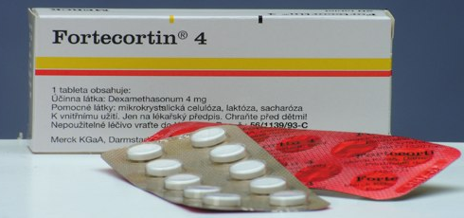
Phase Identification - Tablet Screening
Fortecortin®
Tablets measured in their original packing environment in transmission geometry

Slide 27
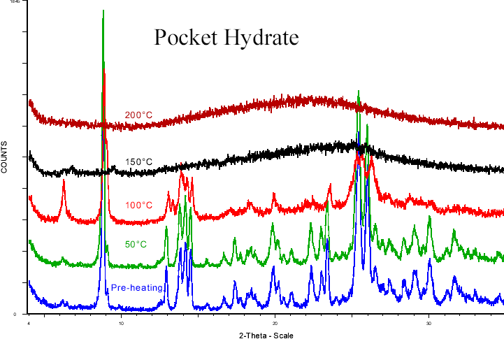
Non-Ambient Phase ID (T, RH)
Pocket Hydrate
Water is key to crystal lattice, on drying crystal lattice collapses
Chemically and physically unstable amorphous material produced
Storey, Pfizer Global R&D (2003)
IWPCPS 4, www.assainternational.com, collected presentations

Slide 28
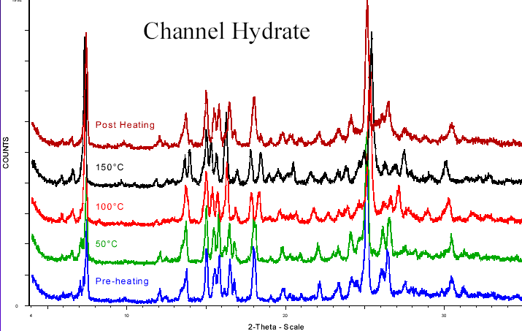
Non-Ambient Phase ID (T, RH)
Channel Hydrate
Water is present in channels and freely moves in and out of lattice
  Some changes to crystal lattice on dehydration but crystalline form remains at high-temperature
  Hydrate rapidly reforms on cooling
Storey, Pfizer Global R&D (2003)
IWPCPS 4, www.assainternational.com, collected presentations

Slide 29
Quantitative Phase Analysis
API / Excipient
Paracetamol
Lactose Hydrate
Paracetamol : Lactose Hydrate // 85 : 15

Slide 30
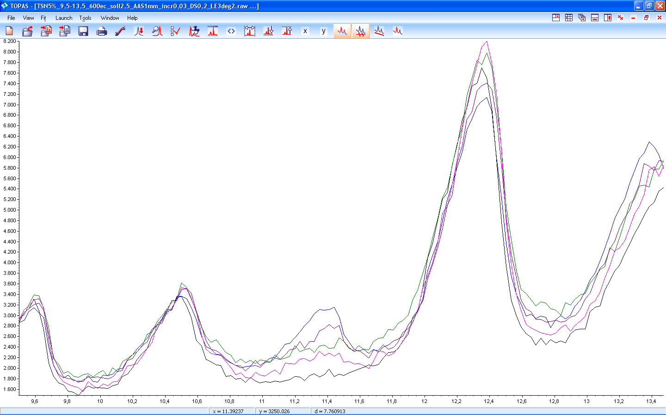
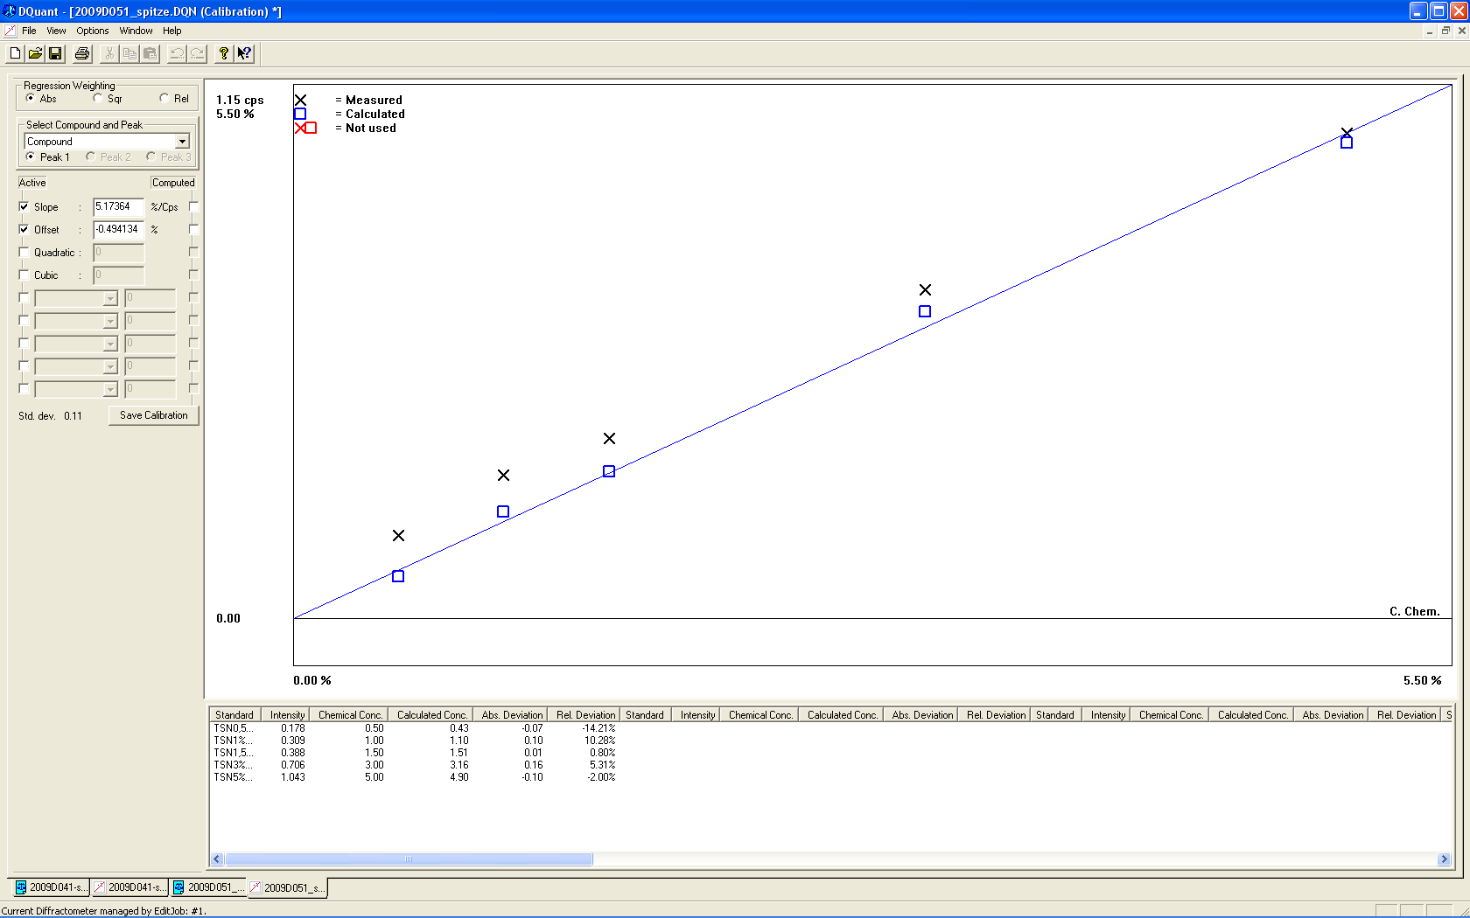
Quantitative Phase Analysis
Telmisartane - Form Beta in Form Alpha
Mixtures containing different concentrations of form beta are measured…
Form beta
…a calibration curve is then plotted, and relative amounts of form beta in other mixtures can be determined.
Accuracy better than 0.2% for all samples

Slide 31
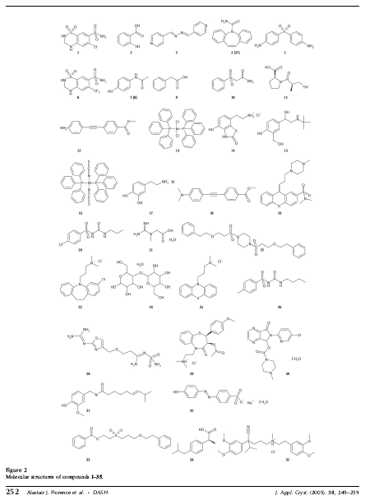

Structure Determination
Solving molecular crystal structures from laboratory X-ray powder diffraction data with DASH: the state of the art and challenges
Florence et al.
J. Appl. Cryst. (2005), 38, 249–259
D8 ADVANCE

Slide 32
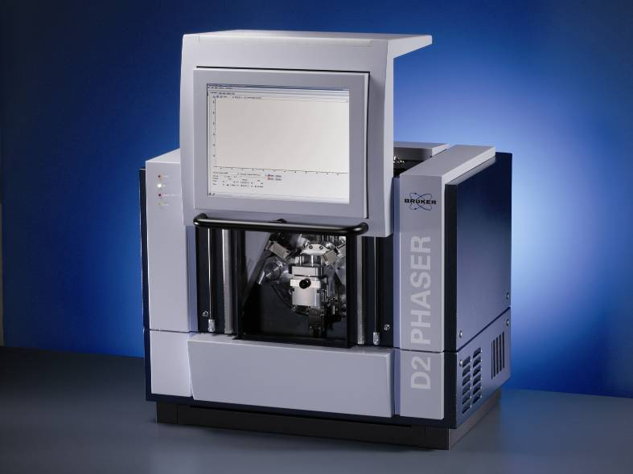
Instrumentation in XRPD
D2 PHASER
Applications
Phase identification
Quantitative phase analysis
(single peak methods)

Slide 33
Instrumentation in XRPD
D4 ENDEAVOR
Applications
Phase identification
Quantitative phase analysis
(single peak methods)
Fully automated powder diffractometer with large sample handling system for high throughput analysis

Slide 34
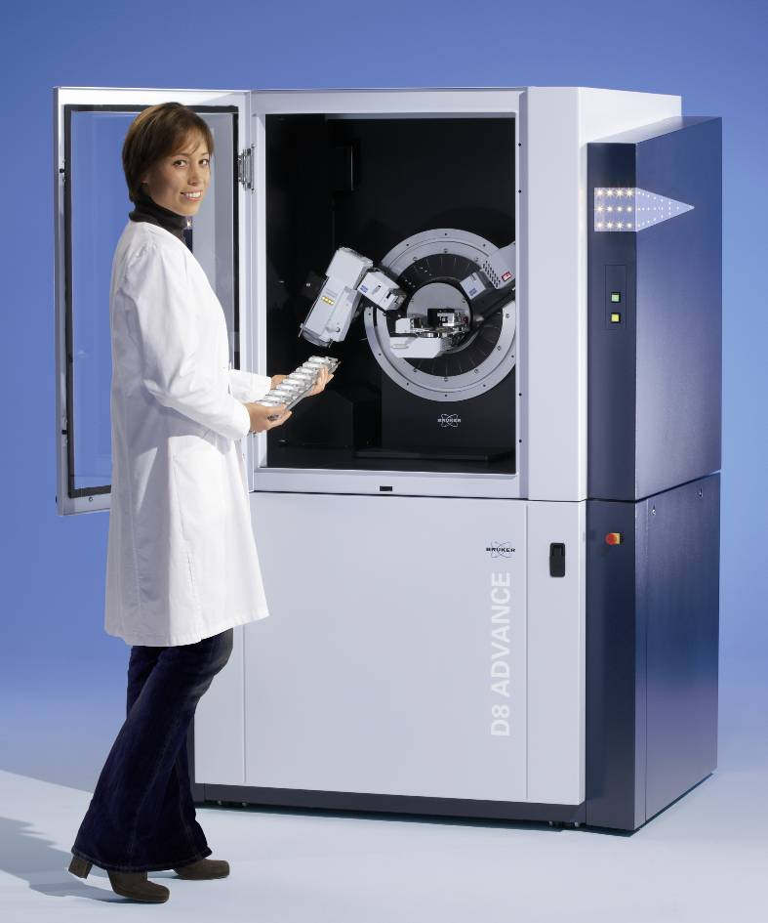

Instrumentation in XRPD
D8 ADVANCE / D8 DISCOVER
Applications
Phase Identification
Quantitative Phase Analysis
Structure Determination and Refinement
PDF Analysis
Non-Ambient Analysis (p, T, rH)
Can be operated in transmission and reflection geometry

Slide 35
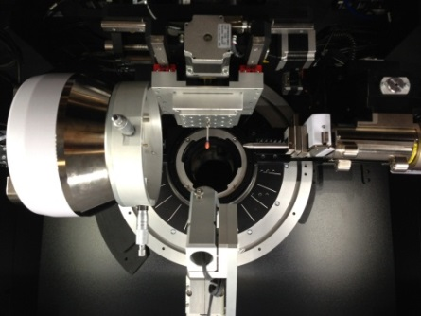
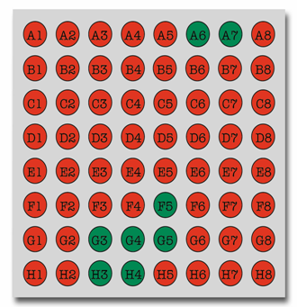
Instrumentation in XRPD
D8 DISCOVER
Applications
High-throughput of small sample amounts
  Combinatorial Screening
  Polymorph Screening
Tablet screening

