Slide 1
Building strength in science: The role of education and regional cooperation
Romain Murenzi, Executive Director
The World Academy of Sciences (TWAS)
IYCr South Asia Summit Meeting on Vistas in Structural Chemistry
Karachi, Pakistan
28 April 2014

Slide 2
A Dream of Science in the South
"The Third World Academy of Sciences must serve in the cause of enhancing South-South and South-North collaboration."
– Abdus Salam
Physicist, Nobel Prize winner
Pakistan

Slide 3
Since TWAS was founded in 1983, the world has changed
Today, TWAS is
a global academy with
1105 elected Fellows
91 countries represented
15 Nobel laureates
103 women

Slide 4
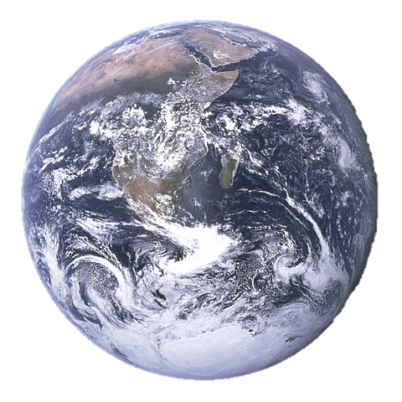
Since TWAS was founded in 1983, the world has changed
The world is facing important new challenges:
Climate change
Food security
Water quality
Energy security
Biodiversity loss
Infectious diseases

Slide 5
Since TWAS was founded in 1983, the world has changed
And a new era of international cooperation is emerging to address them:
Science, engineering and technology play a major role
Global partnerships are crucial

Slide 6
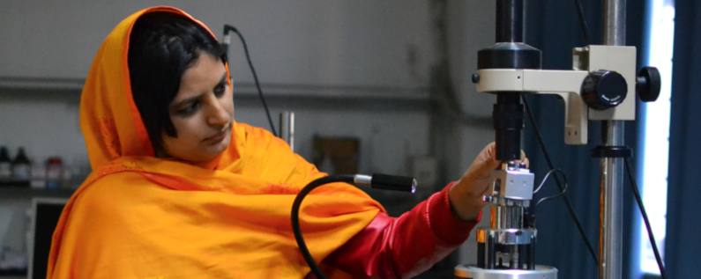
A New World: Development through S&T
TWAS has joined with others to promote a science-for-development model for the South.
Photo: UCAS National Center for Nanoscience and Technology

Slide 7
What does TWAS do?
Scientific capacity and excellence in the South
Researcher
mobility
Research
support
Honouring excellence
PhD
training

Slide 8
TWAS funding and support
Italy
China
Brazil
Sweden
UNESCO

Slide 9
South-South Fellowships
PARTNERS cover
registration/tuition
stipend
TWAS covers
travel and visa costs
administrative costs
16 programme partners for TWAS Fellowships in 9 developing countries
Brazil | Malaysia (2)
China | Mexico
India (4) | Pakistan (4)
Iran | Thailand
Kenya
Notes:
PhD and postgraduate research fellowships are among the most important programmes that TWAS offers

Slide 10
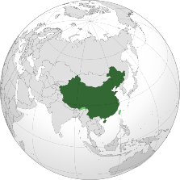
South-South network leaders: China
In 2013:
CAS-TWAS President’s Fellowship Programme
140 four-year PhD students per year from the developing world
22 Centres of Excellence
5 new CAS-TWAS Centres of Excellence
Notes:
CHINA:
187 TWAS Members
7 Young Affiliates
More than 30 TWAS Prizes since 1985
AT NEW CENTRES, hundreds of scientists from the developing world will be able to visit for education, training, and joint research projects

Slide 11
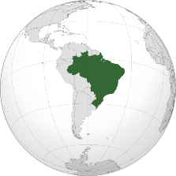
South-South network leaders: Brazil
TWAS-CNPq Fellowship Programme
up to 50 postgraduate students per year from developing world
TWAS-Instituto Agronômico de Campinas Centre of Excellence
Notes:
BRAZIL
122 TWAS Members
15 Young Affiliates
More than 30 TWAS Prizes since 1985

Slide 12
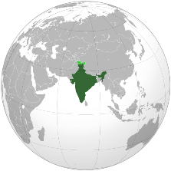
South-South network leaders: India
More than 60 postgraduate fellowships at four major institutions
27 centres of excellence under TWAS-UNESCO Associateship Scheme
Notes:
INDIA:
197 TWAS Members
10 Young Affiliates
More than 50 TWAS Prizes since 1985
FOUR MAJOR INSTITUTIONS: the Indian Asso. For the Cultivation of Science; Dept. of Biotechnology at MoST; S.N. Bose Center for Basic Sciences; Centre for Scientific and Industrial Research

Slide 13
South-South network leaders: Pakistan
Fellowship Partners:
COMSATS Institute of Information Technology (90 fellowships/year)
National Centre of Excellence in Molecular Biology (20)
International Center for Chemical and Biological Sciences (11)
National Centre for Physics (3)
Notes:
PAKISTAN offers a microcosm of how TWAS and it’s partners build science capacity through international cooperation:
Abdus Salam (founder) and Salimuzzaman Siddiqi (founding fellow)
33 current TWAS fellows
7 Young Affiliates

Slide 14
South-South network leaders: Pakistan
68 TWAS Fellowship awardees from 10 countries have been hosted in Pakistan since 2007
256 TWAS Fellowship awardees from Pakistan have pursued studies or research overseas since 2004 in:
Brazil 116
China 102
Malaysia 29
India 5
Mexico 3
Iran 1
Notes:
These are most PhD and post-graduate research fellowships, and also some visiting scientists

Slide 15
South-South network leaders: Pakistan
COMSTECH-TWAS
Joint Research Grants (2013):
26 research grants to scientists in
10 countries in Asia, South Asia, Middle East and Africa, totaling
$200,000
$7,700 average grant
Notes:
PAKISTAN:
Abdus Salam (founder) and Salimuzzaman Siddiqi (founding fellows)
33 current TWAS fellows
7 Young Affiliates
3 TWAS Prizes since 1985

Slide 16
The Promise of Science Diplomacy
“Our future must not be hostage to our past. If we can move on cultural exchanges and trade links, why can’t we go ahead with joint efforts in education, science and technology?”
–Atta-ur-Rahman
TWAS Fellow 1985
Notes:
Atta-ur-Rahman is one of the giants of global science, elected a TWAS Fellow in 1985. He offered these words after Pakistan and India reached a science cooperation agreement in 2012, focused on joint education and research projects. But his words also reflect the overall spirit of science diplomacy – advancing science and building positive relations between nations.
TALK HERE ABOUT TWAS SCIENCE DIPLOMACY PROGRAMS, IN AGREEMENT WITH AAAS AND FUNDED BY SIDA/SWEDEN. Both high-level events such as Budapest, and eventssuch as our energy workshop in December and our upcoming summer course in Trieste.

Slide 17
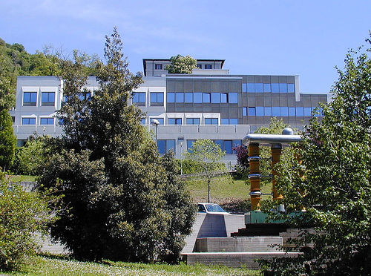
Romain Murenzi, Executive Director
r m u r e n z i @ t w a s . o r g
www.twas.org
Presentation prepared by TWAS Public Information Office

