Slide 1
Solid Form Control and Design
through Structural Informatics
Ghazala Sadiq
Karachi, IYCr South Asia Summit Meeting, 2014
Notes:
Hello my name is Ghazala Sadiq and I work at the CCDC which is based in Cambridge in the UK.
I am here today with Dr Colin Groom.
The title of my presentation is ….

Slide 2
Outline
The Cambridge Crystallographic Data Centre
Structural informatics tools to guide solid form selection
Beyond hydrogen bonding
Conclusions
Notes:
A brief out line of my talk.
I will talk about the CCDC..

Slide 3
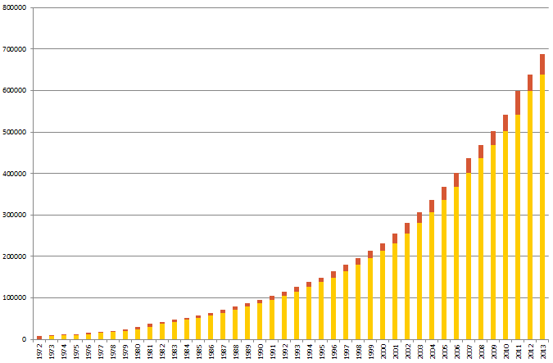
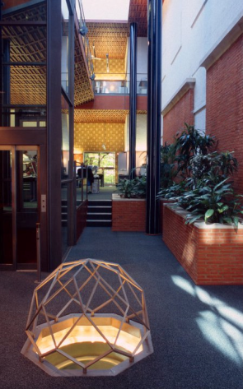
The Cambridge Crystallographic Data Centre
A not-for-profit, charitable institution, established 1965
Community funded and governed
Around 60 members of staff
  In Cambridge, UK and at Rutgers University, US
Create and distribute the Cambridge Structural Database System. The CSD contains every published small organic molecule and many more.
700,000
600,000
500,000
400,000
300,000
200,000
100,000
1972
2014
Notes:
The Cambridge Crystallographic Data Centre is a no proft, charitable organisation, established in 1965.
We have around 60 members of staff, split across 2 sites. A UK site based in Cambridge and a US site based at Rutgers University.
What we do at the CCDC is maintain the Cambridge Structural Databse.
The CSD contains every small organic molecule every published, plus many more.
There are 700,000 structures in the database with 50,000 or so added every year. This is a fantastic achievement of the crystallography community, and that includes many of you present here today.

Slide 4
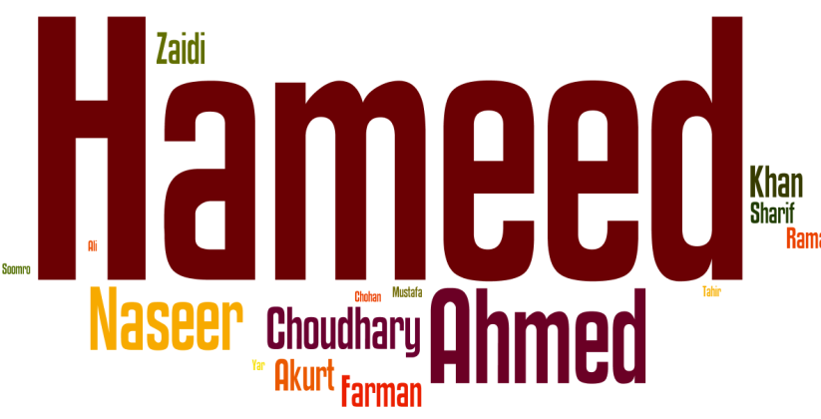
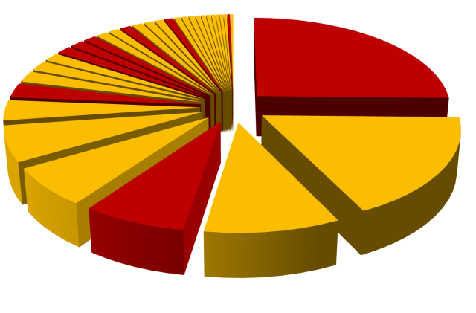
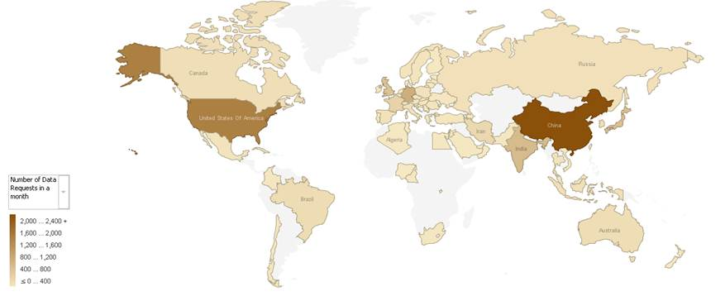
Structural Chemistry in Asia
Iran
China
Pakistan
South Korea
India
Representation of tools and services from the CCDC website
Notes:
This brings me to say that’s Structural Chemistry is very important in Asia
These names here, Hameed, Naseer etc and some of the most prolific crystalographers in Pakistan.
The pie chart is a representation of tools and services by Pakistan, India, China etc from the CCDC website.

Slide 5
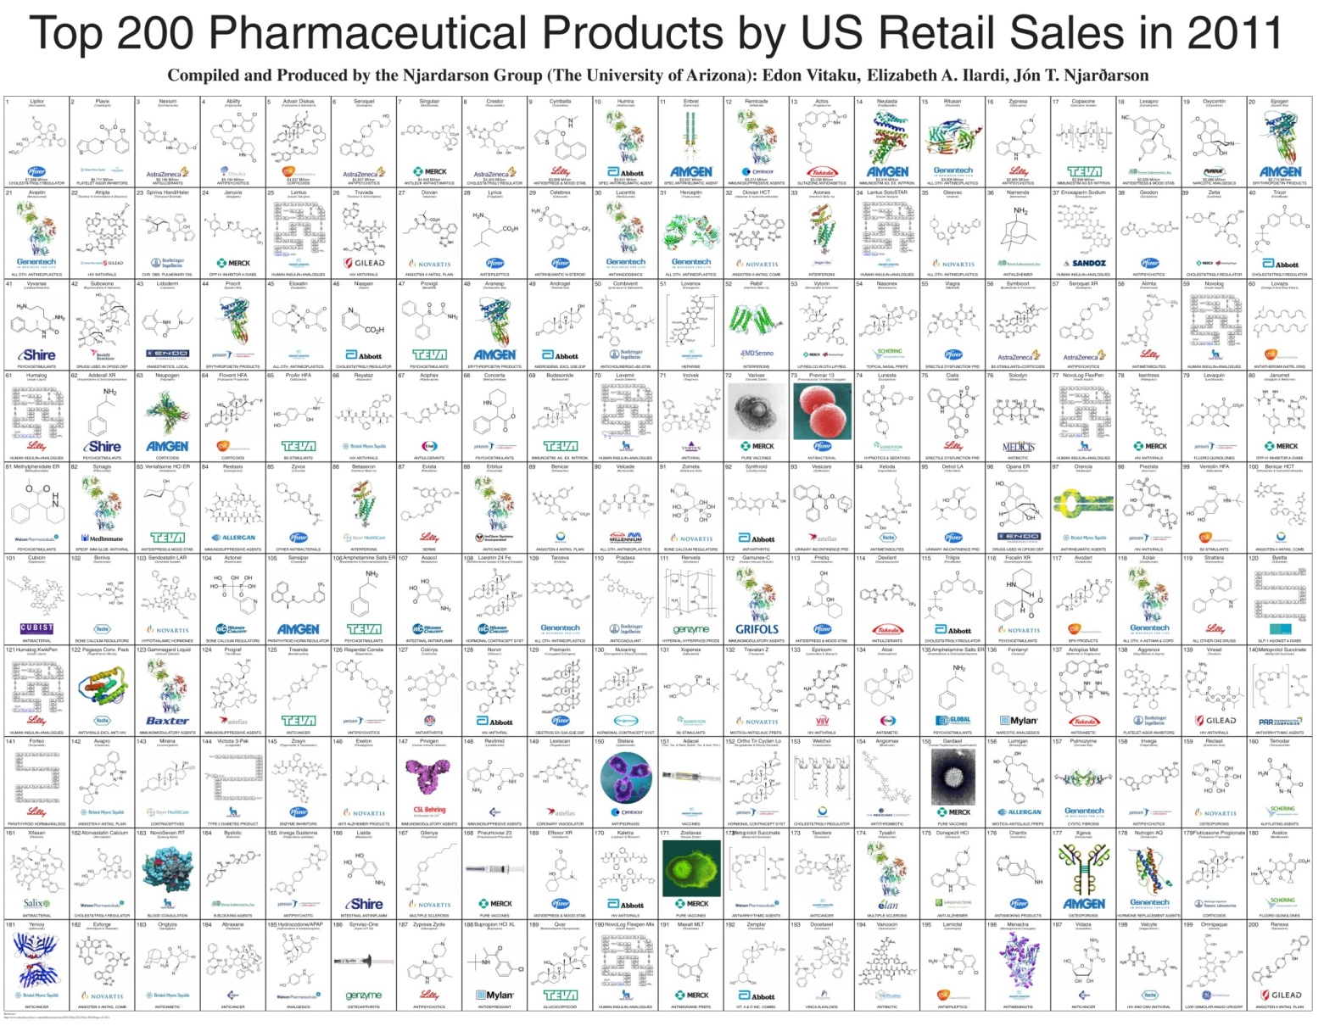
The CSD System and Drugs
Key communities which benefit from the CSD is the pharmaceutical industry
Notes:
One of the key communities which benefits from the CSD is the Pharma Industry.
This poster shows the top selling drugs in the US.
The grey boxes represent biological therapies and the green boxes small drug molecules for which we have the crystal structure.
The CSD has excellent coverage of actual drug molecules plus good coverage of drug like molecules which help towards crystal engineering.

Slide 6
Drug discovery and development by design
“Drug discovery” – Identifying an API
  Conformations
  Interactions
“Drug development” – API to drug substance
  Conformations
  Interactions
Crystal structures extremely useful for crystal engineering, drug discovery and drug development
Notes:
So, the crystal structures we have in the database are extremely useful for crystal engineering, drug discovery and drug development.
The part we are in interested in drug development and that’s converting an API into a drug substance.
We can use the crystal structures to understand, optimise and engineer the conformations and interactions of molecules to understand this process.

Slide 7
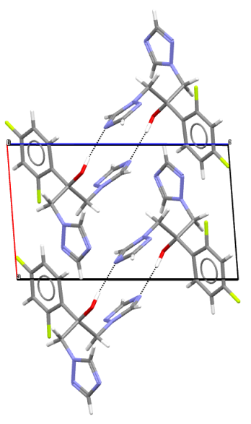
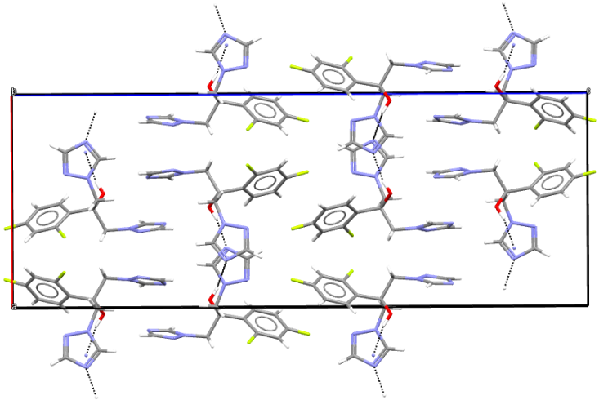
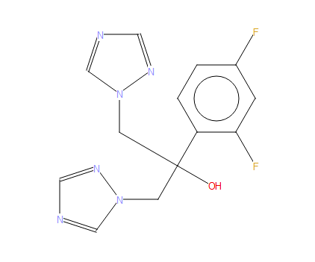
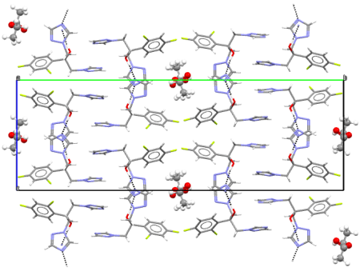
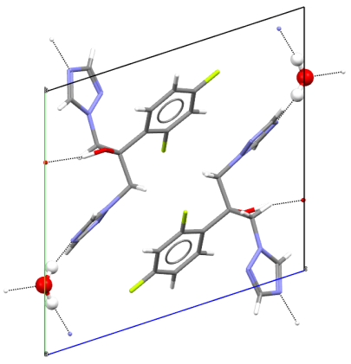
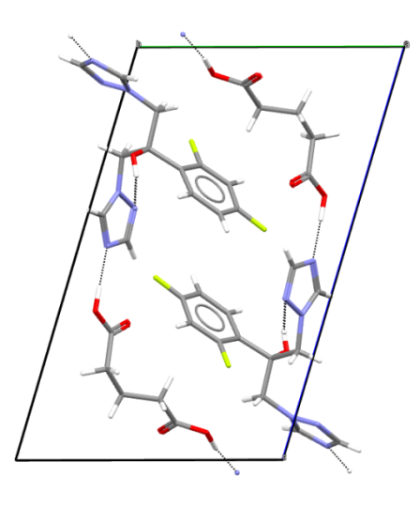
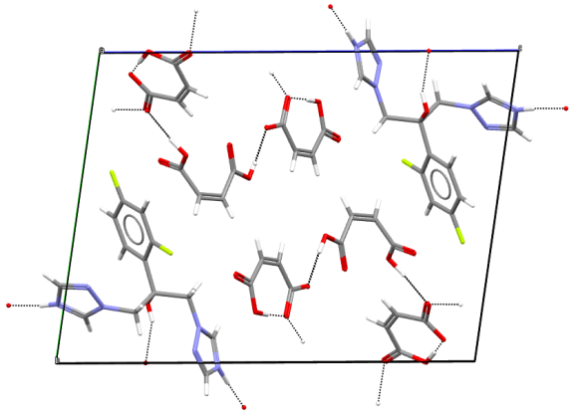
Structural Perspective of the Solid Form Landscape
Polymorphs
fluconazole
Solvates
Hydrates
Co-crystals
Salts
Notes:
In drug development there are lots of challenges.
The API can exist in multiple solid forms such as hydrate, solvate, contain multiple polymorphs etc. All these different forms contain different properties.

Slide 8
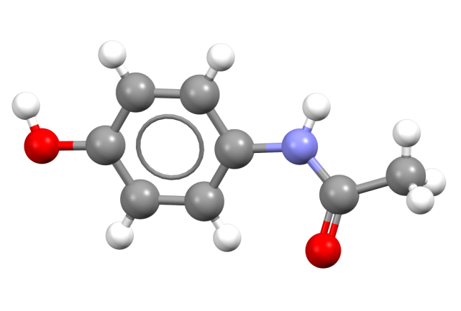
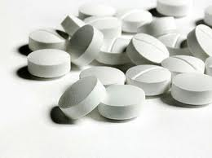
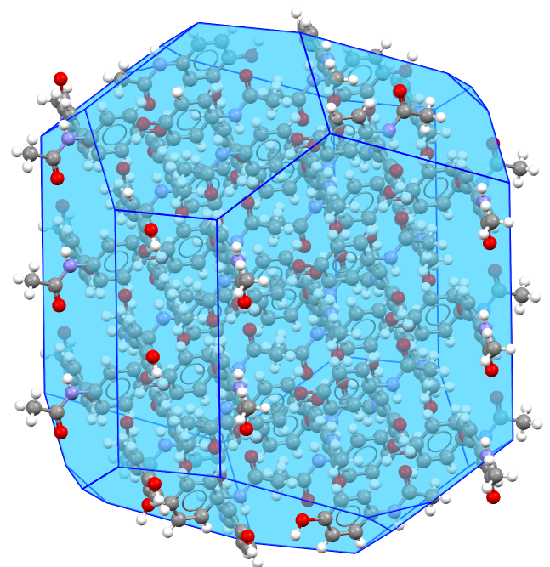
Pharmaceutical Solid Form Selection
Chemical & Physical
Stability
Mechanical
Properties
Solubility
Particle
Control
Purification
Product Process
Control
90% of small molecule drugs delivered in a crystalline state
Notes:
Some of these properties are listed here.
We have stability, solubility etc just to name a few.
Its extremely important to control the solid form, because if we don’t exert sufficient control things can and do wrong.
Eg od Ritonavir

Slide 9
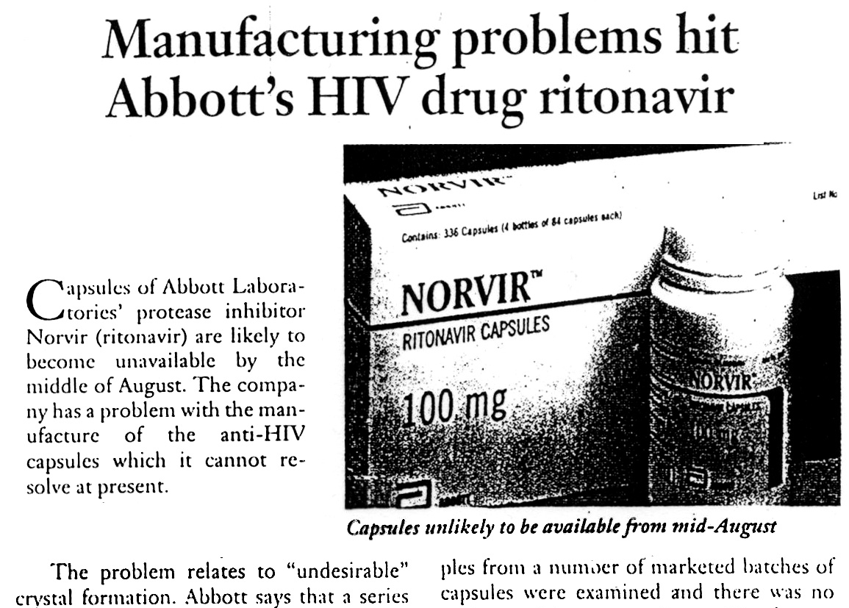
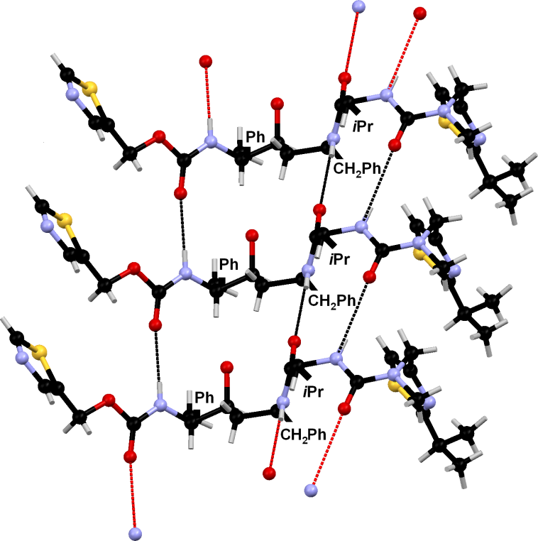
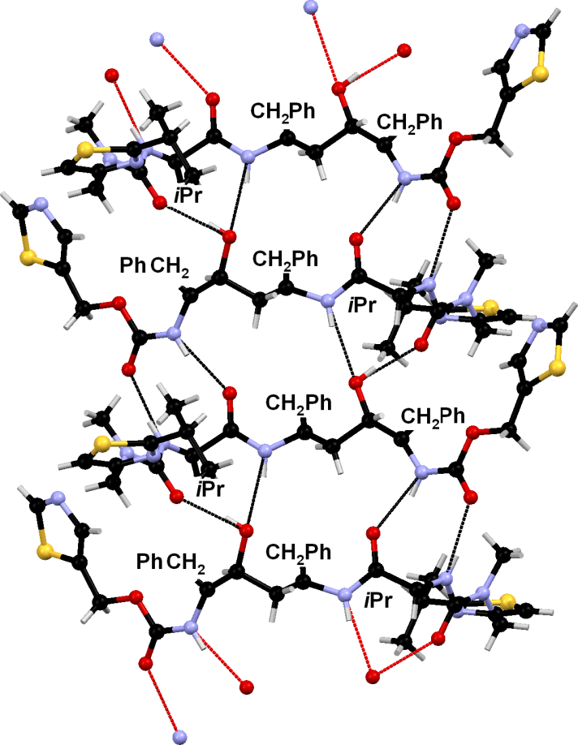
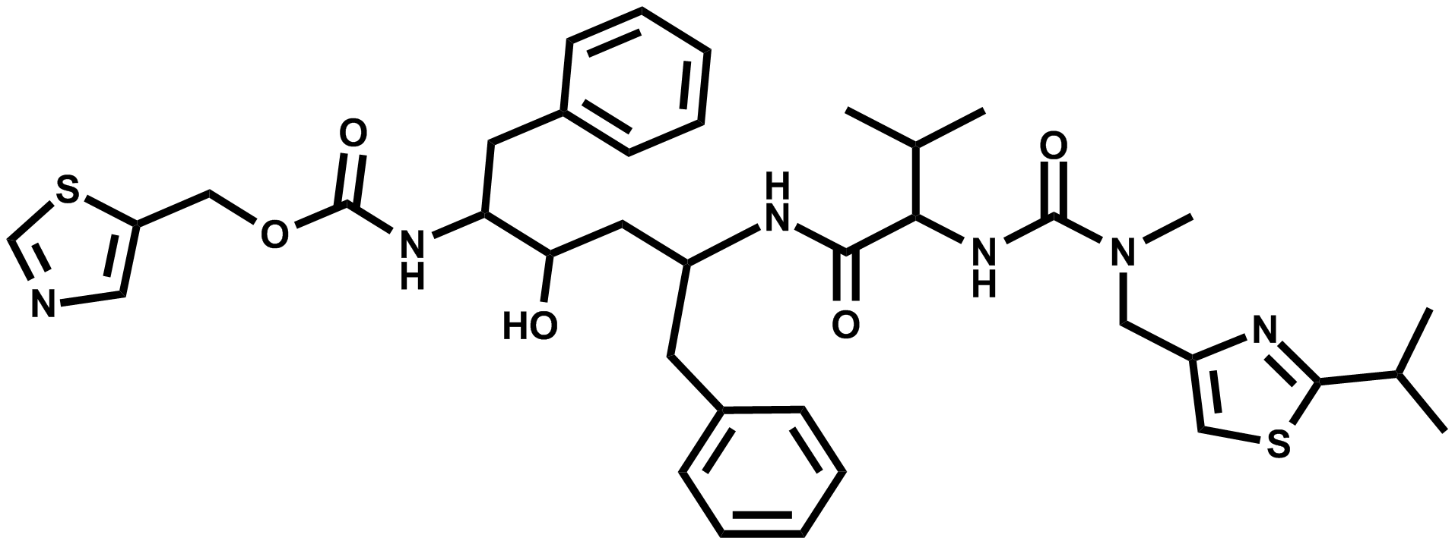
Understanding Polymorph Risk
~5-fold decrease in solubility
Form I
Form II
Notes:
Application of example
Why polymorphism is important - re-emphasising the variation in properties that can result.
Abbott scientists’ retrospective analysis indicated that form II was the best that could exist.
Could we have predicted that form I wasn’t the best?

Slide 10
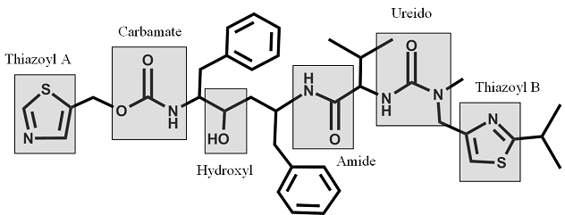
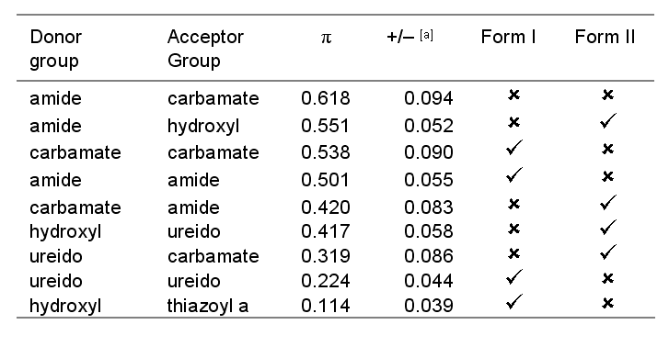
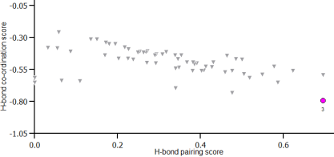
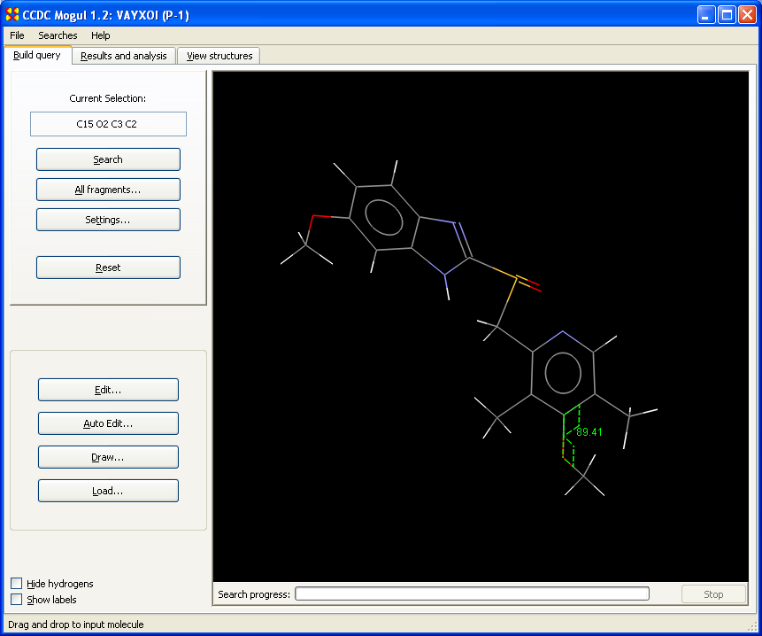
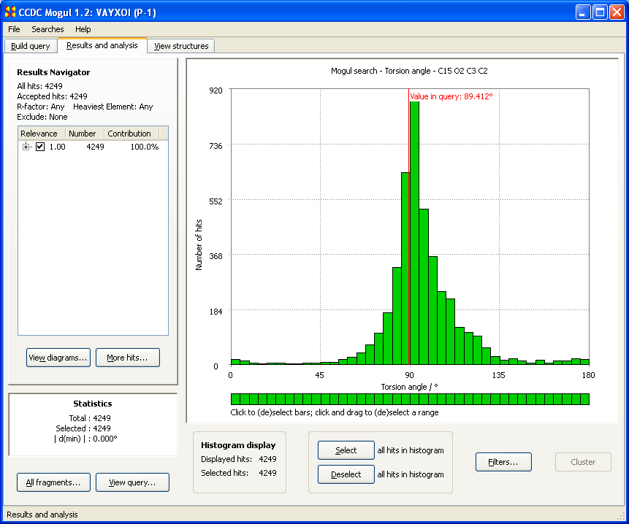
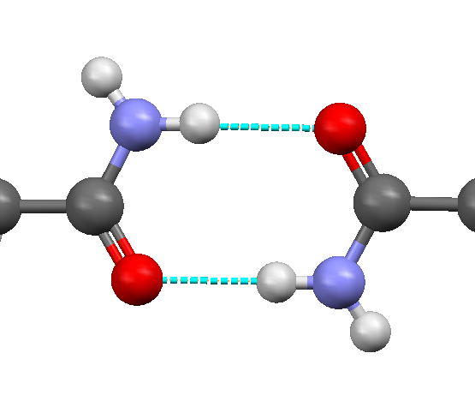
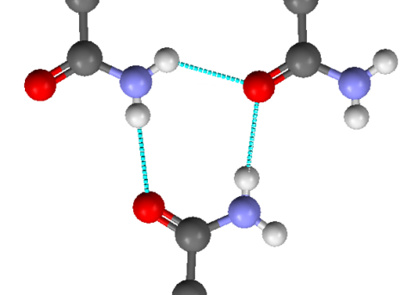
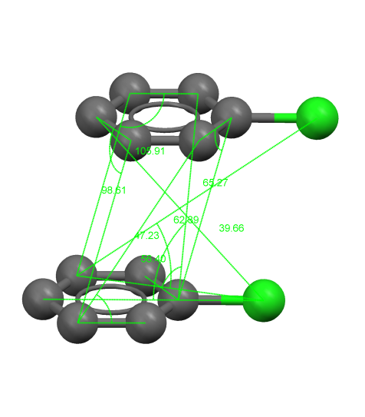
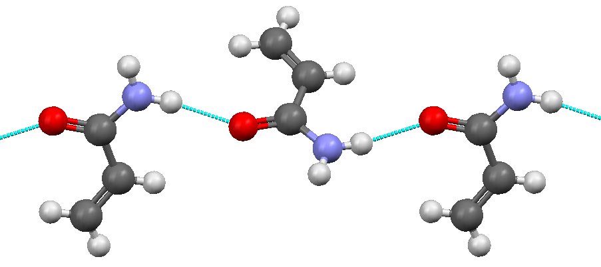
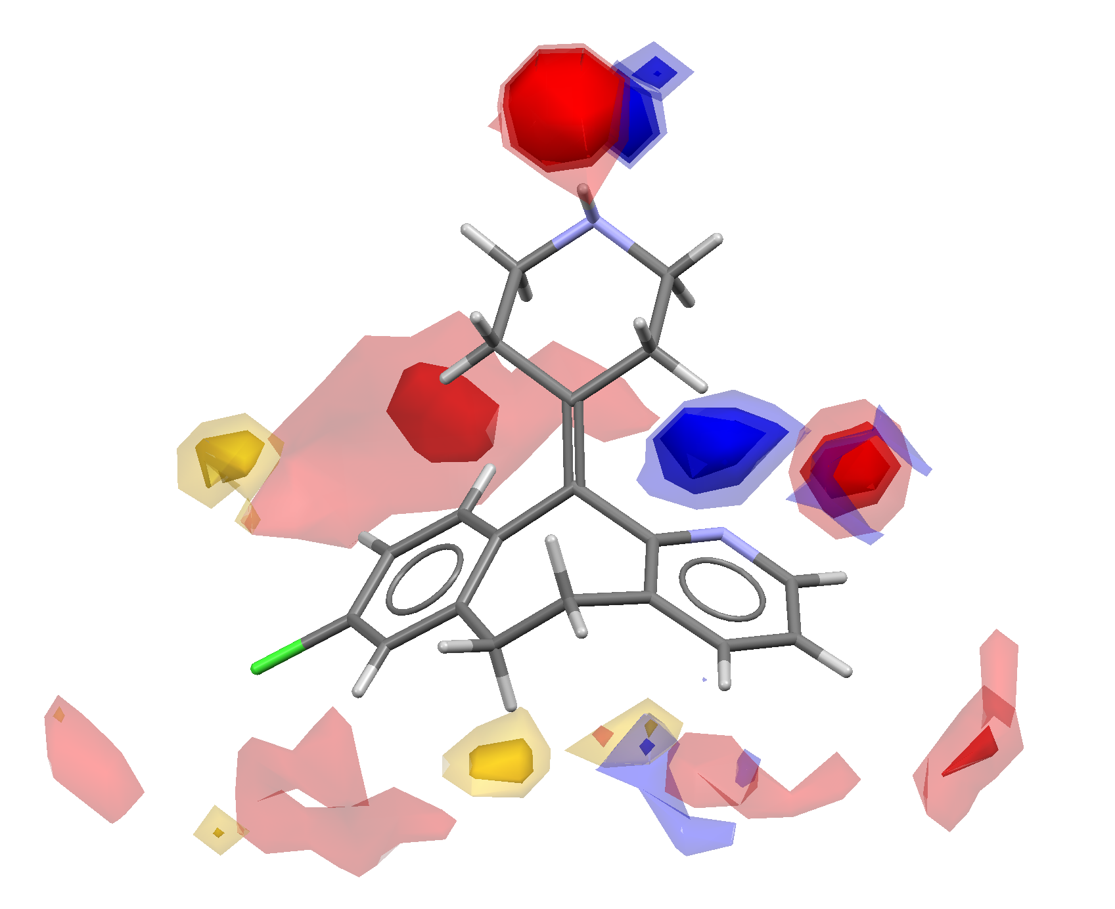
Structural Informatics tools to guide
Solid Form Selection
Hydrogen Bond Propensity
Intramolecular Geometry
700,000
structures
Motif & Packing Feature
Frequency
37.7%
1.5%
Full Interaction Maps
22.3%
Notes:
How????????
Tools to provide structural insights and analysis of solid forms.
Guiding experiments and building an understanding of solid form risk (focus of the rest of this talk).

Slide 11
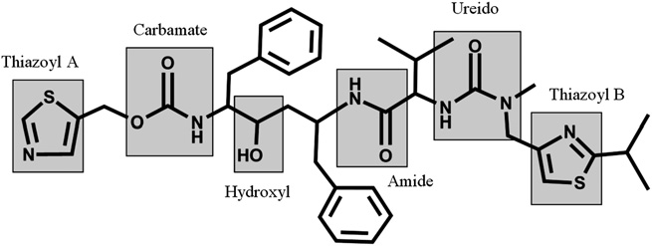
Using the CSD knowledge base to predict:
Hydrogen Bond Propensity
Form I
Form II
Galek et al, CrystEngComm, (2009), 11, 2634 - 2639
Notes:
Statistical model fitted using CSD data to make predictions about H-bond outcomes
Form 1 weird (very unlikely H-bonds)
Form 2 better (all H-bonds reasonable propensity)

Slide 12
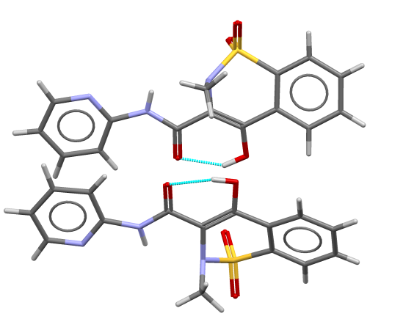
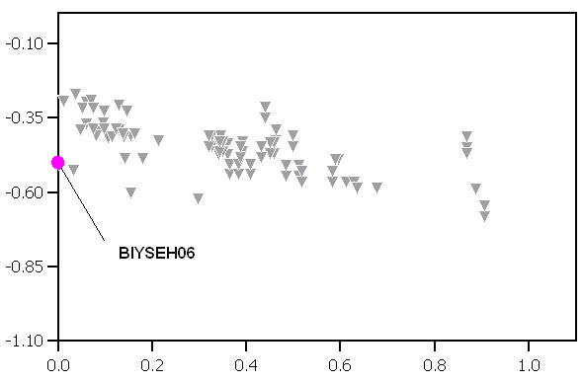
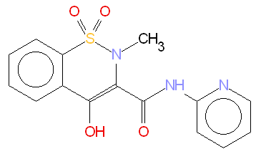
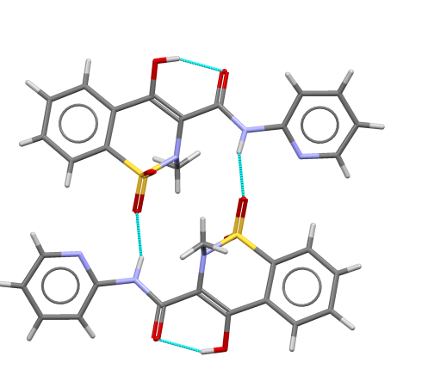
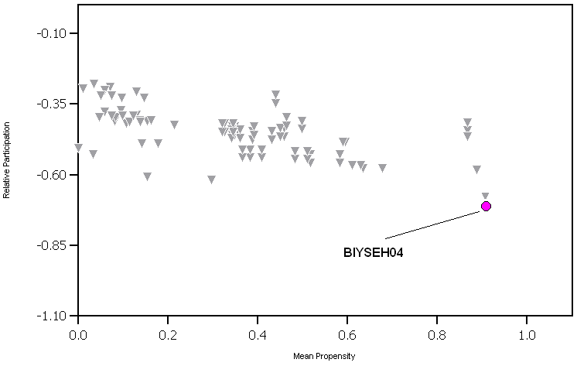
Hydrogen bond Propensity: piroxicam
Hydrogen Bond Co-ordination Score
Likelihood of hydrogen bonding against the likelihood of coordination for each functional group
Hydrogen Bond Pairing Score
Cumulative H-Bond propensities
Notes:
Take piroxicam. It can form at least two solid forms, or polymorphs. We plot the average likelihood of the individual hydrogen bonding against the likelihood of the coordination for each functional group. We do this for every possible hydrogen bonding network. Using this, we can look at the overall picture and identify how stable a particular polymorph might be. This H-bonding network is very unusual (top graph), this possible network is optimum (bottom graph) – so we would be confident in taking this crystal form to market – we wouldn’t expect any alternative forms to be identified in development or post market.

Slide 13
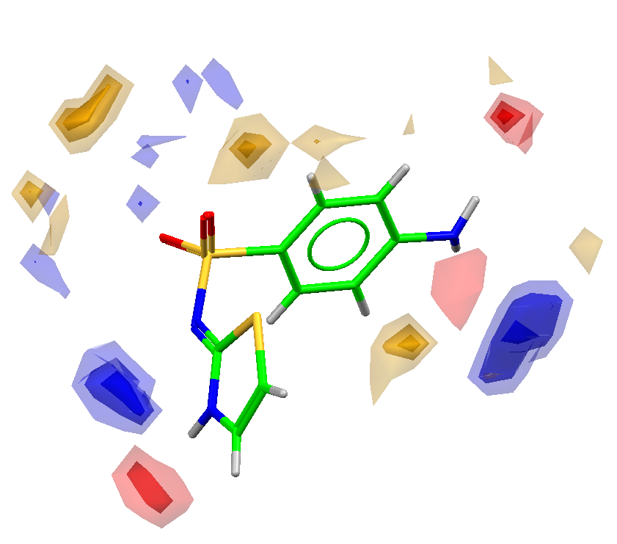
Interaction likelihoods from existing structures
conventional hydrogen-bonding
halogen bonding
π-π stacking
dipole-dipole stacking
hydrophobic contacts
Notes:
We can even go beyond H-bonding!

Slide 14
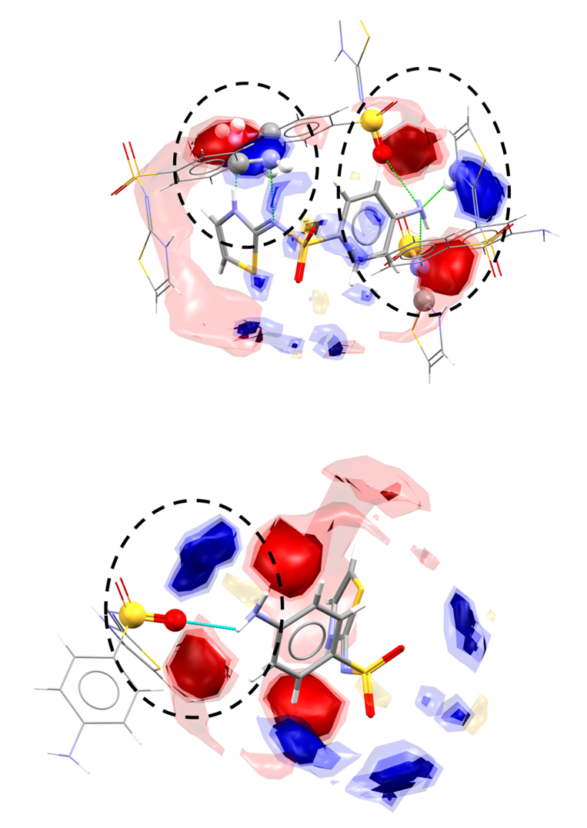
Beyond Hydrogen Bonding
Donor probe
Acceptor Probe
Hydrophobic Probe
Packing shell does not satisfy the Full Interaction Map
Metastable Form
Sulfathiazole Polymorphs
Packing shell satisfies the Full Interaction Map
Stable Form

Slide 15

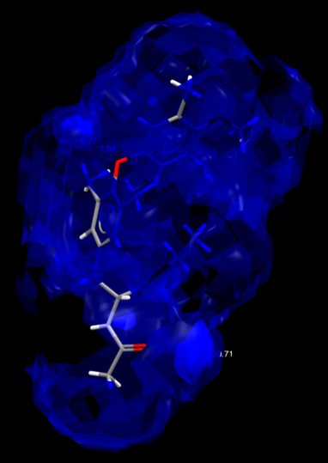
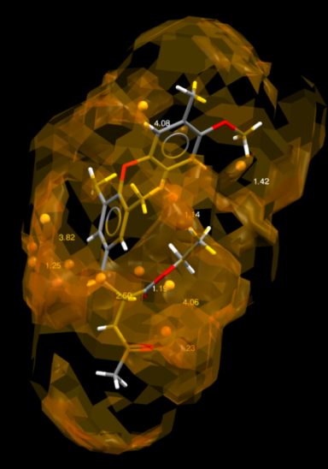
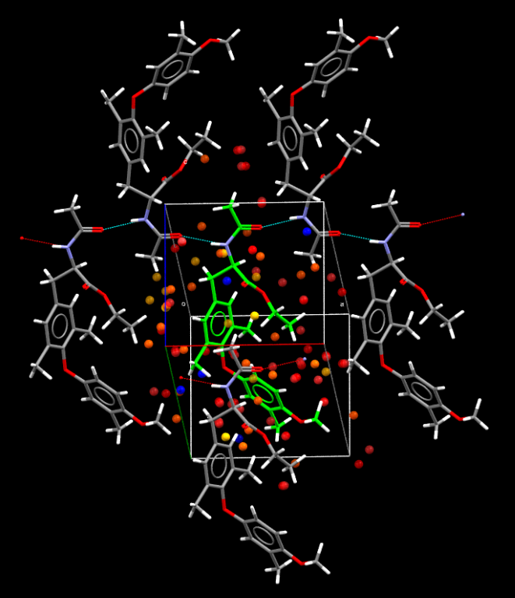
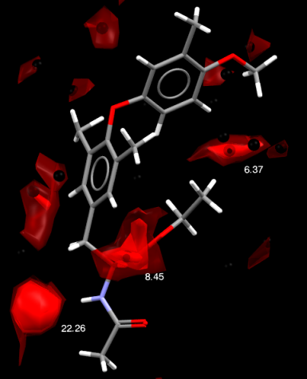
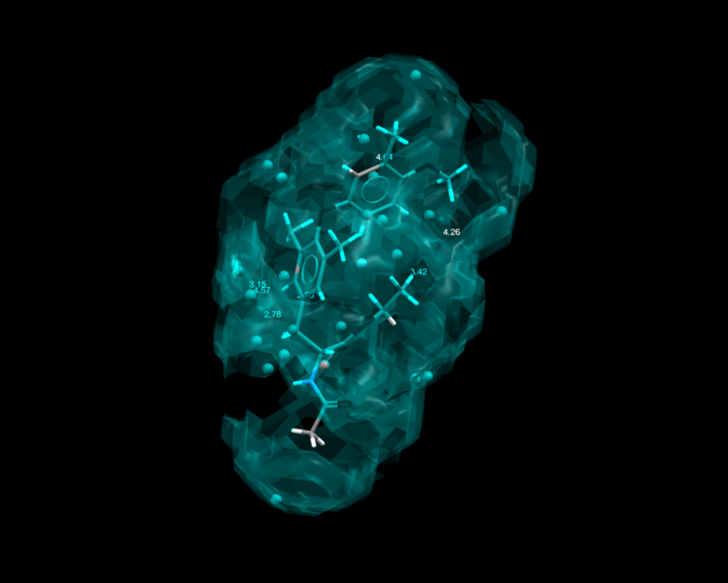
Knowledge based prediction
Notes:
and come up with something approaching a crystal packing pharmacophore

Slide 16
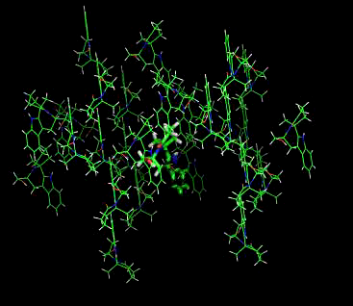
Knowledge based prediction
Notes:
Heres some examples of this – all using the same code and pdfs. We can use distributions directly from crystal structures to generate the most probable 3D structures, the most probable conformers, we can fit molecules to pharmacophore and even begin to attempt crystal structure prediction – based directly on conformation and interaction probablilities from crystal structures.

Slide 17
Conclusions
Structural informatics
  Using the 700,000 crystal structures the community has generated
  Helps understand and predict interactions in the solid state
    complements and guides experimental screening
These tools allow the scientist to validate & compare observed crystal forms
Allows us to understand and control solid form behaviour
Allows us to begin to think about knowledge based crystal structure prediction

Slide 18
Thank you for listening

