Slide 1
STRUCTURE AND BONDING OF MOLECULAR COMPLEXES IN THE GAS PHASE: ARE THEY RELEVANT TO CONDENSED PHASE?
E. Arunan
Department of Inorganic and Physical Chemistry
Indian Institute of Science
Bangalore. 560012
IYCr Summit Meeting, University of Karachi,
April 28-May 1, 2014

Slide 2
ACKNOWLEDGEMENTS
Dr. Pankaj K. Mandal (IISER, Pune)
Dr. B. Raghavendra (Tumkur college)
Dr. Mausumi Goswami (Postdoc at Virginia)
Dr. P. Aiswaryalakshmi (UK)
Devendra Manai
Abhishek Shahi
Project Assistants S.T.Manju, R. Lavanya
Prof. P. C. Mathias
Prof. A. G. Samuelson
Prof. S. R. Gadre and Dr. R. A. Klein
Prof. T. N. Guru Row and Prof. G. R. Desiraju
DST, CSIR, IFCPAR, IUPAC, IISc, IUCr.
Prof. Iqbal Chowdhary
Local Organizing team
University of Karchi

Slide 3
Outline of the talk
INTRODUCTION
MICROWAVE SPECTROSCOPY AND STRUCTURE DETERMINATION IN THE GAS PHASE
PULSED NOZZLE FOURIER TRANSFORM MICROWAVE SPECTROMETER
EXAMPLES OF MOLECULAR COMPLEXES
  BENZENE AND NAPHTHALENE DIMERS
  H₂O and H₂S DIMERS. What is a hydrogen bond?
  METHANE WATER DIMER IS IT C-H•••O or O-H•••C
  FCl •••CH₄ Halogen bonded complex
  Halogen bonding, chalcogen bonding and pnicogen bonding.
  Ar-propargyl alcohol complex O-H •••Ar and C •••Ar interactions
  Hydrophobic interactions and Carbon bonding
  Beryllium bonding.
CONCLUSIONS

Slide 4
INTRODUCTION
Neutron diffraction gives accurate structure in the solid phase, though it is difficult and the number of structures solved is too few.
X-ray diffraction has been used to give reasonable and reliable structure for a huge no of molecules. Electron density analysis has given an important dimension. Are the atoms that happen to be close, ‘bonded’?
Microwave spectroscopy is used for accurate determination of structure in the gas phase.
Coupling of a supersonic beam allows weakly bound molecular complexes to be investigated

Slide 5

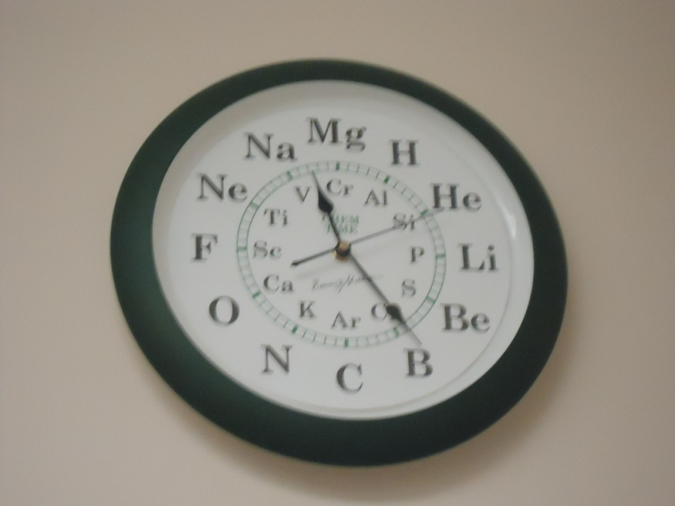
Chemical and Engineering News turns 90 and they picked 9
Thanks to Prof. R. N. Zare
And Prof. B. Shakashiri

Slide 6
Bonding within a molecule
Coulson “Sometimes, it seems to me that a bond between two atoms has become so real, so tangible, so friendly, that I can almost see it. Then I awake with a little shock, for a chemical bond is not a real thing. It does not exist. No one has ever seen one. No one ever can. It is a figment of our own imagination.”
Hoffman: “I think that any rigorous definition of a chemical bond is bound to be impoverishing, Push the concept to its limits. Be aware of the different experimental and theoretical measures out there. Accept that at the limits a bond will be a bond by some criteria, maybe not others. Respect chemical tradition, relax, and instead of wringing your hands about how terrible it is that this concept cannot be unambiguously defined, have fun with the fuzzy richness of the idea.”
Arunan: “Chemical bonds are made of electrons”

Slide 7
What can microwave spectroscopy tell us about these complexes?
Rotational constants give the structure.
Several isotopes need to be investigated to get accurate structure
Centrifugal distortion constants can give some information about the intermolecular bonding and large amplitude vibrations.
Tunneling splittings reveal information about the various large amplitude motions as well, these can happen even at 0 Kelvin.

Slide 8
Pulsed Nozzle Fourier Transform Microwave Spectrometer
Arunan, Dev and Mandal, Appl. Spectrosc. Rev. 39, 131 (2004)

Slide 9
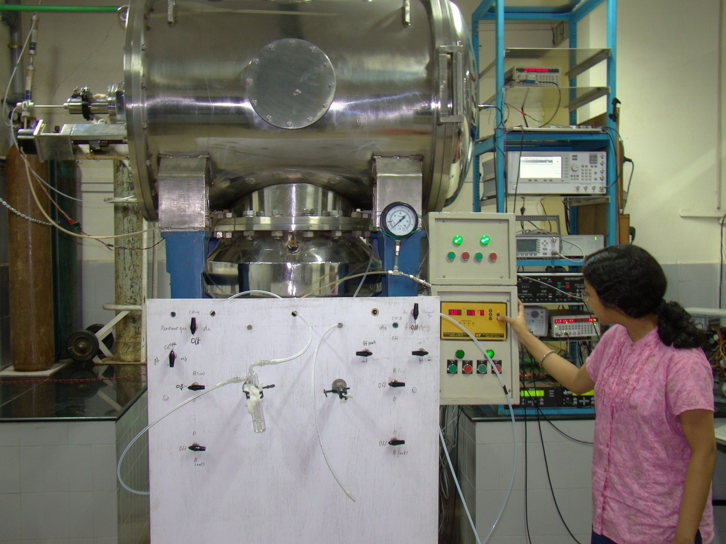

Slide 10
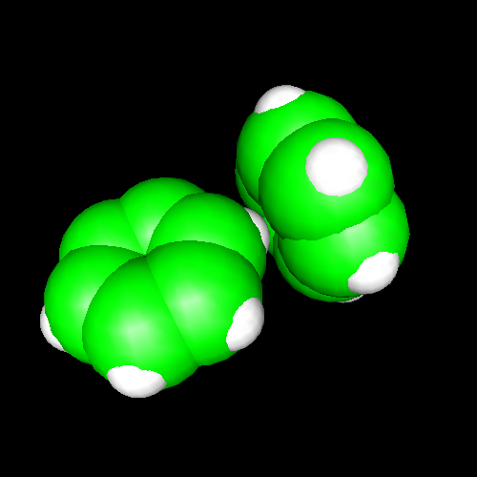
Benzene dimer, c.m-c.m distance 4.96Å
Distance very close to what is found in crystal!
The geometry in the gas phase and solid are nearly the same!
Arunan and Gutowsky J. Chem. Phys. 98, 4294 (1993) The rotational spectrum, structure and dynamics of a benzene dimer.

Slide 11
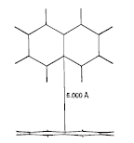
Naphthalene dimer
Resonance enhanced multi-photon ionization, time-of-flight mass spectroscopy reveals the structure to be T-shaped again! (K. Naata and coworkers, J. Phys. Chem. A, 2007, 111 (20), pp 4211–4214).
From the IUPAC report 2011: The crystal packing of a non-hydrogen bonded solid (say naphthalene) is often determined by the principle of close-packing, and each molecule is surrounded by a maximum number of other molecules.
Gas phase and solid are completely different!

Slide 12
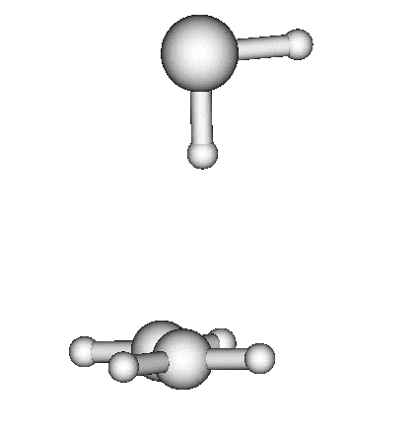
C₂H₄-H₂S dimer
Structurally very similar
to C₂H₄-H₂O
Binding energy is less
Rotational spectrum reveals
evidence for large amplitude
motions.
Referee: Please do not call it a
Hydrogen bond!
Bridging hydrogen bonding
van der Waals (dispersion?)
interactions
M. Goswami, P. K. Mandal, D. J. Ramdass, and E. Arunan,
Chem. Phys. Lett. 393, 22 , (2004)

Slide 13
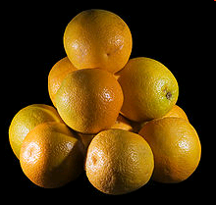
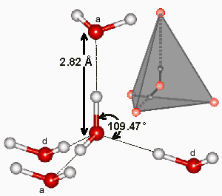
Water and hydrogen sulphide in condensed phase
H₂O at 0 °C 4 neighbours
H₂S at – 60 °C 12 neighbours
http://www.lsbu.ac.uk/water/hbond.html
Packing of spheres from Wikipedia
Hydrogen bonding Van der Waals interaction

Slide 14
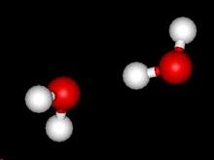

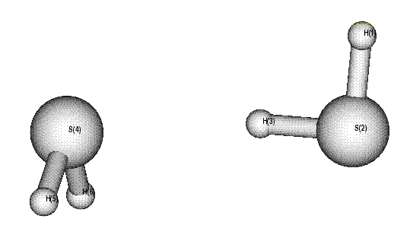
Gas phase: (H₂O)₂ and (H₂S)₂
 | R (Å) | θ°
H₂O | 0.97 | 104.5
H₂S | 1.34 | 92
P. K. Mandal, F. J. Lovas, E. Arunan, unpublished

Slide 15
When does a complex or molecule reveal the effect of Hydrogen bond?
For a ‘hydrogen bonded complex’, the zero point energy along any large amplitude vibrational coordinate that destroys the orientational preference for the hydrogen bond should be significantly below the barrier along that coordinate so that there is atleast one bound level.
  Goswami and Arunan PCCP 11, 8974 (2009) perspective article
Notes:
15

Slide 16
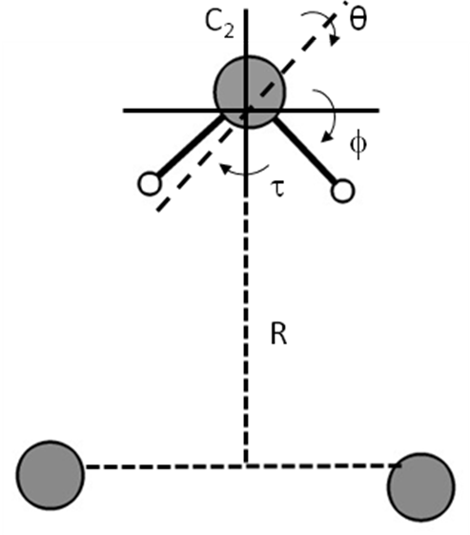
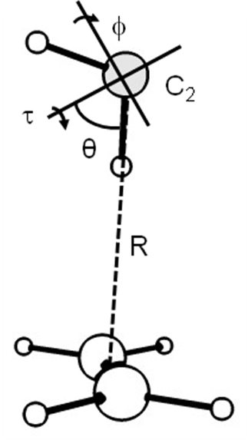
Computational methodolgy
All the calculations were done at MP2/aug-cc-pVTZ level
 | R (Å)
Ar₂···H₂O | 3.4
Ar₂···H₂S | 3.8
C₂H₄···H₂O | 3.4
C₂H₄···H₂S | 4.0
4/29/2014
16

Slide 17
What is the best criterion of calling a system as hydrogen-bonded?
V = 0
Case II. No Hydrogen bond
H-X---Y
H-X---Y
X
H
Y
θ
X-H---Y
V = 0
Case I. Hydrogen bonded
Model system: Ar₂···H₂O/H₂S and C₂H₄···H₂O/H₂S
4/29/2014
17

Slide 18
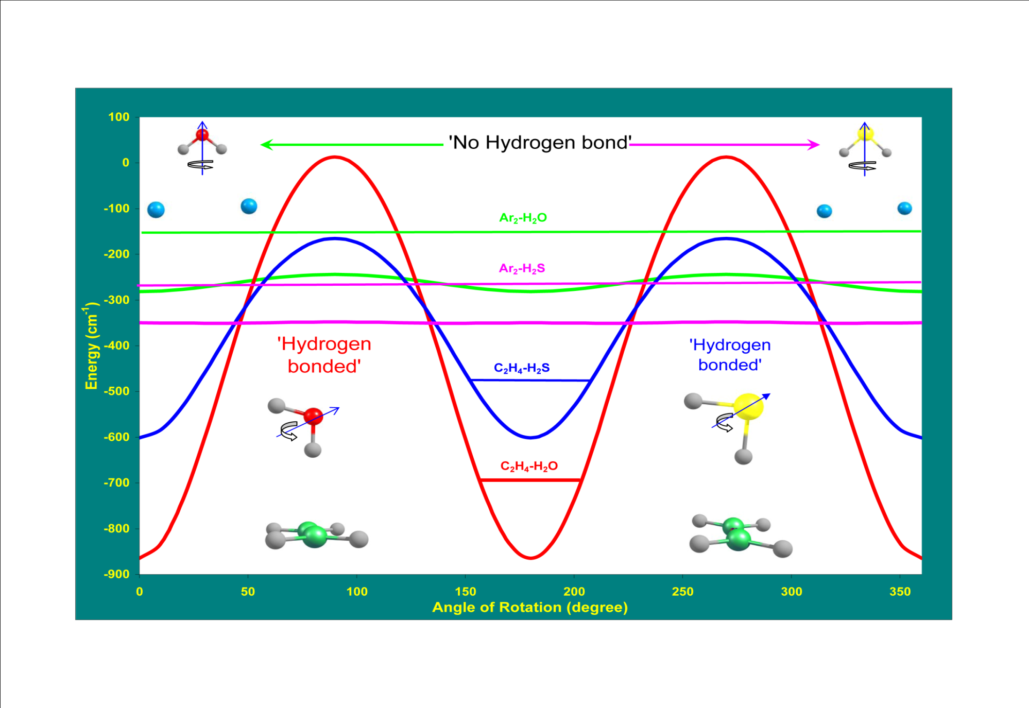
  Goswami and Arunan PCCP (2009) perspective article

Slide 19
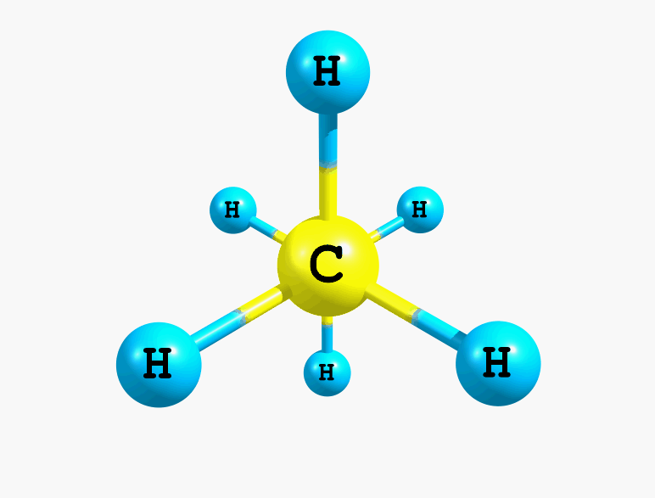
Torsion in ethane, staggered

Slide 20
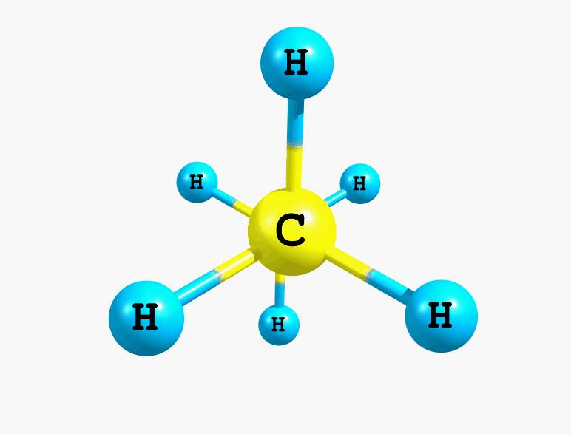
Towards hindered rotation

Slide 21
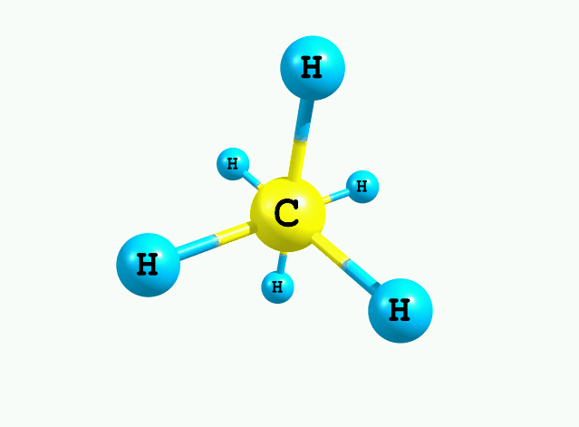
Free rotation, no more eclipsed or staggered

Slide 22
We predicted hydrogen sulphide solid to have hydrogen bonding at lower temperature in 2008. Could someone confirm?

Slide 23
Hydrogen sulphide at low T and high P
The structure becomes gradually ordered with the signature of hydrogen bond formation.
H₂S is a good model system where we can tune the hydrogen bond strength from “absent or very weak to structurally significant”.
  J. S. Loveday, R. J. Nelmes, S. Klotz, J. M. Besson, and G. Hamel, Phys. Rev. Lett. 2000, 85, 1024.

Slide 24
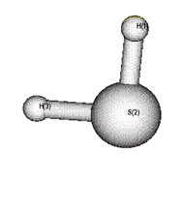
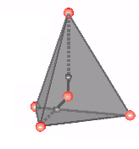
CH₄-H₂O complex
This structure on the left is a local minimum in the potential surface.
Most of the theoretical work deal with this C-H•••O H bond.
However, the structure on the right is the global minimum confirmed by microwave spectroscopy!
What kind of interaction does it have? Electron density analysis could help AIM Theory

Slide 25
Quantum Theory of Atoms in Molecules
Explores the total electron density in a molecule which leads to drawing boundaries of atoms within a molecule. The critical points in the electron density help in identifying which of the atoms are directly bonded.
X-ray diffraction provides experimental picture (deformation density is used)
Bader introduced the name, though electron density topology have been used by many earlier, Politzer, Gadre, Klein…
Has been extensively used, abused and criticized

Slide 26
Atoms in Molecules Theory
A conversation between three theoretical chemists (Roald Hoffman, Sason Shaik and Henry Rzepa, Angew Chemie. Int Ed. Engl 2013) about bonding in C₂
Roald:…and got widely different results. I like to show these to people who claim there is a good way to define a bond. Of course they’ll tell me that I should do a QTAIM analysis.
Sason: Better define that.
Henry: Quantum Theory of Atoms and Molecules, QTAIM, a method based on the topology of the electron density ρ,[14] has its uses.
Roald: I was saying that tongue-in-cheek, Henry. I am no great fan of QTAIM – in the hundreds of QTAIM papers that crowd the literature, I have yet to see one that makes a chemical prediction, or suggests an experiment.
  (The same issue has an essay ‘Chemistry in India’ written by four of us)

Slide 27
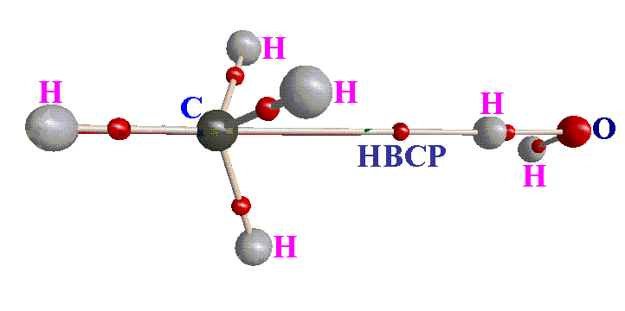
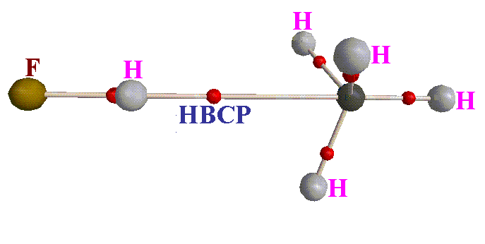
CH₄-HX global minimum geometry
MP2(FULL)/aug-cc-pVTZ.
Systems | ρ | ∇²ρ
H₄C---HF | 0.0113 | -0.0099
H₄C---H­₂O | 0.0078 | -0.0076
Raghavendra and Arunan, Chem. Phys. Lett 467, 37 (2008)
(submitted earlier to Phys.Chem.Chem.Phys. One referee was very pleased
and another one suggested that it should be rejected ““As this complex has
already proven to be bound by dispersive forces”
CPL editor David Clary sent a personal note thanking us for
submitting it to CPL (has improved the impact factor of CPL ☺ )

Slide 28
Penta-coordinate carbon
Appears like close packing, however, electron rich region is the hydrogen bond acceptor
Pentacoordinate carbon! CH5+ has been a difficult ion to produce and investigate.
As H+ gets closer, H---H attraction dominates and it becomes a weak complex of H₂ + CH3⁺ (Oka, Nesbitt)
Interestingly NH₃ and H₂O can form protanated ions much easily as H⁺ comes away from the H atoms

Slide 29
O-H •••C in condensed phase? RareC
WEWHAI ( Distance = 2.281A˚ and Angle = 167.506).

Slide 30
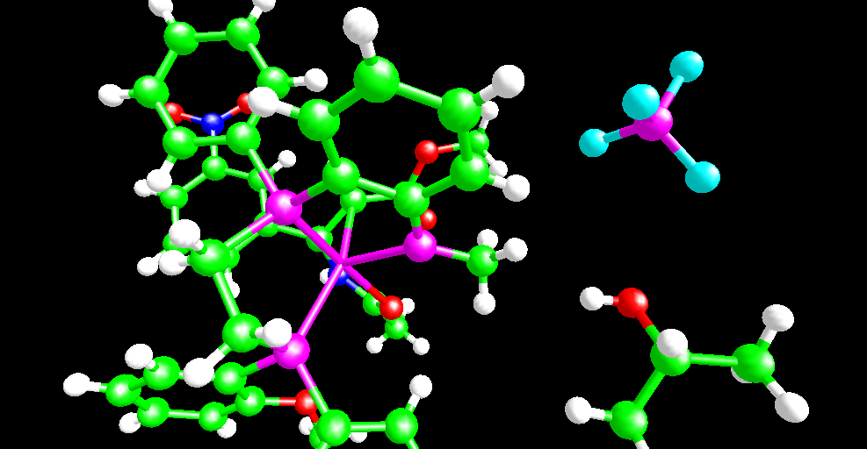
One more
FIXXOA ( Distance = 2.445A˚ and Angle = 165.535˚).

Slide 31
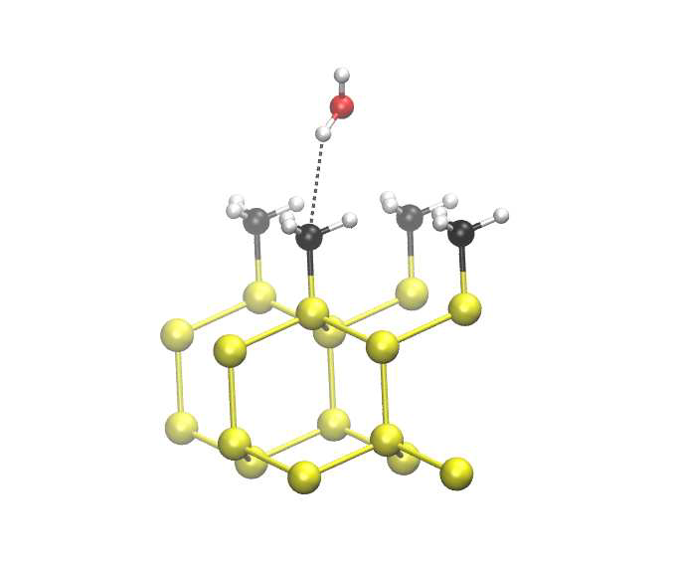
Water on Si-CH₃ surface
A. Ambrosetti*, F. Costanzo, and P. L. Silvestrelli
J. Phys. Chem. C, 2011, 115 (24), pp 12121–12127
DOI: 10.1021/jp202704c
Publication Date (Web): May 13, 2011

Slide 32
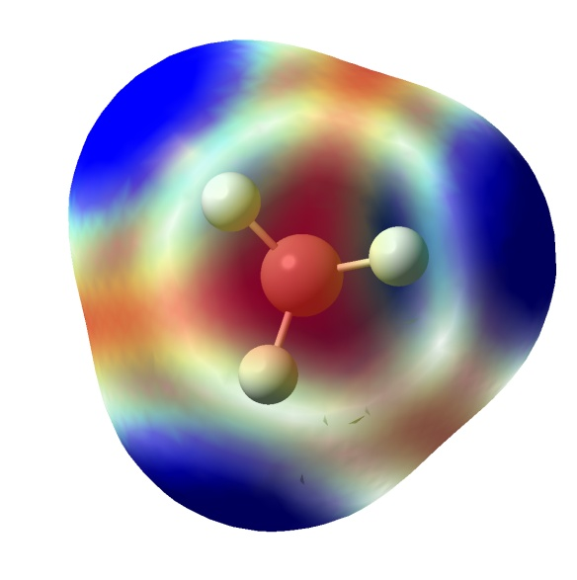
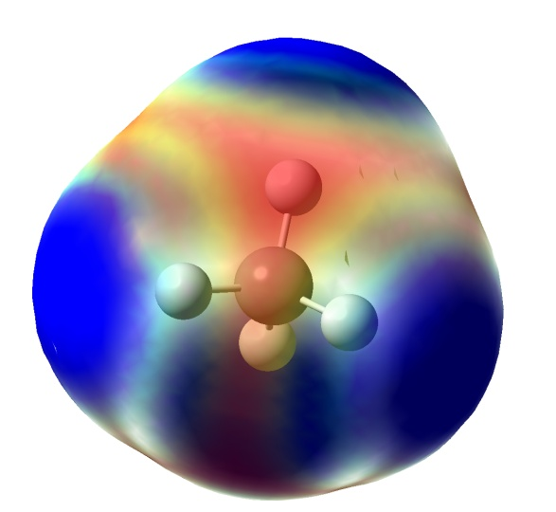
Where are the electrons in CH₄
Water forms H bonds with its lone pair of electrons
Ethylene forms H bonds with its π pair of electrons
CH₃ radical can form H bonds with its unpaired electron
H₂ can form H bonds with its σ electrons
CH₄ forms H bonds with the face center rich in electons
Kr (with an electronegativity of 3) forms with all its electrons
Hydrogen bond is the bond between an electron deficient
Hydrogen in XH and some electron rich region in another
Molecule!

Slide 33
IUPAC TASK GROUP
E. Arunan , Bangalore (Chairman)
Steve Scheiner, Utah (Co-chairman)
G. R. Desiraju (Bangalore, core-group, was in Hyderabad)
R. A. Klein (Bonn, core-group)
J. Salej (Warsaw, core-group)
I. Alkorta, Spain
David Clary, Oxford,
Rob Crabtree, Yale
J.J.Dannenberg, New York,
Pavel Hobza, Prague
Henrik Kjaergaard, Otago (now in Copenhagen)
A. C. Legon, Bristol
Benedetta Mennucci, Pisa
David Nesbitt, Colarado.

Slide 34
New IUPAC Definition
The hydrogen bond is an attractive interaction between a hydrogen atom from a molecule or a molecular fragment X–H in which X is more electronegative than H, and an atom or a group of atoms in the same or a different molecule, in which there is evidence of bond formation.
E. Arunan, G. R. Desiraju, R. A. Klein, J. Sadlej, S. Scheiner, I. Alkorta, D. C. Clary, R. H. Crabtree, J. J. Dannenberg, P. Hobza, H. G. Kjaergaard, A. C. Legon, B. Mennucci and D. J. Nesbitt, "Definition of the hydrogen bond", Pure Appl. Chem. 83, 1619 and 1637 (2011)

Slide 35
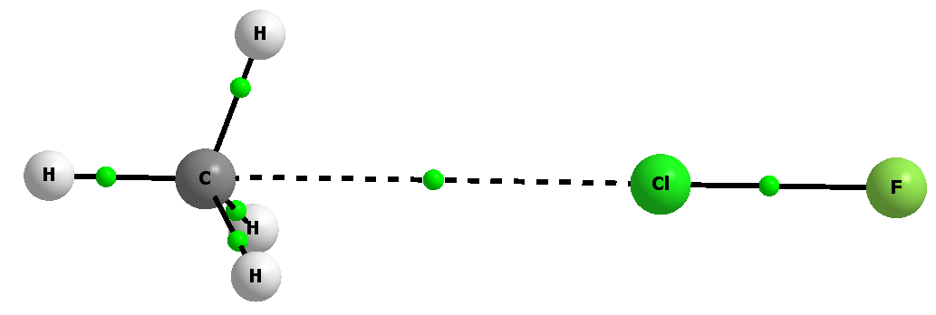
CH4 can accept a halogen bond too! FCl---CH4 complex
Legon and coworkers microwave spectrum
Devendra Mani AIM and ab initio theory, to be published
IUPAC has setup another task group to define halogen bonding
Following the successful completion of the hydrogen bond project.
Legon, Desiraju are both common members. Metrangolo and Resnati
chairs

Slide 36
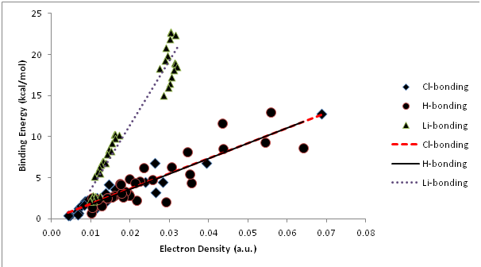
H/Cl/Li bonding
Abhishek Shahi to be published

Slide 37

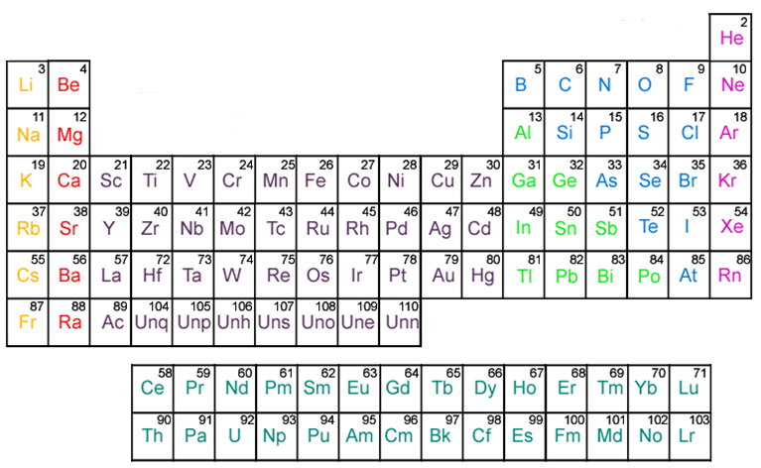
Lithium Bonding and Halogen Bonding
Pnicogen and chalcogen bonding,
Carbon bonding? Beryllium bonding?

Slide 38
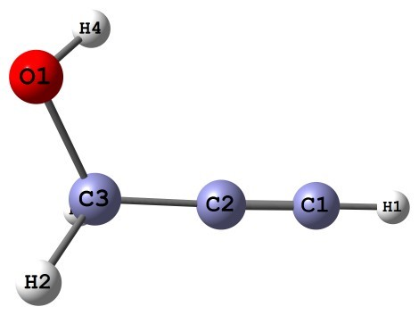
Ar-propargyl alcohol dimer
Towards carbon bonding

Slide 39
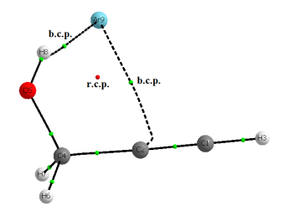
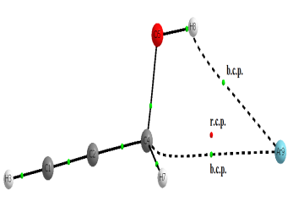
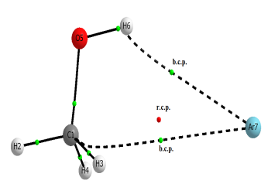
Nature of interactions: AIM analysis
Microwave spectrum proves this structure
Ar••• g-PA
Ar••• t-PA
?
?
Ar••• methanol

Slide 40
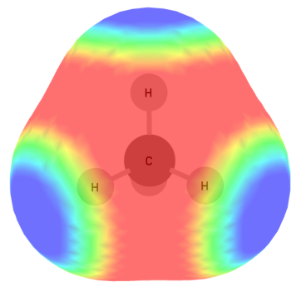
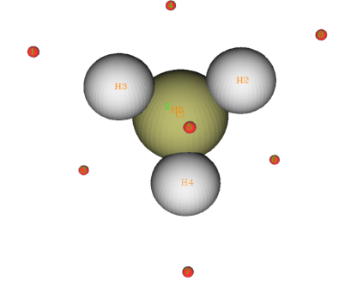
Methanol ESP surface
ESP value at face centre +50.2 kJ.mol⁻¹
Tetrahedral face of methane has a –ve centre!
ESP value at face centre = -7.5 kJ.mol⁻¹

Slide 41
H₂O•••CH₃OH complex
H₂O•••CH₃OH complex was optimized taking initial geometry in which oxygen
of water points towards the CH₃ face of methanol.
3.167 Å
b.c.p.
BSSE corrected interaction energy = 4.2 kJ mol⁻¹
Electron density ρ(r), at intermolecular b.c.p. = 0.0050 a.u.
Laplacian of electron density ∇²ρ(r) at intermolecular b.c.p. = 0.0248 a.u.
Is this a general interaction ?

Slide 42
Similar interaction with other molecules
Optimized geometries for (a) H₂O•••CH₃OH, (b) H₂S•••CH₃OH, (c) HF•••CH₃OH, (d) HCl•••CH₃OH, (e)HBr•••CH₃OH, (f) LiF•••CH₃OH, (g) LiCl•••CH₃OH, (h) LiBr•••CH₃OH, (i) ClF•••CH₃OH, (j) H₃N•••CH₃OH, (k) H₃P•••CH₃OH complexes.
D.Mani, E. Arunan, PCCP, DOI: 10.1039/C3CP51658J

Slide 43
Nomenclature ?
D.Mani, E. Arunan, PCCP, DOI: 10.1039/C3CP51658J

Slide 44
X-C---Y Carbon bonding shows
Red-shift in C-X stretching frequency
Linear X-C---Y
Distance between C and Y less than the sum of van der Waals radii.
Bond critical point between C and Y
Hyper-conjugation n-σ* overlap between Y lone pairs and C-X anti-bonding orbitals
Finally, referees, editors all agreed and there was a blog. Became the number 1 paper downloaded in that period (not read?)

Slide 45

Carbon bond covered
Hydrogen bond seen, halogen bond defined and carbon bond
proposed: intermolecular bonding, a field that is maturing!
E. Arunan, Current Science 10 October 2013 issue 892-894

Slide 46
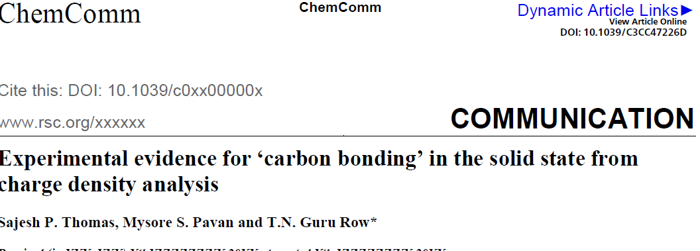
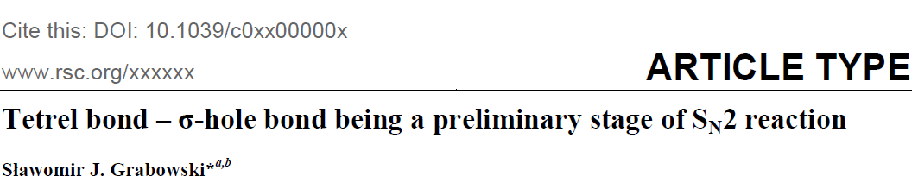
Experimental verification by Prof. Guru Row of IISc in a few months
Published online 25 October 2013

Slide 47
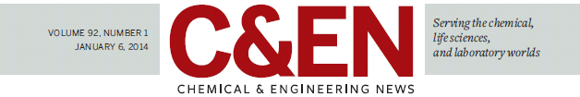
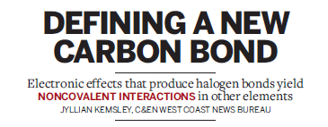
Chemical and Engineering News
January 6, 2014

Slide 48
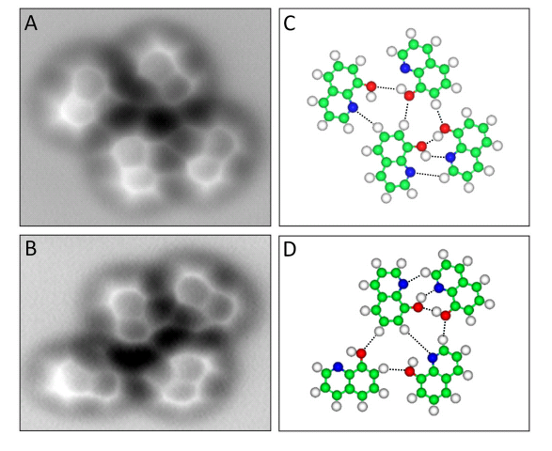
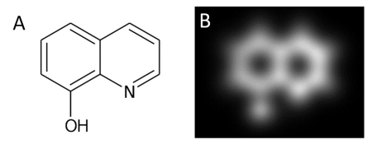
AFM image of hydrogen bonds
The first AFM image of hydrogen
Bonding shows O-H---N and
C-H---N hydrogen bonds!
Science, Zhang et al. published
Online Sep 2013

Slide 49
Review of Annu. Rev. Phys. Chem.
Review on beryllium clusters by Heaven, Merrit and Bondybey.
Of course, chemists do not worry much about metal clusters and if not a ‘beryllium bond’ may have been defined to highlight the uniqueness in its interaction in comparison to magnesium (van der Waals) and lithium (covalent). The internuclear distance in Ne2 and Mg2 are closer to the sum of their van der Waals radii.“
  E. Arunan, Curr. Sci. 102, 501 (2012)
dimer | Distance Å | Energy cm⁻¹ | van der Waal’’s radii sum | Nature of bonding
Li | 2.67 | 8517 | 3.64 | covalent
Be | 2.54 | 930 | 3.06 | ?
Mg | 3.40 | 430 | 3.46 | Van der Waals
Ne | 3.10 | 29 | 3.08 | Van der Waals

Slide 50
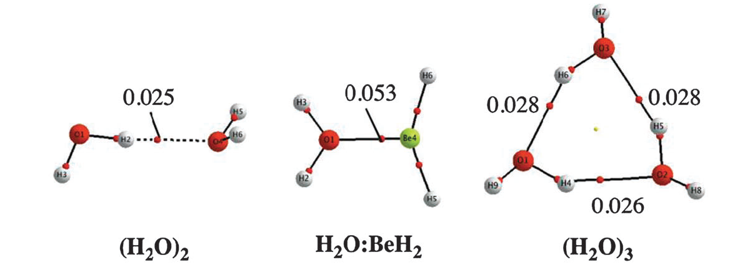
Indeed beryllium bond
Laura Albrecht ª, Russell J. Boyd *ª, Otilia Mó ^{b} and Manuel Yáñez “Cooperativity between hydrogen bonds and beryllium bonds in (H2O)nBeX2 (n = 1–3, X = H, F) complexes. A new perspective”
Phys. Chem. Chem. Phys., 2012, 14, 14540-14547

Slide 51
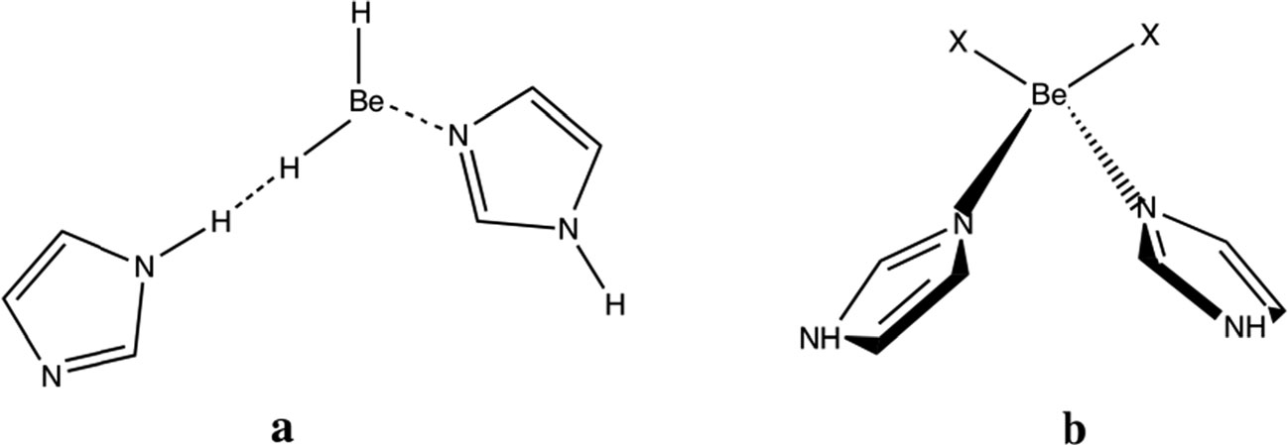
Russel Boyd’s email (Jan 7, 2013)
I am delighted that you found our PCCP paper interesting. I think beryllium bonds are fascinating and I expect they will attract considerable interest in the next few years.
Hydrogen bond replaced by beryllium bond

Slide 52
Conclusions
Structural determination of molecular complexes in the gas phase does provide accurate data.
These have helped in improving our understanding intermolecular interactions that control the behaviour of solid, condensed phase.
Fundamental understanding of hydrogen bonding has resulted by comparing results from gas phase to condensed phase.
Some times the structures agree but when they don’t agree, we learn more.
Hydrogen bond radii applicable to gas and solid phase have been derived.

Slide 53

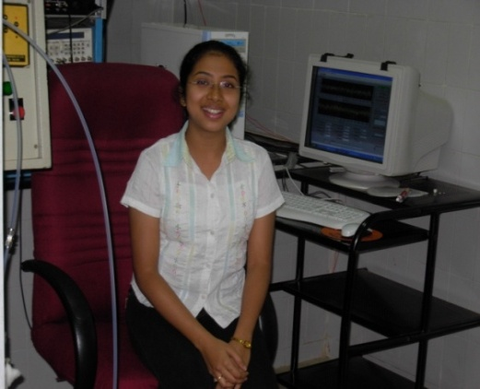
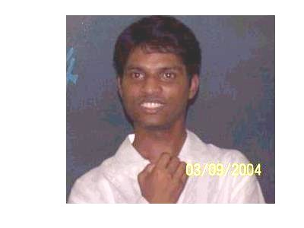

Thanks for listening

