Slide 1

STRUCTURAL AND BIOLOGICAL STUDIES OF SOME CALIX[4]RESORCINARENE
BOHARI M YAMIN
HAMZAM ABODISAYA
AISHAH HASBULLAH
JUMINA

Slide 2
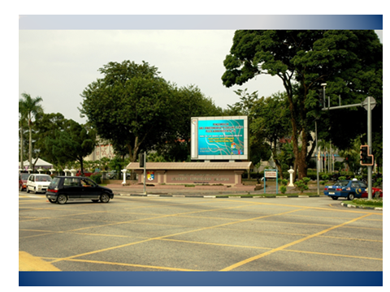
UNIVERSITI KEBANGSAAN MALAYSA

Slide 3
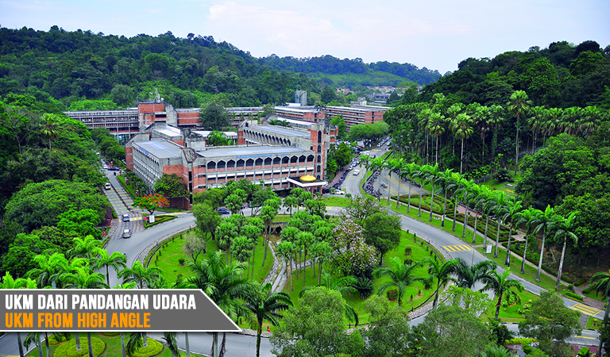

Slide 4
POINTS OF TALK
CALIX[4]RESORCINARENE
STRUCTURAL STUDIES
THERMAL STABILITY
BIOLOGICAL STUDIES

Slide 5
calix[4]resorcinarene

Slide 6
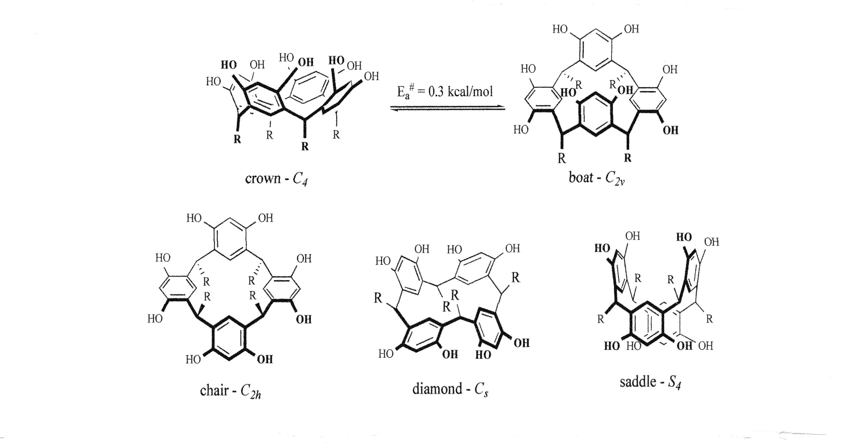
Calix[4]resorcinarenes are not planar but
can exist in a variety of conformations

Slide 7
PROGRESS ON X-RAY STRUCTURAL STUDIES
ON CALIXARENE
FIRST X-RAY STRUCTURE 1968 BY EARDTMAN et al.,
CCDC SEARCH (26TH APRIL 2014) 430 STRUCTURES REPORTED
RATE OF PROGRESS ABOUT 9 STRUCTURES/YEAR
CALIX[4]RESORCINARENE
AROMATIC LINGKAGER ABOUT 10 STRUCTURES REPORTED

Slide 8
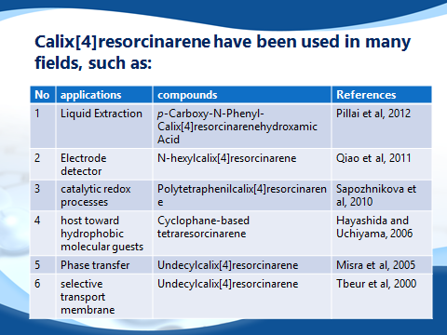

Slide 9
Calix[4]resorcinorene
Where R1= H, OH or CH3
R2= NO2, OH, Br or NH(CO)CH3

Slide 10
we have synthesized and characterized some of calix[4]resorcinarene which listed in the table 1
Calix[4]resorcinarene | Linkages group (R1)
 | 3-nitrophenyl
 | 4-nitrophenyl
 | 4-acetamidophenyl
 | 2- sulfonatephenyl
 | 4-chlorophenyl
 | 4-methoxyphenyl
 | 2-hydroxo-5-bromophenyl
 | 2-hydroxo-3,5-dibromophenyl
 | 3,4,5-Trimethoxyphenyl 3,5-dimethoxy-4-hydroxophenyl
Calix[4]-2-methylresorcinarene | Linkages group (R1)
 | 3-nitrophenyl
 | 4-nitrophenyl
 | 4-acetamidophenyl
 | 2-hydroxo-5-bromophenyl
 | 2-hydroxo-3,5-dibromophenyl
 | 3,4,5-Trimethoxyphenyl 3,5-dimethoxy-4-hydroxophenyl
Calix[4]pyrogallol | Linkages group (R1)
 | 3-nitrophenyl
 | 4-acetamidophenyl
 | 3,4,5-Trimethoxyphenyl
 | 4-nitrophenyl

Slide 11
Recently, we have synthesized and characterized of C-5-bromo-2-hydroxycalix[4]-2-methylresorcinarene

Slide 12
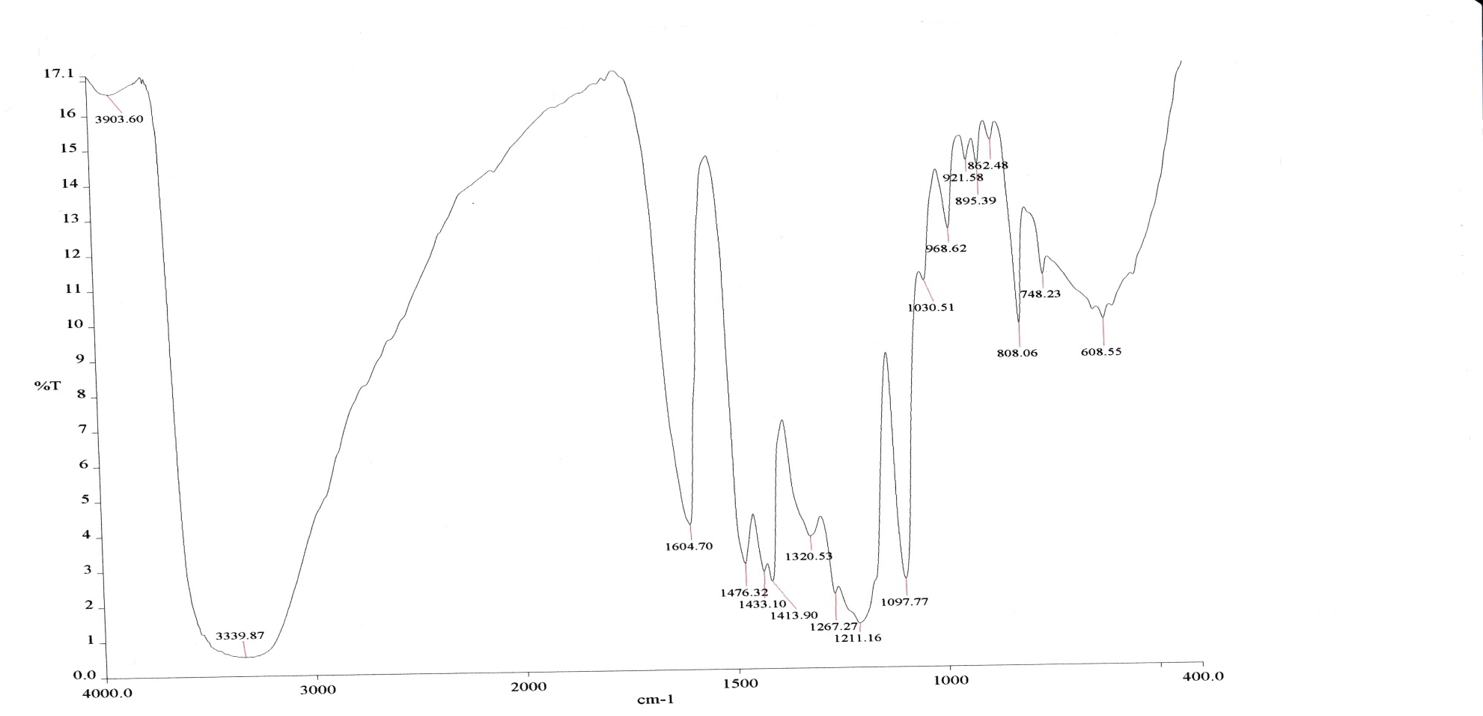
Microelemental analysis CHNS-O data are in agreement with the expected formula of the compound
Anal. Calcd for (molecular formula): C=54.75 and H= 3.61 Found: C, 54.22 and H, 3.59.
Infrared spectra of the compounds
C-Br
C=C
OH

Slide 13
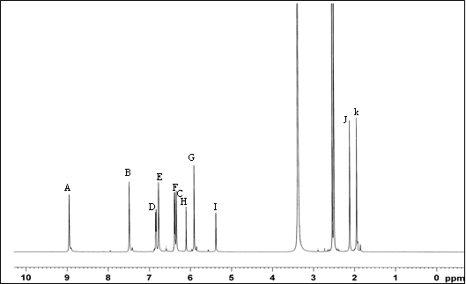
¹H NMR data

Slide 15
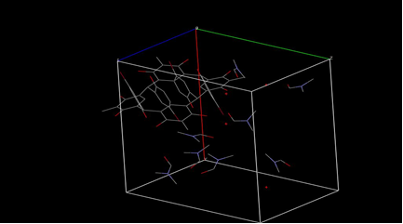
  X-Ray Structure study
  The X-ray investigation showed that C-5-bromo-2-hydroxycalix[4]-2-methylresorcinarene crystallized in DMF possesses a triclinic system with the space group Pī, a= 15.9592(16) Å, b= 16.9417(17) Å, c= 17.0974(17) Å, α =68.656(3)°, β =85.689(3)°, γ =81.631(3)°, Z= 2 and V= 4258.6(7) Å³.
  Asymmetric unit of C-5-bromo-2-hydroxycalix[4]-2-methylresorcinarene

Slide 16
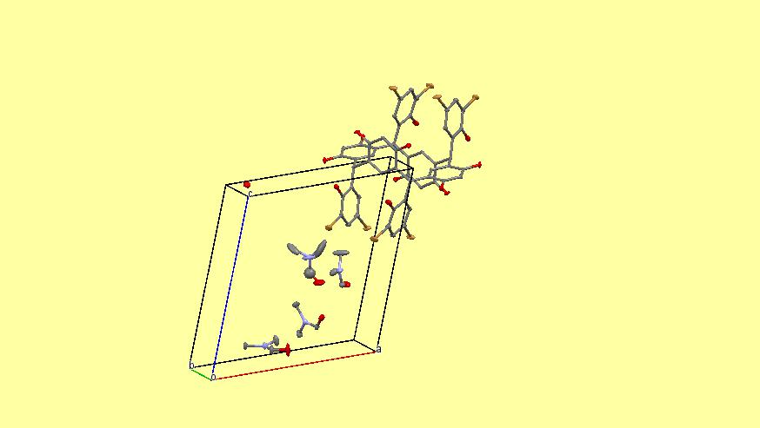
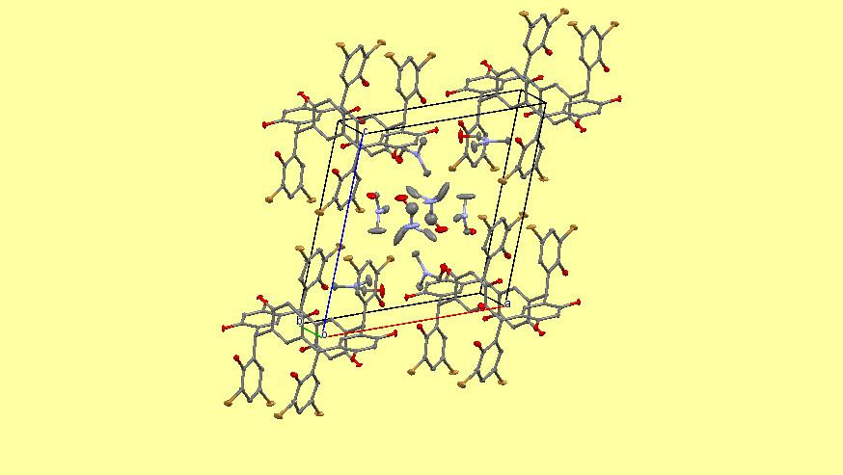
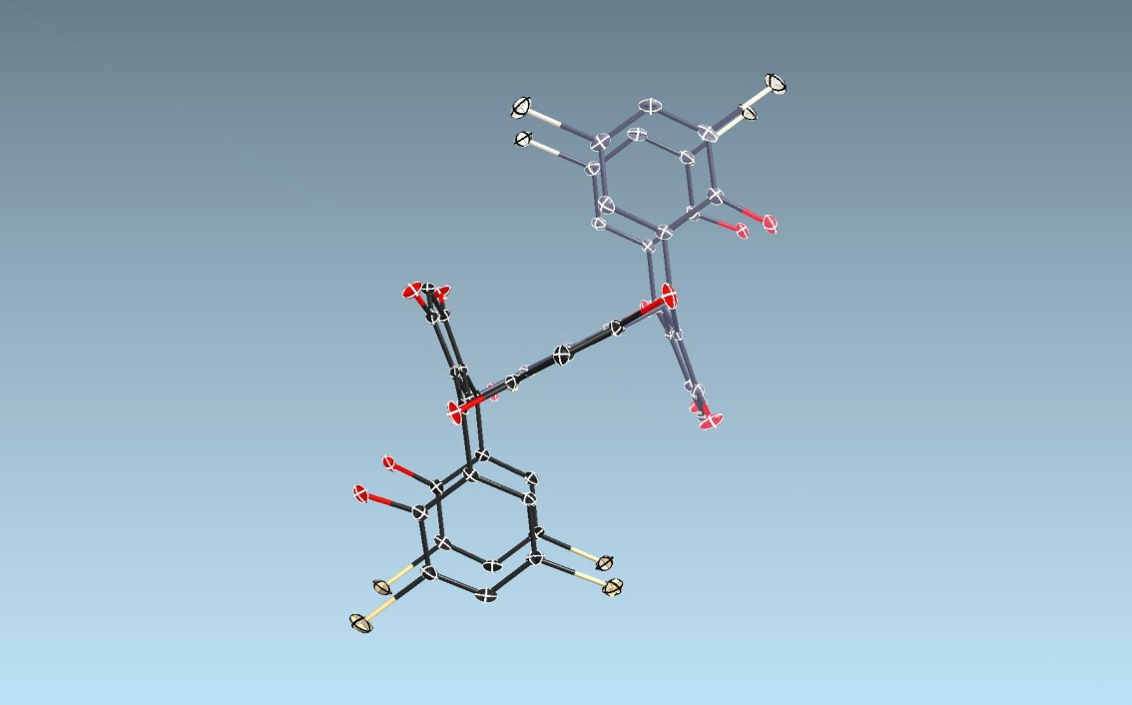
Space group P-1 ,a, b, c 12.9555(4) 13.2342(4) 14.0456(4)
80.862(1) 67.898(1) 80.738(1)
V = 2189.40(11), Z = 1
Asymmetric unit of C-3,5-dibromo-2-hydroxycalix[4]resorcinarene
C76 H92 Br8 N8 O22
C52 H32 Br8 O12, 8(C3 H7 N O), 2(H2 O)

Slide 17
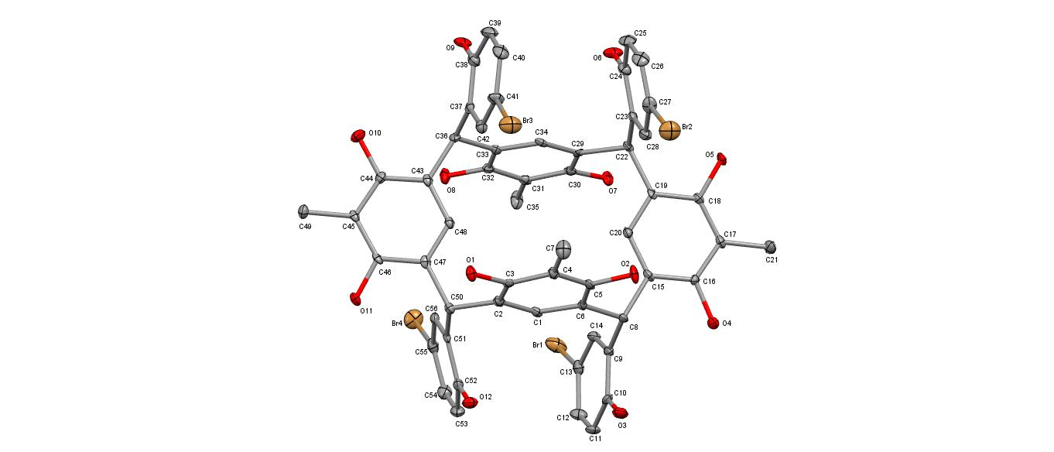
The X-ray study was in agreement with NMR data and the calix molecule adopted chair C_{2h} conformation

Slide 18
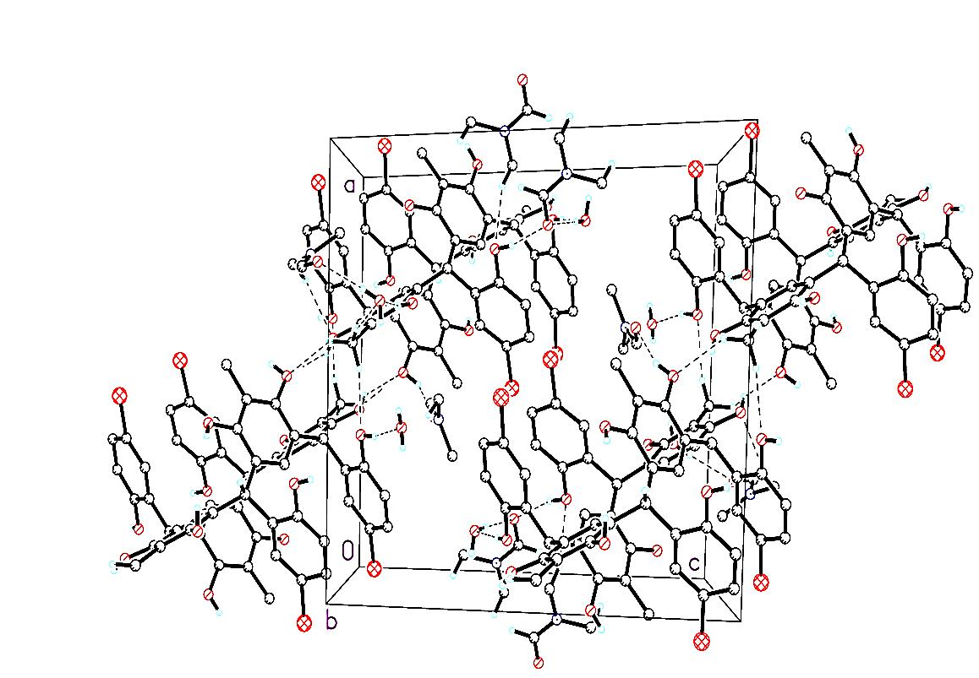
There are intramolecular hydrogen bonds involving the phenolic, DMF and water oxygen atoms). In the crystal structure, the molecule is stabilized by extensive intermolecular hydrogen bonds of O—H…O and C—H…O types connecting the calix(I)

Slide 19
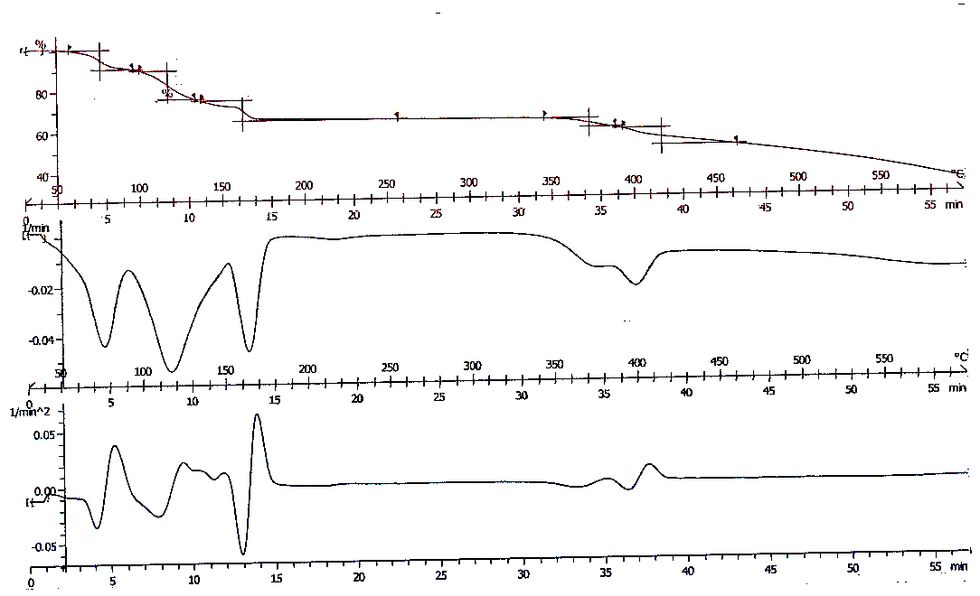
Thermogravimetric study

Slide 20
Biological studies
1-Antioxidant properties
Antioxidant properties by radical scavenging activity are due to transfer of electrons or hydrogen atoms to an oxidizing agent such as DPPH (1,1-diphenyl-2-picryl-hydrazyl) . The antioxidant activity exhibited by compound (I) was 84.9%
= [(1.012-0.1523)/1.012] x 100 = 84.94%
2-Antibacterial activity
Antibacterial activity was determined by the disc diffusion method followed by minimum inhibitory concentration (MIC) and minimum bactericidal concentration (MBC) tests against two Gram negative and three Gram positive bacteria
MRSA= methicillin-resistant Staphylococcus aureus; Sa= Staphylococcus aureus; Ef= Enterococcus faecalis; Ea= Enterobacter aerogenes; Pa= Pseudomonas aeruginosa; a = vancomycin; b= chloramphenicol (30µg).

Slide 21
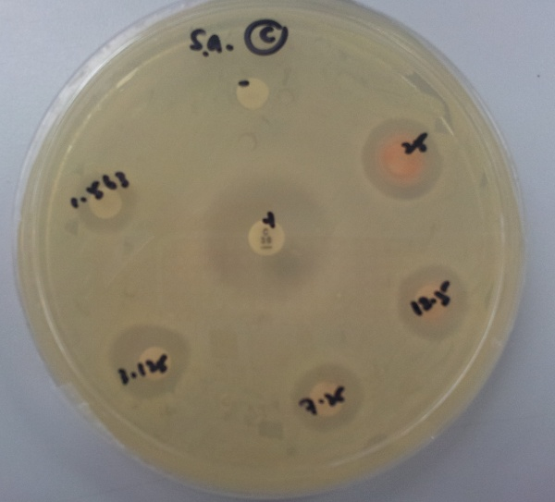
Inhibition zones of C-5-Bromo-2-hydroxophenylcalix[4]2-methylresorcinarene at two fold dilutions against Staphylococcus aureus using the disc diffusion assays
Negative control
25.0 mg/mL
1.563 mg/mL
Positive control
12.5 mg/mL
3.125 mg/mL
6.250mg/mL

Slide 22
Table 4. Diameter of inhibition zone for antibacterial screening of C-5-Bromo-2-hydroxophenylcalix[4]2methylresorcinarene
_________________________________________________________________
Concentration (mg/ mL) Diameter of inhibition zone (mm)
MRSA Sa Ef Ea Pa
__________________________________________________________________
25 13±0.00 13±0.71 15±0.71 6±0.00 6±0.00
12.5 12±1.41 12±0.00 13±0.00 6±0.00 6±0.00
6.25 12±0.71 11±0.00 11±0.71 6±0.00 6±0.00
3.125 11±0.00 11±1.41 11±0.00 6±0.00 6±0.00
1.563 10±0.71 10±1.41 10±0.00 6±0.00 6±0.00
Antibiotic 15a 22b 23b 26b 16b
control
DMSO 6 6 6 6 6 6
(Negative control)
Notes: MRSA= Methicilin Resistant Staphylococcus aureus; Sa= Staphylococcus aureus; Ef= Enterococcus faecalis; Ea= Enterobacter aerogenes; Pa= Pseudomonas aeruginosa; a= vancomycin; b= chloramphenicol

Slide 23
Table 4. Minimum inhibition concentration (MIC) (mg/mL), minimum bactericidal concentration
(MBC) (mg/mL) and selectivity index (SI) of C-5-bromo-2-hydroxophenylcalix[4]-2-methylresorcinarene (I).
Note: MRSA = methicillin-resistant Staphylococcus aureus); Sa = Staphylococcus aureus);
Ef = Enterococcus faecalis; Ea = Enterobacter aerogenes; Pa = Pseudomonas aeruginosa (-ve);
SI = selectivity index = CC₅₀/MIC (refer to section 2.4.3).
Microorganism | MIC mg/mL | MBC mg/mL | SI
MRSA (Gram-positive) | 1.563 | 25 | 0.256
Sa (Gram-positive) | 6.25 | 12.5 | 0.064
Ef (Gram-positive) | 6.25 | 12.5 | 0.064
Ea (Gram-negative) | >25 | - | -
Pa (Gram-negative) | >25 | - | -

Slide 24
Table 5. Minimum inhibition concentration (MIC) (mg/ml), minimum bactericidal concentration (MBC) (mg/ml) and Selectivity Index (SI) of C-5-bromo-2-hydroxophenylcalix[4]2-methylresorcinarene
MIC MBC SI
MRSA 1.563 25 0.256
Sa 6.25 12.5 0.064
Ef 6.25 12.5 0.064
Ea >25 - < 0.016
Pa >25 - < 0.016
Note: MRSA= methicilin resistant Staphylococcus aureus; Sa= Staphylococcus aureus; Ef= Enterococcus faecalis; Ea= Enterobacter aerogenes; Pa= Pseudomonas aeruginosa; - = not determined; SI=selective index
MBC < 2X MIC FOR GRAM(+) CLASSIFIED AS BACTERIACIDAL
MRSA IS SHOWED ACTIVITY EVEN AT LOW CONCENTRATION
SI<10 NOT SUITABLE AS ANTIBAC COMPOUNDS

Slide 25
Percentage of cell survival against concentration of compound C-5-bromo-2-hydroxyphenylcalix[4]-2-methylresorcinarene (I).

Slide 26
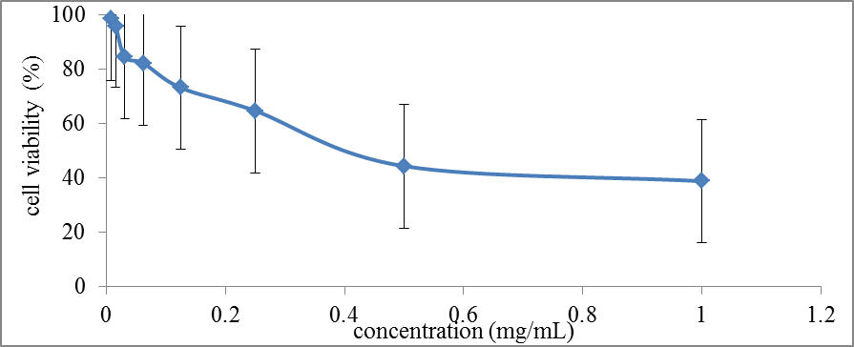
The cytotoxicity test indicated that calix[4] is safe to be used as antimicrobial therapeutic agent due to its non-toxic property to Vero cells with CC₅₀ value of 0.4 mg/mL. According to Zirihi et. al, a test compound is considered toxic if CC₅₀ value is less than 0.02 mg/mL

Slide 27
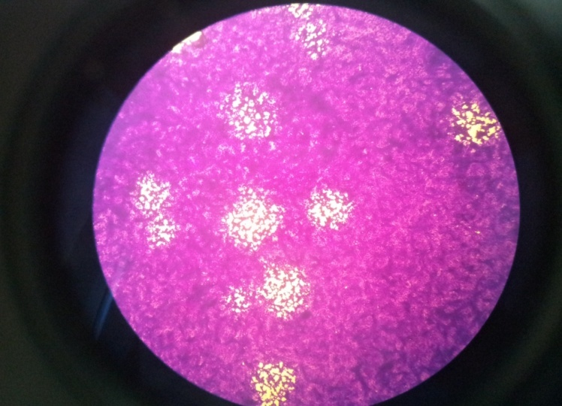
3-Antiviral Activity towards HSV-1
Antiviral test showed that the compound (I) was suitable as an antiviral agents because of its ability to inhibit 100 % plaque formation even at the lowest concentration of 0.011 mg/mL
Plaque formation to determine virus titer

Slide 28
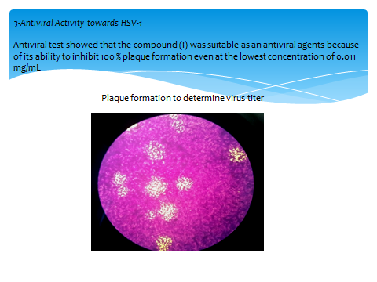
SI= LC50/EC50> 36….. POTENTIAL AS ANTIVIRIAL AGENT

Slide 29
Synthesis, Characterization, X-ray Structure and Biological Activities of C-5-Bromo-2-hydroxyphenylcalix[4]-2-methyl resorcinarene
Hamza M. Abosadiya ¹, Siti Aishah Hasbullah ¹, Mukram Mohamed Mackeen ^{1,2}, Seow Chew Low ³, Nazlina Ibrahim ³, and Bohari M. Yamin ^{1,}*
MOLECULES 2013

Slide 30
Tetra-thiourea derivatives of calix[4]resorcinorene

Slide 31
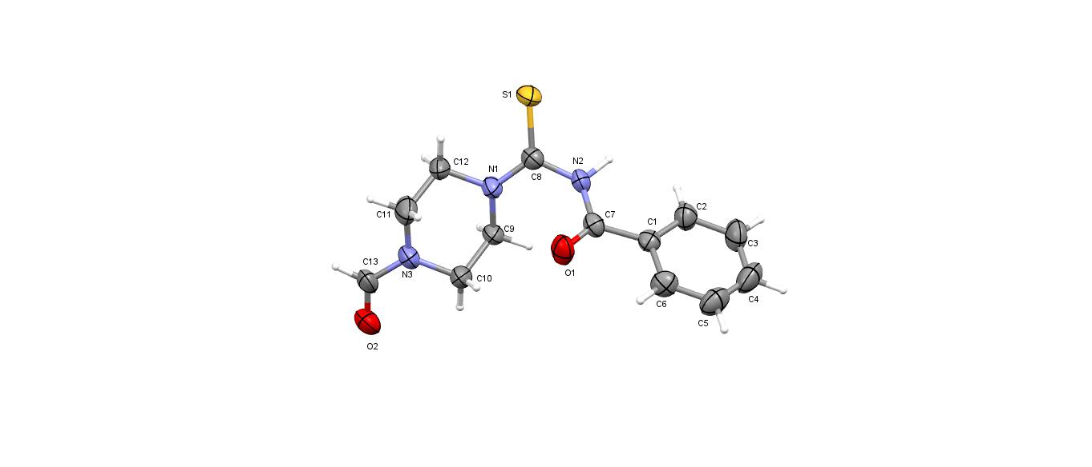
We have successfully synthesized and characterized a new benzoyl thiourea derivatives which has aldehyde group from the reaction
Aldehyde group
Monoclinic system
Unit cell dimensions
a = 7.3198(9) Å α= 103.711(3)°.
b = 7.7553(15) Å β= 102.519(3)°.
c = 13.0490(17) Å γ = 102.381(4)°.
Volume 674.38(18) Å3
Z 2

Slide 32
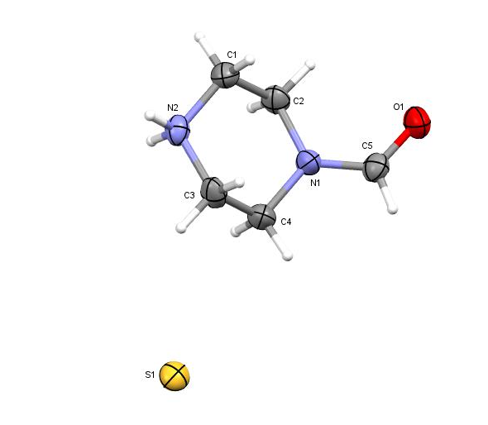
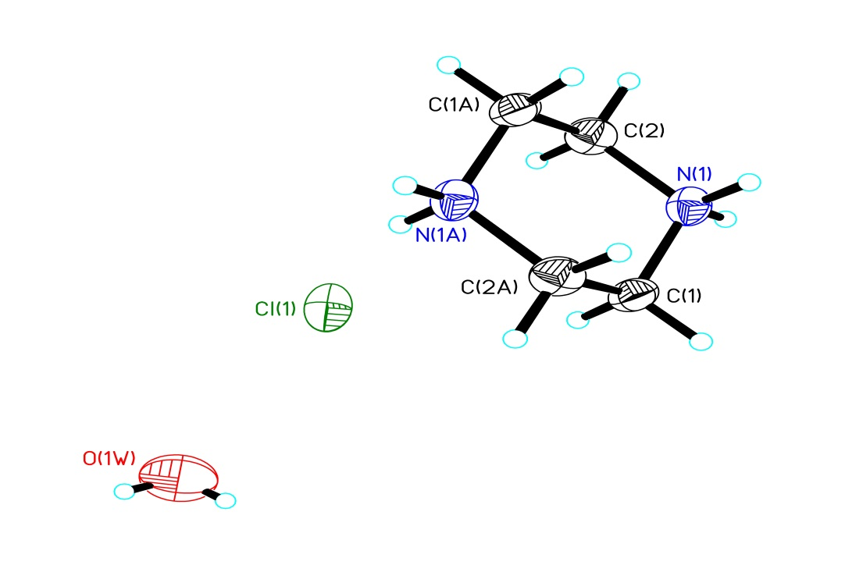
Generally , amine compounds can be protonated by hydrochloric acid that used in the syntheses of calix[4]resorcinorene . Single crystal X-ray investigation showed that the terminal nitrogen atom in Piperazine fragment can easily a protonated from the reaction of preparing thiourea derivatives or from syntheses of calix[4]resorcinorene
Monoclinic system
Unit cell dimensions
a = 10.2092(7) Å a= 90°.
b = 6.3196(4) Å b= 107.619(2)°.
c = 13.5092(11) Å g = 90°.
Volume 830.70(10) Å3
Z 8
Orthorhombic system
Unit cell dimensions
a = 14.0262(11) Å α= 90°.
b = 7.4514(5) Å β= 90°.
c = 6.8982(5) Å γ = 90°.
Volume 720.96(9) Å3
Z 4

Slide 33
ACKNOWLEDGEMENT
UNIVERSITI KEBANGSAAN MALAYSIA
MINISTRY OF EDUCATION FOR FRGS GRANTS
PROF. NAZLINA IBRAHIM
DR.AISAH HASBULLAH
HAMZAH PhD student

Slide 34
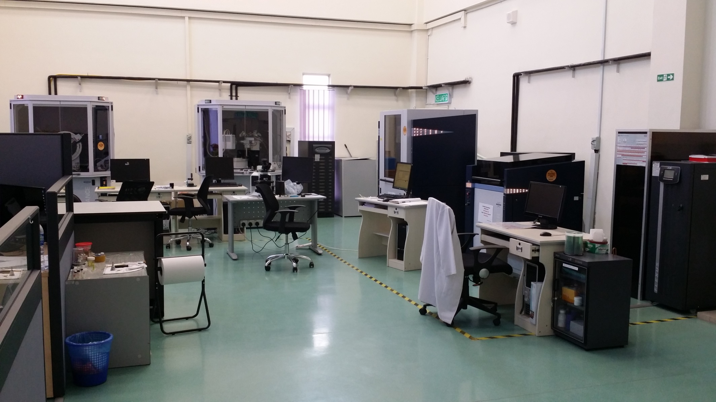

Slide 35


Slide 36


Slide 37
¹H NMR data

Slide 38
Reaction mechanism
.

Slide 39
Synthesis of calix[4]resorcinarene of thiourea derivatives
Where R2=Thiourea derivatives
Figure 4 Calix[4]resorcinarene of thiourea derivatives

Slide 40
Biological studies
1-Antioxidant properties
Antioxidant properties by radical scavenging activity are due to transfer of electrons or hydrogen atoms to an oxidizing agent such as DPPH (1,1-diphenyl-2-picryl-hydrazyl) . The antioxidant activity exhibited by compound (I) was 84.9%
= [(1.012-0.1523)/1.012] x 100 = 84.94%
2-Antibacterial activity
Antibacterial activity was determined by the disc diffusion method followed by minimum inhibitory concentration (MIC) and minimum bactericidal concentration (MBC) tests against two Gram negative and three Gram positive bacteria
MRSA= methicillin-resistant Staphylococcus aureus; Sa= Staphylococcus aureus; Ef= Enterococcus faecalis; Ea= Enterobacter aerogenes; Pa= Pseudomonas aeruginosa; a = vancomycin; b= chloramphenicol (30µg).

Slide 41
  X-Ray Structure study
  The X-ray investigation showed that C-5-bromo-2-hydroxycalix[4]-2-methylresorcinarene crystallized in DMF possesses a triclinic system with the space group Pī, a= 15.9592(16) Å, b= 16.9417(17) Å, c= 17.0974(17) Å, α =68.656(3)°, β =85.689(3)°, γ =81.631(3)°, Z= 2 and V= 4258.6(7) Å³.
  Asymmetric unit of C-5-bromo-2-hydroxycalix[4]-2-methylresorcinarene

Slide 42
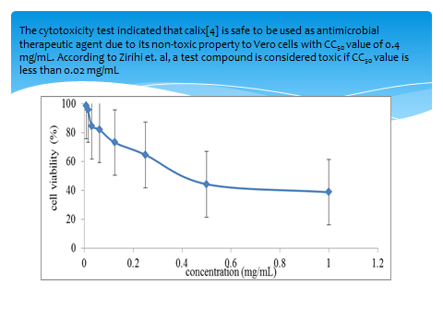

Slide 43
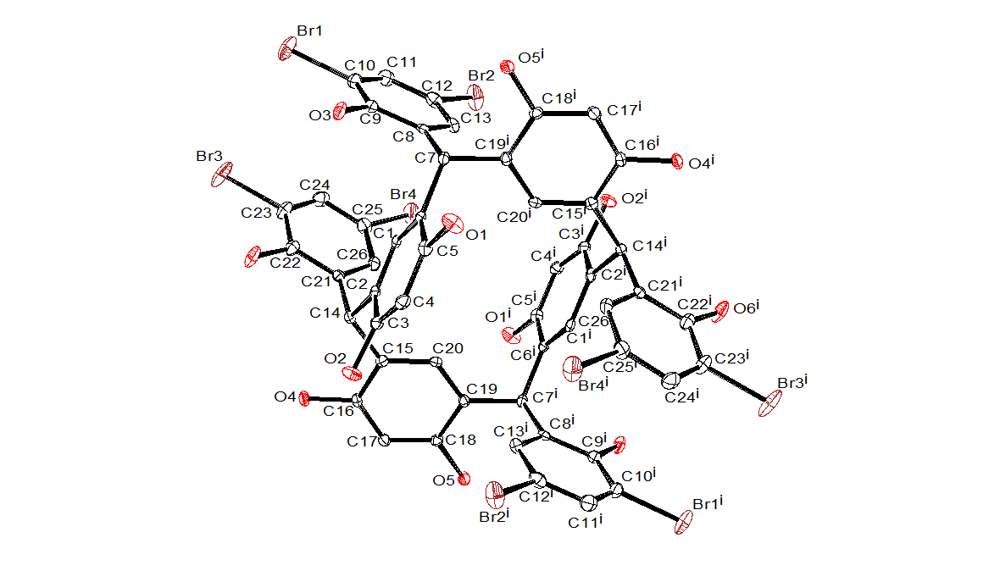
Molecular structure of C-3,5-dibromo-2-hydroxycalix[4]resorcinarene

Slide 44
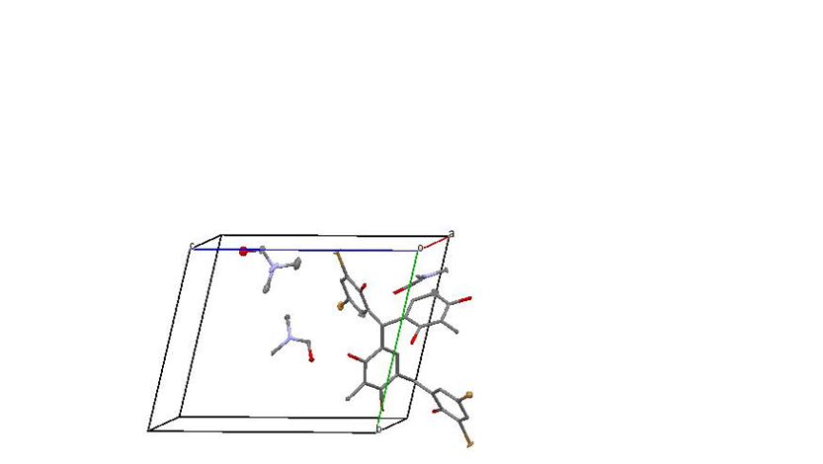
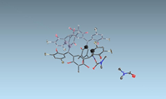
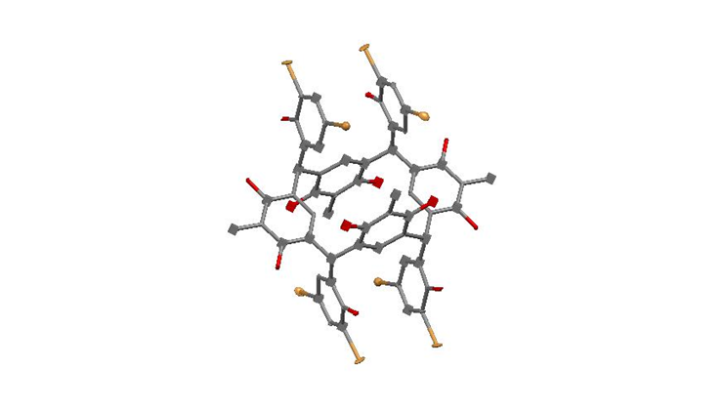
C-(2-hydroxyl-3,5-dibromophenyl)CALIX[4]methylresorcinarene
Crystal system Triclinic, Space group P Ī, a = 11.119(3) Å, b = 13.233(3) Å, c = 15.321(4) Å, α= 68.715(12)°, β= 77.341(14)°, γ = 68.185(13)°, Volume=1940.8(8) Å3, Z=2.

Slide 45
Reaction mechanism
.

Slide 46
Minimum inhibition concentration (MIC) (mg/mL), minimum bactericidal concentration (MBC)
(mg/mL) and selectivity index (SI) of C-5-bromo-2-hydroxophenylcalix[4]-2-methylresorcinarene (I).
Note: MRSA = methicillin-resistant Staphylococcus aureus); Sa = Staphylococcus aureus);
Ef = Enterococcus faecalis; Ea = Enterobacter aerogenes; Pa = Pseudomonas aeruginosa (-ve);
SI = selectivity index = CC₅₀/MIC
Microorganism | MIC mg/mL | MBC mg/mL | SI
MRSA (Gram-positive) | 1.563 | 25 | 0.256
Sa (Gram-positive) | 6.25 | 12.5 | 0.064
Ef (Gram-positive) | 6.25 | 12.5 | 0.064
Ea (Gram-negative) | >25 | - | -
Pa (Gram-negative) | >25 | - | -

Slide 47
Table 3. Diameter of inhibition zone for antibacterial screening of C-5-bromo-2-hydroxy
phenylcalix[4]-2-methylresorcinarene (I).
Notes: MRSA = methicillin-resistant Staphylococcus aureus; Sa = Staphylococcus aureus;
Ef = Enterococcus faecalis; Ea = Enterobacter aerogenes
; Pa = Pseudomonas aeruginosa; a = vancomycin;
b = chloramphenicol (30 µg). SD inhibition zone = ± 1 mm (biological replicates, 3).
Dose (µg) | Diameter of inhibition zone (mm)
 | MRSA | Sa | Ef | Ea | Pa
250 | 13 | 13 | 15 | 6 | 6
125 | 12 | 12 | 13 | 6 | 6
62.5 | 12 | 11 | 11 | 6 | 6
31.25 | 11 | 11 | 11 | 6 | 6
15.63 | 10 | 10 | 10 | 6 | 6
Antibiotic control (30 µg) | 15 ª | 22 ^{b} | 23 ^{b} | 26 ^{b} | 16 ^{b}
DMSO (solvent control) | 6 | 6 | 6 | 6 | 6

