Slide 1
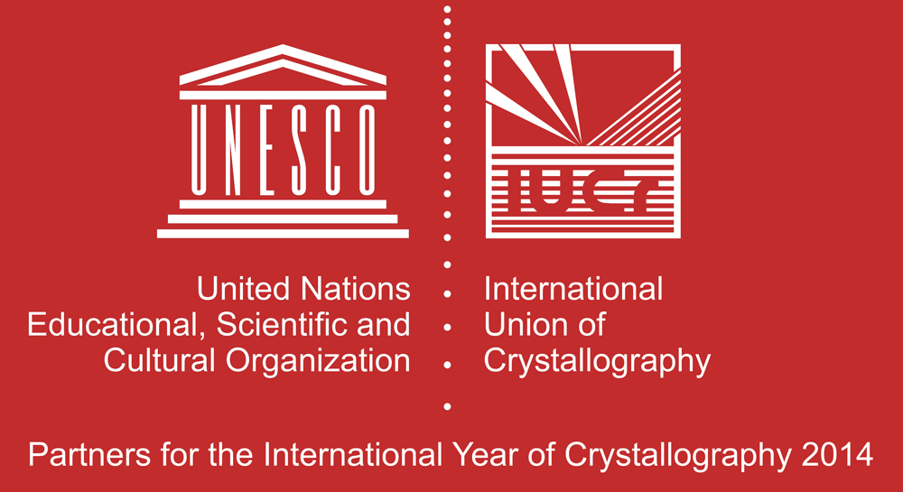
IUCR MEMBERSHIP AND WHAT IT OFFERS

Slide 2
FORMATION OF IUCR
The IUCr became a member of ICSU in April 1947.
Acta Crystallographica was launched in 1948.
The first General Assembly was held in 1948 in Cambridge, USA.
Four founding Adhering Bodies: Canada, Norway, UK, USA
Six Commissions

Slide 3
AIMS
(a) to promote international cooperation in crystallography;
(b) to contribute to the advancement of crystallography in all its aspects, including related topics concerning the non-crystalline states;
(c) to facilitate international standardization of methods, of units, of nomenclature and of symbols used in crystallography;
(d) to form a focus for the relations of crystallography to other sciences.

Slide 4
1951 GA – STOCKHOLM, SWEDEN
MEMBERSHIP GROWS
Australia France South Africa
Belgium India Spain
Brazil Italy Sweden
Canada Japan Switzerland
Czechoslovakia Netherlands UK
Denmark Norway USA

Slide 5
1978 GA – WARSAW, POLAND
32 ADHERING BODIES
Argentina
Australia
Austria
Belgium
Brazil
Canada
Chile
China, PR
Czechoslovakia
Denmark
Egypt
Finland
France
Germany, DR
Germany, FR
Hungary
India
Israel
Italy
Japan
Netherlands
New Zealand
Norway
Poland
South Africa
Spain
Sweden
Switzerland
UK
USA
USSR
Yugoslavia

Slide 6
2014 – 42 Adhering Bodies representing
51 countries
Argentina
Consejo Nacional de Investigaciones Cientificas y Tecnicas
Australia
Australian Academy of Science
Austria
Österreichische Akademie der Wissenschaften
Belgium
Académie Royale des Sciences, des Lettres et des Beaux-Arts de Belgique
Brazil
Brazilian Crystallographic Association
Bulgaria
Bulgarian Crystallographic Association
Canada
National Research Council
Chile
Comision Nacional de Investigacion Cientifica y Tecnologia
China, People's Republic of
Chinese Association for Science and Technology
China, Taipei
The Academy of Sciences Located in Taipei
Croatia
Croatian Crystallographic Association (under the auspices of the Croatian Academy of Science and Arts)
Czech and Slovak Republics
Regional Committee of Czech and Slovak Crystallographers
Denmark
Royal Danish Academy of Sciences and Letters
Egypt, Arab Republic of
Academy of Scientific Research and Technology
Finland
Suomen Tiedeakatemiain Valtuuskunta
France
Académie des Sciences (Institut de France)
Germany
Deutsche Gesellschaft für Kristallographie
Greece
Hellenic Crystallographic Association
Hungary
Magyar Tudományos Akadémia
India
Indian National Science Academy
Ireland, Republic of
Irish Crystallographic Association
Israel
Israel Academy of Sciences and Humanities
Italy
Consiglio Nazionale delle Ricerche
Japan
Science Council of Japan
Korea, Republic of
Korean Crystallographic Association
Mexico
Consejo Nacional de Ciencia y Tecnologia
Netherlands
The Dutch Association for Crystallography (NVK)
New Zealand
The Royal Society of New Zealand
Norway
Det Norske Videnskaps-Akademi
Poland
Polska Akademia Nauk
Portugal
Sociedade Portuguesa de Fisica
Regional Committee – AsCA
RC of Crystallographers from Bangladesh, Malaysia, Singapore, Thailand and Vietnam
Regional Committee – ECA
RC of Crystallographers from Algeria, Latvia, Morocco, Tunisia, Turkey and Ukraine
Russia
Russian Academy of Sciences
Serbia
Serbian Ministry for Science and Technology
Slovenia
Slovenian Ministry of Science and Technology
South Africa
National Research Foundation
Spain
Subdireccion General de Organismos y Programas Internacionales, Ministerio de Ciencia y Tecnologia
Sweden
Kungliga Vetenskapsakademien
Switzerland
Schweizerische Gesellschaft für Kristallographie
UK
The British Crystallographic Association
USA
National Academy of Sciences - National Research Council

Slide 7
STRUCTURE
ADHERING BODIES
COMMISSIONS
REPRESENTATIVES
GA
EXECUTIVE COMMITTEE
FINANCE COMMITTEE
UNION CALENDAR (MEETINGS)
COMCIFS
IUCR/OUP BOOK SERIES
CHESTER OFFICE

Slide 8
HOW DOES THE UNION FULFILL ITS AIMS?
Through its interactions with Other Scientific Associations and Bodies
Through its Commissions
Through its publications

Slide 9
ASSOCIATIONS AND OTHER BODIES
to promote international cooperation in crystallography
Regional Associates
Scientific Associates
Representatives on other bodies

Slide 10
REGIONAL ASSOCIATES
to promote international cooperation in crystallography
European Crystallographic Association (ECA) (1978)
Asian Crystallographic Association (AsCA) (1987)
American Crystallographic Association (ACA) (1990)
Latin-American Crystallographic Association (LACA)
(2014)?

Slide 11
SCIENTIFIC ASSOCIATES
to promote international cooperation in crystallography
International Centre for Diffraction Data (ICDD)
International Organization for Crystal Growth (IOCG)

Slide 12
OTHER BODIES
to facilitate international standardization of methods, of units, of nomenclature and of symbols used in crystallography
Interdivisional Committee on Terminology, Nomenclature and Standards (IUPAC–ICTNS)
International Council for Scientific and Technical Information (ICSTI)
ICSU Committee on Data for Science and Technology (CODATA)
International Standards Organization (ISO)

Slide 13
OTHER BODIES
to form a focus for the relations of crystallography to other sciences
International Council for Science (ICSU)
ICSU Committee on Space Research (COSPAR)

Slide 14
NON-PUBLISHING COMMISSIONS
Aperiodic crystals
Biological macromolecules
Charge, spin and momentum densities
Crystal growth and characterization of materials
Crystallographic computing
Crystallographic nomenclature
Crystallographic teaching
Crystallography in art and cultural heritage
Crystallography of materials (ad interim)
Electron crystallography
High pressure
Inorganic and mineral structures
Magnetic structures
Mathematical and theoretical crystallography
Neutron scattering
Powder diffraction
Small-angle scattering
Structural chemistry
Synchrotron radiation
XAFS
NMR ?

Slide 15
PUBLICATIONS
International Tables for Crystallography
Journals
IUCr/OUP Book Series

Slide 16
HOW IS THE UNION ABLE TO CARRY OUT ITS GOOD WORKS?
The IUCr is a not-for-profit organization with 25 staff
Income from three main sources:
  Membership subscriptions (4%)
  Investment income (2.5%)
  Publications (93.5%)

Slide 17
Good works
Sponsorship of meetings
Visiting professorships
Inter-regional bursaries
Crystallography in Africa, and beyond . . .
Senior scientists
IUCr Newsletter
World Directory of Crystallographers
International Year of Crystallography

Slide 18
102 MEETINGS IN 34 COUNTRIES SUPPORTED SINCE 2011
Argentina
Australia
Brazil
China
Colombia
Costa Rica
Croatia
Cuba
Egypt
France
Germany
Greece
India
Italy
Japan
Morocco
Norway
Philippines
Poland
Portugal
Romania
Russia
Senegal
Serbia
Slovakia
South Africa
Spain
Sweden
Switzerland
Tunisia
UK
USA
Uruguay
Zimbabwe

Slide 19
MEETINGS SUPPORTED IN ASIA/AUSTRALASIA IN 2011
Improving the Data Quality and Quantity for XAFS Experiments, Tsukuba, Japan
Workshop on Crystallographic Software, Tokyo, Japan
Workshop on Mathematical Crystallography, Manila, Philippines

Slide 20
MEETINGS SUPPORTED IN ASIA/AUSTRALASIA IN 2012
Sagamore XVII – Great Potentials from Advanced Probes, Hokkaido, Japan
International Workshop on New Developments of Methods and Software for Protein Crystallography, Xi’An, People’s Republic of China
Aperiodic 2012, Cairns, Australia
Advances in Crystallography at High Pressure, Mito, Japan
Fifth K.H. Kuo Summer School of Electron Microscopy and International Crystallography Workshop of Cryo Electron Microscopy and Tomography, Hefei, People’s Republic of China
AsCA ‘12/CRYSTAL 28, Adelaide Australia

Slide 21
MEETINGS SUPPORTED IN ASIA/AUSTRALASIA IN 2013
Biomolecular Forms and Functions: A Celebration of 50 Years of the Ramachandran Map, Bangalore, India
International Conference on Structural Genomics 2013 – Structural Life Science, Hokkaido, Japan
AsCA ‘13, Hong Kong, People’s Republic of China
Australasian Course in Macromolecular Crystallization 2013, Melbourne, Australia

Slide 22
MEETINGS SUPPORTED IN ASIA/AUSTRALASIA IN 2014
Quantum Materials, Beijing, People’s Republic of China
Symmetry Relationships Between Crystal Structures with Application to Structural Phase Transitions, Varanasi, India
(Another 4 meetings are currently under consideration – in India, Indonesia and People’s Republic of China)

Slide 23
VISITING PROFESSORSHIPS AWARDED SINCE 2011
Argentina
Brazil
Costa Rica
Cuba
India
Morocco
Philippines
Romania
Russia
Serbia
South Africa
Uruguay
Zimbabwe

Slide 24
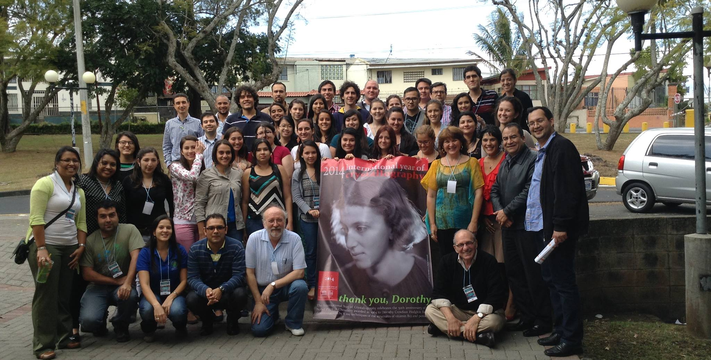
COSTA RICA SCHOOL OF CRYSTALLIZATION AND POLYMORPHISM 2014 – YOUNG SCIENTIST SUPPORT AND TWO VPs

Slide 25
19 INTER-REGIONAL BURSARIES
SINCE 2012
ACA Annual Meetings
  12 young scientists from Africa, Asia, Europe and Latin America have been supported
AsCA Annual meetings
  3 young scientists from Europe have been supported
ECA Annual Meetings
  4 young scientists from Asia and USA have been supported

Slide 26
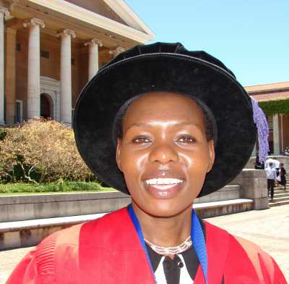
VIEWS OF RECIPIENTS
Serah Kimani (South Africa)
What attracted me most to this year’s ACA meeting was the good coverage of my area of interest in the program –talks and posters in these sections did not disappoint. I gained valuable knowledge on approaches and methods that I will apply in my research going forward.
I’m glad to have participated in the ACA 2012 meeting, and it’s all thanks to the IUCr travel bursary that made my trip from Cape Town to Boston possible. Thank you!

Slide 27
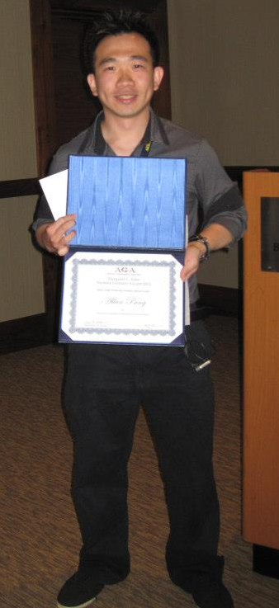
VIEWS OF RECIPIENTS
Allan Hung Pang (UK)
As a first timer, I was really quite worried and
feel a bit lost, but fortunately, the people in the
conference were very nice and made me feel
relaxed very quickly;
Overall, it was such a great opportunity to meet new people, to learn what other people’s research was about,and what they thought about my project (and their suggestions), to find out new ideas and, most important of all, to step out of the four corners of the lab and be a scientist who can and has the ability to relay things to others. It was a very pleasant experience and I am looking forward to more conferences.

Slide 28
CRYSTALLOGRAPHY IN AFRICA
The Executive Committee is keen to promote crystallography in developing regions. In particular, it has established a small Committee to manage the Crystallography in Africa initiative [C. Lecomte (Chair), L. Van Meervelt, D. Billing, A. Roodt, A. Thalal].
Lecture series and Schools
Equipment
Bursaries

Slide 29
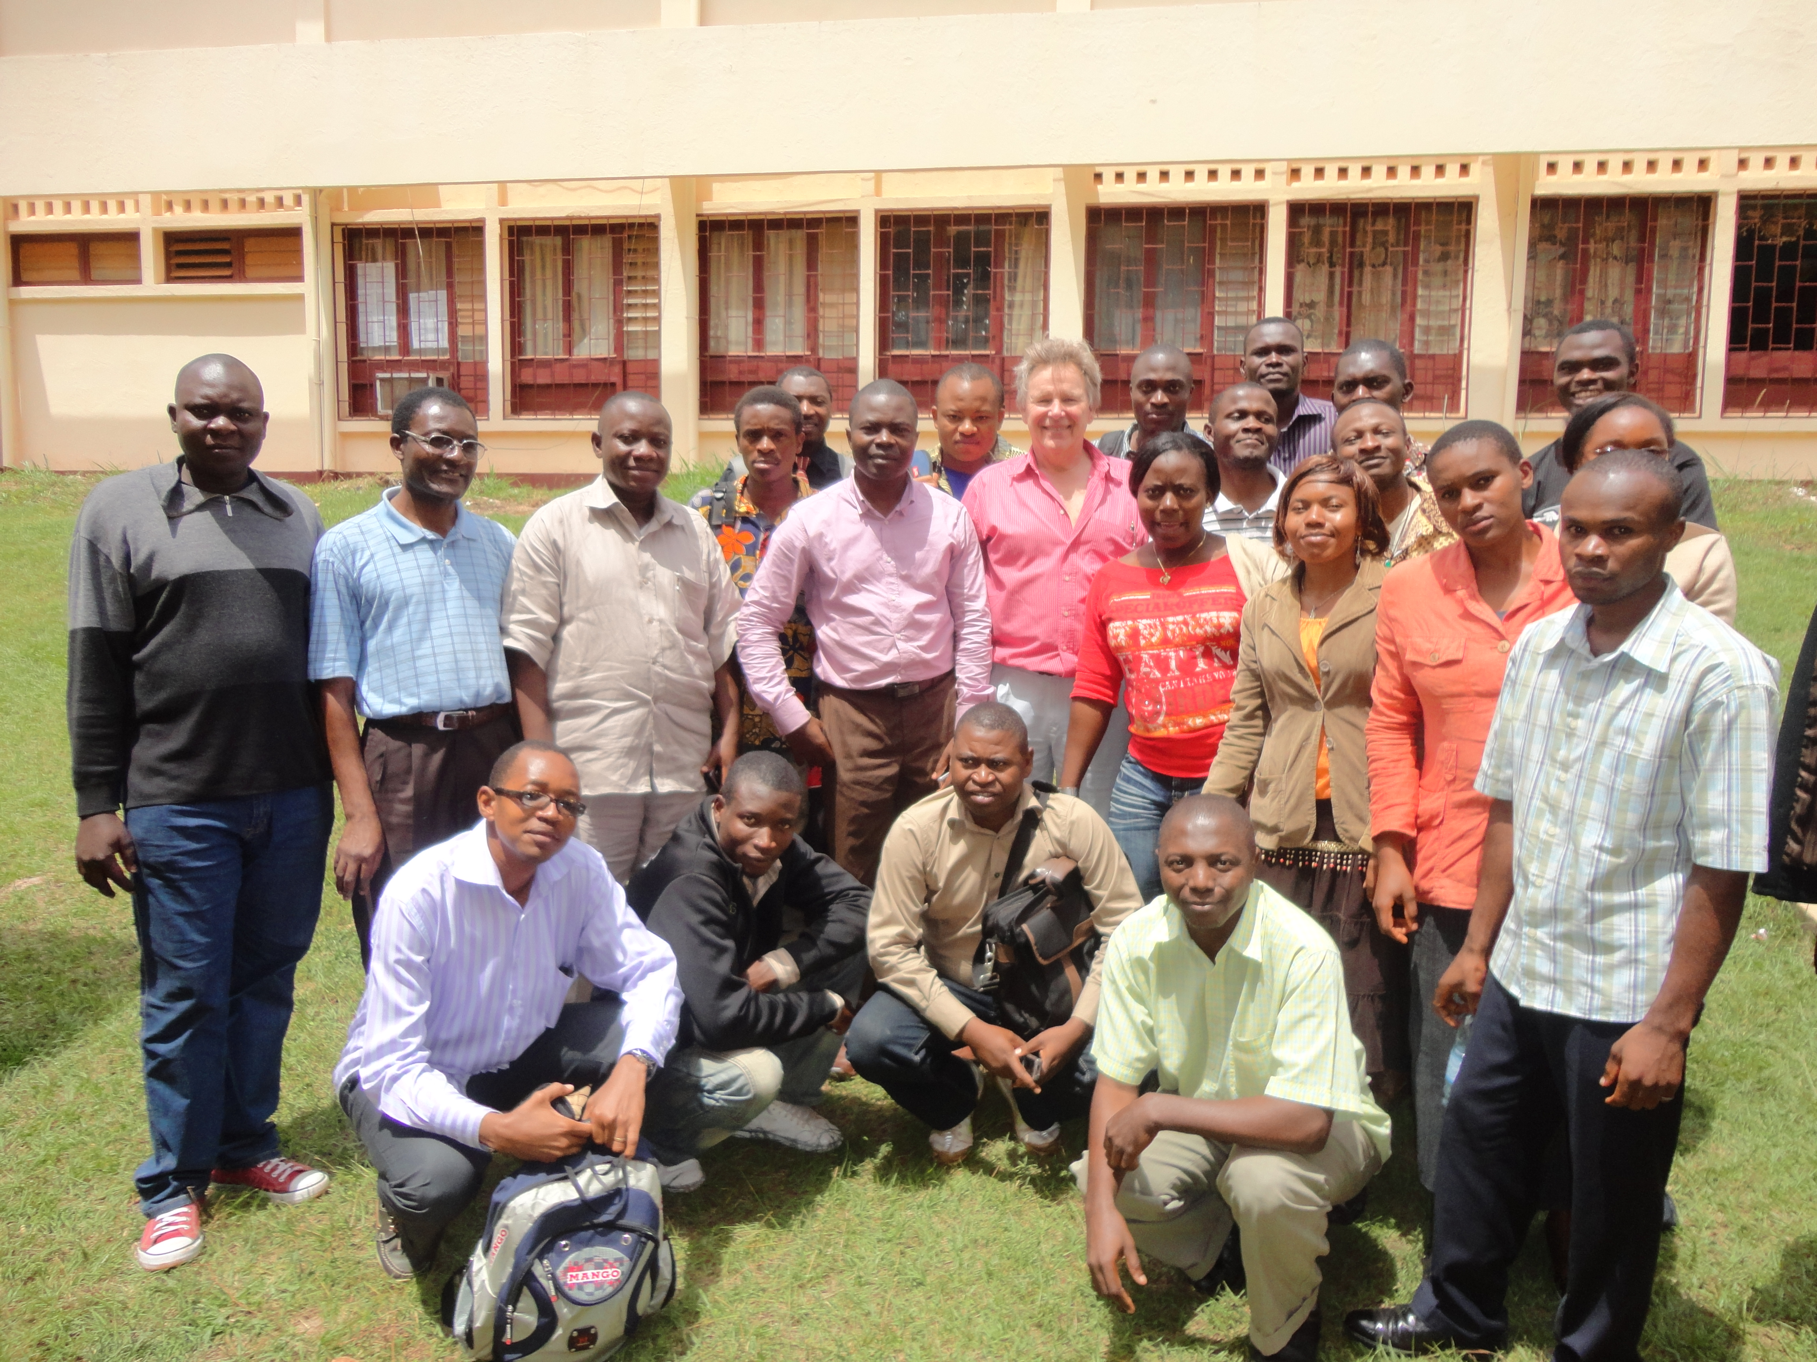
AFRICA – LECTURE SERIES AND SCHOOLS
Lecture series and schools on general crystallography have been held in various countries (for example, Cameroon, Congo, Ivory Coast, South Africa). The host pays
the accommodation costs and
the IUCr pays the travel costs
for one lecturer and also
Contributes towards the travel
costs of other African professors
coming to attend the course from
other universities.

Slide 30
AFRICA – EQUIPMENT
Diffractometer manufacturers have supplied powder and single-crystal diffractometers free of charge. The IUCr pays the shipping costs and the recipient Universities undertake to ensure their successful installation. Schools are organized at these locations following the installation.

Slide 31
AFRICA – BURSARIES
Bursaries are available to African students to enable them to attend regional meetings and the IUCr Congress.

Slide 32
AFRICA AND BEYOND . . .
The Crystallography in Africa initiative has proved successful and the Executive Committee will consider extending this to Latin America and Asia. The needs of the different regions are, of course, different.

Slide 33
IUCR NEWSLETTER/WORLD DIRECTORY OF CRYSTALLOGRAPHERS
The IUCr Newsletter is subsidized by the IUCr and distributed electronically to 12,000 crystallographers and other interested individuals in 102 countries.
The electronic mailing list is based on the World Directory of Crystallographers and this will prove a valuable way to inform recipients of news and developments within the IUCr and its journals

Slide 34
HOW TO BECOME A MEMBER
Membership provides an opportunity to play a part in all the activities of the Union and join a friendly active community.
Membership is straightforward!
In order to apply for membership you will need to specify:
the Adhering Body (which undertakes to pay the subscription);
the membership of the National Committee for
Crystallography;
the category of adherence.

Slide 35
HOW TO JOIN – AS PART OF A REGIONAL COMMITTEE
Membership as part of a Regional Committee is a good way for smaller countries to join.
At present there are three Regional Committees:
The Regional Committee of Czech/Slovak Crystallographers
The Regional Committee of Crystallographers from Bangladesh, Malaysia, Singapore, Thailand and Vietnam
The Regional Committee of Crystallographers from Algeria, Latvia, Morocco, Tunisia, Turkey and Ukraine

Slide 36
WEB SITES
Details of all IUCr activities (including a photographic archive)may be found at the IUCr web sites
www.iucr.org
and
www.iycr2014.org
For any questions about membership, I will be very pleased to help:
execsec@iucr.org

Slide 37
FINALLY . . .
None of the good work of the Union could be undertaken without the IUCr journals – a dedicated team of editors and the Chester staff ensure that the publications are at the forefront of modern publishing and that the contents are of the highest calibre.
Present and continuing developments (including the new journal IUCrJ) are aimed to ensure that you will have a good experience when you come to the IUCr as an author or as a reader!
Income from publications provides 93.5% of Union income

