Slide 1



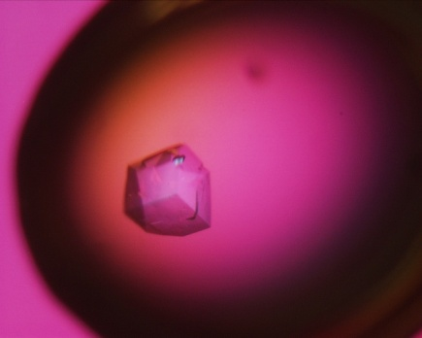
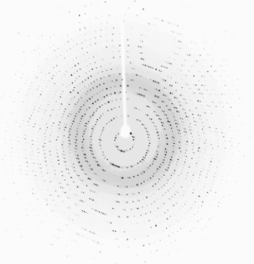
Characterization and Crystal Structure Determination of a Papain-like Cysteine Protease from the Bulbs of Crocus sativus
Dr. Sadaf Iqbal
DR. PANJWANI CENTER FOR MOLECULAR MEDICINE AND DRUG RESEARCH,
INTERNATIONAL CENTER FOR CHEMICAL AND BIOLOGICAL SCIENCES,
UNIVERSITY OF KARACHI

Slide 2
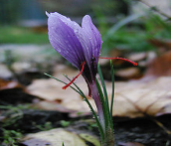
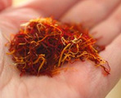
Crocus sativus - Introduction
Scientific classification
Kingdom: | Plantae
(unranked): | Angiosperms
(unranked): | Monocots
Order: | Asparagales
Family: | Iridaceae
Genus: | Crocus
Species: | C. sativus
Crocus sativus, commonly known as saffron crocus, well known because of its mineral content and essential vitamins
Crocus sativus is best known for the spice saffron, which is produced from parts of the plant's flowers
Saffron spice contain medicinal properties like anticarcinogenic (cancer-suppressing), anti-mutagenic (mutation-preventing), immunomodulating, and antioxidant
C. sativus blossom with crimson stigmas
Saffron, dried C. sativus threads

Slide 3
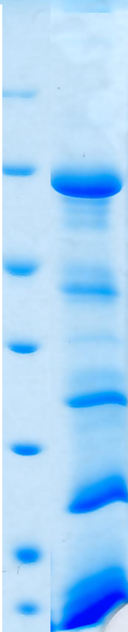
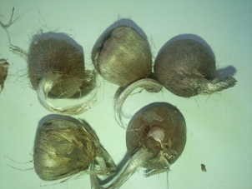
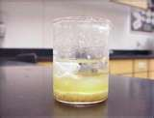
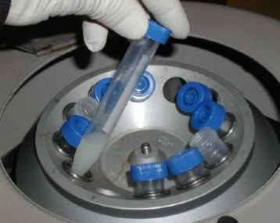
Extraction of 22 kDa Protein
Protein profile of plant extract
Bulbs
Homogenized extract
Centrifugation
M
97
66
45
35
25
18
14
10 g bulbs in 25 mL extraction buffer
Grinding & Stirring at 4°C for 4 hrs in Acetate pH 5.5 of 50 mM Strength
Filtration of the supernatant using series of filter papers & finally by 0.22 µm filter

Slide 4

Single Step Purification of 22 kDa Protein
Size Exclusion Chromatography buffer: 50 mM Sodium Acetate pH 5.5 + 150 mM NaCl

Slide 5
Characterization of 22 kDa Protein
In the Coomassie stained gel, the 22 kDa band was cut down, and the protein was reduced with DTT (10 mM, 56 °C, 30 min.).
For mass spectrometry, the protein in-gel digestion was performed with 5 ng/µl trypsin (Promega, Madison, USA) in 50 mM NH₄HCO₃, at 37 °C for 16 hrs.
After digestion, the gel pieces were repeatedly extracted in 50% acetonitrile / 5% formic acid solution and the combined fractions were dried in a vacuum concentrator. The concentrate was re-dissolved in 5% methanol / 5% formic acid solution, desalted on a C18 µZipTip (Millipore, Billerica, USA), eluted with 1 µL 60% methanol / 5% formic acid mixture and analyzed by nano-eletrospray mass spectrometry technique in a QTOF II instrument (Micromass, Manchester, UK).
MS/MS spectra obtained were evaluated by the Mascot web server
* Fragments by Mass Spectrometry
LSDGGLASDADYPYTGLK
WVLSDGGLASDADYPYTGLCLTWK
QPDQTGALEGLNALTTGR
FQTQLEGLNALTTGR
EPSVSEQQLVDCHTGSSGCQNDANDAFR
* Mass spectrometric characterization was performed by Dr. Friedrich Buck in UKE University Hamburg Germany

Slide 6
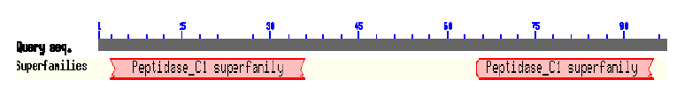
Identification of Papain-like Cysteine Protease
* Fragments by Mass Spectrometry
LSDGGLASDADYPYTGLK
WVLSDGGLASDADYPYTGLCLTWK
QPDQTGALEGLNALTTGR
FQTQLEGLNALTTGR
EPSVSEQQLVDCHTGSSGCQNDANDAFR
Blast in PDB
40% sequence similarity with the PDB-ID: 2B1M (Pachyrhizus erosus cysteine protease)
CSCP -QPD--------------------------QTGALEGLNALTTGREPSVSEQQLVDCHTG 33
2B1M DAPESWDWSKKGVITKVKFQGQCGSGWAFSATGAIEAAHAIATGNLVSLSEQELIDCVDE 60
*: ***:*. :*::**. *:***:*:**
CSCP SSGCQNDAN-DAFRWVLSDGGLASDADYPYT---GLCLTWK------------------- 70
2B1M SEGCYNGWHYQSFEWVVKHGGIASEADYPYKARDGKCKANEIQDKVTIDNYGVQILSNES 120
*.** *. : ::*.**:..**:**:*****. * * : :

Slide 7
Characterization: Activity Profiling
Protease Fluorescent Detection Kit: (Sigma cat # PF0100)
Leu – Leupeptin
CI – Calpain I
CII – Calpain II
E-64 – specific inhibitor of cysteine proteases
Chy - Chymostatin

Slide 8
Uses of Papain-like Cysteine Proteases
Cysteine Proteases are an efficient choice for the pharmaceutical, medicinal, and food industries because of their broad substrate specificity as well as activity over wide range of pH, and temperature
Papain-like Cysteine Proteases utilize in breaking down tough meat fibers, the protein toxins in the venom, used to dissociate cells for cell culture preparations, in the care of some chronic wounds to clean up dead tissue, etc
In plants, their roles are diverse, at one side in growth and development and at the other in senescence, degradation and mobilization of storage proteins

Slide 9
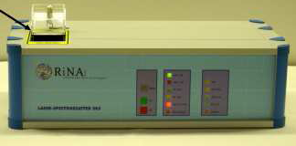
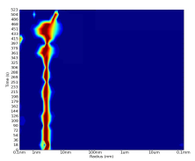
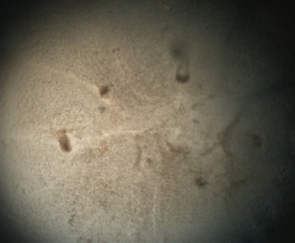
Quality Tests for Crocus sativus Cysteine Protease (CsCP)
Protein in its pure monomeric state or whatever its natural state (Monodisperse)
PCT (Pre-Crystallization Test) performed in A1, A2, B1, B2 conditions
A1 - 0.1 M TRIS hydrochloride pH 8.5, 2.0 M Ammonium sulfate
B1 - 0.1 M TRIS hydrochloride pH 8.5, 1.0 M Ammonium sulfate
A2 - 0.1 M TRIS hydrochloride pH 8.5, 0.2 M Magnesium chloride hexahydrate, 30% w/v Polyethylene glycol 4,000
B2 - 0.1 M TRIS hydrochloride pH 8.5, 0.2 M Magnesium chloride hexahydrate, 15% w/v Polyethylene glycol 4,000
Spectroscattter 201 system, (Molecular Dimensions, England)
Dynamic Light Scattering (DLS) showed single line for monodispersive Cysteine Protease solution
Granular Precipitate in A2 condition at 25 mg/mL concentration of Cysteine Protease by nanodrop

Slide 10
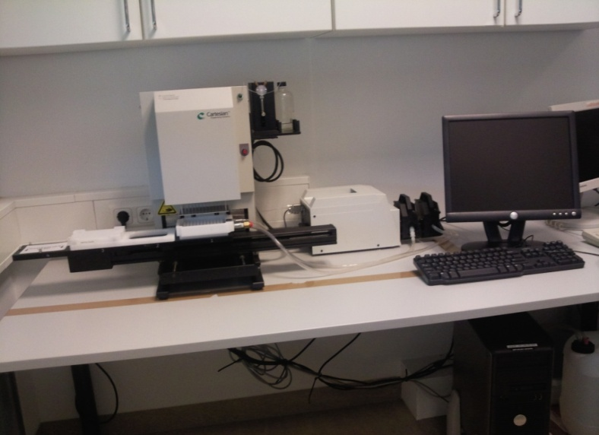
Robotic Screening of Crocus sativus Cysteine Protease (CsCP)
The main advantage is the small sample size (300 nL protein drop), a crystallization robot handle the sample by maintaining reproducibility
QIAGEN master blocks classic, compass, cryo, and JCSG were used to set up 400 pre-formulated random conditions
96-well crystallization plates (NeXtal QIA1 mplates, Qiagen) were used
Honeybee 961 Robot
(Zinsser Analytic GmbH, Frankfurt Germany)

Slide 11
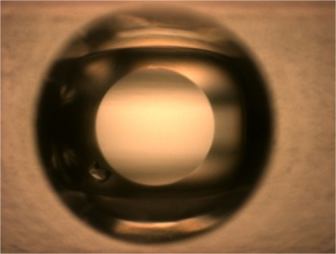
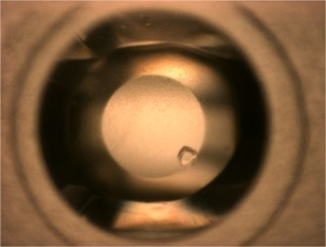
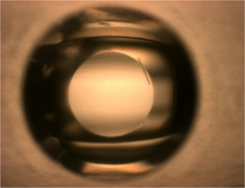
Screening Results of Crocus sativus Cysteine Protease (CsCP)
Tray | Well | Condition | Score | Description | Picture
Cryo | C5 | 0.08 M Sodium acetate pH 4.6, 1.6 M Ammonium sulfate, 20% (v/v) Glycerol | 8 | Crystals (3D Growth < 0.2mm)
Cryo | E9 | 0.085 M Tri-sodium citrate pH 5.6, 0.85 M Lithium sulphate, 0.425 M Ammonium sulfate, 15% (v/v) Glycerol | 9 | Crystals (3D Growth > 0.2mm)
Cryo | F11 | 15% (v/v) Glycerol, 0.17 M Sodium acetate, 25.5% (w/v) PEG 8000, 0.085 M Sodium cacodylate pH 6.5 | 6 | Needle (1D Growth)

Slide 12
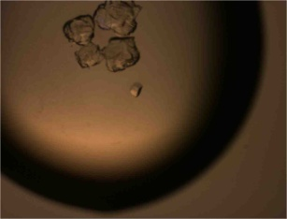
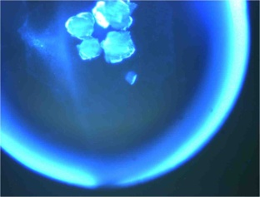
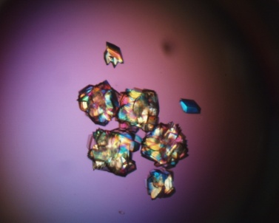
Distinction b/w Protein and Salt Crystals
UV light exposure provided clear fluorescence due to tryptophan residue showing formation of protein crystals
Optimization of CsCP Crystals
Successful single crystals by slowing down the rate of nucleation

Slide 13
Data Collection and Refinement Statistics
Space group | H3
Unit cell parameters | a = b = 97.97 Å, c = 48.78 Å and γ = 120°
Resolution (Å ) | 1.31
Completeness (%) | 100
I/σ | 24.9
*R_{merge} (%) | 5.7
* Data was collected under the guidance of Dr. Markus Perbandt at X13 beamline, DESY, Hamburg, Germany and by the senior scientist Dr. Banumathi Sankaran from Advanced light source (ALS) Barkely, USA.

Slide 14
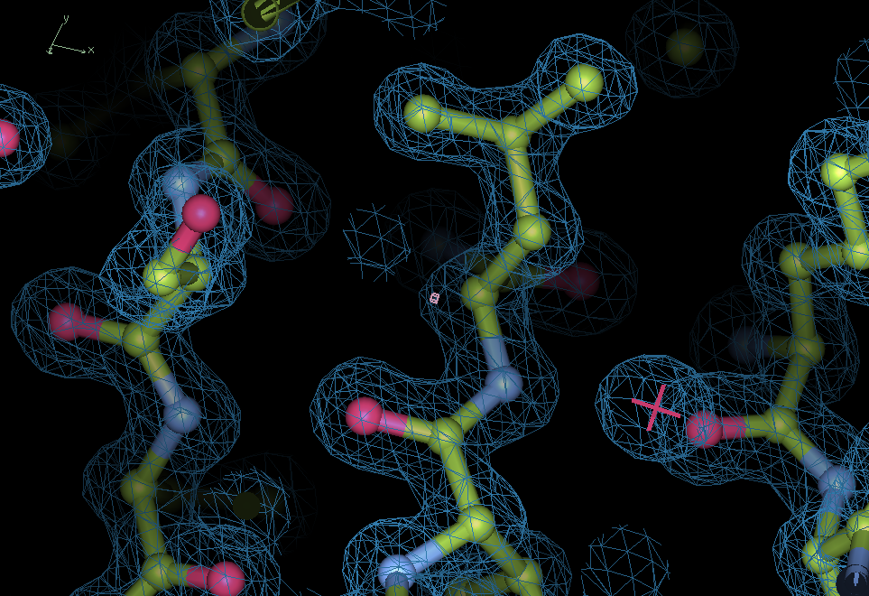

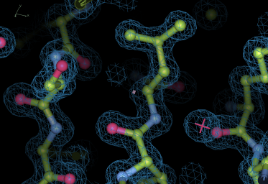
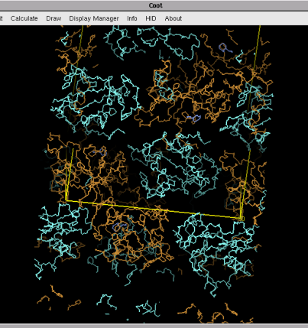
Structure Solution and Refinement
H K L I σ
1 0 4 3295.4 174.0
1 3 8 482.1 28.7
0 1 12 9691.0 500.7
4 3 16 1743.9 67.4
0 0 20 5856.0 221.0
. . . . .
. . . . .
. . . . .
24 7 0 28.5 16.2
37 9 1 110.1 10.9
Scaled structure factor file
PDB-ID 2B1M: All atom
Diffraction images
Model building
& refinement
Phase solution

Slide 15
Structure Refinement Statistics
Structure Refinement
Resolution (Å ) | 1.31
R_{factor} (%) | 14.37
R_{free} (%) | 18.93
No. of non-hydrogen Atoms
Protein | 1596
Water | 192
Ligand | 24

Slide 16
Structure Deposition (PDB-ID: 3U8E)

Slide 17
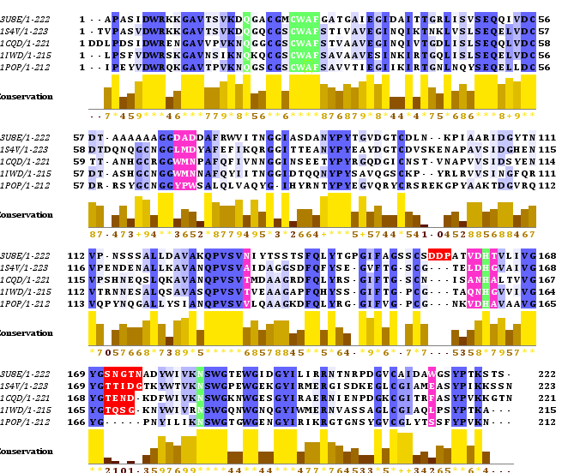
Multiple Sequence Alignment of CsCP against Plant CPs
-- Conserved
-- Catalytic
-- Active site
-- 3U8E (Crocus sativus)
-- 1S4V (Ricinus communis)
-- 1CQD (Zingiber officinale)
-- 1IWD (Ervatamin B)
-- 1POP (Carica papaya)

Slide 18
Conserved Structure of CsCP
Superimposition with Plant CPs
Alpha C RMSD = 0.91
-- insertion
-- 3U8E (Crocus sativus)
-- 1S4V (Ricinus communis)
-- 1POP (Carica papaya)

Slide 19
Overall Topology of CsCP
-- Inactive Form
-- Active Form
Catalytic Triad:
C25, H162, and N183
(Active Site Cleft)
Inactive Form:
C25 bridged with C22
Active Form:
C22 bridged with C64
C25 is free

Slide 20
KEY Findings …. Identification of S₂ Pocket Residues of CSCP
Cathepsin K-E64
Actinidin-E64
-- Others
-- CsCP

Slide 21
What has done so far!
The crystal structure of a papain-like CP, extracted, purified and crystallized for the first time from the medicinally important plant Crocus sativus, was determined at 1.3 Å resolution.
The high resolution electron density map aided in the unbiased assignment of the unknown primary amino acid sequence of the protein.
The overall fold of the structure is highly conserved and equally similar to plant and mammalian papain-like CPs.
Some unique differences were found in the S₂ pocket residues like D68, A69, N131, and W213 in the CSCP structure, which may have some influence on the substrate specificity of the enzyme .

Slide 22



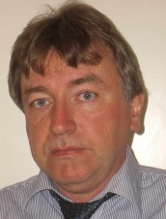


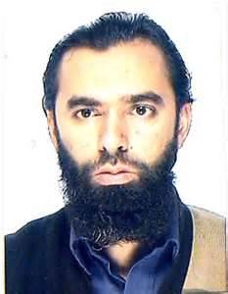
Acknowledgments
Prof. Dr. Atta-ur-Rehman _{F.R.S., N.I., H.I., S.I., T.I}
Prof. Dr. Dr. Christian Betzel
Prof. Dr. M. Iqbal Choudhary _{H.I., S.I., T.I}
Dr. Markus Perbandt
Dr. Ahmed Akrem
22

