Slide 1
Methods of developing new secondary metabolites
Vintha M. Thadhani¹, Syed G. Musharraf², Afshan Begum², M. Iqbal Choudhary² & Veranja Karunaratne³
¹Institute of Chemistry, Colombo, Sri Lanka; ²ICCBS, University of Karachi, Pakistan,³University of Peradeniya, Sri Lanka

Slide 2
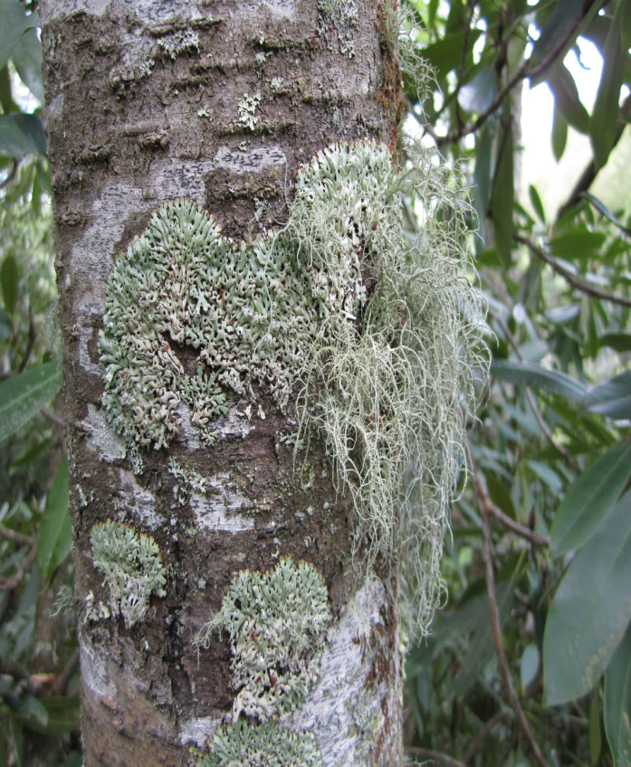
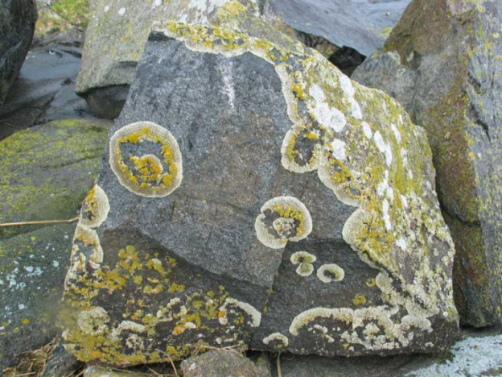
Lichens
Symbiotic association of fungus & algae
Worldwide distribution
Able to grow under extreme conditions
About 20,000 lichen species identified .
Still many lichen rich areas remain unexplored
Total number may well be close to 100,000.

Slide 3
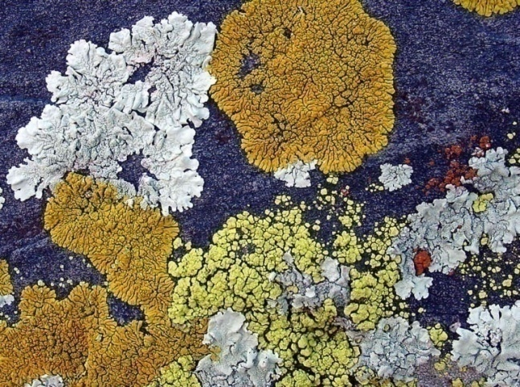
Secondary metabolites of lichens
Occurs exclusively in these symbiotic organisms
Even with the advances of analytical methods, there is comparatively less isolation of new lichen metabolites may be due to the limited biosynthetic pathways.
Approximately only 1050
lichen metabolites have been
isolated to date.

Slide 4
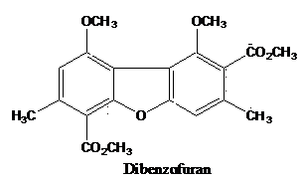
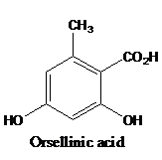
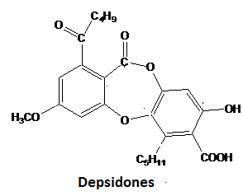
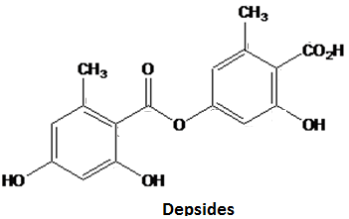
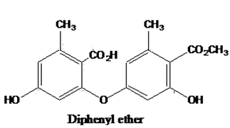
Polyketides- common classes of compounds reported from lichens

Slide 5
Secondary metabolites of lichens- Rich source of biologically active compounds
We have already reported various biological activities of lichen compounds including,
  antioxidant,
  α-glucosidase inhibitory,
  urease inhibitory,
  antimicrobial,
  cytotoxicity etc

Slide 6
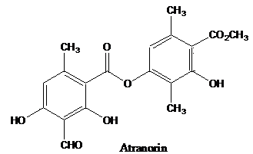
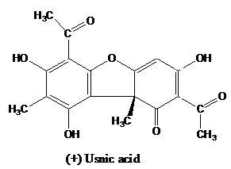
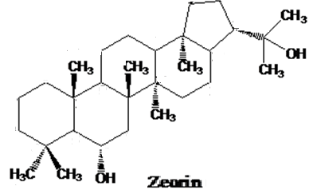
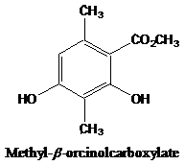
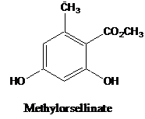
Common secondary metabolites of lichens

Slide 7
Biotransformation of major lichen metabolites-Zeorin
Zeorin isolated in 3.4% yield from Cladonia sp.
Subjected to various bioassays
Patent obtained for α-glucosidase inhibitory activity.
Biotransformation through Cumingharella elegans
Yielded 1,3-diacylglycerol & diacylperoxide.

Slide 8
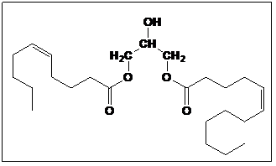
1,3-diacylglycerol
1-(5-dodecenoyl), 3-(5-decanoyl)glycerol

Slide 9
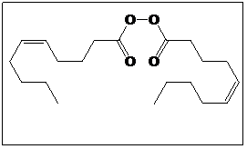
Diacylperoxide
5-decenoic acid-1,1-diacylperoxide

Slide 10
Semisynthesis of minor metabolites

Slide 11
Complete synthesis of dibenzofurans-Reported

Slide 12
Depsides isolated in major quantities

Slide 13
Smiles rearrangement possible only with erythrin

Slide 14
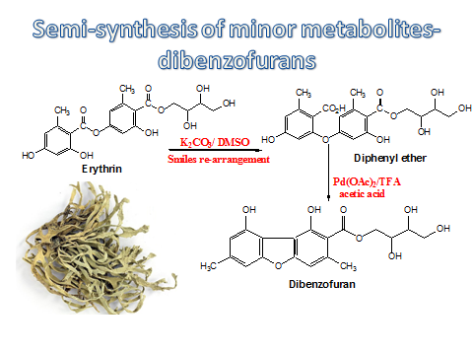

Slide 15
Analogues of 5-decarboxydibenzofurans

Slide 16
Formal synthesis of pannaric acid derivatives

Slide 17
Some natural analogues of dibenzofuran

Slide 18
Conclusion
This study reveals the possibility of conversion of major lichen specific secondary metabolites into new compounds through biotransformation and semi-synthesis.

Slide 19
Thank you

