Slide 1
Synchrotron Radiation for Material Analysis
M. Aslam Baig
National Center for Physics
Quaid-i-Azam University Campus, Islamabad
Pakistan
aslam@ncp.edu.pk baig@qau.edu.pk

Slide 2
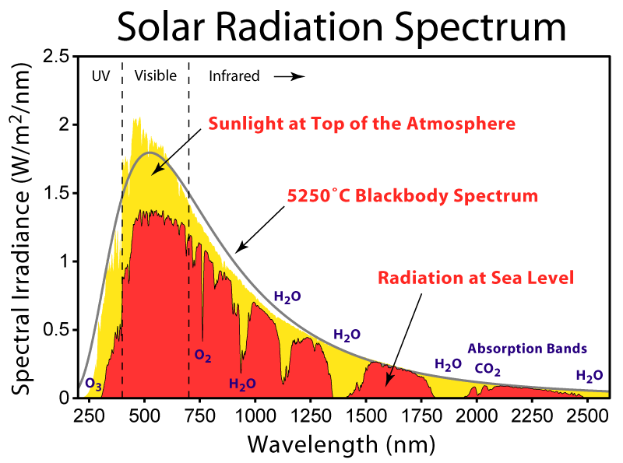

Slide 3
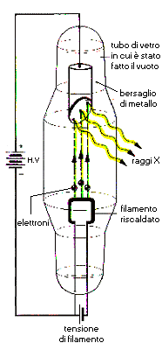
X-ray ray tubes
Vacuum tube
K
Anode
Characteristic
radiation
HV
X-rays
Intensity (a. u.)
K
Bremsstrahlung
radiation
Electrons
Cathode
λ_{min}
0.02
0.04
0.06
0.08
0.10
Wavelength (nm)
Filament supply
The spectrum from an X-ray tube has discrete fluorescent lines superimposed on
the continuous bremsstrahlung radiation

Slide 4

Energy Dissipation

Slide 5
How a Storage Ring Works

Slide 6
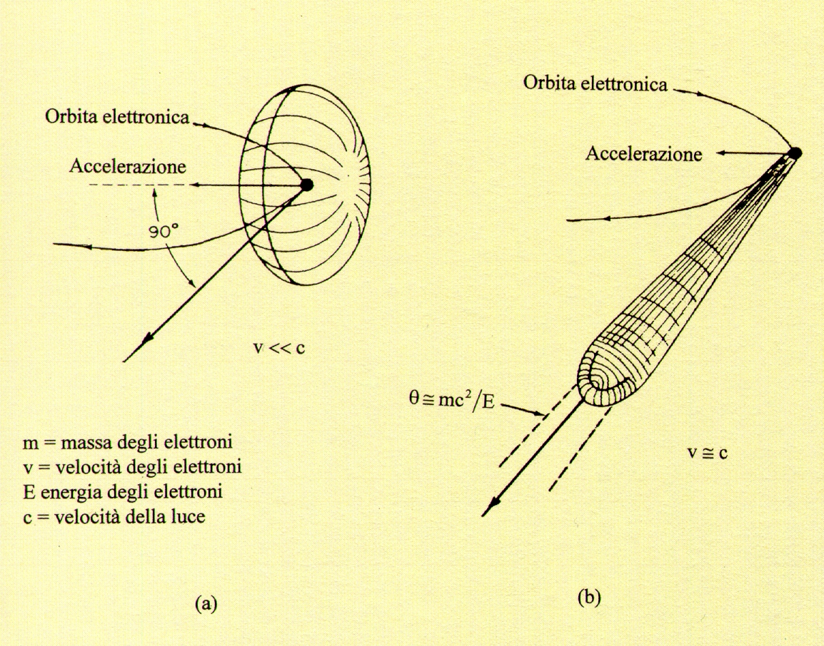
Synchrotron radiation angular distribution
Electron orbit
Electron orbit
e⁻
e⁻
Acceleration
Acceleration
v
v << c
Θ ≅ m₀c²/E
= 1/γ rad
m₀ = electron mass
v = electron velocity
E = electron energy
c = velocity of light
v ≅ c
v
Radiation angular distribution (a) electrons travelling at low speed
(b) electrons travelling at relativistic speed (γ = (1-v²/c²)^{-1/2} ≅ 10000 at ESRF)

Slide 7
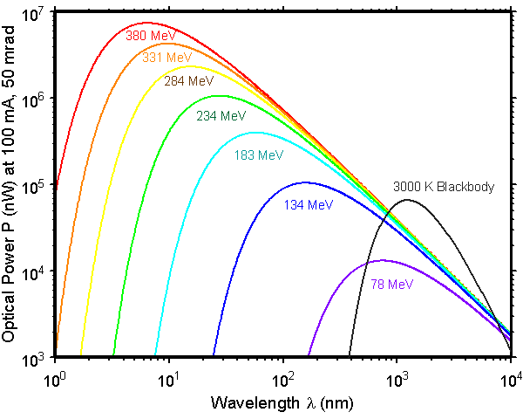

Slide 8
Time structure
Light pulses
e⁻
e⁻
I
e⁻
e⁻
100 ps
t
1μs
Time pulsed emission is interesting for studying rapid reactions

Slide 9
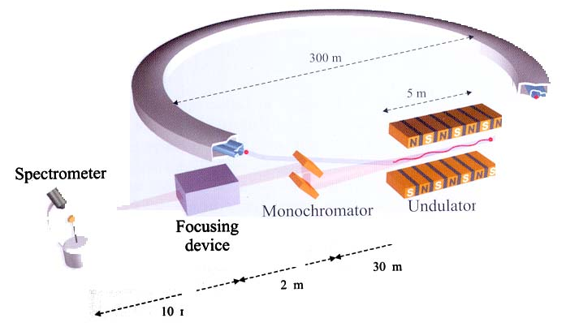
From the magnetic device to the experimental station
Synchrotron storage ring
300 m
5 m
Spectrometer
Monochromator
Undulator
Focusing
device
30 m
2 m
10 m
Als-Nielsen Introduction to Modern X-ray Physics

Slide 10
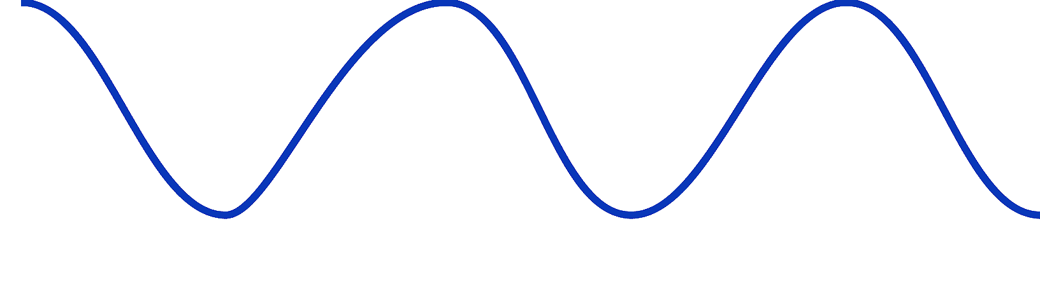
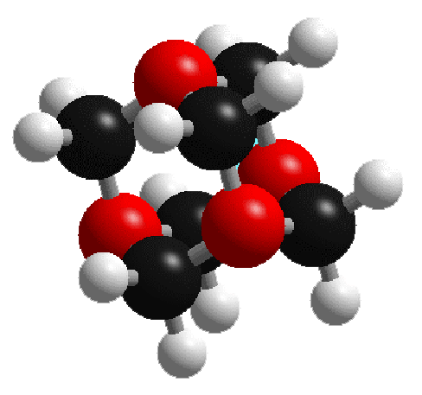
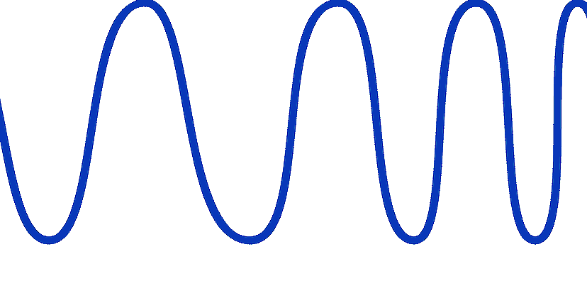
Why is wavelength important?
Why is it special?
sample
sample
Visible light
X-rays
To penetrate a sample, you need a wavelength of similar, or smaller magnitude.

Slide 11
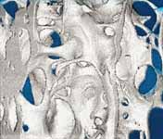
Fluorescence
Elemental analysis
Detector
I
X-rays
Sample
wavelength
Absorption
μ
2.0
X-rays
1.0
Sample
Detector
0.0
8800
8800
9000
9000
9200
9200
9400
9400
9600
9600
9800
9800
10000
Energy
10000
E (eV)
Imaging
X-rays
Detector

Slide 12
The absorption coefficient μ
t
I₀
I
I = I₀ exp(-μt)
linear absorption coefficient
α = μt = ln ( I₀/I )

Slide 13
X-ray
Absorption
Fine
Structure
Zinc K-edge

Slide 14

Extended X-ray absorption fine structure (EXAFS)
In condensed matter the ejected photo-electron (wave) will be scattered by neighbouring atoms.
It is the interference between the outgoing electron and the back-scattered ones which leads to oscillations visible in the absorption
spectrum above the edge.

Slide 15
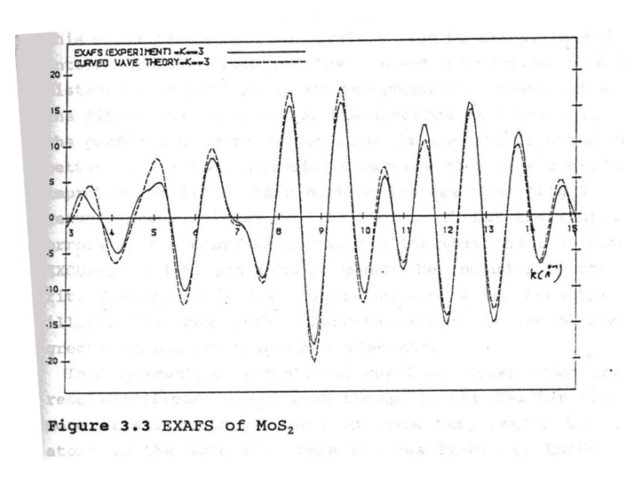
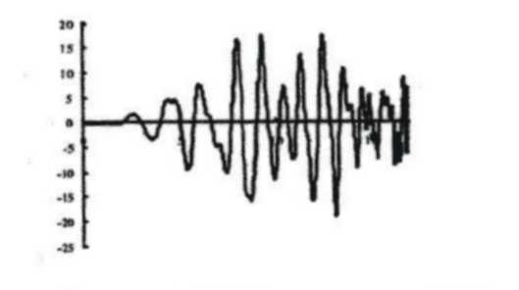
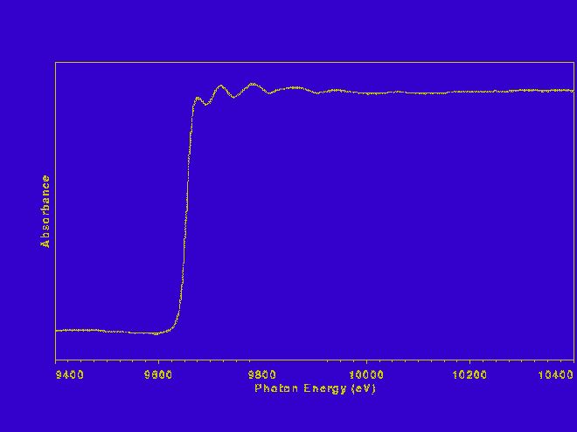
Extended X-ray absorption fine structure (EXAFS)
Lab data took over 12 hours to collect.
Synchrotron data took 25 minutes and could have been collected in about 3.

Slide 16
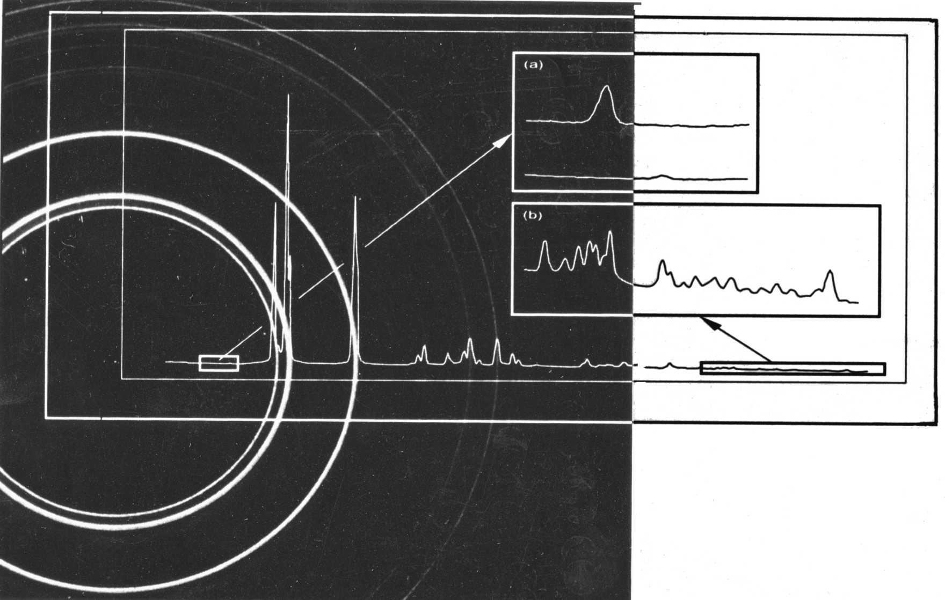
Taken from:
“Introduction to Powder Diffraction”
By: R J Cernik
Daresbury Laboratory

Slide 17
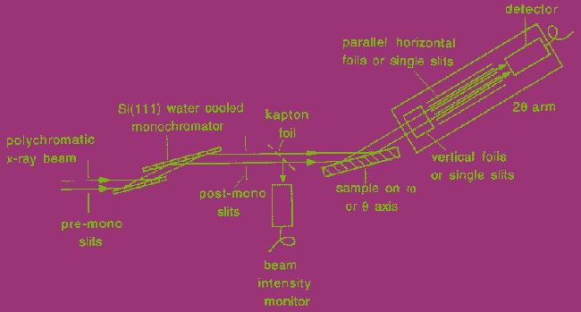
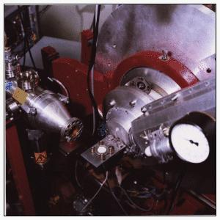
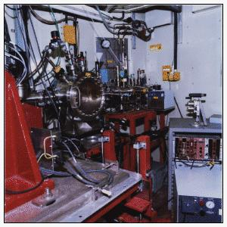
Powder Diffraction

Slide 18
Fe compounds
XANES can be used simply as a fingerprint of phases and oxidation state.

Slide 19
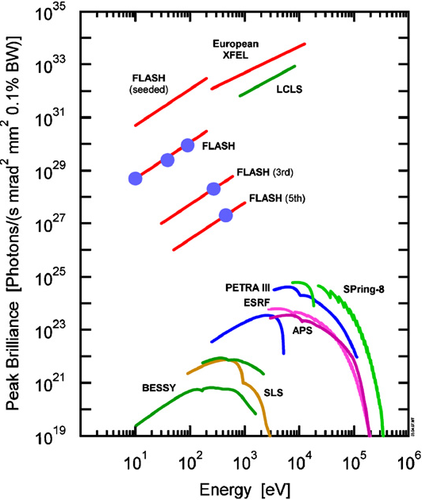
FLASH – Light Source

Slide 20
Photoionization of Neon
Richter et al PRL 102, 163002, 2009

Slide 21
Xenon Ions

Slide 22
Surface analysis of superconducting materials
Ca
Sr
6.0
Bi_{1.7} Pb_{0.4} Sr₂ Ca₂ Cu₂ O₄
Cu₂O
Ca₂CuO₃
Rel. Signal Intensity (arb. units)
Mg
SrO
SrCaO₂
3.0
CaO
Pb/Bi
0.0
0
100
200
300
Mass / charge (m/q)
Baig et al J.Appl. Phys. 2009

Slide 23
Future…….
Prospects for Pakistan
SESAME
Synchrotron Radiation Facility being built in Amman, Jordan

