Slide 1


CRYSTALLOGRAPHY AND SUSTAINABILITY
John R. Helliwell
School of Chemistry, University of Manchester, UK
john.helliwell@manchester.ac.uk
ACA Philadelphia 2015
Transactions Symposium

Slide 2
What precisely is ‘sustainability’ and how might we fit into it?
“The world's sustainable development goals are integrated into the eight Millennium Development Goals (MDGs) that were established in 2000 following the Millennium Summit of the United Nations. Adopted by the 189 United Nations member states at the time and more than twenty international organizations, these goals were advanced to help achieve the following sustainable development standards by 2015:
To eradicate extreme poverty and hunger
To achieve universal primary education
To promote gender equality and empower women
To reduce child mortality
To improve maternal health
To combat HIV/AIDS, malaria, and other diseases
To ensure environmental sustainability
To develop a global partnership for development”
Reference: http://en.wikipedia.org/wiki/Sustainability

Slide 3
Talk contents
Research and Knowledge Transfer
Nanomaterials
Overarching publications and access to data policy and the principle of open access
Databases
Green chemistry: “doing more with less and less pollution”
Capacity building in our crystallographic World
Conclusions

Slide 4


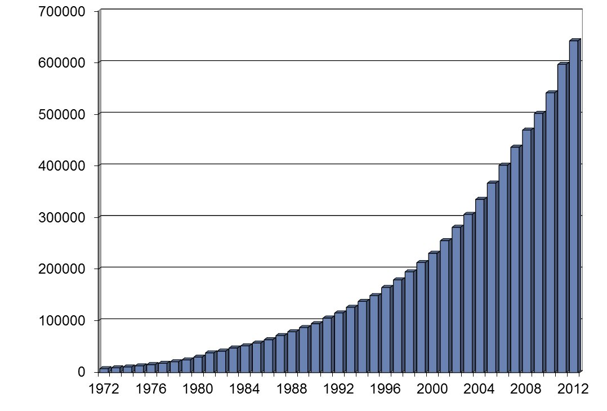
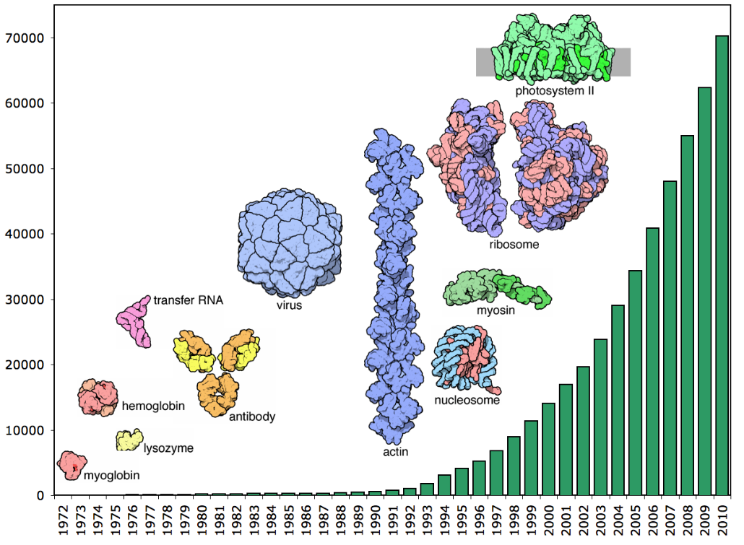
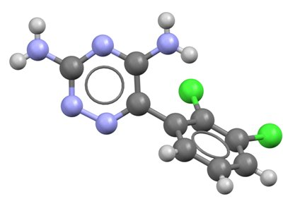
Fruits of our research:
Structures large and small
Cambridge Structural Database
686944 structures at 6 January 2014
Protein Data Bank
104371 structures at 23 October 2014
Notes:
Dorothy Hodgkin’s work encompassed both “small” organic molecules and proteins. Small molecules have a great diversity of compositions and chemical behaviours. Proteins and nucleic acids have – in a sense – greater chemical homogeneity: they are built from a relatively small set of basic building blocks; but they have infinitely more structural complexity. They now have specialized curated databases to manage the collection, organization, validation and searching of all published structures of both types. There are also other high-quality curated databases that provide access to structural data for other categories of materials – metals, inorganic compounds, minerals, powder diffraction patterns etc. There is a great deal of complementarity between the databases.

Slide 5
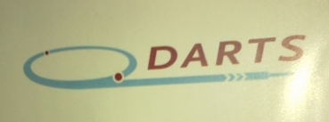
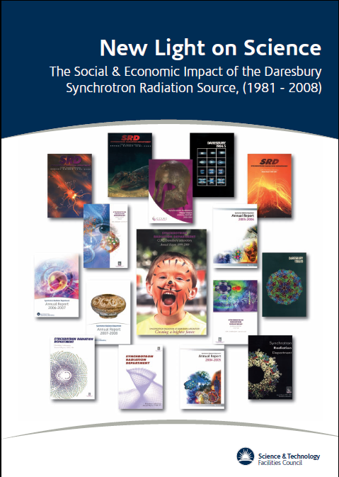
Knowledge Transfer: Daresbury Analytical and Research Technical Services (DARTS); an important aspect of the Economic Impact of the SRS
E.J. Maclean, P.J. Rizkallah and J.R. Helliwell (2006) Protein Crystallography and Synchrotron radiation European Pharmaceutical Review Issue 2, p71-76
Approx £300k income to SRS per annum;
Australia and Canada each pushed on the usual
ceiling of a ‘10% maximum’ commercial use.

Slide 6
IUCr was invited to participate in a CODATA / VAMAS Working Group in 2012
VAMAS is the Versailles Project on Advanced Materials and Standards (www.vamas.org). There have been 3 Workshops so far.
The overall goal is to define the needs of as many scientific disciplines and user communities as possible. This White Paper will be transmitted to ISO Technical Committee 229 on Nanotechnology (http://www.iso.org/iso/iso_technical_committee?commid=381983 ) as well as other international and national standards development bodies and government agencies. Within this Working Group, Crystallographers unambiguously define and characterize nanomaterials.

Slide 7


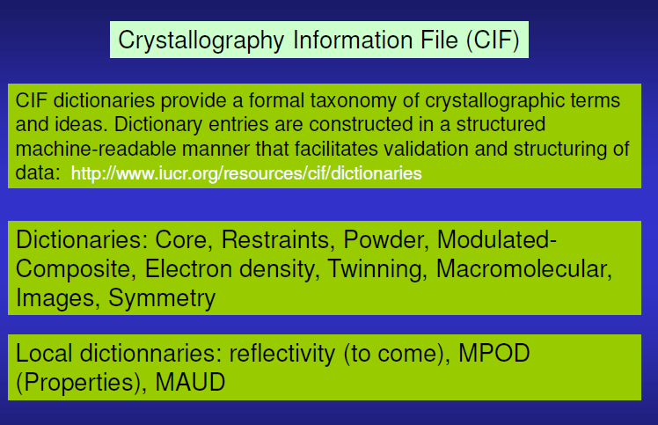
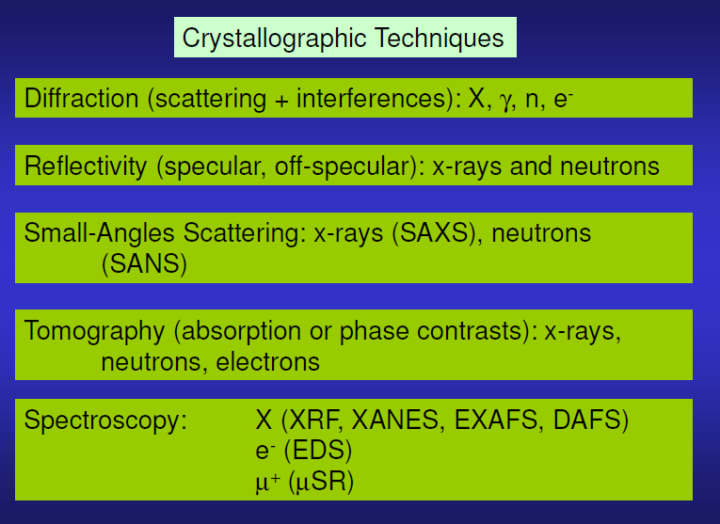
CODATA/VAMAS Nanomaterials project; IUCr’s input

Slide 8
Overarching data policy and the principle of open access
http://www.icsu.org/general-assembly/news/ICSU%20Report%20on%20Open%20Access.pdf
“The International Council for Science advocates the following goals for open access. The scientific record should be:
• free of financial barriers for any researcher to contribute to;
• free of financial barriers for any user to access immediately on publication;
• made available without restriction on reuse for any purpose, subject to proper attribution;
• quality-assured and published in a timely manner; and
• archived and made available in perpetuity.
* These goals apply both to peer-reviewed research publications, the data on which the results and conclusions of this research are based, and any software or code used in the course of the research.”

Slide 9
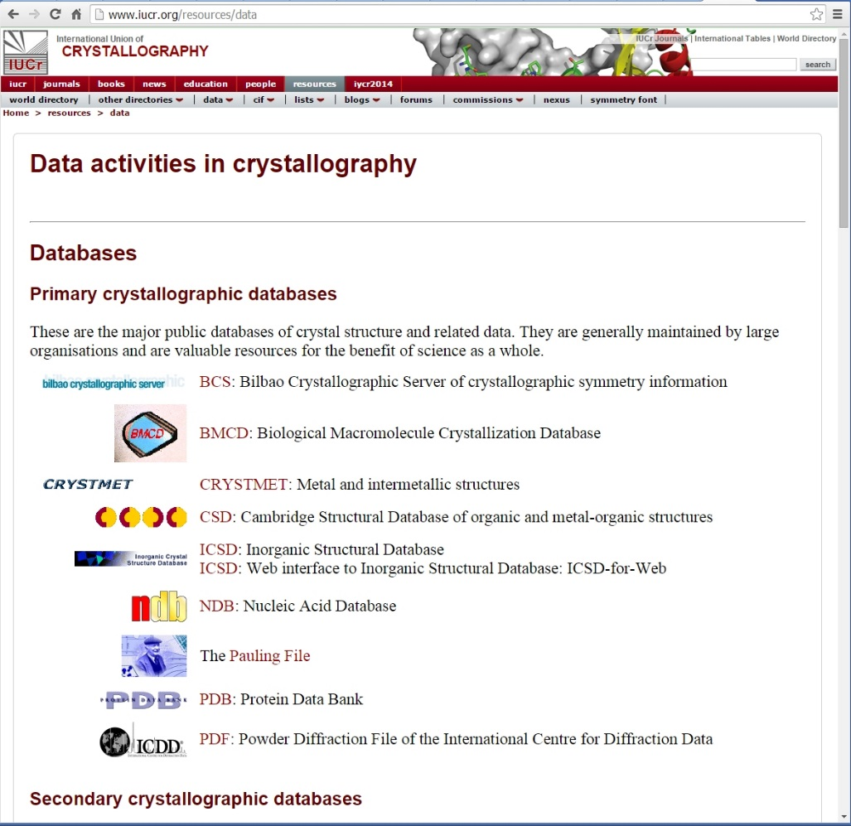

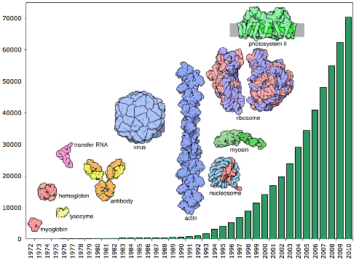
Benefits of retaining derived data
Scientific record
Database-driven discovery
Protein-ligand interactions
New pathways to synthesis, manufacturing, energetics…
Identification/indexing (e.g. forensic science)

Slide 10
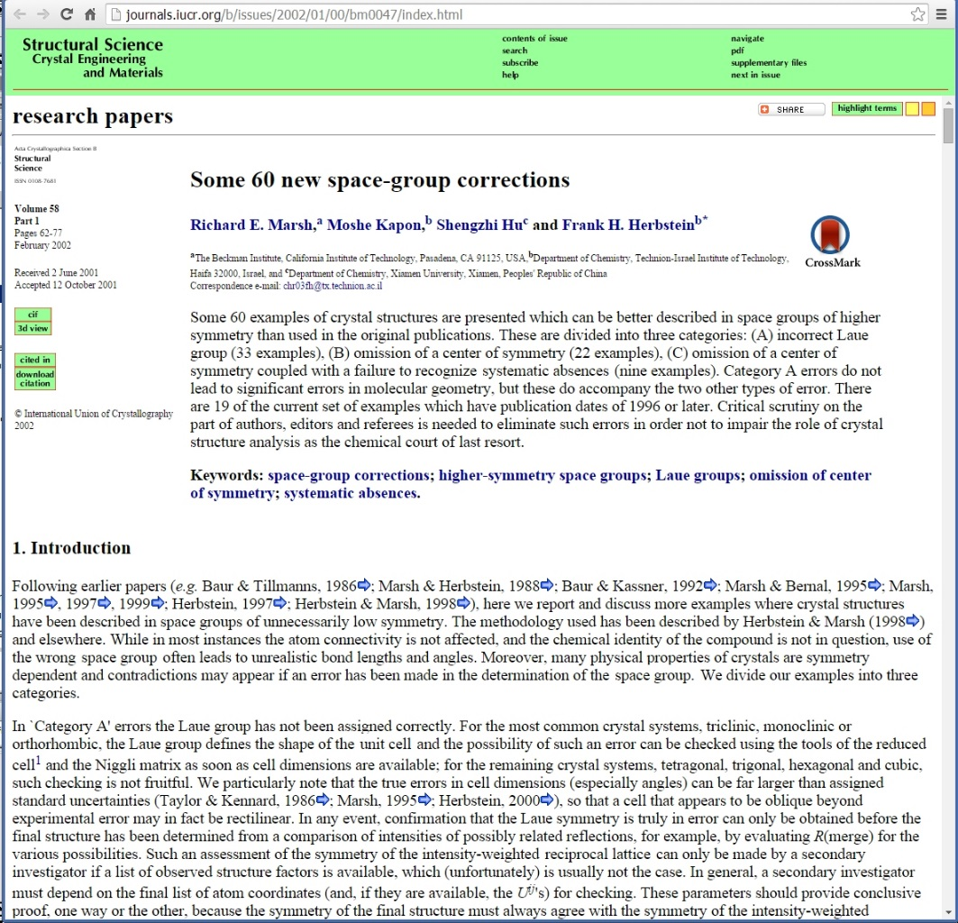
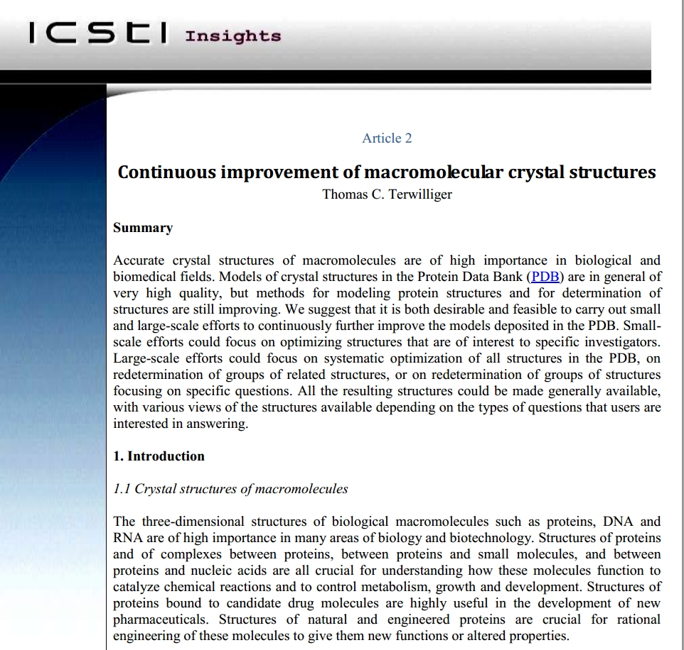
Benefits of retaining processed data
Structure validation
Re-refinement
Systematic bias, methods development
Guard against structures associated with incorrect data sets
Notes:
Until the advent of CIF and its enabling automated structure validation checks with the checkCIF suite, many structures were published which required subsequent correction. Often the interpretation of the results produced molecular structures that were broadly correct, but overlooked higher lattice symmetries. Such examples were best detected and corrected through access to the deposited structure factors. The paper illustrating this is Marsh, R. E., Kapon, M., Hu, S. & Herbstein, F. H. (2002). Some 60 new space-group corrections. Acta Cryst. B58, 62-77.

Slide 11
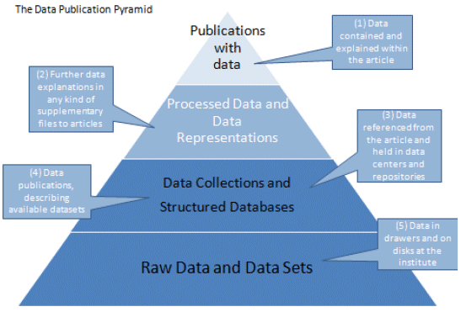
Raw diffraction images offer the opportunity of:-
analysing data at higher resolution than used in the original work
serving as benchmarks in developing improved methods of analysis
checking the interpretation of the symmetries of the crystals
analysing diffraction from multiple lattices present in the crystals
analysing the diffuse scattering that reflects correlated motions or disorder of atoms in the crystals

Slide 12
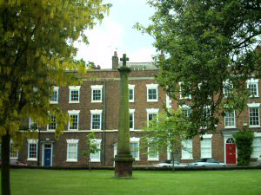
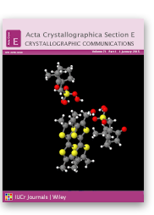
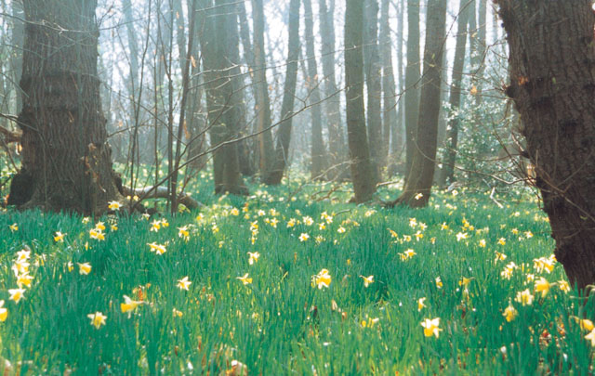
Green chemistry:
Publications in IUCr Journals
A total of 137 entries;
The majority are in Acta Cryst E and thereby Open Access for readers;

Slide 13
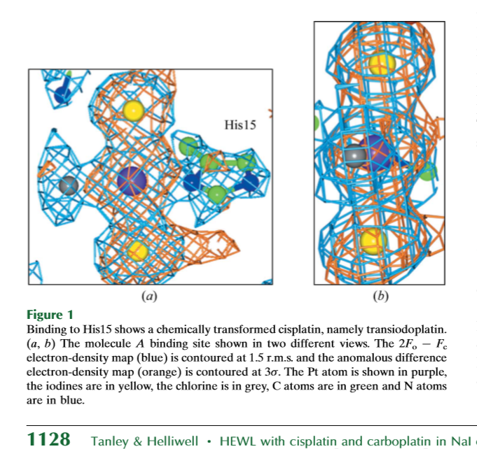
Crystallography research example: the platins
ESRF Medical beamline has conducted
Radiation therapy trials on tumours using
mice and targeting the Pt K edge.
We are now collaborating to try targeting
the iodine K edge as well thus varying the
X-ray penetration depth into a tumour.
The hope is to do work with lower quantities
of these compounds for a patient.
We will soon have made available all the raw
data diffraction images of this suite of studies
Via the University of Manchester eScholar
Repository.
Gold Open Access to the publications, the PDB files and the raw data files.

Slide 14
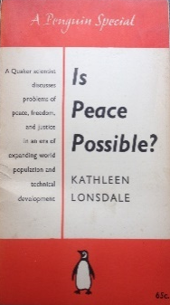
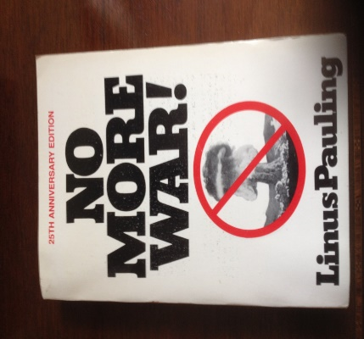
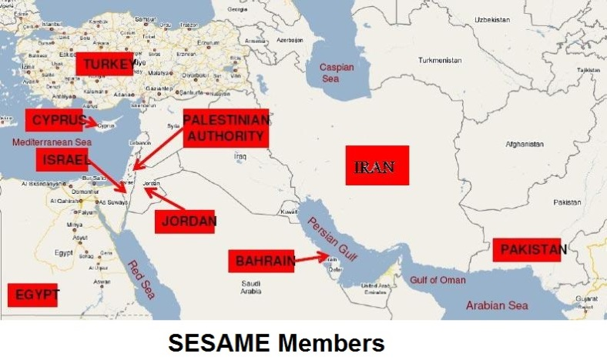
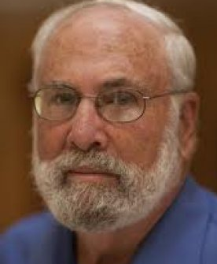

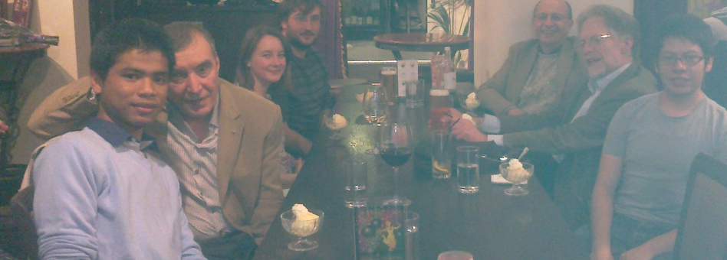

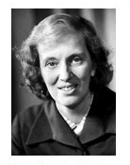
Practical examples of Worldwide capacity building:
SESAME synchrotron and peace in the Middle East
Capacity building; eg SESAME synchrotron radiation project in Jordan; eg ??an African SR project??
One’s own Lab: multi
national research staff
and students eg in 2011:-
AfLS To be
discussed 15-20
November 2015
at ESRF
Dr Hermann Winick
SSRL Stanford
Iraq
Thailand
Mexico

Slide 15
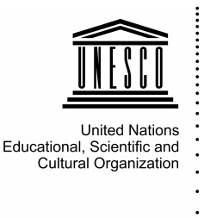




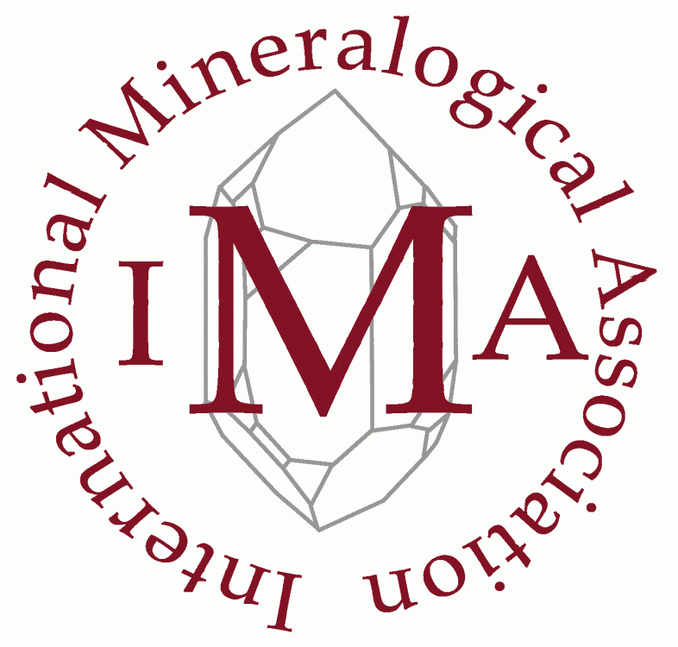
Crystallography for the next generation
– RESOLUTION –
issued on the occasion of the IYCr Legacy Conference, Rabat, Morocco, 22-24 April 2015
[…] At a time when scientific endeavour is critical for societal benefit and the importance of crystallography is greater than ever, crystallography remains a science that still has lower visibility than it should,
the IUCr and all partner institutions commit:
  to enhance the stature of crystallography […]
  to build capacity in developing regions of the world […]
  to extend further the public understanding of science in general and crystallography in particular […]
Private endorsement at http://iycr2014.org/into-the-future/conference/resolution

Slide 16


IUCr Project title: Building Science Capacity in Africa via Crystallography
Funded under the ICSU Grants Programme 2015
Lead Applicant: International Union of Crystallography
Co-Applicant: European Crystallographic Association
Supporting organizations: UNESCO, ICSU Regional Office for Africa, INDABA, SAASTA
Project plan (2015/2016):
Follow-up meeting to the Bloemfontein Summit (to be held in North Africa)
Crystallography workshop in Central Africa (likely, Cameroon)
Support to African scientists to attend the INDABA series of conferences in South Africa
+ many additional actions
http://www.iycr2014.org/capacity-building/icsu2015

Slide 17
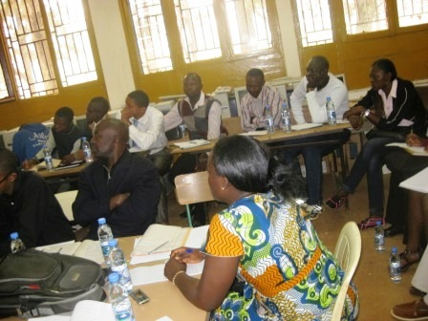
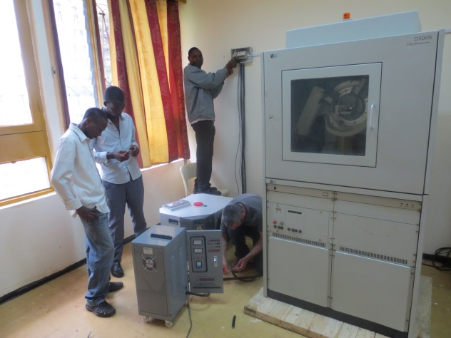
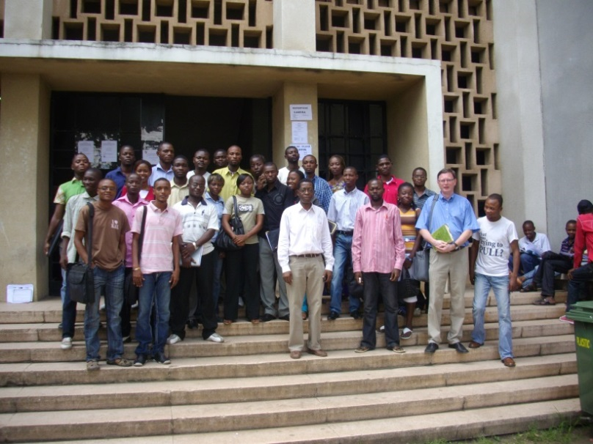
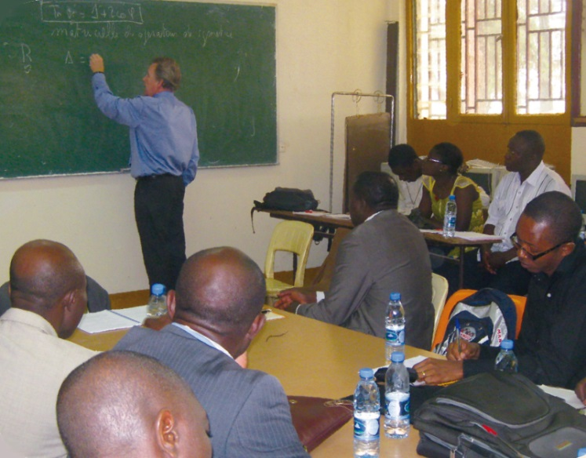
IUCr initiative
Crystallography in Africa
since 1999
Approved by the IUCr Executive Committee following a proposal of Jan Boeyens from South Africa
crystallography lecture series and schools
bursaries awarded to African students to attend meetings of the IUCr Regional Associates
bursaries for young professors (up to the age of 40), post-doctoral students and PhD students from Africa to attend an IUCr Congress
instrumentation supplied free of charge by partner companies (namely, Bruker)
Steering Committee
Claude Lecomte, Chair
Patrice Kenfack
Luc Van Meervelt
Hocine Merazig
Romain Murenzi (TWAS)
Jean Paul Ngome (UNESCO)
Andreas Roodt
Abdelmalek Thalal
Michele Zema

Slide 18


The IUCr-UNESCO OpenLab is a network of operational crystallographic laboratories based in different countries worldwide, mainly in less endowed regions of Africa, South and Central America and South Asia. They are aimed at allowing access to crystallographic knowledge and technology in all parts of the world, key for the fruitful development of science, and to open possibilities for conducting high-level research.
 |  | Dates | Type | Country | Location
1 | Bruker OpenLab Pakistan | 30 Apr 2014 - 8 May 2014 | OpenLab Type 2 | Pakistan | Karachi
2 | Agilent OpenLab Argentina | 5 May 2014 - 10 May 2014 | OpenLab Type 2 | Argentina | La Plata and Buenos Aires
3 | Bruker OpenLab Morocco | 20 May 2014 - 20 Jun 2014 | Travelling Lab | Morocco | Rabat and Agadir
4 | PANalytical OpenLab Ghana | 9 Jun 2014 - 12 Jun 2014 | OpenLab Type 2 | Ghana | Accra
5 | Rigaku OpenLab Cambodia | 7 Jul 2014 - 11 Jul 2014 | OpenLab Type 2 | Cambodia | Phnom Penh
6 | Bruker OpenLab Uruguay | 23 Jul 2014 - 31 Jul 2014 | OpenLab Type 1 | Uruguay | Montevideo
7 | Bruker OpenLab Indonesia | 18 Aug 2014 - 22 Aug 2014 | Travelling Lab | Indonesia | Bandung
8 | Agilent OlexSys OpenLab Turkey | 1 Sep 2014 - 5 Sep 2014 | OpenLab Type 2 | Turkey | Izmir
9 | STOE DECTRIS Xenocs OpenFactory | 10 Sep 2014 - 19 Sep 2014 | OpenFactory | France and Germany | Grenoble and Darmstadt
10 | Rigaku OpenLab Colombia | 27 Oct 2014 - 31 Oct 2014 | OpenLab Type 2 | Colombia | Bucaramanga
11 | PANalytical OpenLab Mexico | 18 Nov 2014 - 21 Nov 2014 | OpenLab Type 2 | Mexico | Mexico City
12 | Agilent OlexSys OpenLab Hong Kong | 3 Dec 2014 - 7 Dec 2014 | OpenLab Type 2 | Hong Kong | Hong Kong
13 | Bruker OpenLab Vietnam | 8 Dec 2014 - 12 Dec 2014 | OpenLab Type 2 | Vietnam | Ho Chi Minh City
14 | PANalytical OpenLab Turkey | 19 Jan 2015 - 22 Jan 2015 | OpenLab Type 2 | Turkey | Ankara
15 | Bruker OpenLab Algeria | 9 May 2015 - 14 May 2015 | OpenLab Type 2 | Algeria | Constantine
16 | Bruker OpenLab Tunisia | 14 May 2015 - 23 May 2015 | Travelling Lab | Tunisia | Monastir and Nabeul
17 | CCDC OpenLab Kenya | 6 Sep 2014 - 10 Sep 2015 | OpenLab Type 2 | Kenya | Nairobi
18 | PANalytical OpenLab Mexico | 28 Sept 2015 - 2 Oct 2015 | OpenLab Type 2 | Mexico | Puebla
19 | Bruker OpenLab Senegal | 5 Oct 2014 - 10 Oct 2015 | OpenLab Type 1 | Senegal | Ziguinchor
2014
2015

Slide 19
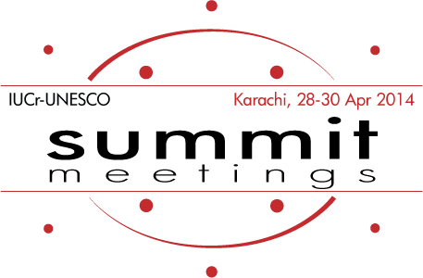
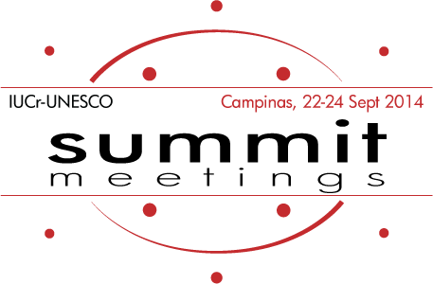
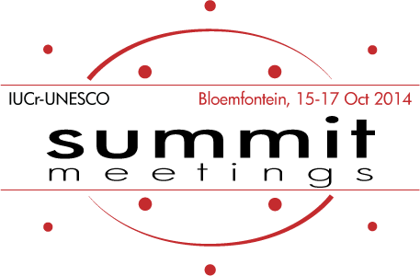
Aims and outcomes of the IYCr2014 Summit meetings
The IUCr-UNESCO Summit meetings have been intended to bring together scientists from countries in three widely separated parts of the world, using a common crystallographic theme. There is a real necessity for scientists to think beyond political borders and other distinctions. These meetings, focussed on high level science, also highlighted the difficulties and problems of conducting competitive scientific research in different parts of the developing world.
South-East Asia
Karachi, Pakistan
28-30 April 2014
Latin America
Campinas, Brazil
22-24 September 2014
Africa
Bloemfontein, South Africa
15-17 October 2014
Summit Declaration
Establishment of the
China-Pakistan-India fund
Foundation and 1st meeting of the Pakistani Crystallographic Association Lahore, 9 Oct 2014
1st India-Bangladesh bilateral meeting, Kolkata, 18-19 Sept 2015
New edition of OpenLab planned in Cambodia
Summit Declaration
Foundation and 1st meeting of LACA, Sao Paulo, 9-11 Sept 2015
New editions of OpenLabs planned in Mexico and Uruguay
Summit Declaration
AfCA Steering Committee formed
ICSU proposal approved
2nd North African Crystallographic Conference, Algeria or Tunisia, mid-2015
1st Crystallographic workshop for Central Africa, Cameroon, Sept 2015
New OpenLabs planned in Senegal, Kenya, Cote d’Ivoire

Slide 20
Acknowledgements
Wikipedia for their helpful descriptions and quotes from the UN resolutions on global sustainability.
Michele Zema, Brian McMahon and Peter Strickland of the IUCr Chester, UK for help with slides and detailed comments.
Dr Cora Lind-Kovacs and Prof Robin Rogers.

Slide 21
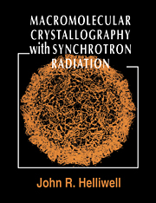
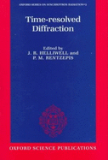
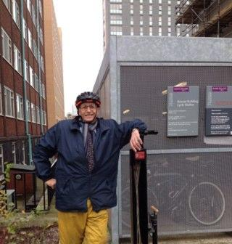
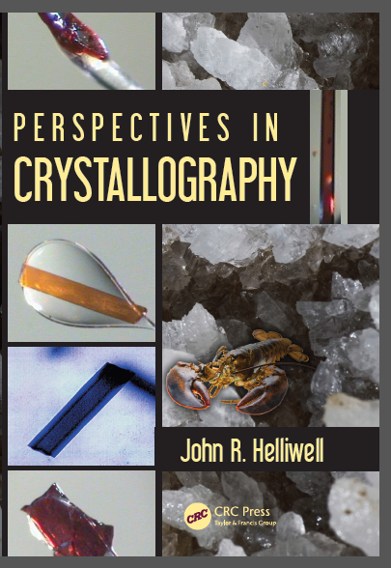
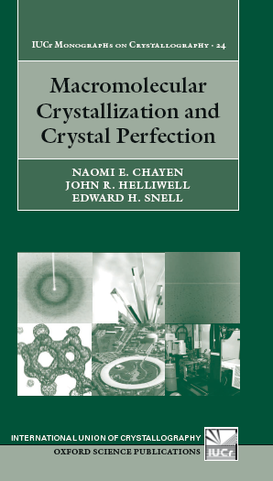
Thankyou to the ACA!

