Slide 1
Motivations, challenges, horror stories and opportunities
Experiences of diffraction data management, archival and publication at the UK National Crystallography Service.
Simon Coles (s.j.coles@soton.ac.uk)
Changing and Challenging times for service crystallography, Chem. Sci., 2012, 3, 683-689
Notes:
Please use the dd month yyyy format for the date for example 11 January 2008. The main title can be one or two lines long.

Slide 2
Single Crystal Diffraction @ Southampton
£4.5M structure – centric research facility
State-of-the-art instrumentation and expert personnel
Fully integrated and spanning materials, chemical and life sciences
Learn from each other through collaborative research at the interface between physical and life sciences
Southampton Diffraction Centre
Macromolecular Crystallisation
Chemical Crystallography
Thermal Characterisation
National Crystallography Service
Southampton Chemistry Analytical Solutions
Macromolecular structure

Slide 3

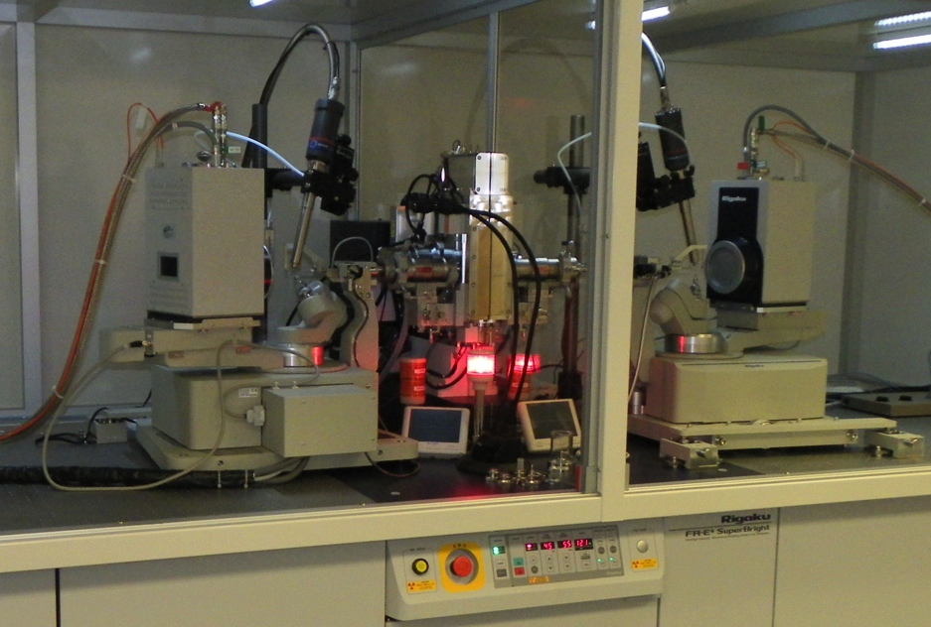
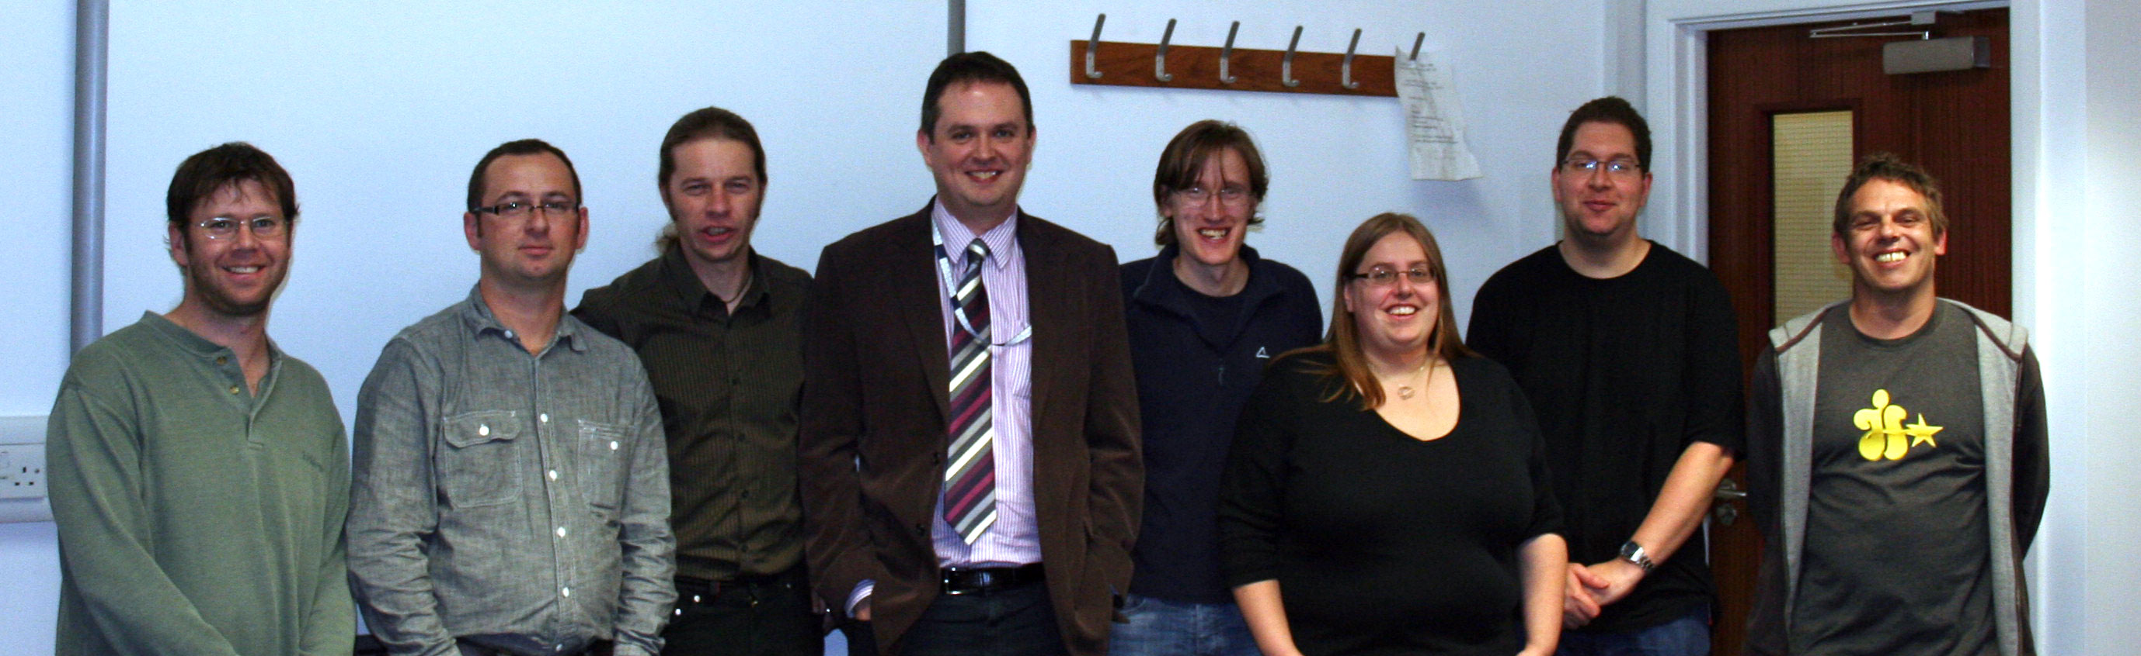
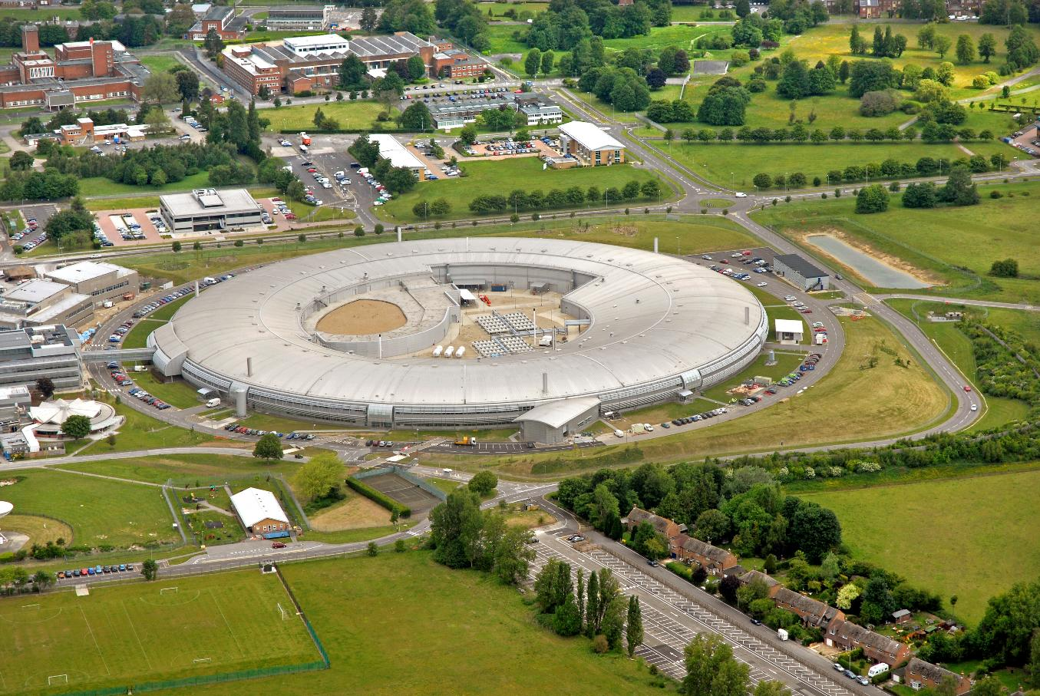
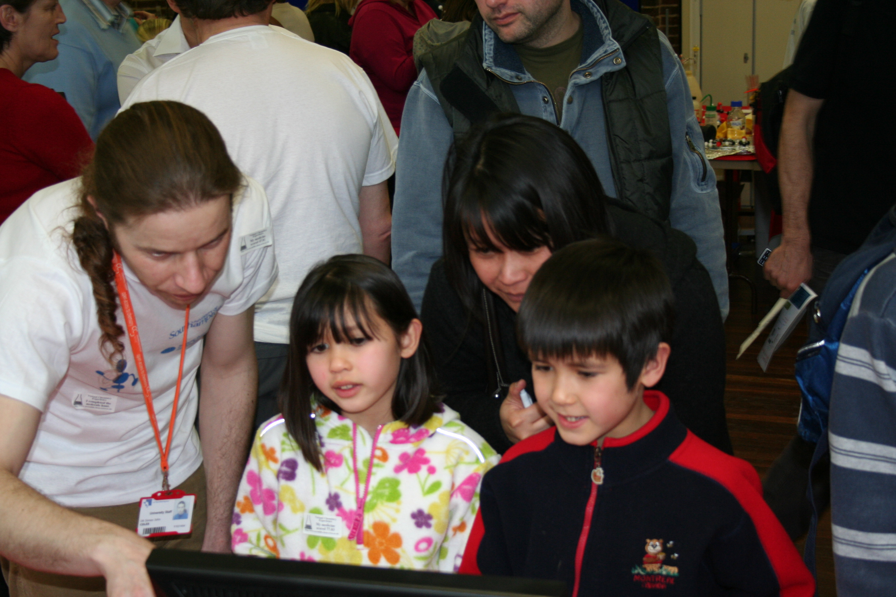
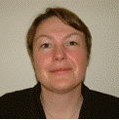
The NCS
The most powerful and highest throughput chemical crystallography laboratory in the world
New service started May 2010
Expert personnel
Around 100 users from UK academia
Diamond synchrotron component
Outreach and training

Slide 4
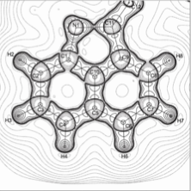
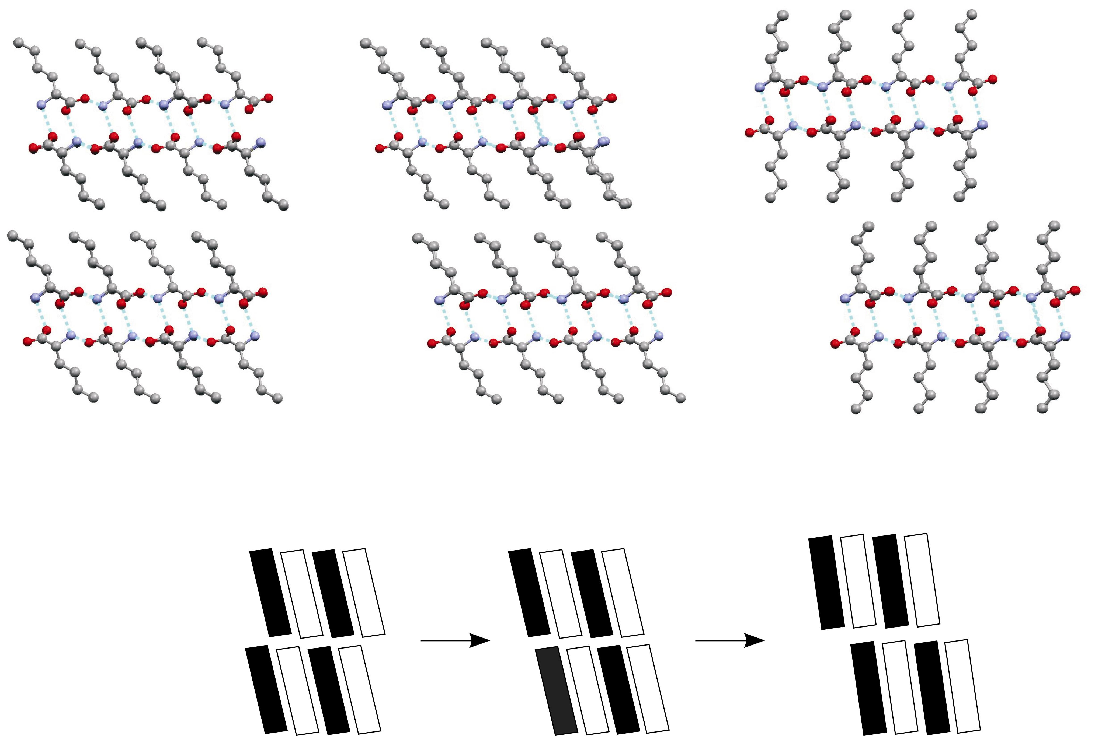
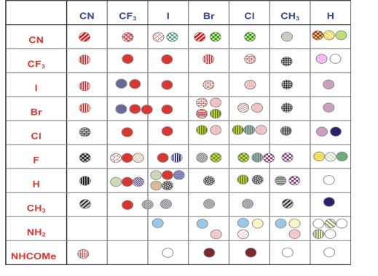
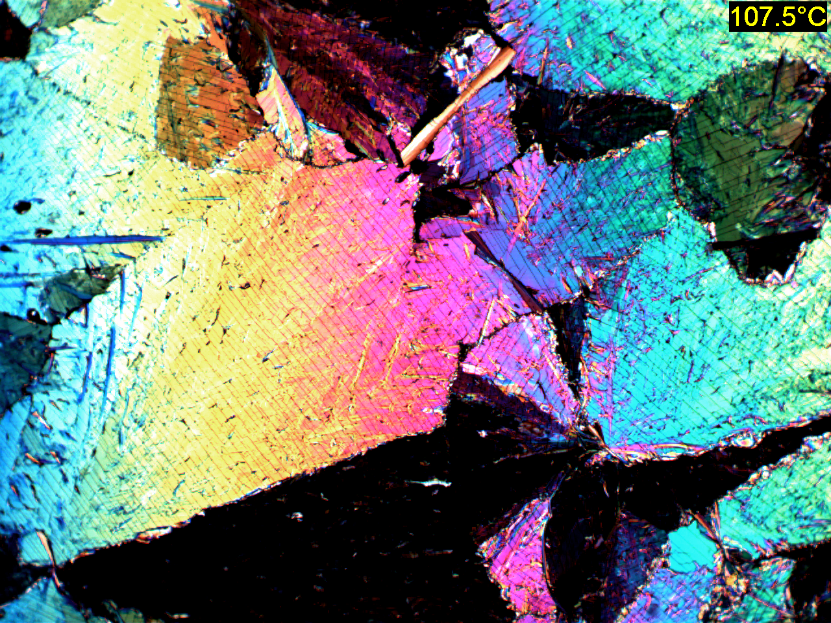
Chemical Crystallography
Chemistry Departmental Service
Commercial Service
Research areas
  Charge density
  Structures under change
  Structural systematics
  Crystal growth & formulation
  Data recording, management & publication
120K
293K
395K

Slide 5
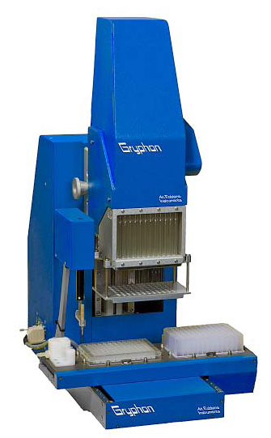
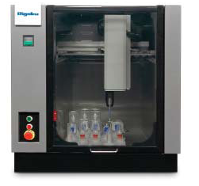
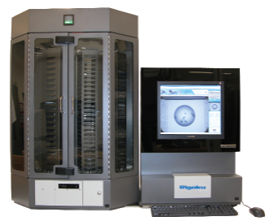
Macromolecular Crystallisation
Nanodrop
Screen Formulation
Imaging & Storage
Rigaku / Art Robbins Gryphon
Rigaku Alchemist
Rigaku Minstrel / Gallery

Slide 6
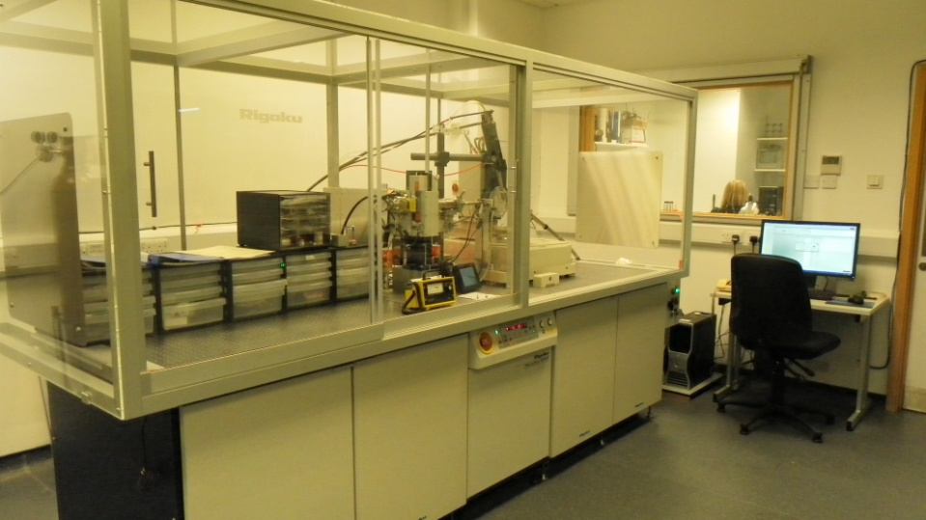
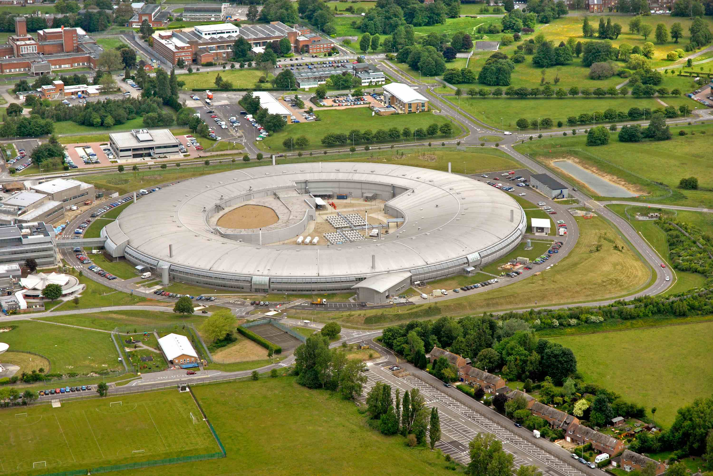
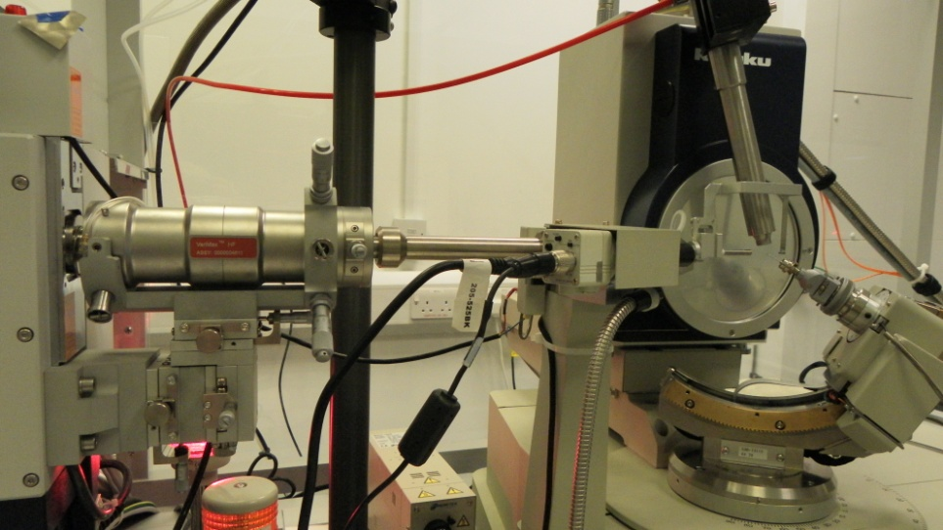
Macromolecular Diffraction
Cu rotating anode
Combined use by chemical and macromolecular groups
Notes:
If using a school logo, make sure that if you have a long page title, it does not encroach on the logo. Allow about 2cm around the logo. Run the page title onto two lines if necessary.

Slide 7
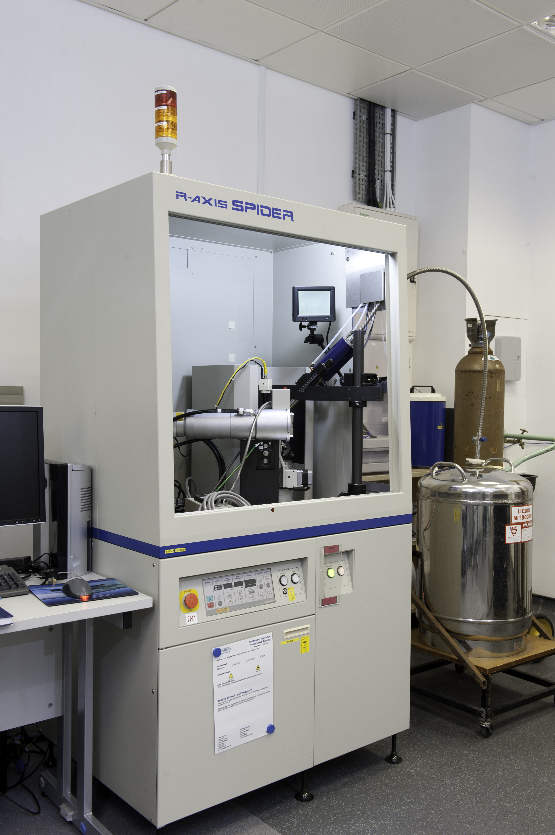
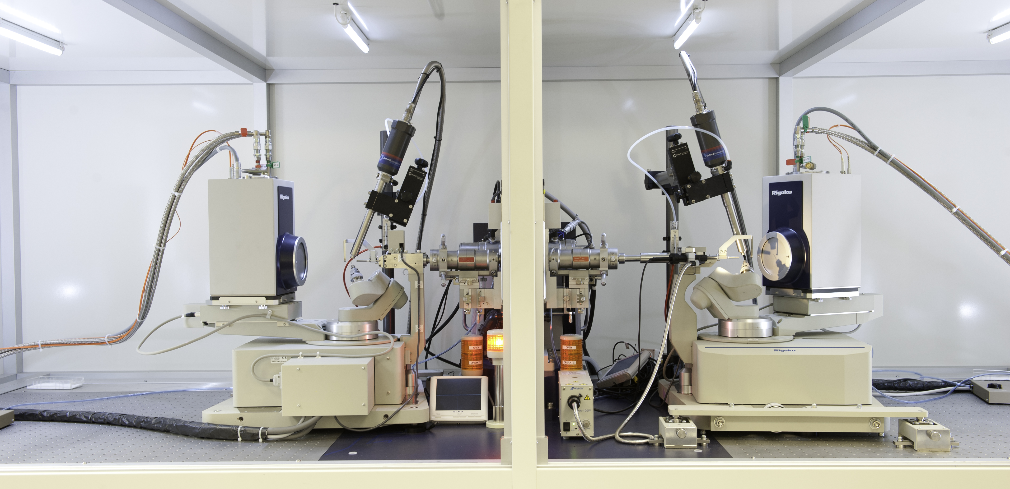
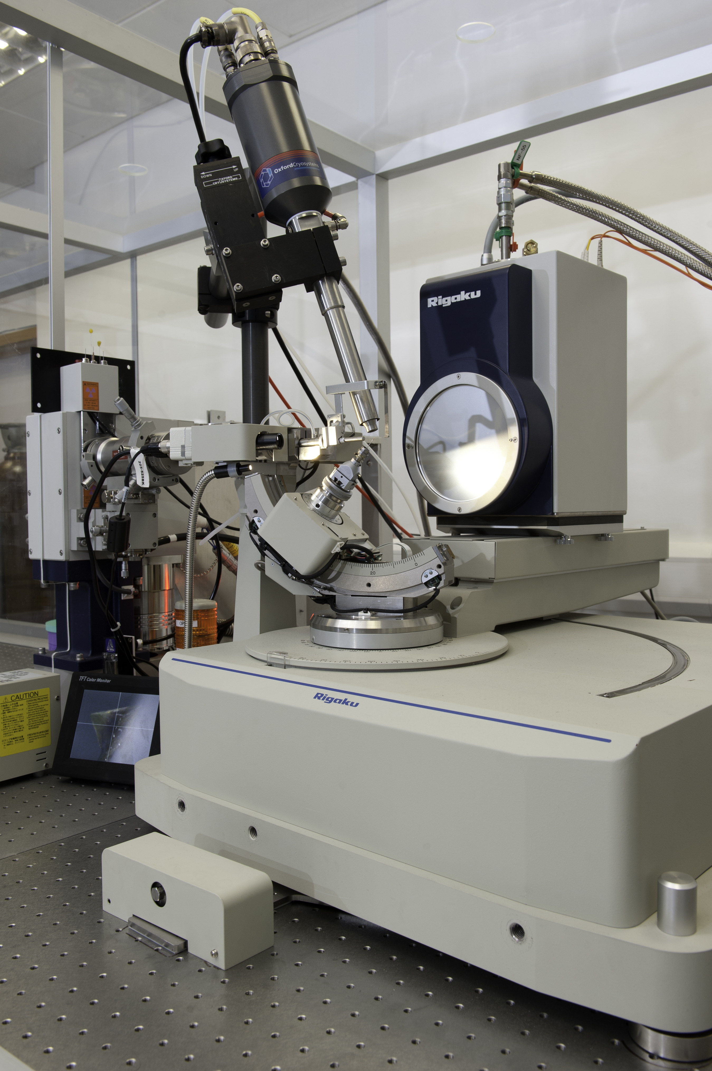
SDC diffraction instrumentation
FR-E+ with 2 Saturn 724+HG CCD detectors
007HF with Saturn 944+HG CCD
SPIDER Image Plate
Diamond synchrotron
  I19
  I24
  I02, 3 & 4

Slide 8
Why manage? #1
Volume
  Day to day coping
  How to “publish”??
Scientific Responsibility
  Accurate recording of the whole experiment
  Archival & curation
  Enabling future science

Slide 9
Why manage? #2
Diversity
  Heterogeneous data
  Disciplinary differences
  Institutional boundaries
Accountability
  Auditing and charging
  Funder mandates

Slide 10
Scale and Volume.
Notes:
Please use the dd month yyyy format for the date for example 11 January 2008. The main title can be one or two lines long.

Slide 11
Crystallographic Data Generation
At time of Mike Hursthouse retirement…
From 2011 -
Due to advances in:
Instrumentation
Software
Computing power
Efficiency
Data management is not keeping up!

Slide 12

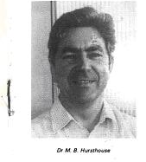
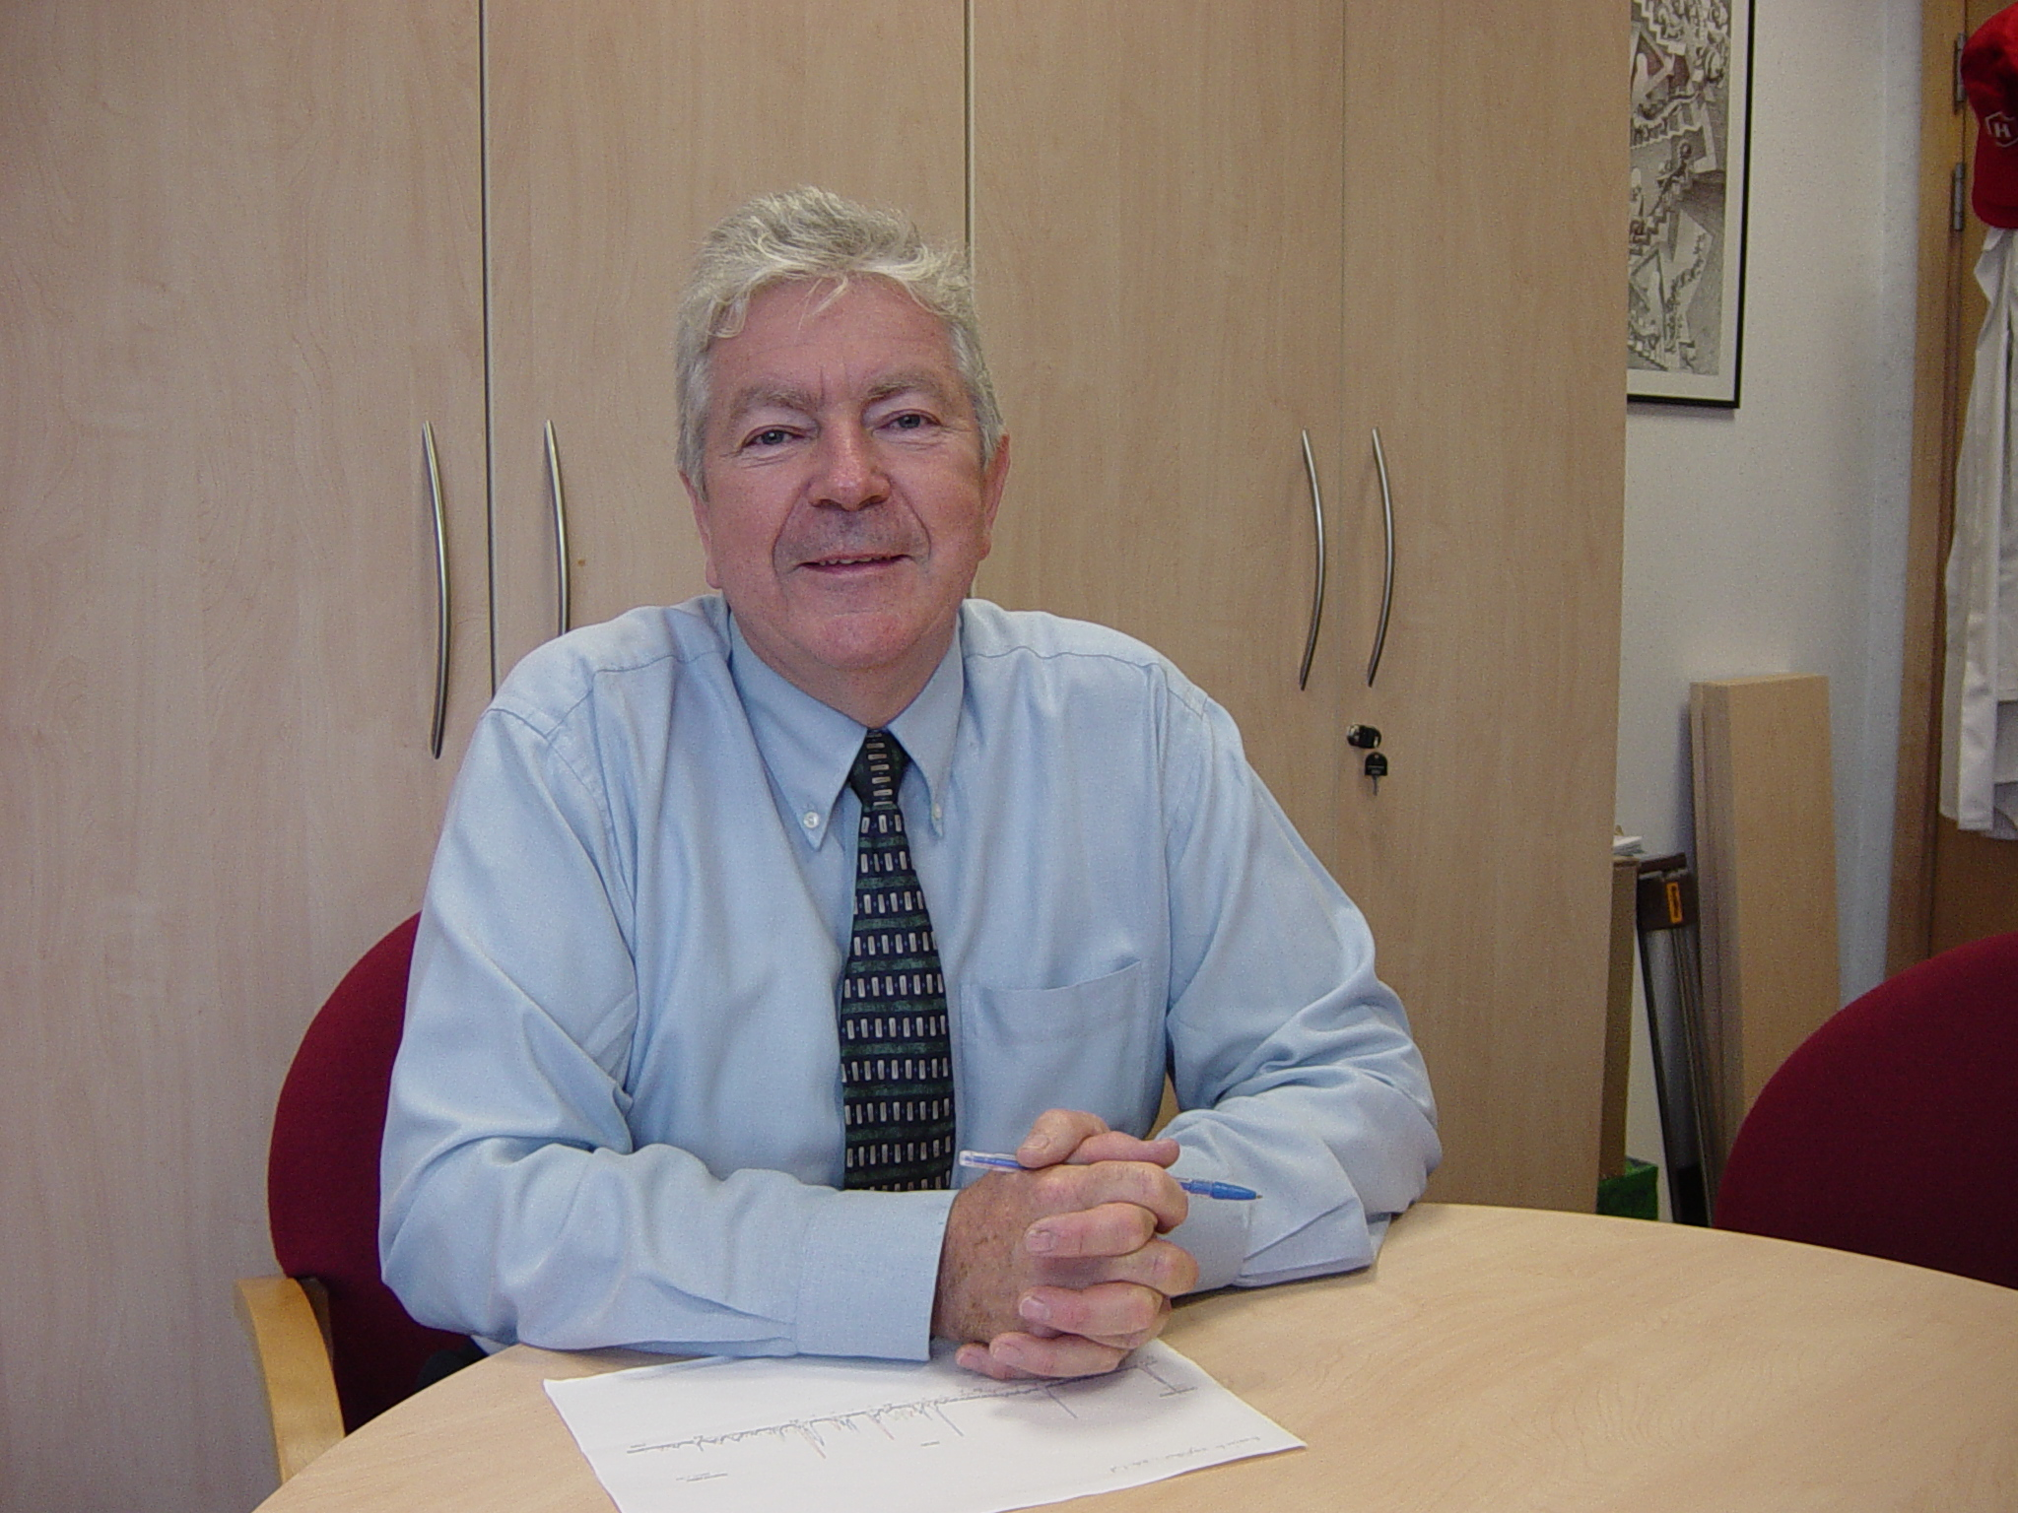
Learning from the past…
Mike Hursthouse
1967 > 2009
Only (formally) published ca 20% of the structures he produced
‘Records’ included - punch cards; line printouts; tapes; floppy disks (5¼” & 3½”); CD’s & DVD’s; removable media; on-line.
Management challenges over the years - much of these not retrievable
Resorting to theses and paper reports for required detail to make available in modern format
Only possible through ‘manual processing’
Ca 36 person months work has ‘clawed back’ some of the lost data
This effort will result in around 10-15% more life work being ‘published’
WE ARE HEADING DOWN THE SAME ROUTE WITH UNMANAGED DIGITAL DATA

Slide 13
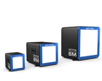
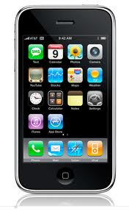
New Technology…
always comes along. Since Hursthouse retirement…

Slide 14
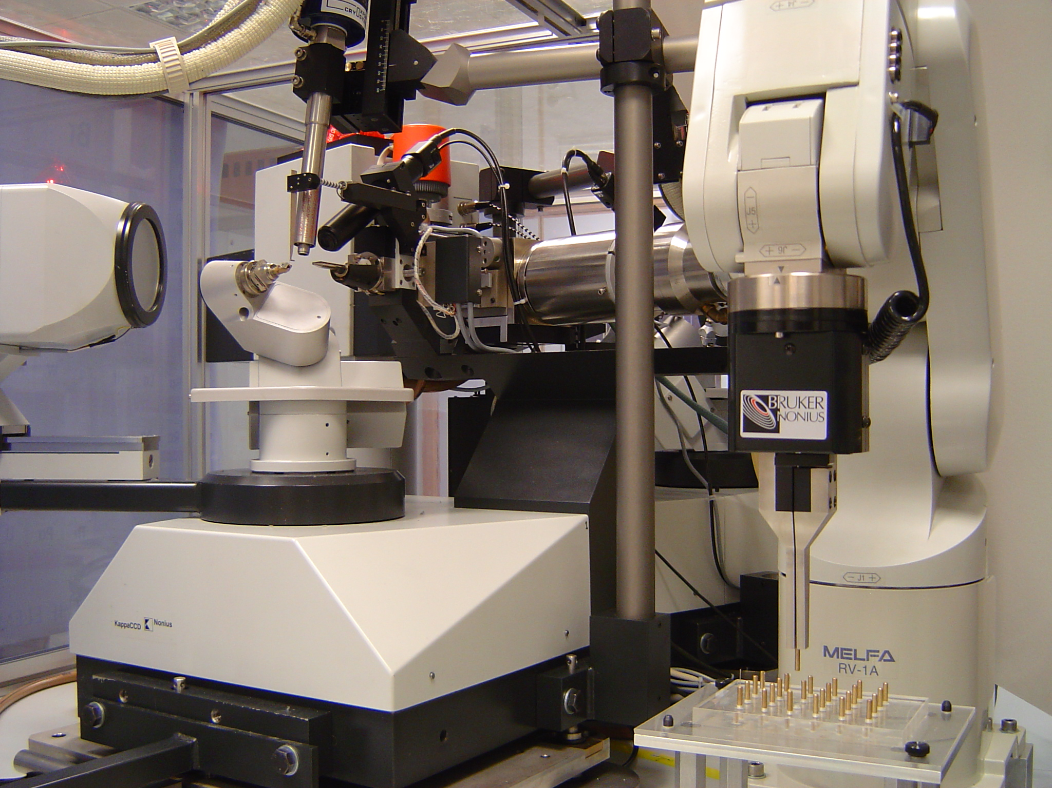
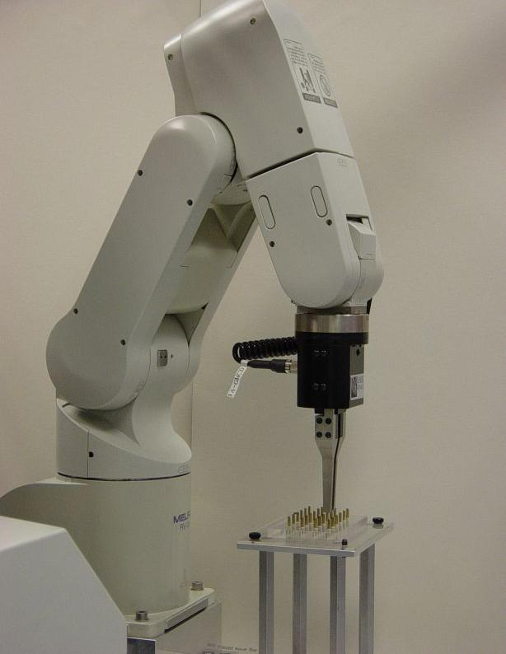
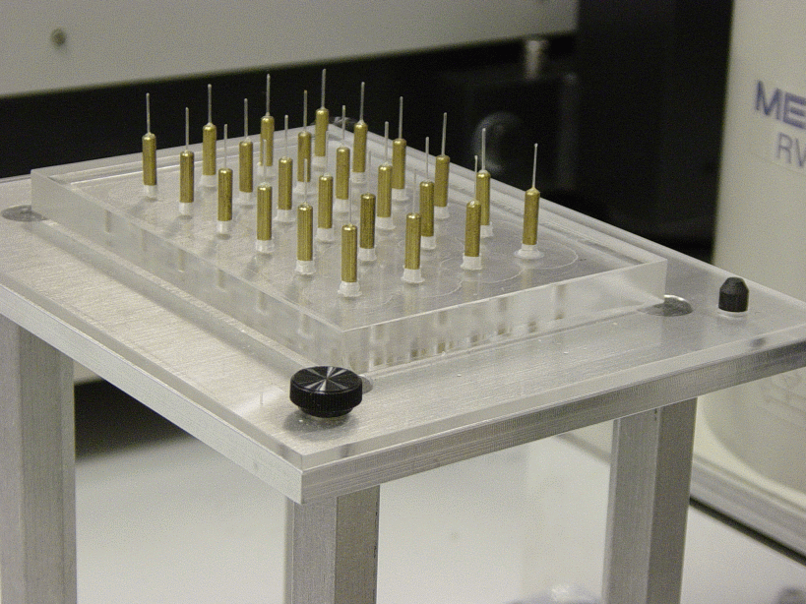
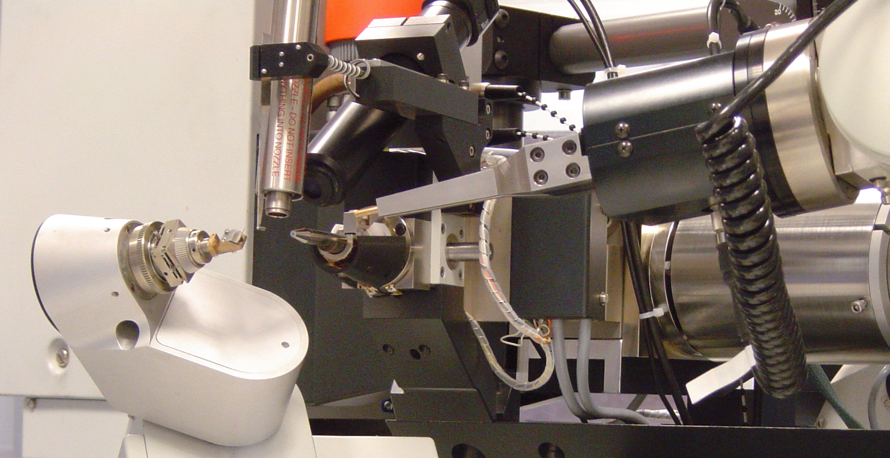
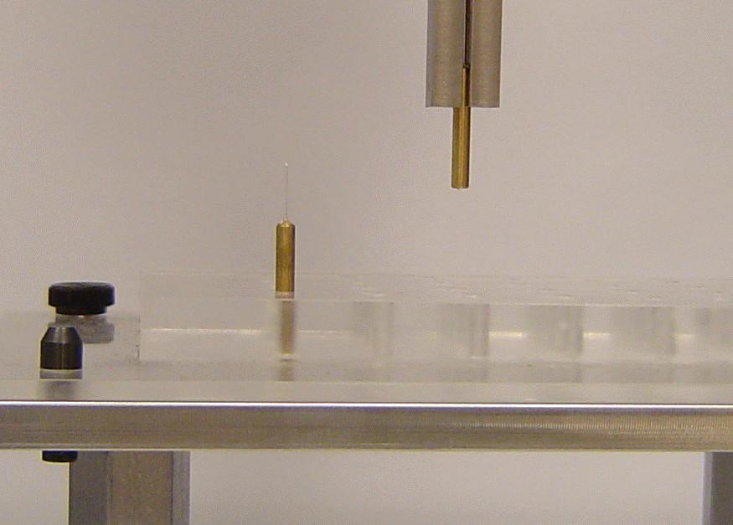
Automation (Chem. Cryst, 2003)
Mitsubishi Movemaster RV-1A 6 axis industrial robot with a CR1 controller – 30K
Internal control program accessed via serial port
24 capacity sample tray – bolted to table

Slide 15
Automation and the next generation: ECSES (2003)
e-Science pilot project
Proof of concept system
Informed design for real service developed under CombeChem testbed project
J. Appl. Cryst., (2005), 38, 819-826

Slide 16
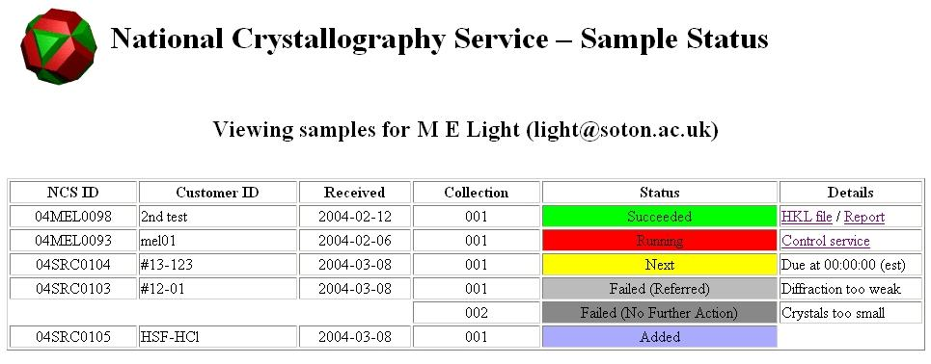

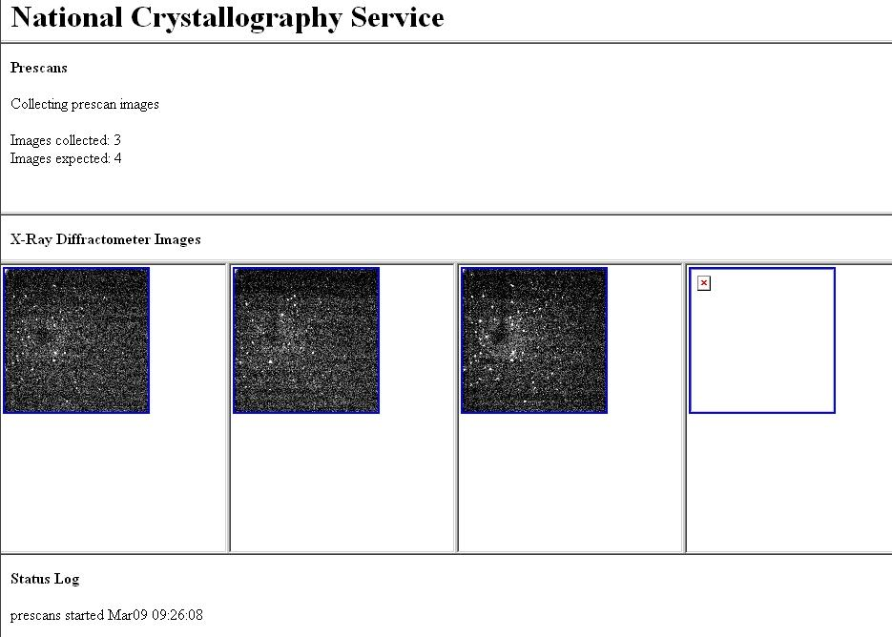
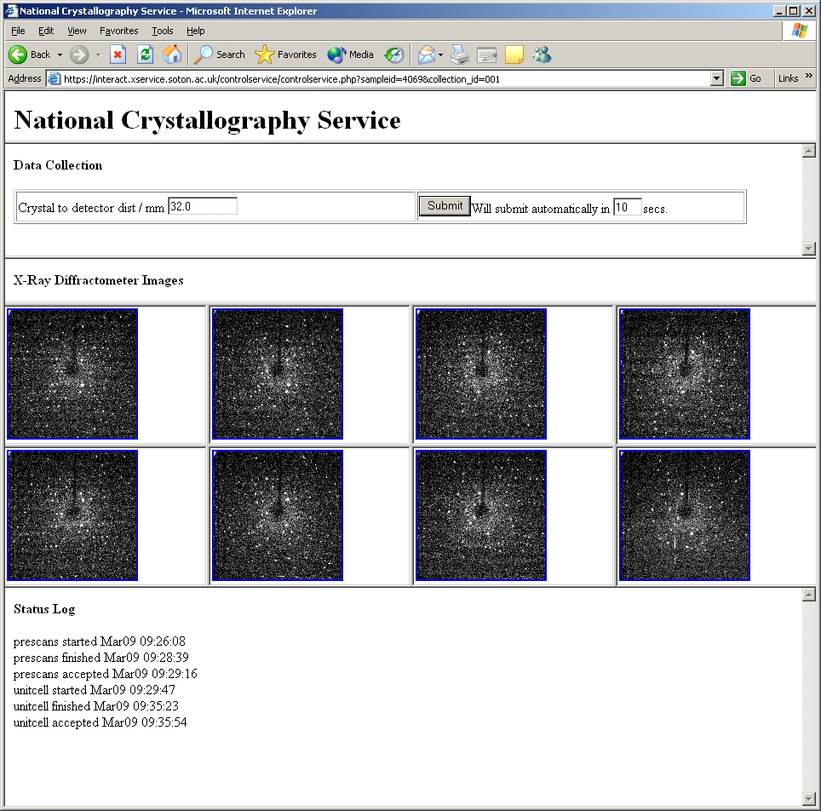

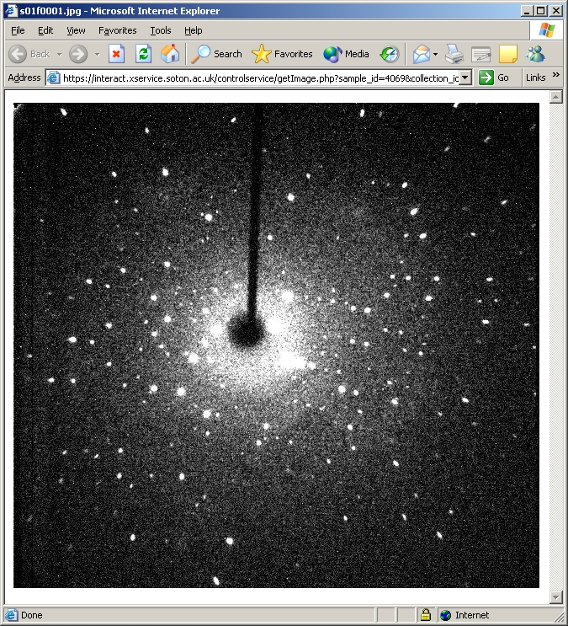
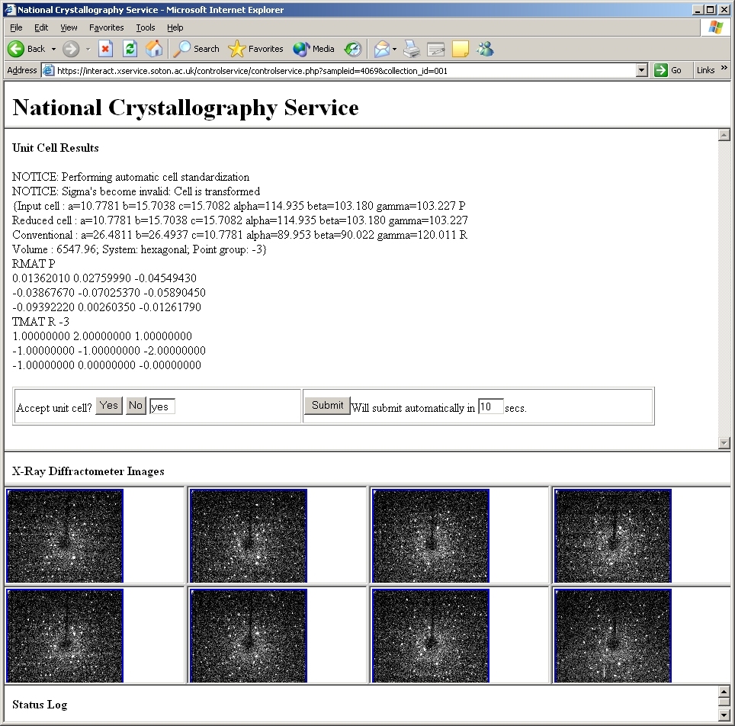
NCS Grid Service (2006)
J. Chem. Inf. Model., 2006, 46, 1006-1016

Slide 17
Rate of Diffraction Data Generation
2002-2011 8TB - archived at an off-site datastore (ATLAS)
New laboratory generates 6GB/day (3TB/year)
Diamond activity at least 1TB/year
Need large ‘scratch space’ for active data
Now cheaper and more practical for retrieval to run a local datastore with off site back up

Slide 18
Data Management (Eco)Systems
Publication Repository [Results Data]
LIMS [User & Sample Data]
ELN [Supporting Experiment Data]
Datastores [Underlying Diffraction Data]
How to integrate these??
J. Chem. Inf. Model., 2006, 46, 1006-1016

Slide 19
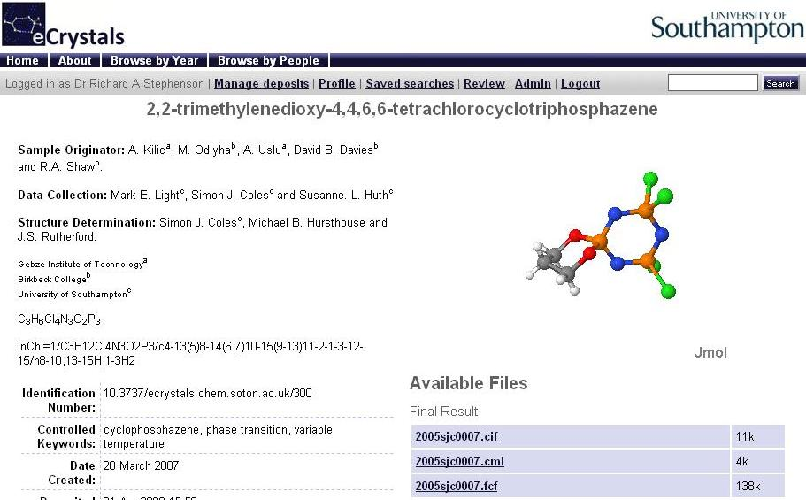

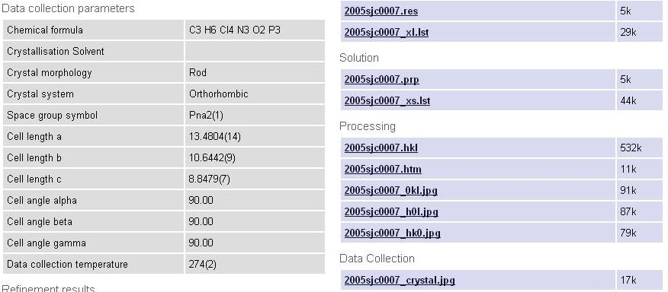



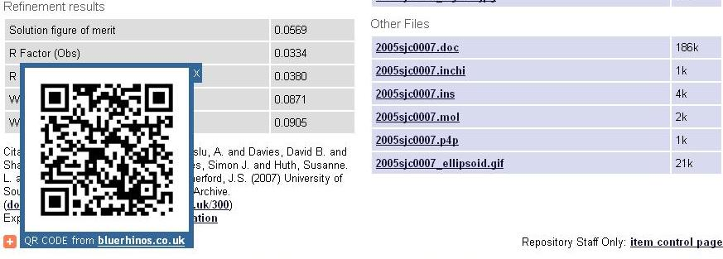


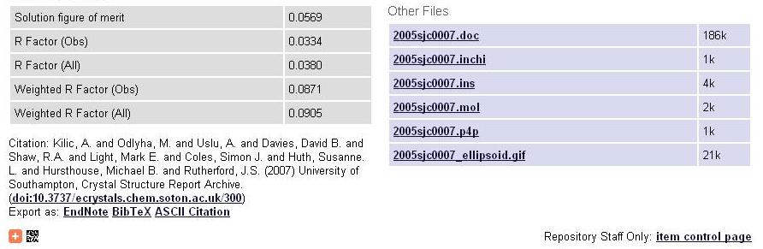
The eCrystals Data Repository
Quick & simple to deposit
Software tools
Laboratory archive
Community involvement
‘Embargo’ facility
Structured foundations
Discoverable & harvestable
http://ecrystals.chem.soton.ac.uk

Slide 20
A Thorough Approach to Dissemination
Using simple Dublin Core protocol (OAI-PMH)
    Crystal structure
    Title (Systematic IUPAC Name)
    Authors
    Affiliation
    Creation Date
Additional chemical information through Qualified Dublin Core
    Empirical formula
    International Chemical Identifier (InChI)
    Compound Class & Keywords
Specifies which ‘datasets’ are present in an entry
Application Profile http://www.ukoln.ac.uk/projects/ebank-uk/schemas/
DOI links http://dx.doi.org/10.1594/ecrystals.chem.soton.ac.uk/145
Rights & Citation http://ecrystals.chem.soton.ac.uk/rights.html

Slide 21
But what about the rest of the experiment - especially the diffraction data?!
Representative information, but not designed for big data
Little experimental detail

Slide 22
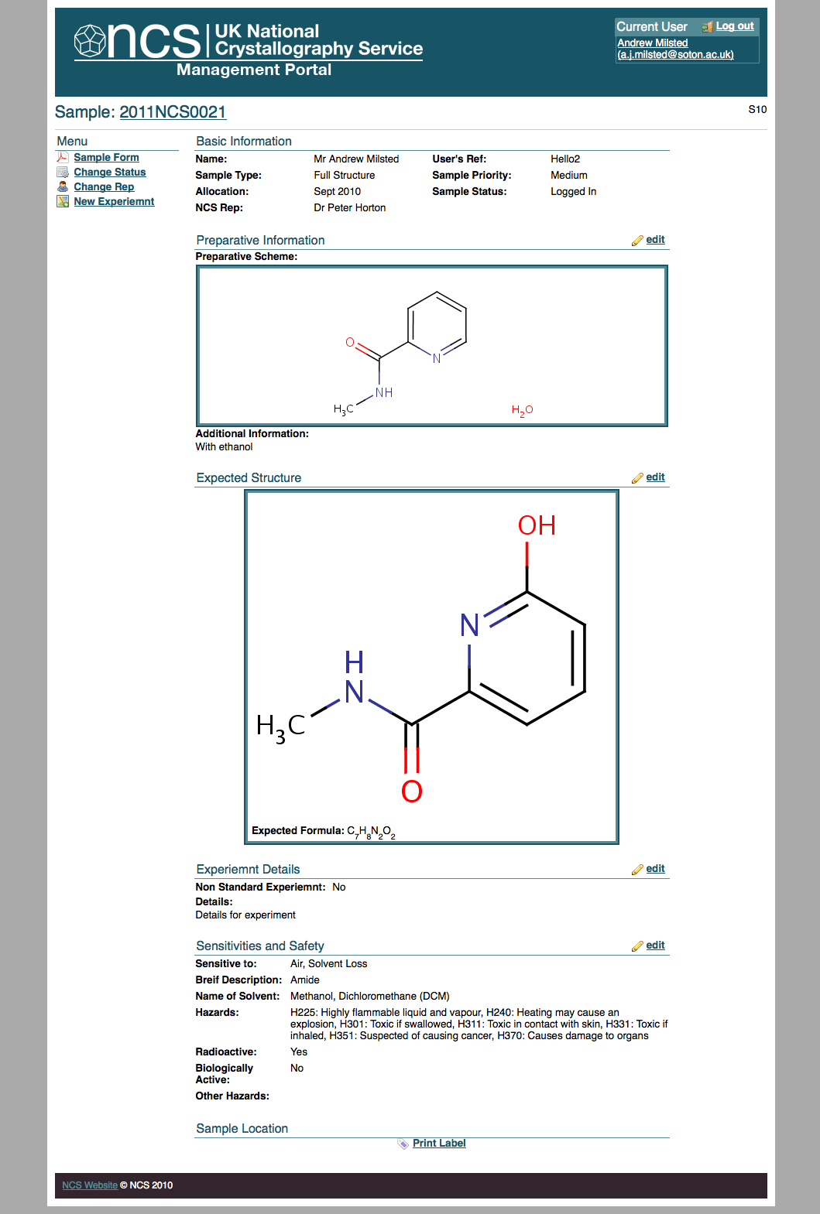
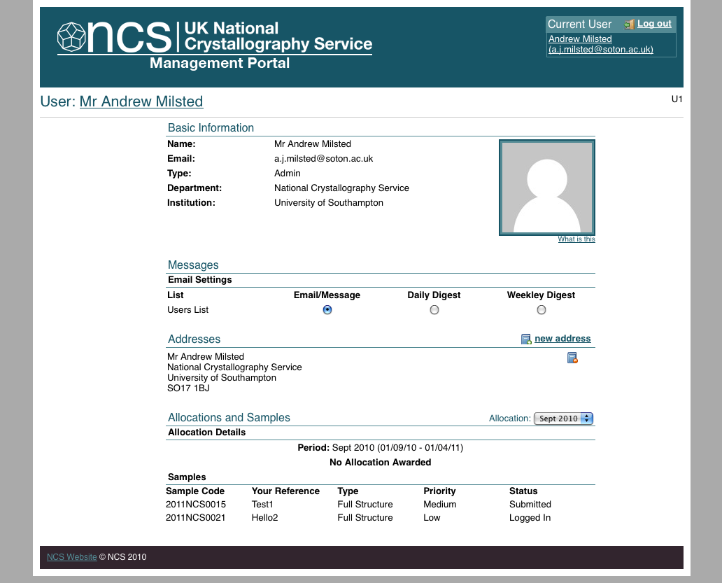
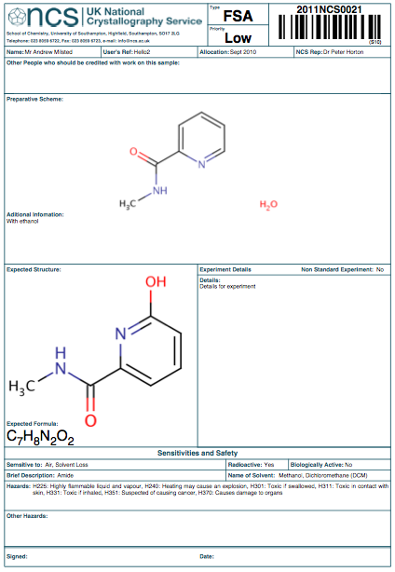
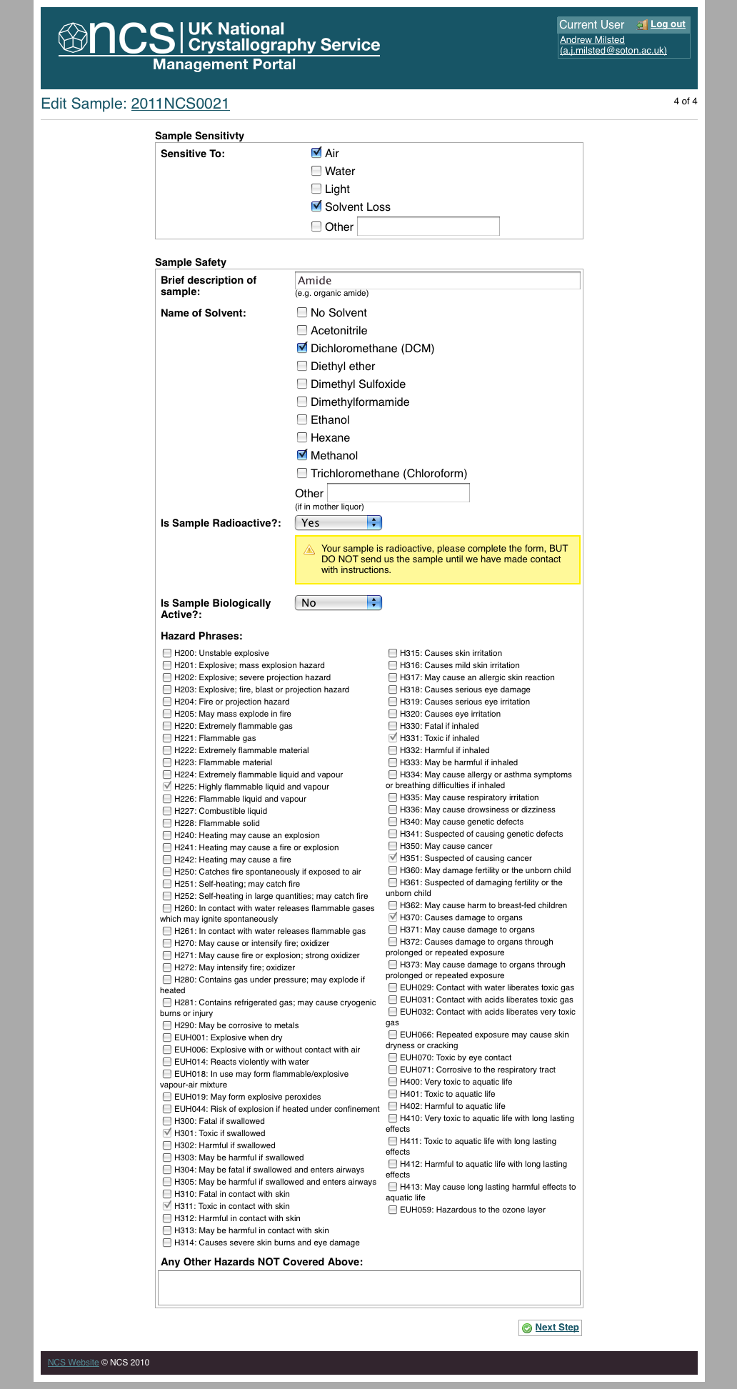
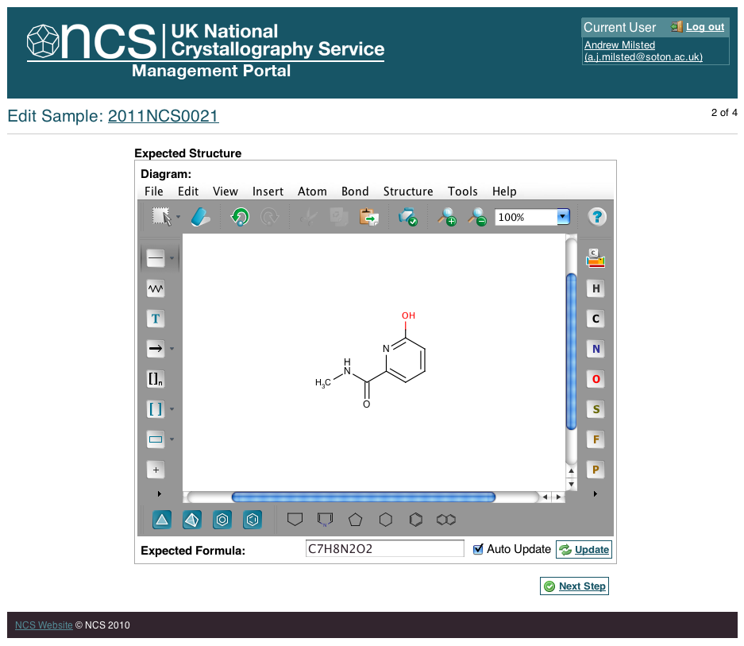
Whole Lifecycle Management
Laboratory Information Management System
Proposal
Approval
Submission
Experiment
Analysis
Publication
Admin
Reporting

Slide 23
Scientific Responsibility.
Notes:
Please use the dd month yyyy format for the date for example 11 January 2008. The main title can be one or two lines long.

Slide 24
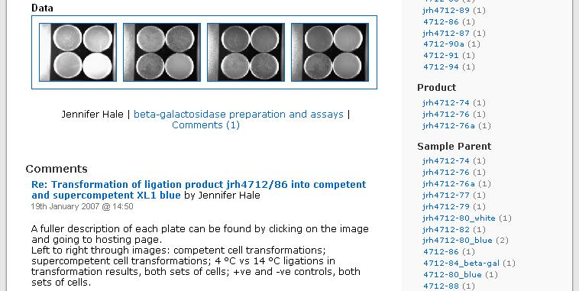
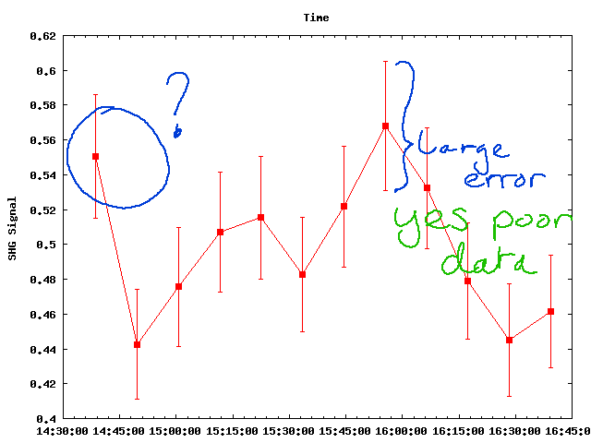
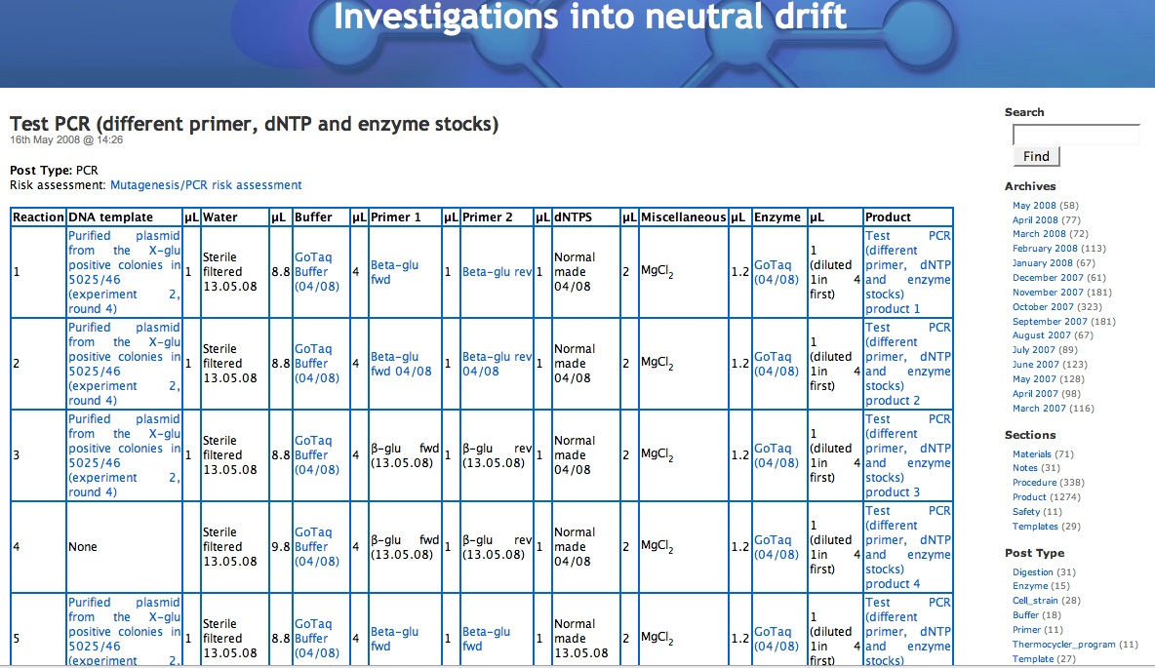
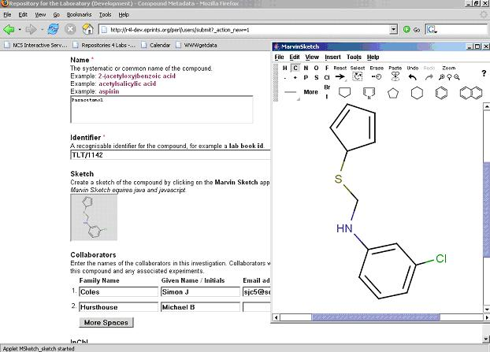
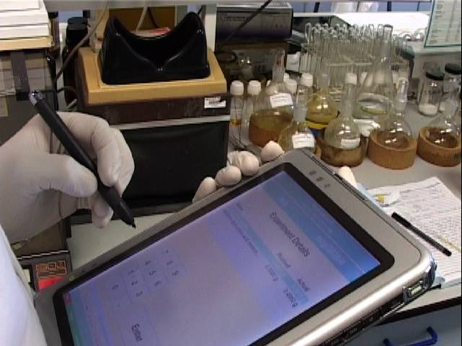
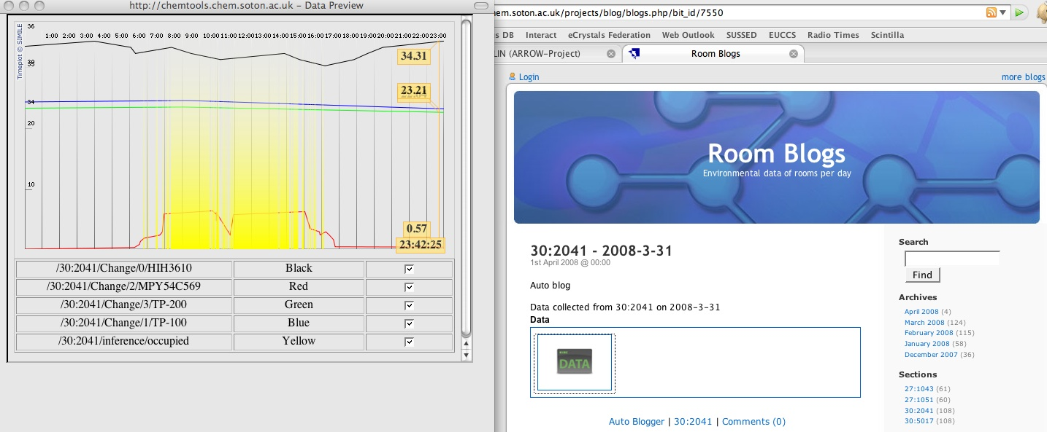

Capture, Management & Sharing
– of everything
Note taking
Collaboration
Synthesis
Structure
Spectra
Instruments
Rooms
http://www.labtrove.org/

Slide 25
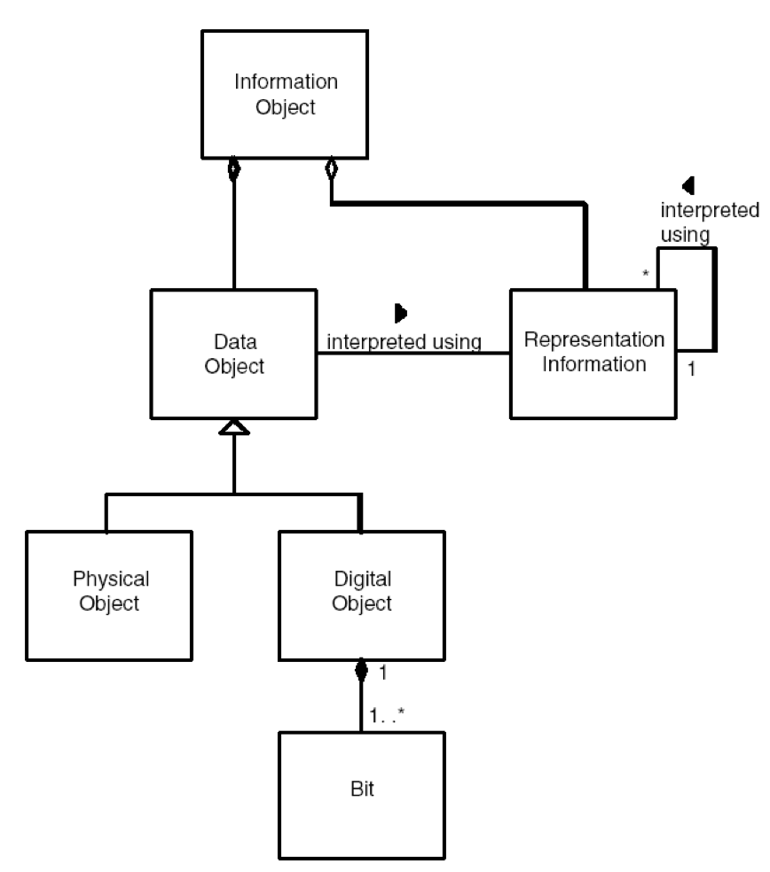
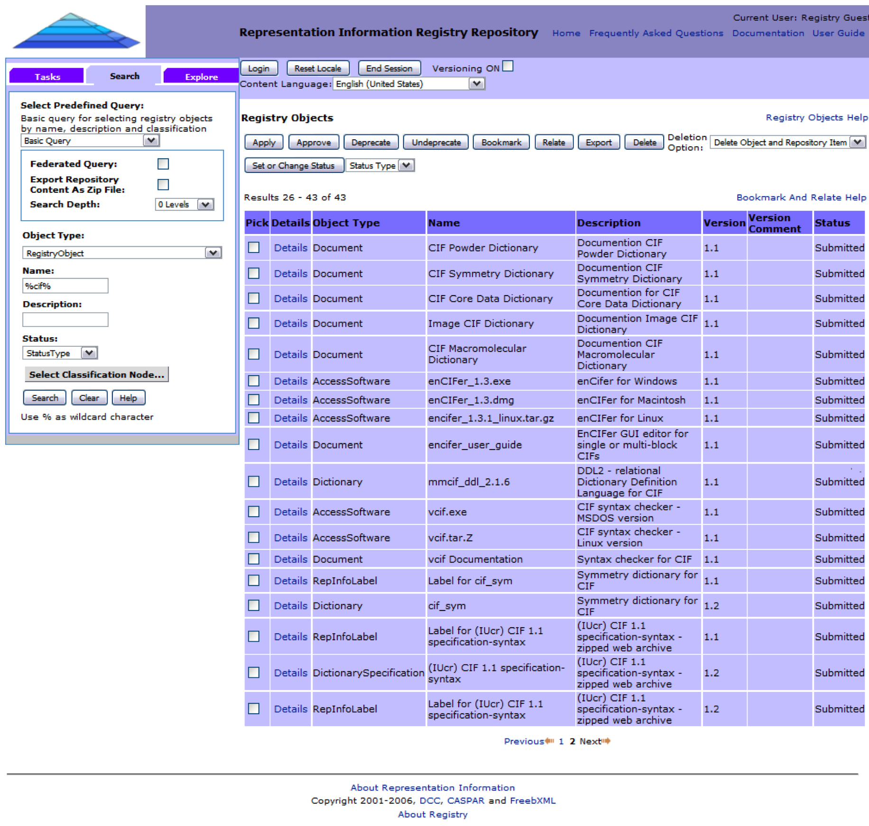
Preserving the record
Representation Information for Crystallography Data
OAIS model
  Information required for rendering, processing, interpreting, using and understanding data
Developed DCC/CASPAR registry (RRoRI)
  Combination of workflow and domain analysis
M. Patel, S. Coles, D. Giaretta, S. Rankin & B. McIlwrath, The role of OAIS representation information in the digital curation of crystallography data, IEEE International Conference on eScience, 2009, 132-139

Slide 26
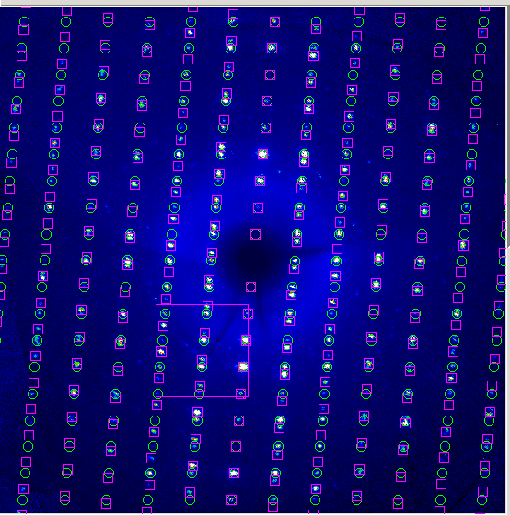



Enabling Future Science
- tackling hard problems
180º rotation about c*: R-factor = 3.5%

Slide 27



Enabling Future Science
- saving what we cant do now for later
Split crystals
Disorder
Anisotropic Mosaicity

Slide 28


Enabling Future Science
- standing on the shoulders of giants
We increasingly rely on the work of others to get a better understanding of the bigger picture.
Must be able to reliably evaluate the ‘quality’ of others results

Slide 29
Diversity.
Notes:
Please use the dd month yyyy format for the date for example 11 January 2008. The main title can be one or two lines long.

Slide 30

The Whole Research Process

Slide 31
How Many Standards?!
Papers, articles, presentations, reports
CCDC; PDB; IUCr XML; CIF
Scholarly Knowledge
Publish
Research
CML; PDBML; TopCAT; TARDIS; eCrystals; DCC
Research Concept
and/or
Experiment Design
P&E; DCC; NSF; ICAT; NCS
Publication Database
Research Outputs
Validate, Reuse
& Repurpose Data
Write Proposal
(include DMP)
Peer Review Research
Discover & Access
Peer-review Proposal
Prepare Manuscript
IPR, Embargo & Access Control
Comments, annotations, ratings etc.
Reference Linking
Prepare Supplementary Data
Archive, Preservation & Curation
Start Project
User registration data; Instrument allocation data etc.
Documentation, Metadata & Storage
(Reference, Provenance, Context, Calibration etc.)
Write Usage Reports
Acquire Sample
Results Data
Derived Data
Processed Data
Raw, Correction
& Calibration
Data
Risk assessment data; other sample data
P&E; CIF; imgCIF; ICAT; NeXus
Interpret & Analyse
Results Data
Analyse
Derived
Data
Process Raw Data into Derived Data
Conduct Experiment
Generate, Create,
& Collect Raw Data
Appraisal & Quality Control
Programs (generate customised software)
KEY
Research Activity
Research Admin Activity
Archive Activity
Publication Activity
Information Flow

Slide 32

Different Practices
- The ‘Lone’ Researcher
Considers research as ‘linear’ &/or ‘individual’ processes
Considers data volumes to be manually manageable
Relatively low-powered instrumentation
Is less concerned with sharing
Has little or no support infrastructure
Conceive
Propose
Experiment
Research
Analyse
Publish

Slide 33
Different Practices
- Mid-range Facility
Proposal
Approval
Submission
Experiment
Analysis
Publication
Service provision function / working as a team
Technique focused
High powered lab-based instrumentation
Operating across institutions
Moderate infrastructure
Local data management solutions

Slide 34


Different Practices
- Central Facilities
Operate on behalf of multiple institutions (community)
Have established and often bespoke & formulaic experimental processes
Very powerful custom instrumentation
Have large supporting infrastructure
Users take data away (different mechanisms)
Don’t often know what happens to data
Proposal
Approval
Schedule
Experiment
Archive
Analyse
Publish

Slide 35

Management Across Boundaries
Management across facilities (ICAT Information Model)
Conceive
Propose
Experiment
Research
Analyse
Publish
NCS User
Proposal
Approval
Submission
Experiment
Analysis
Publication
NCS
Proposal
Approval
Schedule
Experiment
Archive
Analyse
Publish
Central Facility

Slide 36


ICAT & CSMD
The Core Scientific Metadata model forms the information model for ICAT & is designed to describe facilities-based experiments in Structural Science
User Database System
Single Sign On
Data Storage/ Delivery System
Proposal System
Publication System
ICAT API
e-Science Services
RDBMS
Software Repository
Web Services API
Command Line Tools
Fortran
C++
Java
Glassfish / JBOSS

Slide 37
CSMD as a Starting Point
Topic
Publication
Keyword
Authorisation
Investigation
Investigator
Dataset
Sample
Sample Parameter
Forms the basis for extensions:
  To derived data
  To laboratory based science
  To secondary analysis data
  To preservation information
  To publication data
Datafile
Dataset Parameter
Parameter
Related Datafile
Datafile Parameter

Slide 38
Accountability.
Notes:
Please use the dd month yyyy format for the date for example 11 January 2008. The main title can be one or two lines long.

Slide 39
Financial Considerations
Requirement to fund facility – including publishing outputs
Requirement to report to funders
Cost of preserving crystallographic data (/dataset)
Coles & Beagrie in “Keeping Research Data Safe”, 2009, http://www.beagrie.com/krds.php

Slide 40

Financial Considerations
What’s the cost of NOT managing data??
Cost (/dataset) of migrating data (it was not possible to migrate raw data acquired during 1970-1990 & 1990-2000)
“It is important to note that the cost to generate a structure with current equipment is £328, however the cost to recreate a structure from the 1970 and 1990 periods is around SIXTY times this amount. The reason for this is the differentiation between RAW and RESULTS data: as with most experimental science, these are treated differently in terms of data management and preservation. The cost of recreating historical data is defined by the need to resynthesise the sample from which that data were generated, which includes all the expertise and laboratory infrastructure from an entire research project – it is not simply a matter of ‘doing the experiment (or analysis) again’. The reason the sample needs to be resynthesised is that it has not been possible in these eras to store and preserve raw data.”
Coles & Beagrie in “Keeping Research Data Safe”, 2009, http://www.beagrie.com/krds.php

Slide 41
Funder Mandates
http://www.epsrc.ac.uk/about/standards/researchdata/Pages/
http://www.epsrc.ac.uk/about/infoaccess/Pages/roaccess.aspx

Slide 42
Technical Requirements.
Notes:
Please use the dd month yyyy format for the date for example 11 January 2008. The main title can be one or two lines long.

Slide 43



Architecture of system 1998-2011
Manual deposit into results repository
ATLAS
Datastore
Manual deposit into long-term storage

Slide 44
Architecture of system 2011-
All facility data in a single object store with “permissions”
Object store contents can be made public if desired
Communication with lab through mounted drives and SIMS
Lab
Firewall
NCS
Firewall
Sample Data
Expt Info
Image Data
Processing
Results Data
Facility User
Diffractometer
Control (CrystalClear)
NCS Scientist
Soton
Firewall
Institutional
Datastore

Slide 45

SIMS:
Sample Information Management System
A standard/format for crystallographic sample and experiment data management and archival
Supported by CrystalClear and NCS Portal, providing interaction between facility, instruments and CIF, ImgCIF etc

Slide 46

It still takes people to make it work!
- Particularly understanding crystallographers and “Systems Admin” support!
Mark Light, Mateusz Pitak Simon Coles, Phil Gale, Andrew Milsted, Sarah Milsted, Peter Horton, Graham Tizzard.
Claire Wilson @

Slide 47
Thanks!
You know who you are…
Co-workers, collaborators and funders are too numerous to mention!

