Slide 1
Towards policy for archiving raw data for macromolecular crystallography: Experience gained with EVAL
Loes Kroon-Batenburg, Antoine Schreurs , Simon Tanley and John Helliwell
Bijvoet Centre for Biomolecular Research, Utrecht University
The Netherlands
School of Chemistry, University of Manchester, UK

Slide 2
Reasons for archiving raw data
Allow reproducibility of scientific data
Safeguarding against error and fraud
Allow further research based on the experimental data and comparative studies
Allow future analysis with improved techniques
Provide example materials for teaching

Slide 3
Which data to store?
All data recorded at synchrotrons and home sources?
On ccp4bb we have seen estimates of 400,000 data sets of 4 Gb each, so some 1,600 Tb per year, which would cost 480,000- 1,600,000 $/year for long term storage world wide
Only data linked to publications or the PDB?
Only a fraction of the previous: 32 Tb per year and not more than 10,000 $/year

Slide 4
Where to store the data?
At the synchrotron facilities where most of the data are recorded?
Or is the researcher responsible?
And the data from home sources?
Federated respositories, like TARDIS.
Transfer of data over the network is time consuming
Better leave the data where the are
Large band-width acces?

Slide 5
How should we store the data?
Meta data
Make sure we can interpret the data correctly and that can we can reproduce the original work
Validation, cross checking
Only for those data associated with publications?
Standardization
Standard or well described format?
Compression
Can we accept lossy data compression?

Slide 6
Pilot study on exchanging raw data
Data of 11 lysozyme crystals, co-crystallized with cisplatin, carboplatin, DMSO and NAG, were recorded in Manchester, on two different diffractometers, originally processed with the equipment’s built-in software
Systematic differences between the refined structures, in particular between B-factors, prompted for further study using the same integration software for all data

Slide 7
...pilot study
EVAL, developed in Utrecht, could do the job
Data were transferred from Manchester to Utrecht
35.3 Gb of uncompressed data. Transfer took 30 hours, spread over several days
Data were compressed in Utrecht, using ncompress (lossless data compression with LZW algorithm) to 20 Gb, and can readily be read with EVAL software

Slide 8
The data
Rigaku Micromax-007 R-axis IV image plate
4 crystals ~1.7 Å and 2 crystals ~2.5 Å resolution; redundancy 12-25
One image 18/9 Mb uncompressed/compressed
1° rotation per frame, only φ-scans
Bruker Microstar Pt135 CCD
5 crystals ~1.7 Å resolution; redundancy 5-31
One image 1.1/0.8 Mb
0.5° rotation per frame, ω- and φ-scans
Data sets vary between 0.5-3.1 Gb in size

Slide 9
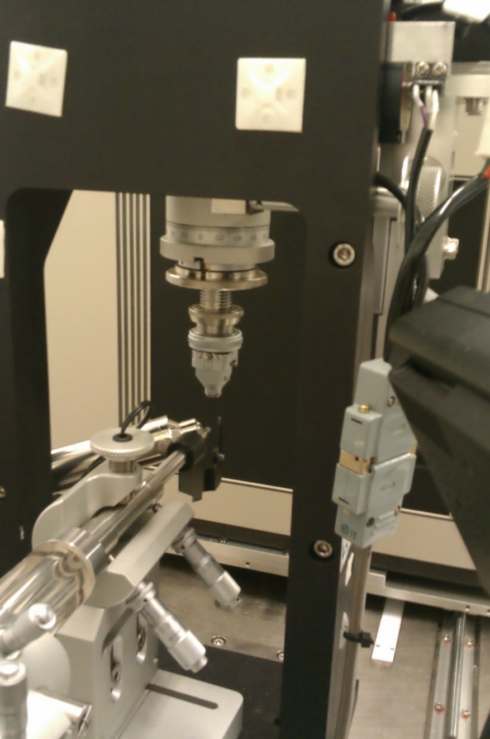
Rigaku Micromax-007 R-axis IV
Single vertical rotation axis
Fixed detector orientation;
variable distance
Cu rotating anode
Confocal mirrors

Slide 10
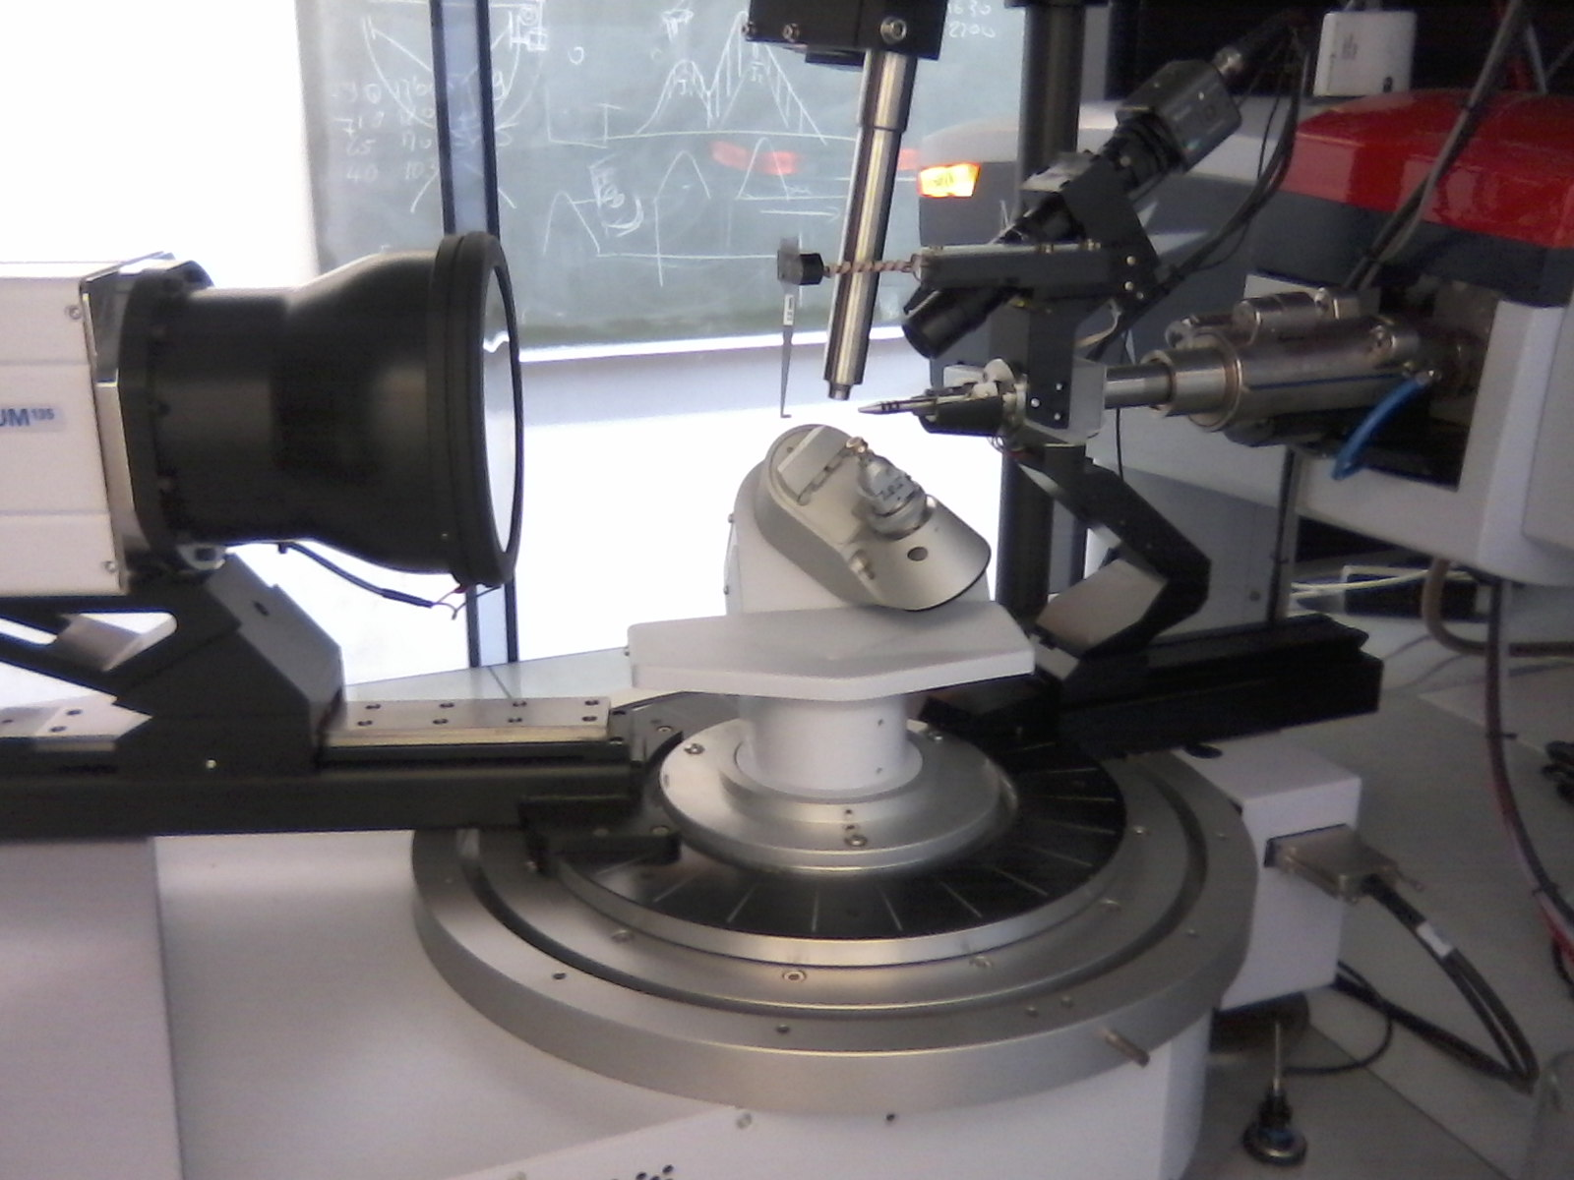
Bruker Microstar Platinum135 CCD
Kappa goniometer
Detector 2θ angle
and distance
Cu rotating anode
Confocal mirrors

Slide 11
Rigaku header information
s01f0001.osc.Z Opened finalfilename=s01f0001.osc.Z binary header
a12cDate [2010-10-25] ==> ImhDateTime=2010-10-25
a20cOperatorname [Dr. R-AXIS IV++]
a4cTarget [Cu] ==> ImhTarget=Cu
fWave 1.5418 ==> Target=Cu Alpha1=1.54056 Alpha2=1.54439 Ratio=2.0
fCamera 100.0 ==> ImhDxStart=100.0
fKv 40.0 ==> ImhHV=40
fMa 20.0 ==> ImhMA=20
a12cFocus [0.07000]
a80cXraymemo [Multilayer]
a4cSpindle [unk]
a4cXray_axis [unk]
a3fPhi 0.0 0.0 1.0 ==> ImhPhiStart=0.0 ImhPhiRange=1.0
nOsc 1
fEx_time 6.5 ==> ImhIntegrationTime=6.5
a2fXray1 1500.700073 ==> beamx=1500.700073
a2fXray2 1500.899902 ==> beamy=1500.899902
a3fCircle 0.0 0.0 0.0 ==> ImhOmegaStart=0.0 ImhChiStart=0.0 ImhThetaStart=0.0
a2nPix_num 3000 3000 ==> ImhNx=3000 ImhNy=3000 ImhNBytes=6000
a2nPix_size 0.1 0.1 ==> ImhPixelXSize=100.0 ImhPixelYSize=100.0
a2nRecord 6000 3000 ==> Recordlength=6000 nRecord=3000
nRead_start 0
nIP_num 1
fRatio 32.0 ==> ImhCompressionRatio=32.0
ImhDateTime=Mon 25-Oct-2010 16:21:52
DetectorId=raxis GoniostatId=raxis
BeamX=1500.7 => ImhBeamHor=0.07 BeamY=1500.9 => ImhBeamVer=0.09 rotateframe=0
ImhCalibrationId=raxis TotalIntegrationTime=6.5 TotalExposureTime=6.5
ImageMotors: PhiInterval=1.0 SimultaneAxes=1 Header 1. ix1=1 ix2=3000 dx=1
iy1=1 iy2=3000 dy=1 nb=0 rotateframe=0 Frame 1. Closed.

Slide 12
Bruker header information
s10f0001.sfrm.Z Opened
FORMAT :100
==> ImhFormat=100
MODEL :MACH3 [541-26-01] with KAPPA [49.99403]
==> ImhDetectorId=smart5412601 ==> ImhGoniostattype=x8
NOVERFL:3599 6808 0
==> Nunderflow=3599 NOverflow1=6808 NOverflow2=0
==> ImhDateTime=06/14/11 10:21:57
CUMULAT:10.000000
==> Exposuretime=10.0
ELAPSDR:5.000000 5.000000
==> Repeats=2
ELAPSDA:5.000000 5.000000
OSCILLA:0
NSTEPS :1
RANGE :0.500000
START :0.000000
==> SmartRotStart=0.0
INCREME:0.500000
==> SmartRotInc=0.5
ANGLES :0.000000 358.750000 0.000000 0.000000
==> Start Theta=0.0 Omega=-1.25 Phi=0.0 Chi=0.0
NPIXELB:1 1
==> ImhDataType=u8
NROWS :1024
==> ImhNy=1024
NCOLS :1024
==> ImhNx=1024
TARGET :Cu
==> ImhTarget=Cu
==> ImhHV=45
==> ImhMA=60
CENTER :503.839996 497.820007 506.869995 499.899994
==> beamx=503.84 beamy=497.82
DISTANC:5.000000 5.660000
==> ImhDxStart=50.0
CORRECT:0138_1024_180s._fl
WARPFIL:0138_1024_180s._ix
AXIS :3
DETTYPE:CCD-LDI-PROTEUMF135 55.560000 0.660000 0 0.254000 0.050800 1
==> px512/cm= 55.56 ImhNx 1024 PixelXSize=89.99 PixelYSize=89.99 Extra distance=6.6 (not used)
NEXP :2 566 64 0 1
==> Baseline=64 MedianAdcZero=67.0
CCDPARM:13.900000 10.450000 40.000000 0.000000 960000.000000
==> DetGain=3.83
DARK :0138_01024_00010._dk

Slide 13
Issues of concern
During the last decade in Utrecht knowledge has been obtained about experimental set-up of both the Rigaku and Bruker equipment
Critical issues are the orientations of the goniometer axes and their direction of rotation
Fastest and slowest running pixel coordinates in the image and definition of direct beam position
Software developer has to implement many image formats

Slide 14
Data processing
Rigaku images: d*Trek, EVAL, Mosflm
Image plates: no distortion and non-uniformity corrections needed
Bruker images: Proteum, EVAL, Mosflm
Distortion and flood field correction is applied in Proteum
EVAL can use the distortion table, data are integrated in uncorrected image space
For Mosflm the images had be unwarped and converted to Bruker/Bis 2 byte format (.img) using FrmUtility. Mosflm interprets ω-scans as if they were φ-scans. Detector swing-angles are treated as detector offsets.

Slide 15
Rigaku data
Crystal that diffract to 1.7 Å
Crystal | 1 | 1 | 1 | 2 | 2 | 2 | 3 | 3 | 3 | 4 | 4 | 4
PDB ID | 3TXB | 4DD0 |  | 3TXD | 4DD2 |  | 3TXE | 4DD3 |  | 3TXI | 4DD9
 | d*Trek | EVAL | Mosflm | d*Trek | EVAL | Mosflm | d*Trek | EVAL | Mosflm | d*Trek | EVAL | Mosflm
Unit cell* | 78.66 36.96 | 78.69 36.90 | 78.61 36.91 | 78.88 36.99 | 78.91 36.99 | 78.90 37.00 | 78.66 37.44 | 78.53 37.36 | 78.54 37.38 | 78.66 36.98 | 78.53 37.36 | 78.04 37.98
Rmerge | 0.106 (0.377) | 0.104 (0.64) | 0.106 (1.36) | 0.076 (0.327) | 0.063 (0.456) | 0.071 (0.24) | 0.084 (0.395) | 0.062 (0.314) | 0.067 (0.30) | 0.053 (0.220) | 0.047 (0.154) | 0.051 (0.13)
R factor/ R free (%) | 20.9/ 25.6 | 18.7/ 23.6 | 17.7/ 22.8 | 19.8/ 25.9 | 20.0/ 24.5 | 18.9/ 25.1 | 20.0/ 25.8 | 19.2/ 23.6 | 18.9/ 25.0 | 18.7/ 23.3 | 18.3/ 22.3 | 18.9/ 23.9

Slide 16
Bruker data
Crystal that diffract to 1.7 Å
Crystal | 6 | 6 | 6 | 7 | 7 | 7 | 8 | 8 | 8
PDB ID | 3TXF | 4DD4 |  | 3TXG | 4DD6 |  | 3TXH | 4DD7
 | PROTEUM2 | EVAL | Mosflm | PROTEUM2 | EVAL | Mosflm | PROTEUM2 | EVAL | Mosflm
Unit cell* | 78.44 36.97 | 78.83 37.02 | 79.11 37.06 | 78.08 37.11 | 78.01 37.07 | 78.05 37.08 | 78.84 37.03 | 78.84 37.02 | 78.80 37.00
Rmerge | 0.116 (0.357) | 0.079 (0.313) | 0.076 (1.33) | 0.060 (0.286) | 0.067 (0.306) | 0.068 (0.22) | 0.0557 (0.156) | 0.057 (0.179) | 0.059 (0.15)
R factor / R free (%) | 17.9/ 23.9 | 20.2/ 25.9 | 22.1/ 25.8 | 18.1/ 23.9 | 21.4/ 26.5 | 19.5/ 26.3 | 16.7/ 23.2 | 18.3/ 22.3 | 17.0/ 22.7
Crystal | 5 | 5 | 5 | 9 | 9 | 9
PDB ID |  | 4DD1 |  |  | 4DDC
 | PROTEUM2 | EVAL | Mosflm | PROTEUM2 | EVAL | Mosflm
Unit cell* | a=78.78 c=37.28 | a=77.88 b=78.70 c=37.07 | a=78.72 c=37.29 | a=78.60 c=37.01 | a=78.94 b=79.08 c=36.98 | a=78.49 c=36.94
Rmerge | 0.094 (0.278) | 0.06 (0.200) | 0.108 (0.28) | 0.106* (0.583) | 0.079 (0.213) | 0.15 (0.74)
R factor / R free (%) | 17.7/ 23.1 | 18.8/ 22.4 | 19.6/ 25.9 | 18.1/ 27.1 | 21.8/ 25.5 | 20.1/ 29.0
P2₁2₁2₁ instead of P4₃2₁2

Slide 17
EVAL
tetragonal
orthorombic
Positional errors (0.01 mm units)
Rotational errors (0.01° units)

Slide 18
Accuracy of predicted reflection positions in EVAL
Rigaku data
fixed orientation
matrix
Rigaku data
different orientation
matrix per box-file
Bruker data
fixed orientation matrix
Rotational errors (0.01° units)

Slide 19
Standard deviations
I/σ
1.7 Å
2.5 Å

Slide 20
Error model for standard deviations
gain
Sadabs:
Mosflm/Scala:
d*Trek: similar to Sadabs
All use:
σ_{c} = K [σ_{I}²+(g<I>)²]^{1/2}
typically: K≈0.7-1.5 and g≈0.02-0.04
σ_{int}=[Σ_{i}(I_{i}-<I>)²/(N-1)]^{1/2}
should be 1.0

Slide 21
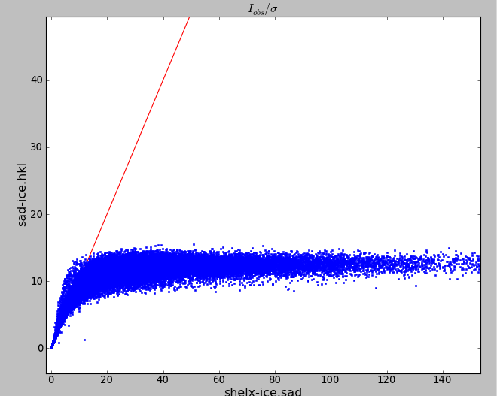
Error model for standard deviations
I/σ output
I/σ input

Slide 22
B-factors
EVAL
Mosflm
d*Trek
Proteum
Difference
Software: B-factors larger in d*Trek
Hardware: B-factors larger with Rigaku data

Slide 23
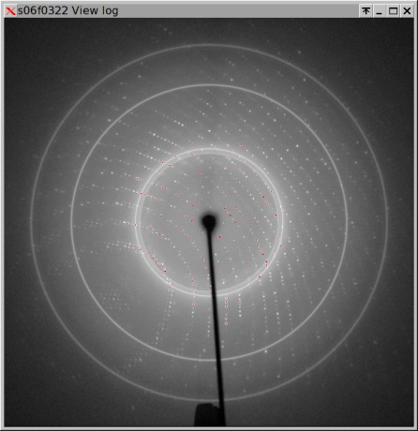
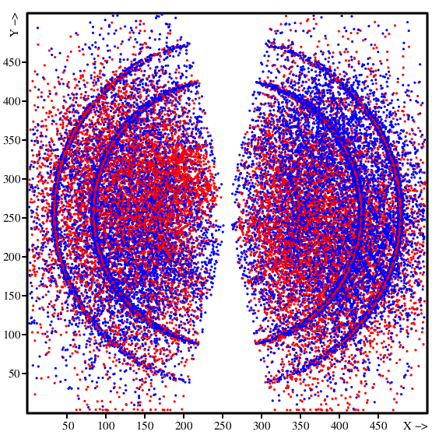
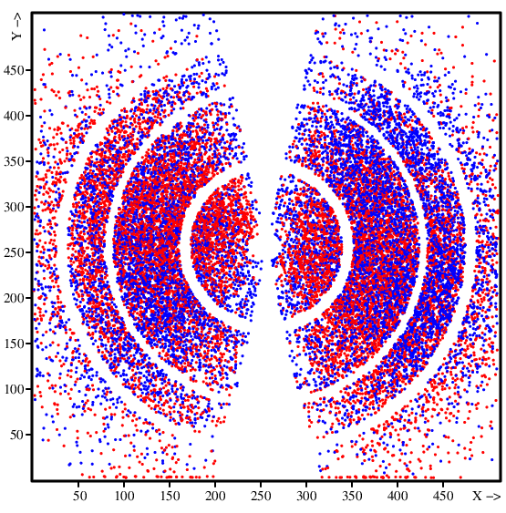
De-ice procedure in EVAL
Raxis IV image
Rejections in Sadabs
After de-ice by EVAL
Crystal 2, data set 4DD2
Has surprisingly little effect on Rmerge, Rwork/Rfree
a
b
c

Slide 24
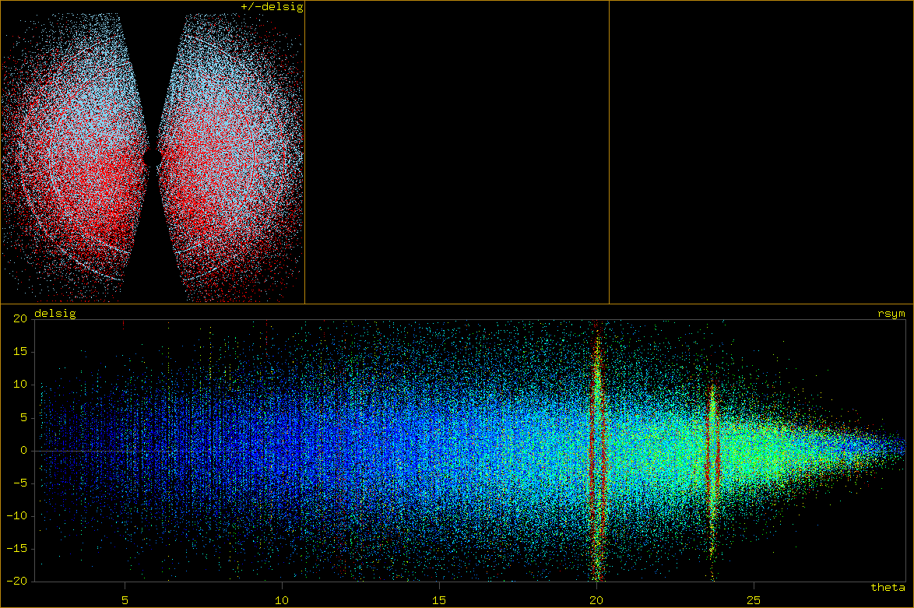
|Δ/σ|>3.0
In ANY resolution regions can be defined were reflections should be rejected.
<-Rmerge->
Δ/σ vs. θ

Slide 25
Conclusions 1
The Rigaku datasets have larger errors when compared with the Bruker datasets which could be due to the crystal not being very well fixed into position, possibly caused by vibrating instrument parts.
Wilson B factors are significantly larger form the Rigaku datasets compared to the Bruker datasets, with Mosflm and EVAL agreeing closely for all 11 datasets
The refined B factors are significantly larger for d*Trek. Meaning that the data processing software may be critical to the published ADP's of protein structures.
It seems that scaling programs can not reject reflections if all equivalents are equally affected by ice scattering. Apparently, this is not the case and most of the ice problems

Slide 26
Conclusions 2
Picture of one image can help
Photo of instrument
Photo of crystal (if visible)
Standardized data format, e.g. CBF-imgCIF containing sufficient meta data
Lossless data compression reduced disk space from 35 to 20 Gb
Software developers are invited to process our data: data repository at University of Manchester, DOI registration for each data set.
PDB depositions: 3TXB, 3TXD, 3TXE, 3TXE, 3TXI, 3TXJ, 3TXK, 3TXF, 3TXG, 3TXH, 4DD0, 4DD2, 4DD3, 4DD9, 4DDA, 4DDB, 4DD1, 4DD4, 4DD6, 4DD7, 4DDC

