Slide 1
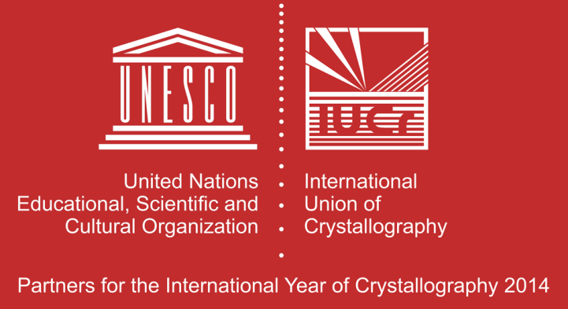
XII SoNS School
April 30 – May 9, 2014
Erice, Italy
Notes:
1
1
1

Slide 2
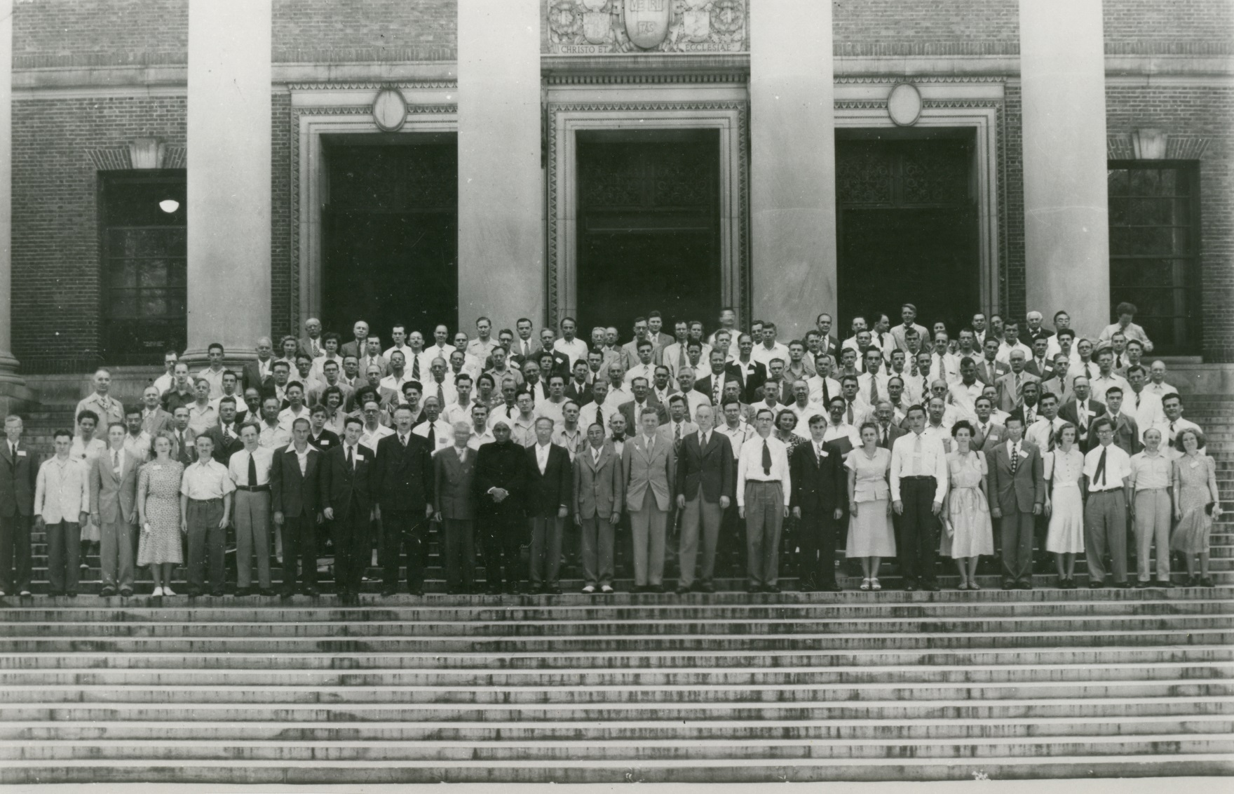
1948 First Congress and General Assembly of the IUCr, Harvard, USA

Slide 3
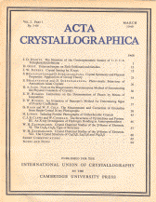
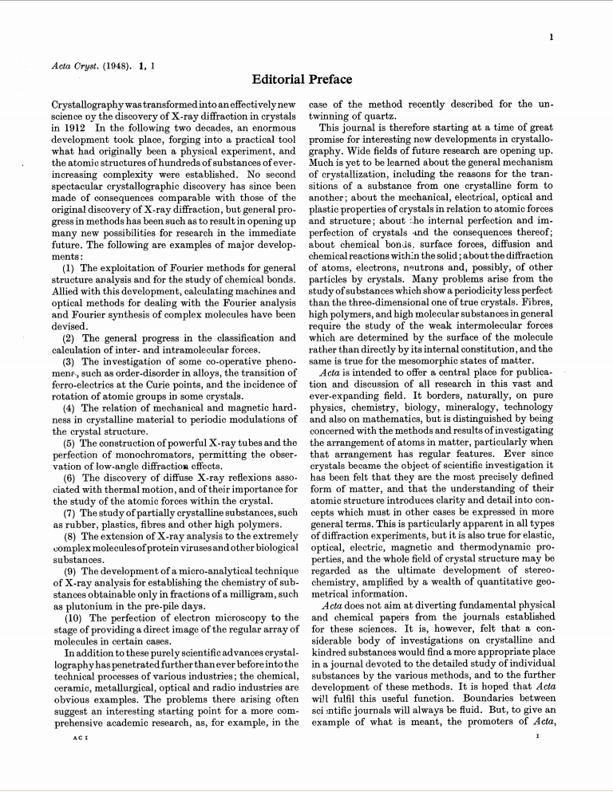
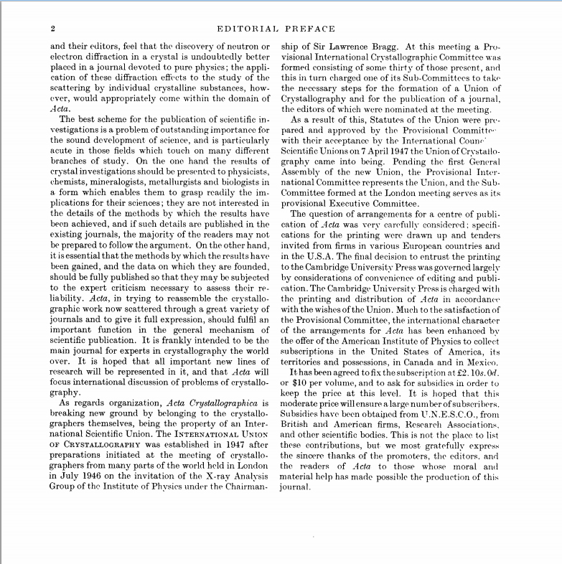
The first issue of Acta Crystallographica in 1948
`Acta is intended to offer a central place for publication and discussion of all research in this vast and ever-expanding field. It borders, naturally, on pure physics, chemistry, biology, mineralogy, technology and also on mathematics, but is distinguished by being concerned with the methods and results of investigating the arrangement of atoms in matter, particularly when that arrangement has regular features.‘ Paul P. Ewald, Acta Crystallographica (1948), 1, 2.

Slide 4

IUCr
facts
53 member countries
42 adhering Bodies (including 3 regional Associates, ACA, AsCA, ECA)
23 commissions
9 journals (IUCrJ launched in 2014)
IUCr Congress every 3 years:
23rd IUCr Congress, Montréal, August 2014
24th IUCr Congress, Hyderabad, India 2017
since 1947
The IUCr is a member of

Slide 5
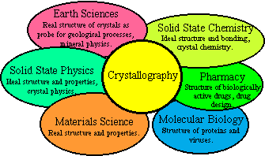
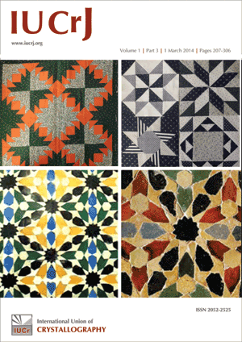

IUCr
aims
promote international cooperation in crystallography
promote international publication of crystallographic research
form a focus for the relations of crystallography to other sciences.
contribute to the advancement of crystallography in all its aspects, including related topics concerning the non-crystalline state
Ò'M*=|˝‚
facilitate standardization of methods, units, nomenclatures and symbols

Slide 6
Countries adhering to the IUCr

Slide 7
IUCr Commissions
Commission on Aperiodic Crystals
Commission on Biological Macromolecules
Commission on Charge, Spin and Momentum Densities
Commission on Crystal Growth and Characterization of Materials
Commission on Crystallographic Computing
Commission on Crystallographic Nomenclature
Commission on Crystallographic Teaching
Commission on Crystallography in Art and Cultural Heritage
ad interim Commission on Crystallography of Materials
Commission on Electron Crystallography
Commission on High Pressure
Commission on Inorganic and Mineral Structures
Commission on International Tables
Commission on Journals
Commission on Magnetic Structures
Commission on Mathematical and Theoretical Crystallography
Commission on Neutron Scattering
Commission on Powder Diffraction
Commission on Small-Angle Scattering
Commission on Structural Chemistry
Commission on Synchrotron Radiation
Commission on XAFS

Slide 8
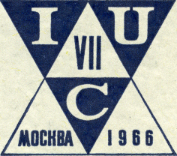
IUCr Commission on Neutron Scattering
(formerly Neutron Diffraction)
established at the Moscow General Assembly in 1966
Concerned with those aspects of crystallography which can be studied almost uniquely by using neutron beams.
Detection of light atoms (particularly hydrogen)
Detection and description of magnetic architecture
Study of crystal dynamics from inelastic scattering data
Actions
Tabulation of data on the neutron scattering amplitudes of elements and isotopes
Collection of information and recommendations on technical procedures
Information on reactor types, neutron flux, background, instrumentation, methods of data collection and handling, design of cryostats and magnet assemblies.
Encouragement of monographs, e.g. on Shubnikov groups, and their application to the determination of magnetic structures, inelastic scattering techniques. Cooperation in the production of Structure Reports for the description of magnetic structures.
Ensure that the various aspects of neutron diffraction techniques get adequate coverage in IUCr meetings.

Slide 9
IUCr Commission on Neutron Scattering
(initially Neutron Diffraction)
established at the Moscow General Assembly in 1966
http://www.iucr.org/resources/commissions/neutron-scattering
Members
M.T. Fernandez-Diaz (Chair, France)
V.L. Aksenov (Russia)
A. Harrison (France)
P. Langan (USA)
G.J. McIntyre (Australia)
Y. Noda (Japan)
Th. Proffen (USA)
P. Radaelli (UK)
W.W. Schmahl (Germany)
I.P. Swainson (Canada)
Consultants
B. Gillon (France)
S.J. Kennedy (Australia)
J. Rodriquez-Carvajal (France)
O. Zaharko (Switzerland)

Slide 10





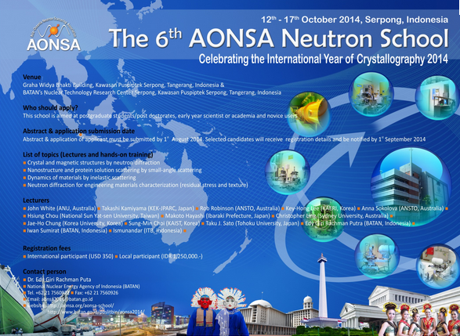
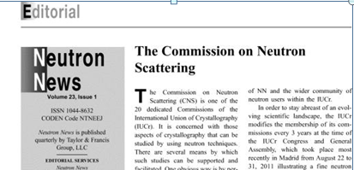
IUCr Commission on Neutron Scattering
(initially Neutron Diffraction)
Connect with regional Neutron Scattering Associations for adequate coverage of crystallography at the regional and international neutron scattering meetings.
Organize and/or support dedicated workshops and schools in developing neutron communities
The activities of the IUCr Commission are presented to the neutron community

Slide 11
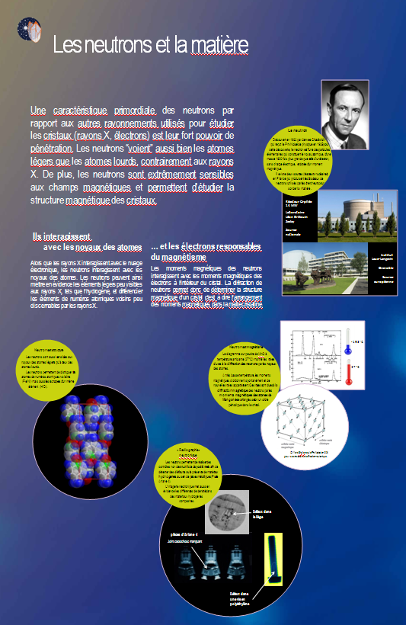
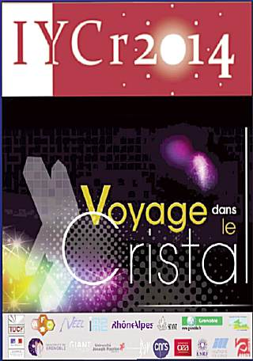
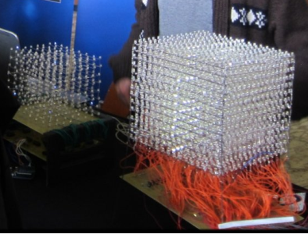
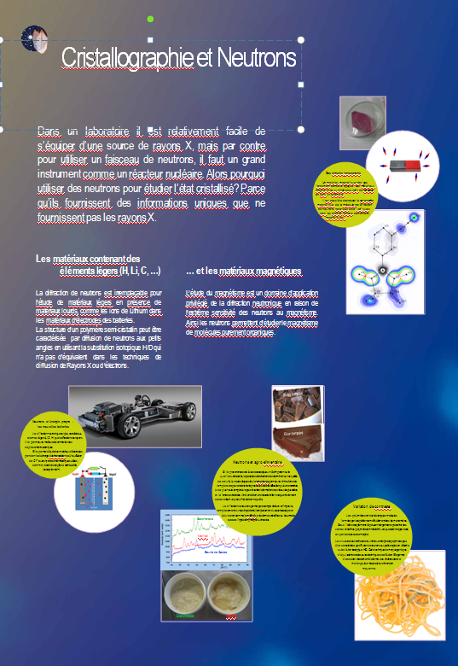
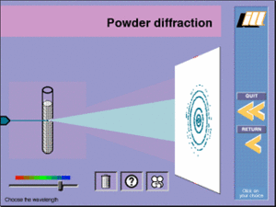
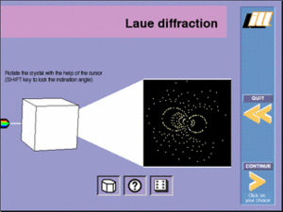
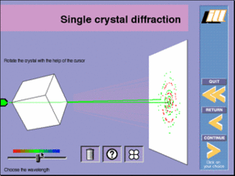
IUCr Commission on Neutron Scattering
(initially Neutron Diffraction)
Collaborate in the preparation of the exhibition “Voyage dans le cristal”, by providing material for the production of posters on neutron diffraction and scattering.
The full exhibition is available for download in 11 languages at
http://www.iycr2014.org/voyage

Slide 12




ACTA CRYSTALLOGRAPHICA SECTION B
STRUCTURAL SCIENCE, CRYSTAL ENGINEERING AND MATERIALS
Main Editors
Alexander J. Blake
University of Nottingham, UK
Marc de Boissieu
Science de l'Ingénierie des Matériaux et
Procédés (SIMaP), France
Editorial Board
D. G. Billing (South Africa), E. V. Boldyreva (Russia), N. B. Bolotina (Russia), A. D. Bond
(Denmark), P. Bordet (France), M. Dusek (Czech Republic), C. H. Görbitz (Norway),
T. N. Guru Row (India), C. J. Howard (Australia), J. A. Kaduk (USA), K. Ogawa (Japan),
S. Parsons (UK), A. A. Pinkerton (USA), U. Rychlewska (Poland), M. A. Spackman (Australia),
T. R. Welberry (Australia)
Managing Editor
Jill Bradshaw
jb@iucr.org
XII SoNS School, April 30 – May 9, 2014
Erice, Italy
Notes:
12
12
12

Slide 13
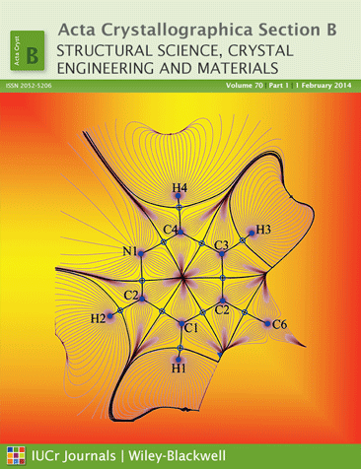
ACTA CRYSTALLOGRAPHICA SECTION B
STRUCTURAL SCIENCE, CRYSTAL ENGINEERING AND MATERIALS
Scope of the journal
All aspects of Structural Science
Crystal Engineering − Special Issue published in early 2014
Non-ambient crystallography − Special Issue due June 2014
New keywords: aperiodic crystals, charge densities, chemical bonding, coherent scattering, crystal engineering, crystal growth and epitaxy, crystal-structure prediction, database analysis, diffuse scattering, electron crystallography, electron densities, neutron, electron and X-ray diffraction and scattering, functional materials, magnetic structures, mineralogy, NMR crystallography, phase transitions in materials, porous materials, powder diffraction, soft condensed matter, solid-state physics and chemistry, structural dynamics, structural materials, structural schematics, structures under extreme conditions, thin films, time-resolved studies
XII SoNS School, April 30 – May 9, 2014
Erice, Italy
Notes:
13
13
13

Slide 14
ACTA CRYSTALLOGRAPHICA SECTION B
STRUCTURAL SCIENCE, CRYSTAL ENGINEERING AND MATERIALS
Recent developments
Reintroduction of Feature Articles and Lead Articles, topics so far include:
  Charge flipping
  Generalized invariom database
  Crystal structure prediction
New category of Perspectives Article (one per year)
Special issue on Non-ambient Crystallography will be published in mid-2014. Articles include:
  Isothermal and isochoric crystallization of highly hygroscopic pyridine N-oxide of aqueous solution (Patyk, Marciniak, Tomkowiak, Katrusiak and Merz)
  In-situ XRD activation study on an Fe/TiO₂ pre-catalyst (Rayner, Billing and Coville)
  Structural simplicity and complexity of compressed calcium: electronic origin (Degtyareva)
Special issues on Energy Materials and Crystal Structure Prediction planned for 2015/2016
Historic trend towards longer papers – but shorter ones are equally welcome
Increase capture in established areas such as high-pressure crystallography
XII SoNS School, April 30-May 9, 2014
Erice, Italy
Notes:
14
14
14

Slide 15





JOURNAL OF APPLIED CRYSTALLOGRAPHY
Main Editors
A.J. Allen,
NIST, MD, USA
J. Hajdu, Uppsala University,
Uppsala, Sweden
A.R. Kaysser-Pyzalla,
Helmholtz-Zentrum Berlin, Germany
,
Editorial Board
A. Borbély (France), V.T. Forsyth (UK), J.M. García-Ruiz (Spain), J.R. Helliwell (UK),
V.H. V. Holý (Czech Republic), K.A. Kantardjieff (USA), G. Kostorz (Switzerland),
D. Pandey (India), Th. Proffen (USA), G. Renaud (France), S. Sasaki (Japan)
Managing Editor
Lisa Stephenson
ls@iucr.org
XII SoNS School, April 30 – May 9, 2014
Erice, Italy
Notes:
15
15
15
To follow
Photos of Allen and Hajdu

Slide 16
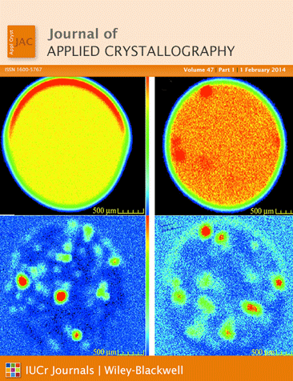
JOURNAL OF APPLIED CRYSTALLOGRAPHY
Scope of the journal
JAC focuses on the use of crystallographic methods to study crystalline and non-crystalline matter with neutrons, X-rays and electrons. Developments of instrumentation and apparatus, theory and interpretation, numerical analysis etc. are also covered. The journal is a primary source of crystallographic computer program information.
Special issues
Small-angle scattering (February 2014): Guest Editors E. P. Gilbert and A. J. Allen
High-resolution X-ray diffraction and imaging (August 2013): Guest Editors P. F. Fewster, M. V. Baidakova and R. Kyutt
X-ray diffraction microscopy (March 2013): Guest Editor A. Borbély
Keywords: anomalous scattering; computer programs; cryocrystallography; crystallographic teaching; diffuse scattering; dislocations and defects; electron diffraction; ferroelectrics; grazing-incidence techniques; high-pressure crystallography; instrumentation; nanomaterials and nanostructure; neutron diffraction; neutron scattering; phase transformations; powder diffraction; protein/macromolecular crystallography; small-angle scattering; strain and stress analysis; structure solution methods; texture; thin films; X-ray diffraction; X-ray scattering; X-ray topography
XII SoNS School, April 30 – May 9, 2014
Erice, Italy
Notes:
16
16
16
Artwork required
Keywords

Slide 17
JOURNAL OF APPLIED CRYSTALLOGRAPHY
Recently published articles
Focusing neutrons with a combination of parabolic and elliptical supermirrors
S. Désert, T. Panzner and P. Permingeat
J. Appl. Cryst. (2013). 46, 35-42
In this work, a new device for focusing neutrons using a combination of a parabolic supermirror, an
asymmetric slit system and an elliptical supermirror is presented.
A new method for evaluating the size of plate-like precipitates by small-angle scattering
F. De Geuser, F. Bley and A. Deschamps
J. Appl. Cryst. (2012). 45, 1208-1218
A methodology is presented for extracting the thickness and length of plate-like precipitates from
streaking that appears in the small-angle scattering pattern of moderately textured polycrystalline samples.
Forthcoming articles
An improved method for calibrating time-of-flight Laue single-crystal neutron diffractometers
C. L. Bull, M. W. Johnson, H. Hamidov, K. Komatsu, M. Guthrie, M. J. Gutmann, J. S. Loveday and R. J. Nelmes
Integration of neutron time-of-flight single-crystal Bragg peaks in reciprocal space
A. J. Schultz, M. R. V. Jørgensen, X. Wang, R. L. Mikkelson, D. J. Mikkelson, V. E. Lynch, P. F. Peterson, M. L. Green and C. M. Hoffmann
GENFIT: software for the analysis of small-angle X-ray and neutron scattering data of macro­molecules in solution
F. Spinozzi, C. Ferrero, M. G. Ortore, A. De Maria Antolinos and P. Mariani
XII SoNS School, April 30-May 9, 2014
Erice, Italy
Notes:
17
17
17

Slide 18
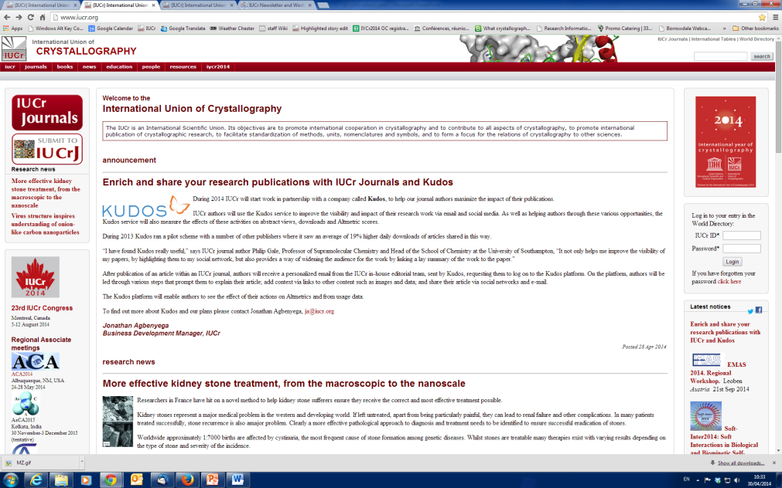
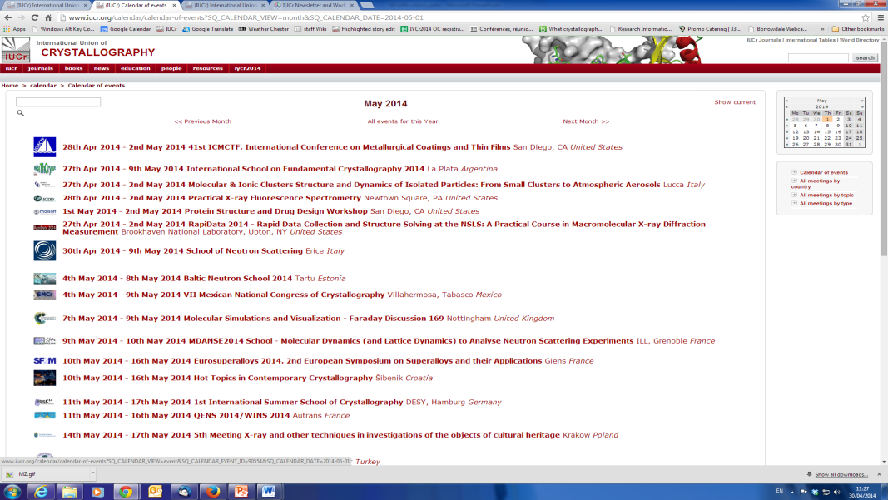
What’s new in Crystallography?
Why not visit our website iucr.org to find out.
Now Featuring news and commentaries on the latest research news in the field of crystallography and related disciplines
Bookmark
http://www.iucr.org/news/whats-new
/
Coming soon: New and refreshed events page where you can add your own meetings
XII SoNS School, April 30 – May 9, 2014
Erice, Italy
Notes:
18
18
18

Slide 19
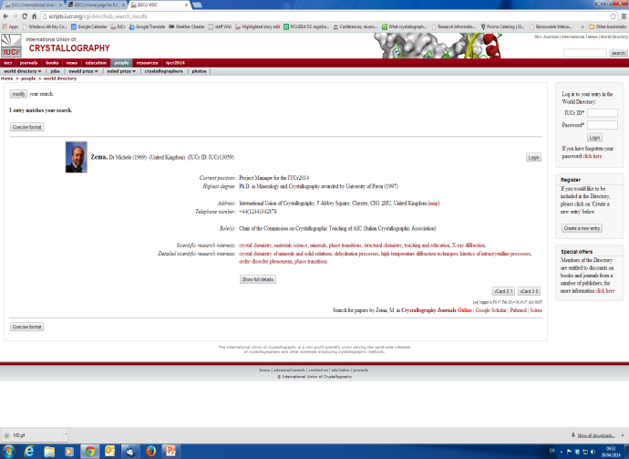
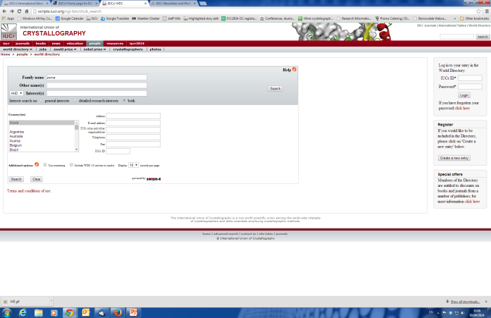
World Directory of Crystallographers
Facilitating communication within the crystallographic community
The first edition of the World Directory of Crystallographers was produced in 1957.
Since then it has continued to grow and is now available online for all researchers associated with crystallography, the database currently has 20,000 entries.
To sign-up is free, and members of the directory have access to large network of scientists practising in similar and related fields of interest, tying together research topics, scientists and institutions in one easy to search database.
Ideal if you are looking for collaborators in other laboratories around the world or trying to find researchers with a general or detailed research background.
The database allows you to create your own unique profile, add your photo, research interests and papers published.
Manage subscriptions to journal e-alerts and the IUCr Newsletter from your profile, as well as enjoying the special offers on publications and services from time to time.
http://www.iucr.org/people/wdc
/
XII SoNS School, April 30 – May 9, 2014
Erice, Italy
Notes:
19
19
19

Slide 20
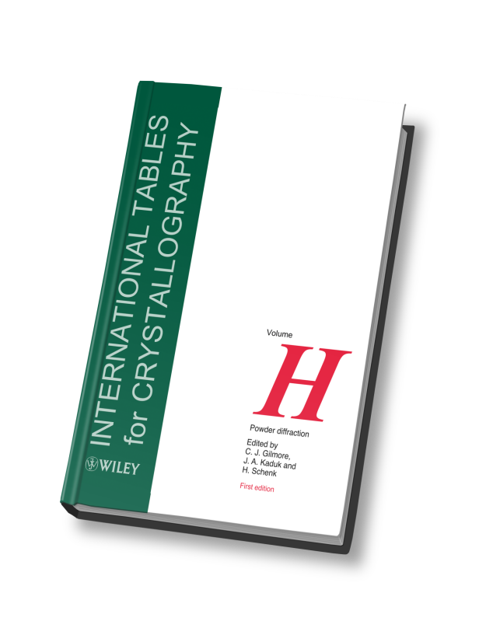
International Tables for Crystallography
8 volume set, planned, edited and maintained by the Commission on International Tables.
C.P. Brock (Chair)
E. Arnold, Editor of Volume F; Crystallography of biological macromolecules
M.I. Aroyo, Editor of Volume A; Space-group symmetry
A. Authier, Editor of Volume D; Physical properties of crystals
G. Chapuis, Editor of Volume B; Reciprocal space
C.J. Gilmore, Editor of Volume H (forthcoming); Powder diffraction
S.R. Hall, Editor of Volume G; Definition and exchange of crystallographic data
D.M. Himmel, Editor of Volume F; Crystallography of biological macromolecules
J.A. Kaduk, Editor of Volume H; (forthcoming) Powder diffraction
V. Kopsky, Editor of Volume E; Subperiodic groups
D. B. Litvin, Editor of Volume E; Subperiodic groups
B. McMahon, Editor of Volume G; Definition and exchange of crystallographic data
U. Müller, Editor of Volume A1; Symmetry relations between space groups
M. G. Rossmann, Editor of Volume F; Crystallography of biological macromolecules
H. Schenk, Editor of Volume H; (forthcoming) Powder diffraction
T.R. Welberry, Editor of Volume C; Mathematical, physical and chemical tables
H. Wondratschek, Editor of Volume A1; Symmetry relations between space groups
it.iucr.org
New volume on powder diffraction due summer 2014:
Covering all aspects of the technique with over 60 chapters written by experts in the field
Volume H will be a practical hands on guide providing many examples of the various methods used and data collected. Software used, when possible will also be made available.
/
XII SoNS School, April 30 – May 9, 2014
Erice, Italy
Notes:
20
20
20

Slide 21
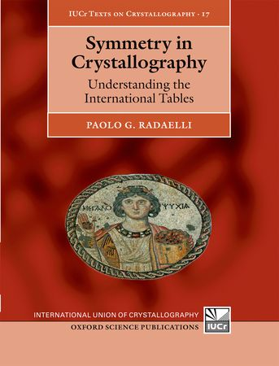
Symmetry in crystallography
Understanding the International Tables
By Paolo G. Radaelli
This book presents the reader with a fresh and unconventional approach to teaching crystallographic symmetry.
Whereas traditional crystallography textbooks make heavy use of algebra, this book adopts in the first few chapters a 'pictorial' approach based on the symmetry diagrams of the International Tables for Crystallography.
Readers are led step-by-step through simple 'frieze' and 'wallpaper' patterns, with many examples from the visual arts.
By the end of chapter 3 readers will be able to identify and analyse all these simple symmetries and apply to them the nomenclature and symbols of the International Tables.
Readership: Graduate students in a variety of fields employing crystallography as a primary or secondary tool: physics, chemistry, earth science, structural biology etc. Also undergraduate students taking advanced courses in symmetry or crystallography.
http://ukcatalogue.oup.com/product/9780199550654.do#
€65.00, 144 pages, isbn 978-0-19-955065-4
/
XII SoNS School, April 30 – May 9, 2014
Erice, Italy
Notes:
21
21
21

Slide 22
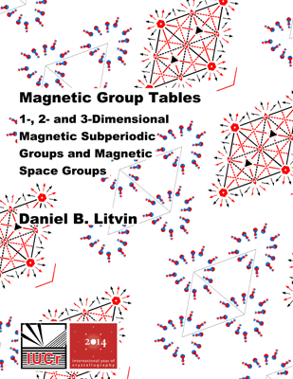
Magnetic Group Tables
1-, 2- and 3-Dimensional Magnetic Subperiodic Groups and Magnetic Space Groups
By Daniel B. Litvin
This PDF format e-book tabulates the structure, symbols and properties of magnetic groups. A survey of magnetic group types is presented, listing the elements of one representative group of:
(i) the 5, 31 and 122 types of groups in the reduced superfamilies of the 1-, 2- and 3-dimensional magnetic point groups, respectively;
(ii) the 31, 394 and 528 types of groups in the reduced superfamilies of magnetic subperiodic groups, i.e. magnetic frieze groups, magnetic rod groups and magnetic layer groups, respectively; and
(iii) the 7, 80 and 1651 types of groups in the reduced superfamilies of 1-, 2- and 3-dimensional magnetic space groups, respectively. Tables of properties of the 1-, 2- and 3-dimensional magnetic subperiodic and magnetic space groups are given. Opechowski-Guccione and Belov-Nerenova-Smirnova magnetic group symbols are compared, and maximal subgroups of index less than or equal to 4 are listed.
With the collaboration of the IUCr Commission on Neutron Scattering and the IUCr Commission on Magnetic Structures
http://www.iucr.org/publ/978-0-9553602-2-0
Free to download
XII SoNS School, April 30 – May 9, 2014
Erice, Italy
Notes:
22
22
22

Slide 23

International Union of Crystallography
NEWSLETTER
Published 4 times per year, available online only subscribe by signing up to the World Directory of Crystallographers
Circulated to over 200 different countries around the world
The newsletter contains many different article types, of interest to the diverse international scientific community involved in understanding the basic structure of matter.
Contents
Letters
General news
Awards
Elections
Useful resources and databases
Event calendar and event reports
Book reviews
Comments and opinions
Submit your own ideas for news coverage by sending an email to iucrnewsletter@gmail.com
/
XII SoNS School, April 30 – May 9, 2014
Erice, Italy
Notes:
23
23
23

Slide 24
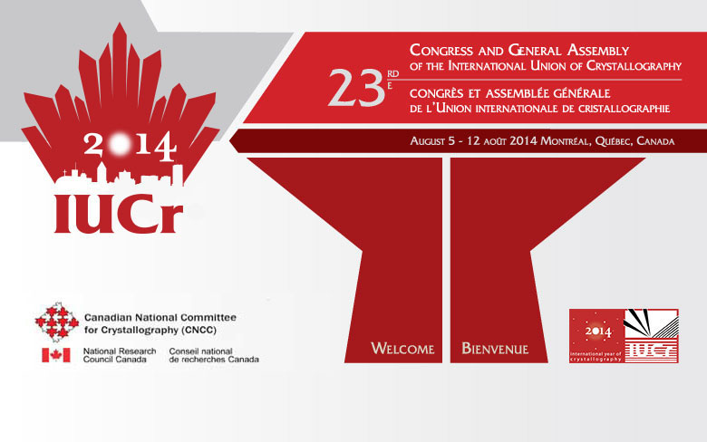
23rd Congress And General Assembly of the International Union of Crystallography
August 5 -12, Montréal, Québec, Canada
Every three years, the community of crystallographers from around the world gathers at the Congresses organized under auspices of the
IUCr to discuss science, and strengthen relationships
Just some of the sessions taking place with a relevance to neutron scattering
MS-106 Combined studies of charge, spin and momentum densities
MS-09 In Situ crystallography under external stimuli
MS-17 High-pressure crystallography of periodic and aperiodic crystals
MS-18 Magneto-structural relationships in molecular compounds
MS-98 X-ray, muon and neutron studies of magnetic structure in materials
MS-106 Combined Studies of Charge, Spin and Momentum Densities
MS-90 Structural, Electronic and Magnetic Ordering: From Fundamental Physics to Functionality
http://www.iucr2014.org/welcome_e.shtml
XII SoNS School, April 30 – May 9, 2014
Erice, Italy
Notes:
24
24
24

