Slide 1

How to publish one’s results
Professor John R Helliwell DSc
The University of Manchester
Editor-in-Chief Acta Crystallographica and
Chair of the IUCr Journals Commission 1996-2005;
IUCr Delegate to ICSTI 2005- ;
IUCr Delegate to CODATA 2012- ;
Joint Main Editor of Crystallography Reviews 2007-;
Co-editor of Journal of Applied Crystallography 2005-
john.helliwell@manchester.ac.uk

Slide 2
Contents re the ‘How’
Overview of the procedure
  When is it timely to publish? Is there Intellectual Property that must be protected?
  Which journal to select?
  Which Editor to select?
  Whether to nominate referees or indicate referees not to use?
  The draft; escalate the key points
  Including the data; derived, processed and raw data categories
The reviewing cycle
  Listen to the referees and the Editor
  The revised version; make it easy for the Editor to accept it
  Read your proofs carefully; technical editing can introduce errors
What helps to attract citations?
  Reviews and books
Wider issues and impacts
Future publishing landscape?

Slide 3
Start of the publishing cycle
1. Idea
5. Write first draft
6. Use critical friend
8. Proof-read and submit
2. Choose Journal
3. Read back issues
4. Check notes for contributors
7. Refine further drafts

Slide 4
The peer review process
1. Editor receives manuscript
5. Amend
6. Article accepted for publication
7. Publisher proof stage
2. Reviewers
3. Accept
Minor amendments
Major amendments
Reject
4. Feedback to author
8. Article Published!
Notes:
Taylor and Francis Notes:-
After the Editor receives the manuscript he or she may well reject the paper without sending it out for peer review. Authors often fail to appreciate this and can get annoyed because their paper hasn’t been reviewed. However, many of the top journals may only accept as little as five per cent of the papers which are sent to them and although we know there is a lot of debate about this, we think it is best that the editor says no at this stage, as this could save you a lot of time in the future.
If the paper does go out for peer review, the process can take six months and then be rejected.
Reviewers are often difficult to find and in general, do not get paid, so Editors prefer not to send them papers that in the editors opinion will not make it through to publication.
If a paper gets through this initial screening stage it will go to reviewers who are anonymous. Reviewers will not know who the author is and authors will not be told who the reviewers for their paper are.
Different journals have different methods of reviewing. On some journals the editorial board sit as a panel and discuss all the papers. More commonly, journals will send each paper to two or three academics who are knowledgeable in subjects relevant to the article, who will review it and then provide written feedback to the Editor with a recommendation.
Of course, two reviewers may have different views on the same paper, so sometimes the editor will need to send the article to a third reviewer. Once the Editor has received the views of the reviewers, he or she will respond to the author with a decision. The decision may be to accept the paper straight away, but that doesn’t happen very often. More commonly, the recommendation provided by the reviewers is that the paper requires minor amendments, which the author then makes and resubmits. If the reviewers comments are taken into consideration and necessary changes made, these papers are then most often accepted for publication.
When the reviewers suggest that a paper needs major amendments for it to be publishable it is often difficult to know what to do next. Some authors make all these major amendments, send their paper back and it still gets rejected. So if you get major amendments as a reply from the editor, we suggest that you check whether you would be better to submit your article to another journal rather than making the amendments, going back through the review process and still getting rejected. Most editors will be willing to advise you.
The reviewers’ feedback that goes to the author is usually amended by the editor. If you have to re-submit your paper it generally goes back to the same reviewers. After all the amendments are made and the paper is accepted, it is sent to the publisher who will send you a proof of your article as a final check, after which your article is eventually published.
Out of every 100 manuscripts that come into an editor, only about 30 will get published. So in our list of journals, you could argue that 70% of papers are rejected. They might go back into the system again with another journal, or keep going round and round the review process. So you should accept that some of your papers are likely to be rejected at some point in your career.

Slide 5
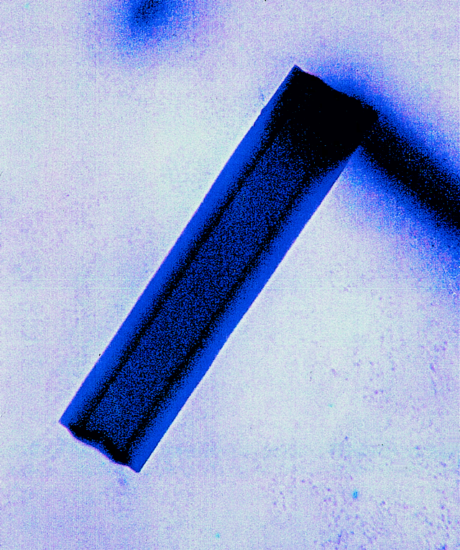
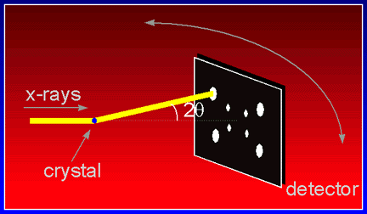
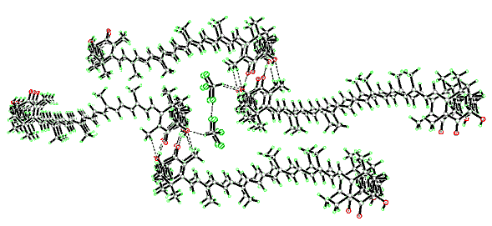
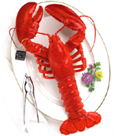

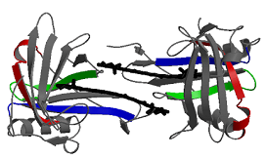
Which journal?
Crystallography is a trusted science: our research can go to many journals
Notes:
Crystallography is a branch of science that is particularly well suited to any concerns about the quality and details of the results. It deals with the structure of materials on molecular scales where well characterised measurements are routinely carried out.

Slide 6
High-impact journals; are they worth the effort?
Yes, if you seek an audience across a wide number of disciplines; this can greatly assist the number of citations your article will subsequently receive
You will need to convince a general editor before you get to detailed refereeing, and so your submission letter must describe why the journal’s wide readership might be interested in your article
Most journals have a particular template and/or house style and so a significant amount of extra effort is needed to format, and reformat, your article as you will likely proceed down the ‘journal-impact-factor’ pecking order, one rejection to the next

Slide 7
When is it timely to publish? Is there Intellectual Property that must be protected?
Do not reveal your results in public by any medium (talk or publication) if you think you might wish to seek a patent
Most universities these days have Intellectual Property (IP) officers to help and advise you
More judgemental is whether to publish a preliminary or ‘fast’ communication to establish precedence; the RSC’s Chem. Comm. is one such journal that allows this option

Slide 8
Which Editor to select?
Never pick a friend or colleague; it’s an easy way to risk losing your friend
Pick someone who gave you an impression of being fair and level headed when you met them at a conference or heard them give a seminar

Slide 9
The ARTICLE draft; getting the title and abstract right; escalate the key points
The abstracting services will offer readers your title and abstract; this can often determine whether your article will be read in detail (apart from your friends and/or competitors)
Escalate the key findings into your Conclusions, and your abstract, and possibly finally your title

Slide 10
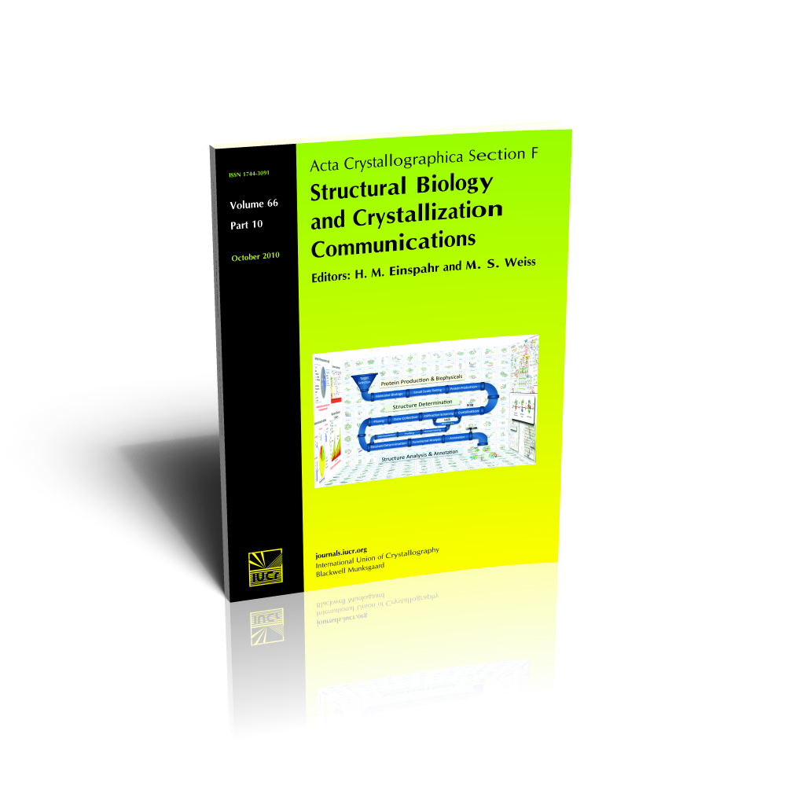
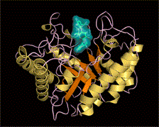
Community data standards
Consensus in small-molecule crystallographic community
Emerging standards in macromolecular crystallography
Tools such as ‘checkCIF’ and the PDB's validation suite help the author pre-validate
Notes:
IUCr Journals Notes:-
The introduction of automated quality assessment during peer review of small-molecule and inorganic structure reports in IUCr journals (ca. 1995) provoked a certain amount of controversy, but with careful tuning of the checks and tests, and sympathetic application of editorial policy, checkCIF has become accepted as a de facto quality indicator for this community. In the burgeoning field of biological macromolecular structure determination, such a consensus is still somewhat remote. It is a younger field, with more technical difficulties and limitations than in small-molecule crystallography. Nevertheless, as the number of protein and nucleic acid structures being determined rises rapidly, and the importance of such studies increases, there is a growing need for criteria to evaluate the quality of macromolecular structure models. An ongoing exercise by the editorial team of the newest IUCr journal, Acta Crystallographica Section F: Structural Biology and Crystallization Communications, is seeking to define requirements for the reporting of relevant experimental data in this field (and, in tandem, to begin to formalize the description of crystallization experiments which are an essential forerunner of crystal structure determination experiments). This is being carried out under the umbrella of the actabiostandards discussion list.

Slide 11
Editors can help authors
The Editor is of course the gate keeper of good science but can be expected to be constructive, offering help and expertise that can lead to article acceptance after ‘major revision’
  The text can be improved
    Papers can be submitted even without a Conclusions section!!!
  The data and the results can be checked
Referees are (nearly) always vital to this process;

Slide 12
Listen to the referees and the Editor; make it easy for the Editor ….
Carefully record your responses to referees, make changes to the article in track changes and provide a final version ‘changes accepted’
Respond expeditiously

Slide 13
Usual reasons for rejection
Sent to the wrong journal; that is it does not fit the journal’s aims and scope
Technically flawed in the data or procedures used
Fails to say anything of significance (makes no new contribution to the subject) or states the obvious at tedious length
Bad grammar, punctuation; poor English (for example not corrected by a native speaker)
Exhausts the patience of the Editor and the referees

Slide 14
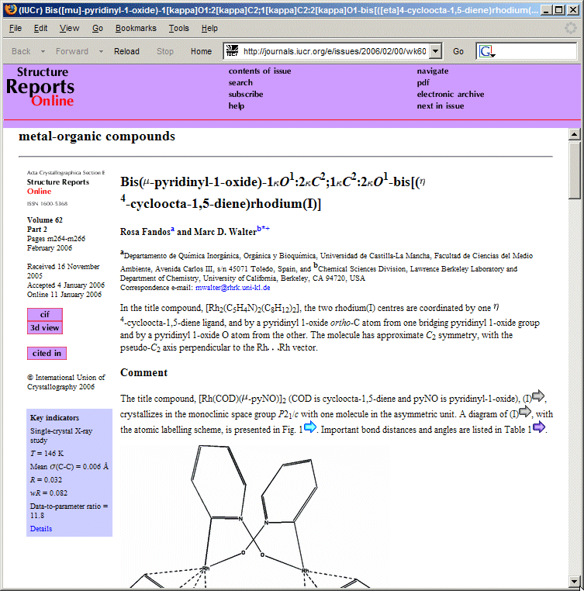
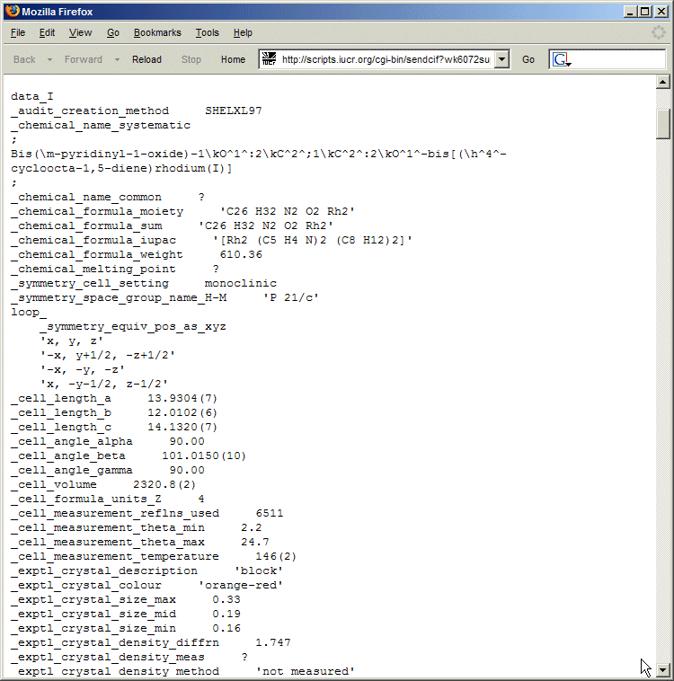
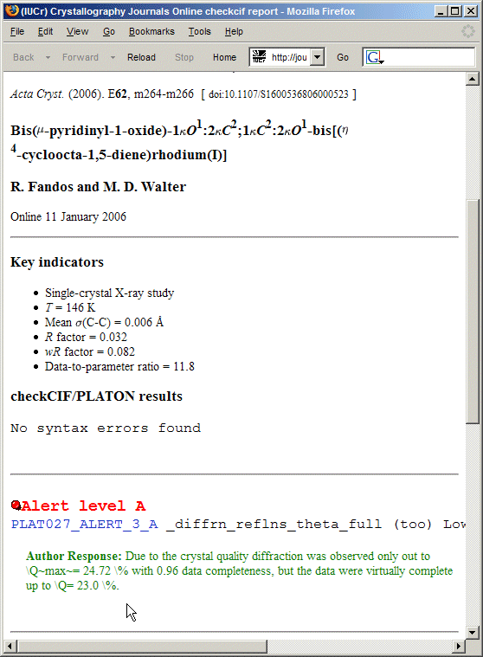
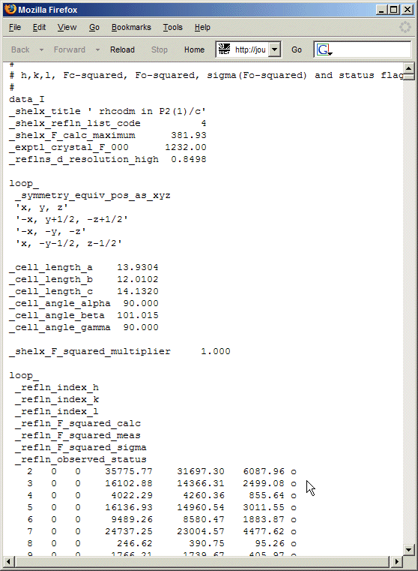
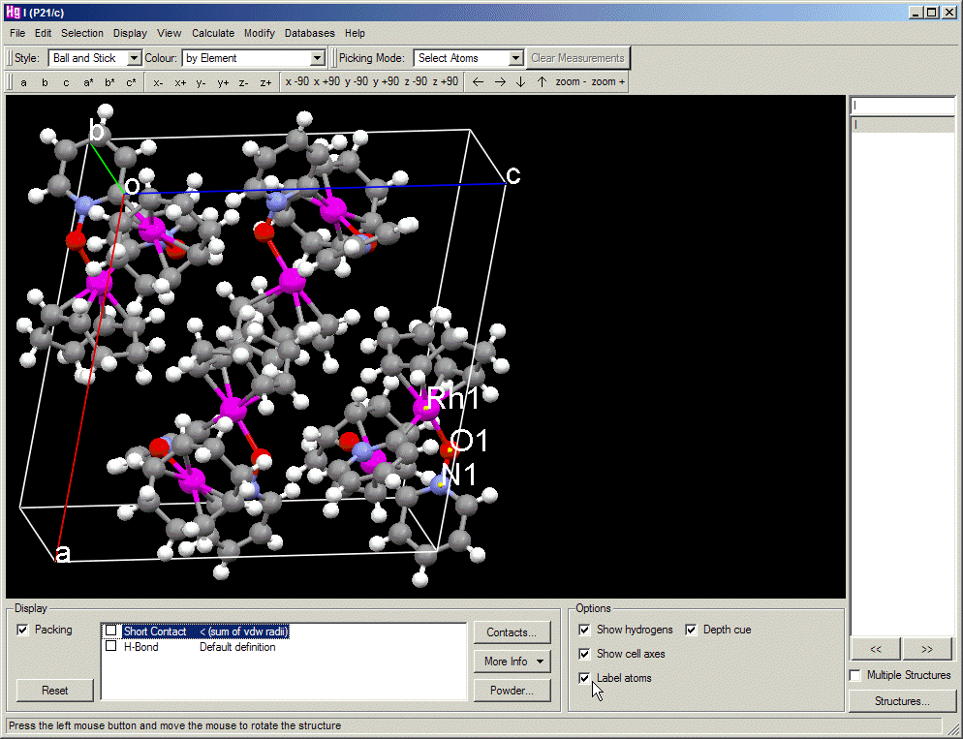
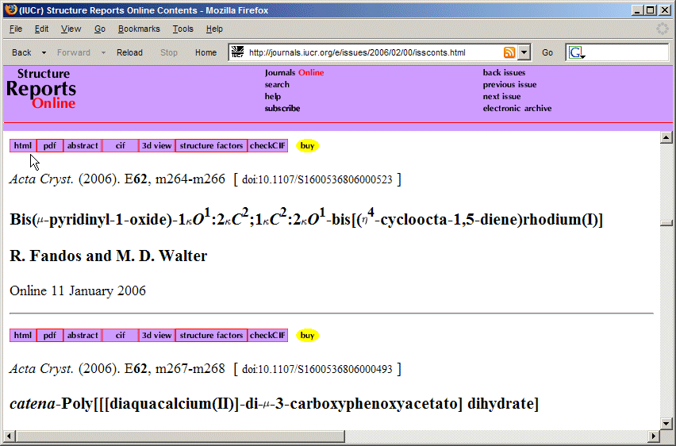
Reader assessment involves the article and the linked data
Notes:
IUCr Journals Notes:-
Although the editors and referees invest much effort in the peer review process, the availability of a full set of accompanying data provides added value for the reader of the article. For example, for any article published in Acta Crystallographica Section E: Structure Reports Online, the reader may assess fully the scientific argument by: (1) reading the text of the article; (2) accessing the full CIF (which will include unpublished data such as the three-dimensional atomic coordinates, and a complete listing of bond lengths and angles); (3) reviewing key indicators and the validation report (in this example the author’s response to a significant problem identified in the validation review is presented); (4) retrieving the primary experimental data to allow an independent redetermination of the structure; or (5) visualizing and manipulating the data in a crystallographic application of choice.

Slide 15
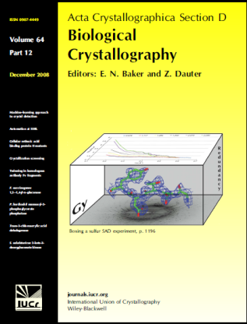
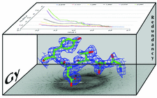
What helps to attract citations?
Try and secure the front cover; send a letter explaining why your article will have impact and therefore be good for the journal
Offer an attractive picture
Alert colleagues by sending out (electronic) reprints

Slide 16
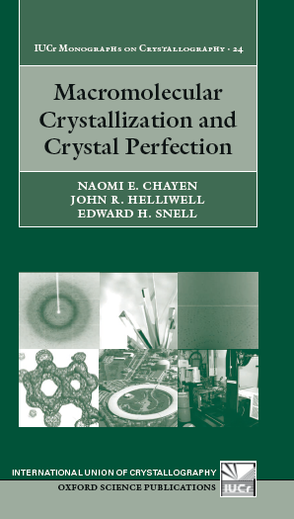
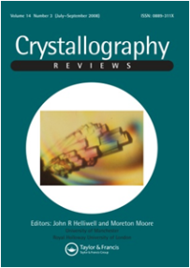
Reviews and books
These publications allow you to bring together a theme of your work and set your publications in the context of the field
Like a journal front cover they can enhance the impact of your research results
A review can seed a book

Slide 17
How to help non-English speakers?
IUCr’s publCIF article drafting tool is agreed to be a great help to such authors
IUCr Journals also have French, German and Russian as ‘official languages’, although this concept is perhaps a little misleading nowadays, as articles are very rarely published in anything other than English

Slide 18
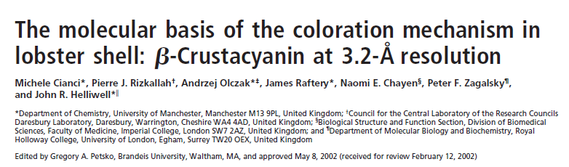
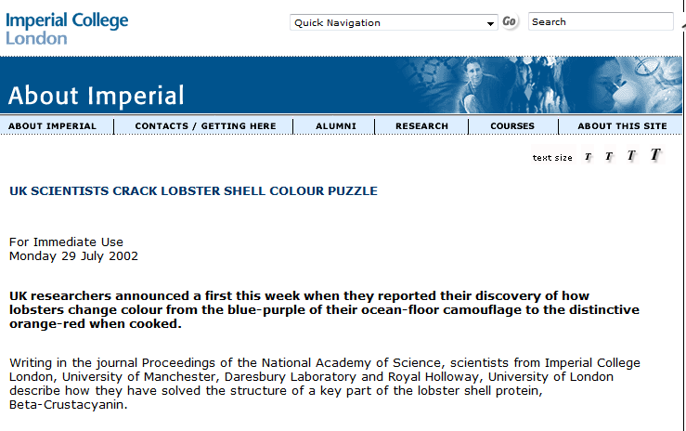
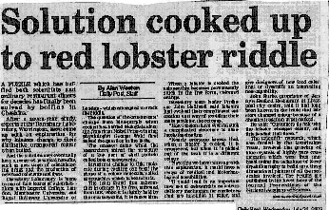
Wider impacts; reaching the media via a press release
Proc. Natl. Acad. Sci. USA, Vol. 99, Issue 15, 9795-9800, July 23, 2002

Slide 19
The future publishing landscape?
Yet more interactive content – embedded videos/audio within articles?
Semantic enrichment and routinely linking to raw data sets
An even greater role for ‘Open Access’; a publishing revolution in progress…..

Slide 20
Summary
Quality of scientific argument depends on
  Quality of data
  Language and syntax being clear
  Rigorous analysis
  Accessibility of relevant data
Not all journals provide you the author with the highest quality of peer review; choose your journal carefully and, for good measure, send your submitted article to a couple of friends in parallel
The rejection + withdrawal rates vary from journal to journal e.g. extremes of between 20% and 90%
The reasons for an article not being accepted are usually a mix of poor or insufficient data and/or poor science
A poorly written article impedes everything; i.e. both the peer review and the article’s impact if published

Slide 21
Overall, let’s not forget
the primary purpose of publication is to share scientific knowledge and thus keep science going as a healthy and collective enterprise

Slide 22
Acknowledgements
The concept for this talk was by Dr Susanne Coles and Dr Laura Roces who were the Microsymposia leaders for a ‘How to’ session of talks aimed at Young Crystallographers at ECM27 Bergen held August 2012
Peter Strickland, Managing Editor and Brian McMahon, R&D Officer at IUCr, Chester
Colin Bulpitt and Huw Price, Managing Editors of Crystallography Reviews and Prof Moreton Moore, Joint Main Editor of Crystallography Reviews
Numerous Co-editor colleagues on the IUCr Journals Commission and a countless number of referees that have helped me as an Editor handling approx 1000 submitted articles from authors since 1990
Dr Michele Cianci, EMBL PETRA III, Hamburg; a former PhD student and collaborator

