Slide 1
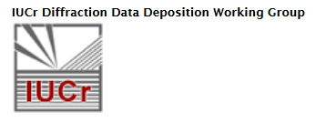

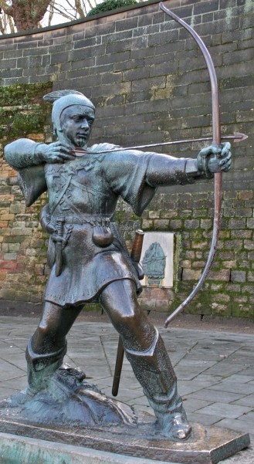
Access to raw diffraction data; current practice in article linking to raw diffraction data
The Future of Structural Science Session
at BCA 2016 Nottingham, UK
John R Helliwell^{1,*} and Brian McMahon²
School of Chemistry, University of Manchester, M13 9PL, UK
IUCr 5 Abbey Square, Chester CH1 2HU, UK
john.helliwell@manchester.ac.uk
The arrow of time…the future

Slide 2
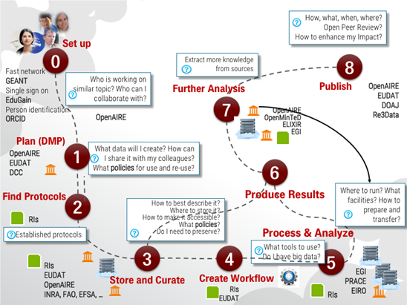
Context; a call for legal interoperability of data and for (a more) open science
Concept for a European Open Science Cloud for Research

Slide 3
Contents
The philosophical view of the importance of access to raw diffraction data; namely analysis through one’s own eyes not the lens of someone else
Brief recap of 2011 to 2014; our DDDWG Report to the IUCr Montreal 2014 General Assembly
The challenge of the sheer volume of our raw diffraction data
The challenge of achieving a new-user depth to raw diffraction data metadata description i.e. can a new-user successfully understand and process any raw data set he/she wishes to analyse?

Slide 4
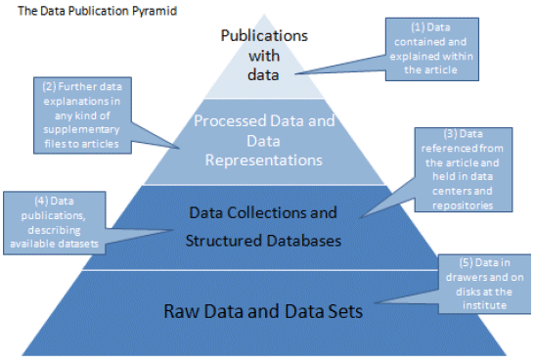
Raw diffraction images offer the opportunity of
analysing data at higher resolution than used in the original work
serving as benchmarks in developing improved methods of analysis
checking the interpretation of the symmetries of the crystals
analysing diffraction from multiple lattices present in the crystals
analysing the diffuse scattering that reflects correlated motions or disorder of atoms in the crystals

Slide 5
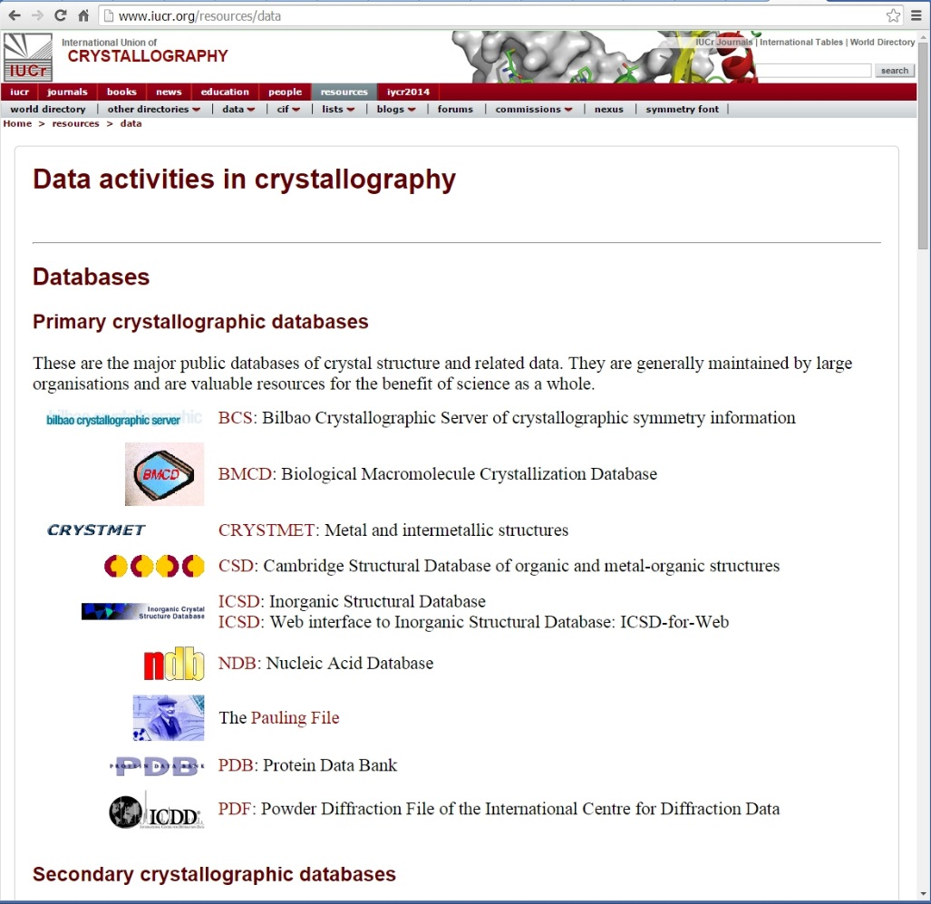
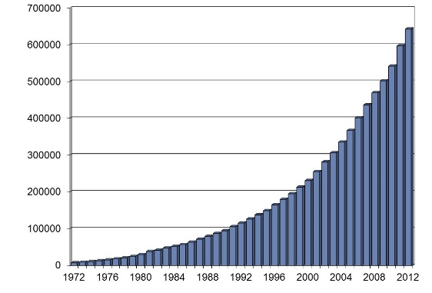
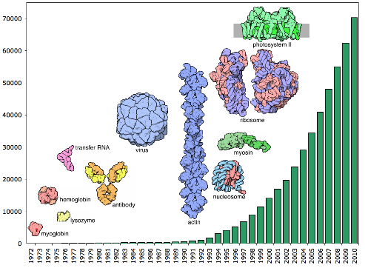
Benefits of retaining derived data
Scientific record
Database-driven discovery
Protein-ligand interactions
New pathways to synthesis, manufacturing, energetics…
Identification/indexing (e.g. forensic science)

Slide 6
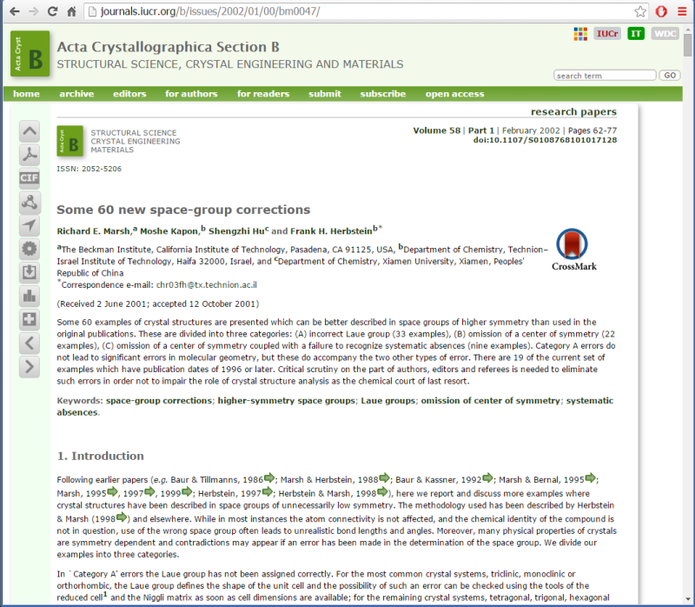
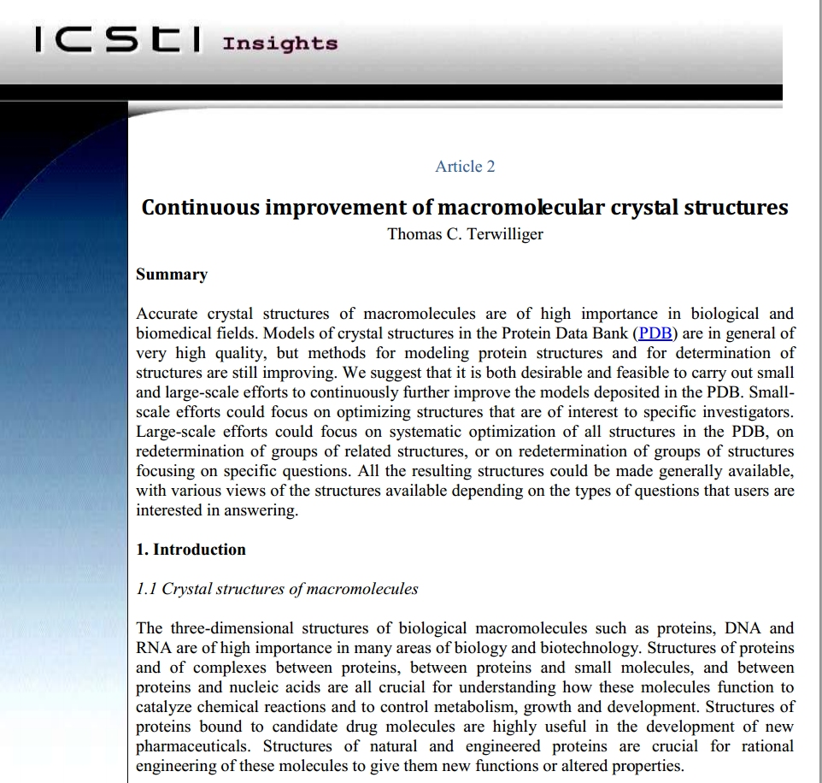
Benefits of retaining processed data
Structure validation
Re-refinement
Systematic bias, methods development
Guard against structures associated with incorrect data sets
Help guard against ‘bad apples’ in the databases (Minor et al 2016)
Notes:
Until the advent of CIF and its enabling automated structure validation checks with the checkCIF suite, many structures were published which required subsequent correction. Often the interpretation of the results produced molecular structures that were broadly correct, but overlooked higher lattice symmetries. Such examples were best detected and corrected through access to the deposited structure factors. The paper illustrating this is Marsh, R. E., Kapon, M., Hu, S. & Herbstein, F. H. (2002). Some 60 new space-group corrections. Acta Cryst. B58, 62-77.

Slide 7



IUCr Diffraction Data Deposition Working Group (DDDWG) report to the IUCr General Assembly Montreal
John R Helliwell on behalf of the DDDWG

Slide 8
Recommendations from the DDDWG for the upcoming Triennium
IUCr Commissions to define their metadata;
J. Appl. Cryst. to introduce a ‘Difficult Raw Data’ Section (Loes Kroon-Batenburg);
A centralised crystallographic repository of raw data set metadata should be scoped, inc a search interface, leading to a pilot service;
With a viable pilot metadata registry authors should provide a permanent and prominent link from an article to their raw data sets underpinning a journal publication.

Slide 9
Issues for the IUCr
The IUCr’s science involves ‘Big data’ up towards the level of the data-deluge of the Square Kilometre Array radio telescope; we may have to consider subsets of data retention or limited time periods for retention;
Rights of access to publicly funded, but unpublished, crystallographic research data after e.g. 3 to 5 years.

Slide 10
Members of the DDDWG 2011 to 2014
John R Helliwell and Brian McMahon (UK), Chair and Co-Chair;
Steve Androulakis (Australia)
Sol Gruner (USA)
Loes Kroon-Batenburg (Netherlands)
Tom Terwilliger (USA)
John Westbrook (USA)
Heinz-Josef Weyer (Switzerland)

Slide 11
Members of the DDDWG 2014 to 2017
John R Helliwell and Brian McMahon (UK), Chair and Co-Chair;
Steve Androulakis (Australia)
Dolothea Szebenyi (USA)
Loes Kroon-Batenburg (Netherlands)
Tom Terwilliger (USA)
John Westbrook (USA)
Heinz-Josef Weyer (Switzerland)†

Slide 12
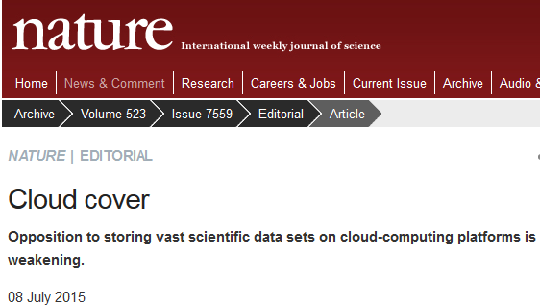
The Cloud to help solve the raw data storage challenge?

Slide 13
Charge to the ECM29 Rovinj IUCr Workshop Participants
Define your Metadata or at the least Define the Challenges you face
We have provided a template form for you to supply information about metadata for your specific research field / IUCr Commission
We consider the challenge of aligning scientific metadata with generic standards like the ‘Dublin Core of Metadata descriptors’
We have to understand each other’s fields; this will assist the philosophical challenge of ‘seeing a data set through a new-user’s eyes’

Slide 14
The Workshop Sessions were
Session I: Introduction
Session II: Diffraction images - what can we get out?
Session III: Metadata for diffraction images and other experimental methods
Session IV: Data in the Wider World - From Laboratory to Database
Session V: What new metadata items are needed?
Session VI: Metadata schemas

Slide 15
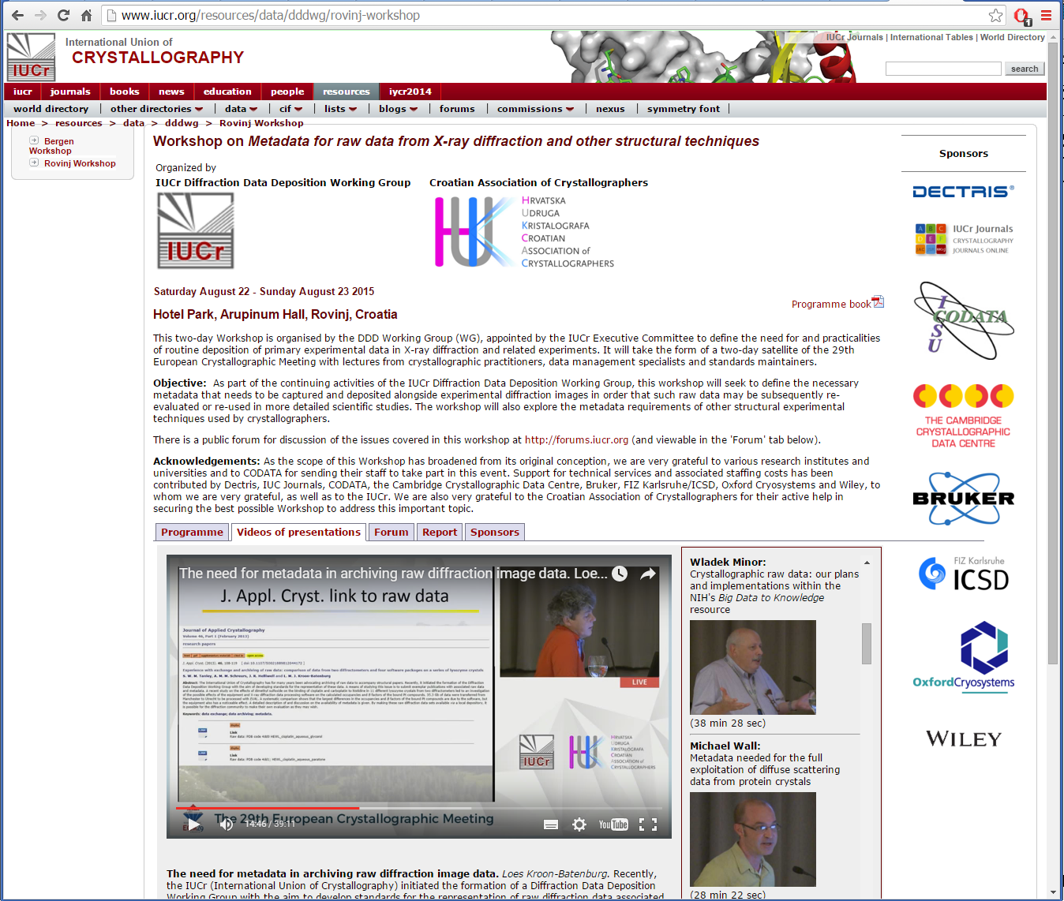
Complete video record of Rovinj Workshop: http://tinyurl.com/diffraction-metadata

Slide 16
Significant pioneering developments
Australian synchrotron MX raw data archive https://store.synchrotron.org.au/public_data/
The USA NIH funded various structural genomics projects with raw data archives

Slide 17
Recent developments
University data repositories
ESRF Data Archive (“every raw data set measured with a registered doi”)
EC’s Zenodo science data archive (free of charge!)
The University of Virginia BD2K for MX, led by Wladek Minor http://www.proteindiffraction.org/ (USA)
IUCrData (initially, derived data sets)

Slide 18
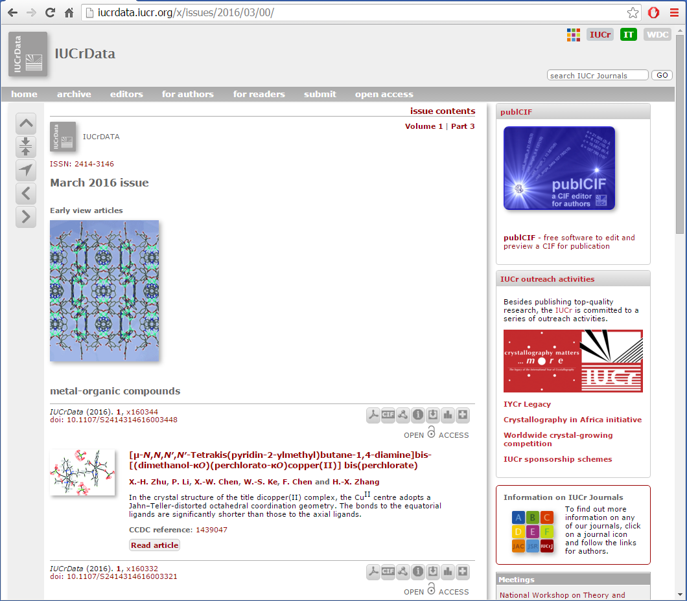
IUCrData
Data publishing platform launched 2016
Addresses immediate need for concise reporting of peer-reviewed structural model data sets
Intends to develop new synergies between journal publications and data sets

Slide 19
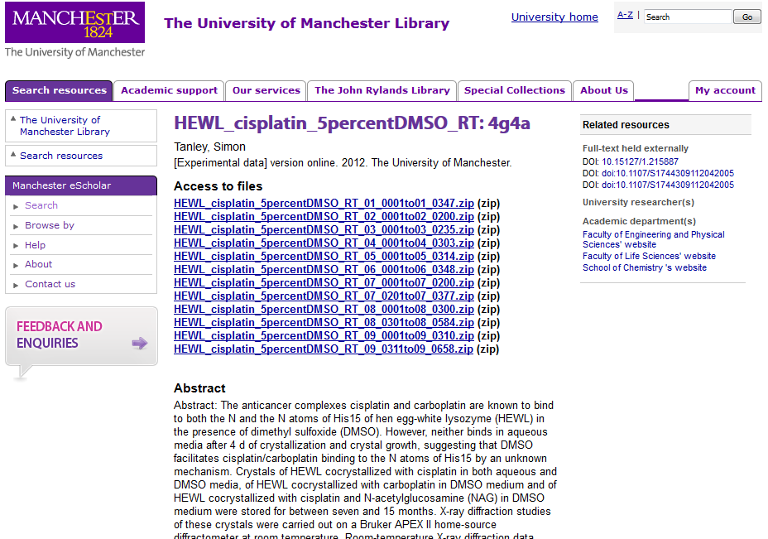

Slide 20
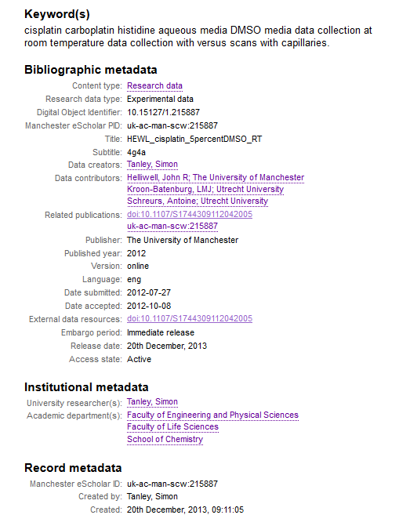

Slide 21
Editor, referee and reader/user
In the early 1990s Acta Cryst. C pioneered refereeing of articles as well as their structure factors and coordinates; any one or all of these could be revised!
Databases can then harvest the fruits of that peer review thoroughness;
In 2002 JRH as IUCr EinC proposed at IUCr Geneva that the Acta Cryst. C method should be harnessed for Acta Cryst. D submissions (sadly, was rejected);
Today I still commend the Acta Cryst. C method to the benefit of journals, databases, authors and readers;
Now we also have the technology and organisation to have access to the raw diffraction data as well.

Slide 22
In conclusion
New modus operandi for published funded research; access to all data and should be open access.
A limited time for funded researchers to analyse their data and publish; typically 3 years. Then the raw data are put on open access.
Policy makers are now discussing new ways to ‘speed up science and discovery for tax payers to reap quicker benefits’; Open Science. New rules of conduct for funded research would be essential!
Next actions of the IUCr DDDWG; articles are in preparation from ECM29 Rovinj Workshop; with IUCr COMCIFS a checkcif for raw data; planned workshop on metadata for raw data at ACA New Orleans; sessions at IUCr Hyderabad…..
Current actions of JRH as a researcher; inviting other platins with proteins and nucleic acids researchers to contribute to the fully open access raw data, SFs, coordinates and publications…….

Slide 23

Join in with the raw diffraction data revolution
Thankyou

